Slide 1

Clustering
Prof.Aruna Ranganath

Slide 2
Today’s agenda
Clustering Problem statement
K-Means
Hierarchical clustering
DBSCAN

Slide 3
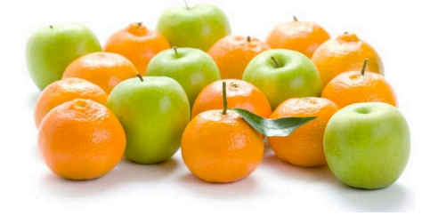
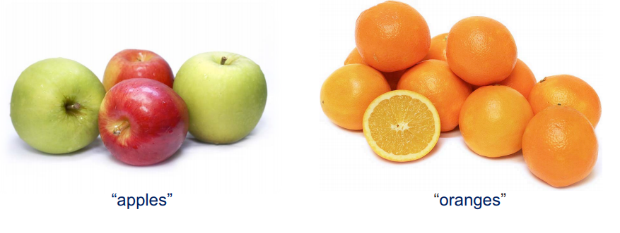
Clustering
Clustering Algorithm

Slide 4
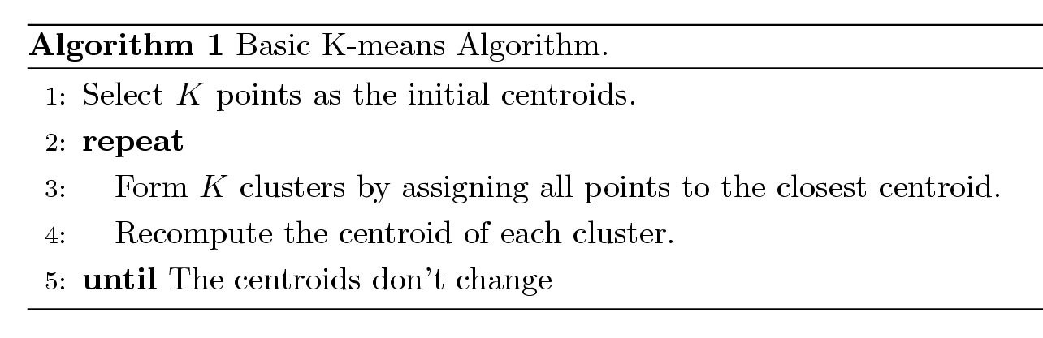
K-means Clustering
Partitional clustering approach
Each cluster is associated with a centroid (center point)
Each point is assigned to the cluster with the closest centroid
Number of clusters, K, must be specified
The basic algorithm is very simple

Slide 5
Importance of Choosing Initial Centroids

Slide 6
K Means clustering
Given the data set {x₁, . . . , x_{N}} where each X_{i} is a D-dimensional Euclidean variable.
Our goal is to partition the data set into some number K of clusters.
μ_{k}, where k = 1, . . . , K, in which μ_{k} is a prototype associated with the kth cluster (representing the centres of the clusters).
Our goal is then to find an assignment of data points to clusters, as well as a set of vectors {μk}, such that the sum of the squares of the distances of each data point to its closest vector μk, is a minimum.

Slide 7
K Means clustering
For each data point x_{n}, we introduce a corresponding set of binary indicator variables r_{nk} ∈ {0, 1}, where k = 1, . . . , K describing which of the K clusters the data point x_{n} is assigned to, so that if data point xn is assigned to cluster k then r_{nk} = 1, and r_{nj} = 0 for j = k.

Slide 8
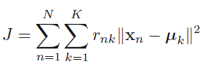
K-means Clustering
We can then define an objective function, which represents the sum of the squares of the distances of each data point to its assigned vector μ_{k}
Our goal is to find values for the {r_{nk}} and the {μ_{k}} so as to minimize J.

Slide 9
Hierarchical Clustering
Produces a set of nested clusters organized as a hierarchical tree
Can be visualized as a dendrogram
A tree like diagram that records the sequences of merges or splits

Slide 10
Hierarchical Clustering

Slide 11
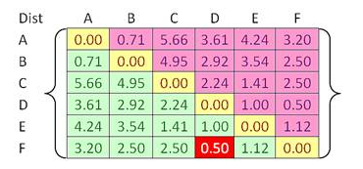
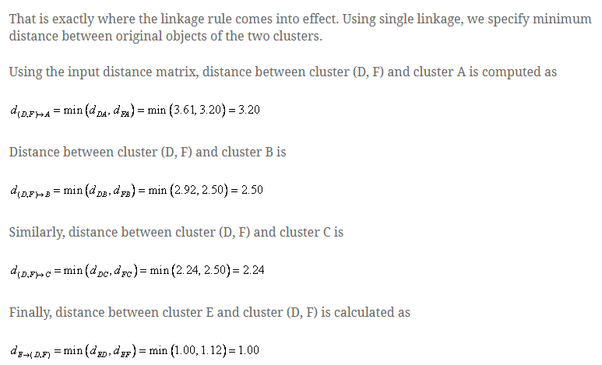
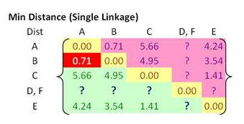
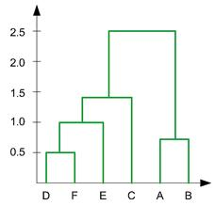
Hierarchical Clustering

Slide 12
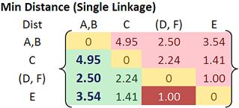
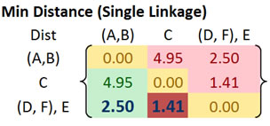
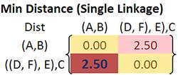
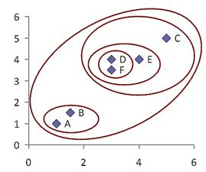
Hierarchical Clustering

Slide 13
Summary

