Slide 1
TRAFFIC CONGESTION
PREDICTION
A Classification-Based Machine Learning Case Study
PRESENTED BY
TEAM MEMBER
REGISTRATION NUMBER
V. Sai Vani
AP24110011750
Department: Computer Science and Engineering
M. Pavani
AP24110011675
D. Priyanjali
AP24110011749
University: SRM University-AP, Amaravati
P. Vinuthna Sai Sri
AP24110010514
FREE-FLOW • MODERATE • CONGESTED

Slide 2
Understanding the Traffic Prediction Challenge
Factors associated with traffic condition in the recorded observations
WHY IS TRAFFIC CONGESTION DIFFICULT TO PREDICT?
01 | CHANGING DEMAND
02 | ROAD CONDITIONS
03 | UNEXPECTED EVENTS
More vehicles can reduce speed and increase travel time.
Road capacity, signals and parking affect traffic flow.
Accidents, weather and roadwork can cause sudden delays.
THE CASE STUDY QUESTION
Can traffic and road information classify each recorded observation as Free-flow, Moderate or Congested?
TRAFFIC DATA
CLASSIFIER
PREDICTION
Past road observations
Learns patterns in labelled records
Traffic condition class
BANGALORE TRAFFIC CONGESTION PREDICTION | MACHINE LEARNING CASE STUDY
02

Slide 3
Defining the Prediction Problem
From a numeric congestion score to an understandable traffic category
PROBLEM STATEMENT
MODEL INPUTS
Traffic conditions differ across Bangalore roads and locations. Understanding these conditions helps identify whether a recorded road situation is Free-flow, Moderate or Congested.
Traffic volume • Average speed
Incidents • Environmental impact
Public transport • Signal compliance
Parking • Pedestrian / cyclist count
Area • Road • Weather • Roadwork
Month • Day • Day of week • Weekend
The dataset provides a numerical Congestion Level score. We convert it into three classes using the 33rd and 66th percentiles of the training data.
PREDICTION OUTPUT
The models use traffic, road, location and environmental features from each record to classify that record's congestion condition.
FREE-FLOW
MODERATE
CONGESTED
OBJECTIVE | Compare three selected classifiers for traffic-condition classification.
Target = class derived from the same record's Congestion Level.
BANGALORE TRAFFIC CONGESTION PREDICTION | MACHINE LEARNING CASE STUDY
03

Slide 4
Understanding the Bangalore Traffic Dataset
A concise profile of the supplied dataset
DATASET AT A GLANCE
FEATURES USED FOR PREDICTION
8,936
16
Traffic inputs
Volume • Average speed
Records
Columns
Other numeric indicators
Environmental impact • Public transport
8
16
Areas
Roads / intersections
Road and activity inputs
Incidents • Signal compliance • Parking
Date coverage: January 2022 – August 2024
Categorical inputs
Area • Road • Weather • Roadwork
0 missing values • 0 duplicate rows
Target variable
Congestion Level (converted to 3 classes)
Source: Kaggle — Banglore City Traffic Dataset; CSV supplied for this case study.
BANGALORE TRAFFIC CONGESTION PREDICTION | MACHINE LEARNING CASE STUDY
04

Slide 5
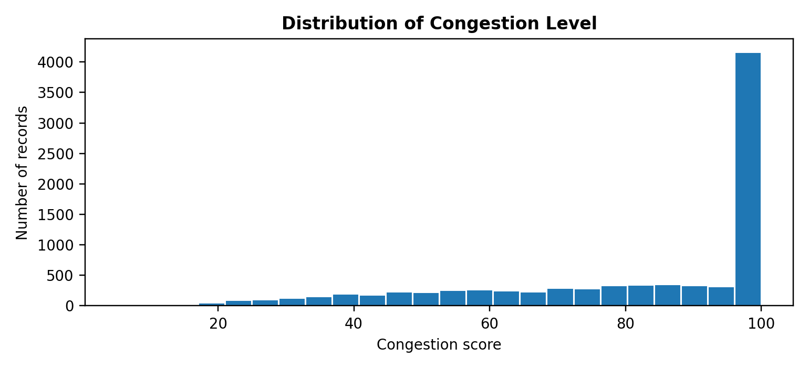
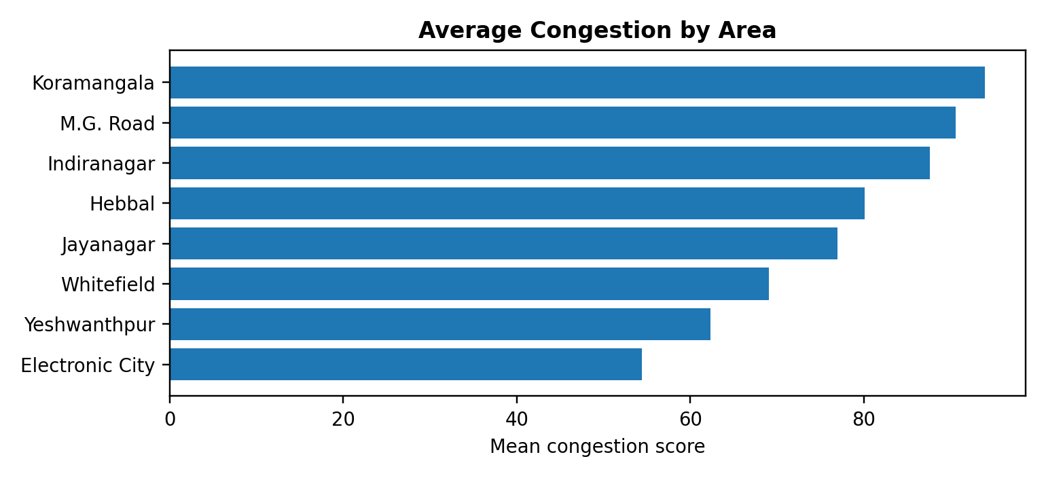
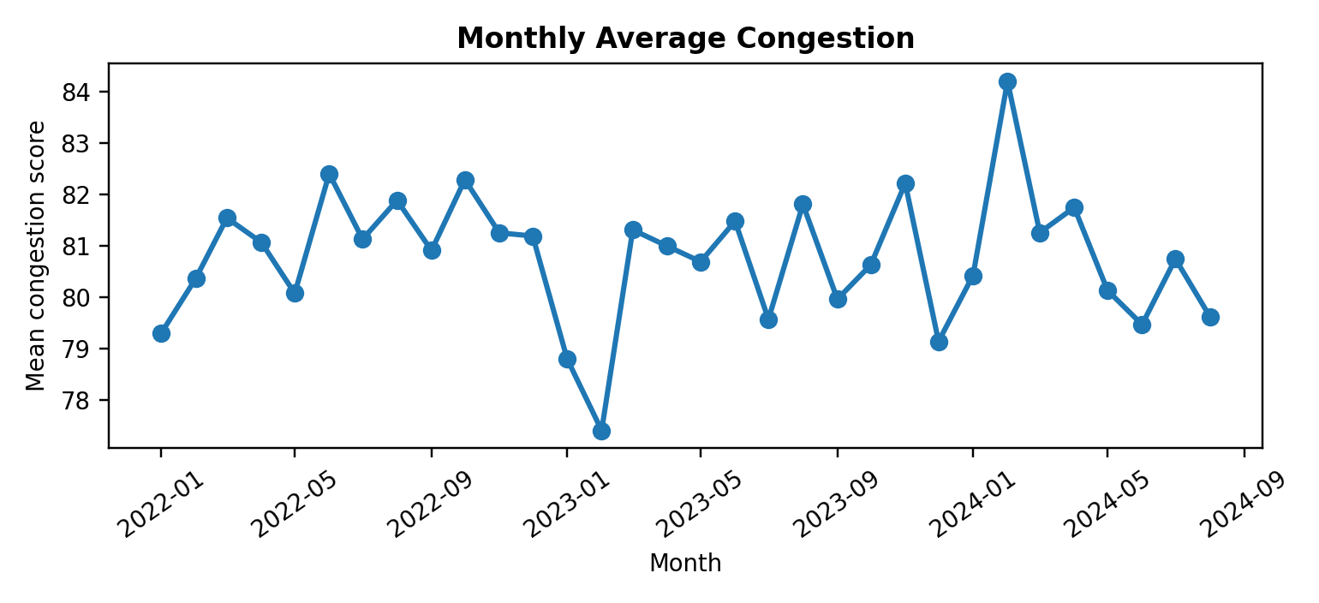
Exploratory Data Analysis
Patterns observed in the actual Bangalore dataset
CONGESTION SCORE DISTRIBUTION
AVERAGE CONGESTION BY AREA
MONTHLY CONGESTION TREND
QUICK INSIGHT
Mean: 80.82 | Median: 92.39
Scores cluster near the high end, including a strong peak near 100.
Koramangala has the highest area average (94.0); Electronic City is lowest (54.5).
Monthly averages stay broadly steady, around 77–84.
BANGALORE TRAFFIC CONGESTION PREDICTION | MACHINE LEARNING CASE STUDY
05

Slide 6
Traffic Class Generation & ML Workflow
Transparent thresholds and chronological model development
1 | CONVERT SCORE INTO CLASSES
2 | MACHINE-LEARNING WORKFLOW
The CSV has a numeric Congestion Level score. Class boundaries are calculated from the training data only:
01
DATA & SORTING
02
PREPARE FEATURES
03
CREATE CLASS LABELS
LOW
Score < 74.59
Load 8,936 rows; parse dates and sort observations chronologically.
›
Use 16 predictors: traffic, road, location, weather and time features. Exclude date, target and proxy columns.
›
Create target labels from each row's own Congestion Level score.
Free-flow condition
MODERATE
74.59 ≤ score < 100
Moderate condition
04
TRAIN THREE MODELS
05
TEST & COMPARE
HIGH
Score = 100
Train three classifiers: Decision Tree, SVM and KNN.
Evaluate on validation and held-out test data using accuracy, macro precision, recall and F1.
Congested condition
IMPORTANT ASSUMPTION
Training-set 33rd percentile = 74.59; 66th percentile = 100.00. Labels are derived using these cut-offs.
CHRONOLOGICAL SPLIT Train: 6,255 | Validation: 893 | Test: 1,788
Target: traffic class of the same observation; this notebook is classification, not future-time forecasting.
BANGALORE TRAFFIC CONGESTION PREDICTION | MACHINE LEARNING CASE STUDY
06

Slide 7
Classification Algorithms Used
Three selected classifiers evaluated on the same training and test periods
01
SUPPORT VECTOR MACHINE (SVM)
02
DECISION TREE CLASSIFIER
03
K-NEAREST NEIGHBOURS (KNN)
Learns class boundaries that separate Free-flow, Moderate and Congested records.
Checks traffic features through a sequence of simple questions.
Finds the 15 most similar records using the selected traffic features.
Uses scaled numeric and encoded categorical features to classify a record.
For example: Is speed low? Is traffic volume high?
The most common class among the neighbours becomes the prediction.
RBF kernel; C = 1; class_weight = balanced.
The final path gives the predicted congestion class.
Uses k = 15 neighbours.
Limitation: performance depends on scaling and kernel settings.
Limitation: deep trees may overfit.
Limitation: sensitive to feature scaling and the choice of k.
MAXIMUM-MARGIN METHOD
RULE-BASED METHOD
SIMILARITY-BASED METHOD
Settings: RBF SVM (C=1, class_weight=balanced); Decision Tree (max_depth=8, class_weight=balanced); KNN (k=15).
BANGALORE TRAFFIC CONGESTION PREDICTION | MACHINE LEARNING CASE STUDY
07

Slide 8
Evaluating the Classification Models
Three selected models evaluated on the same 1,788-record test set
ACCURACY
PRECISION
RECALL
F1-SCORE
Overall share of correct predictions.
How often a predicted class is correct.
How many actual cases of a class are found.
Balance between precision and recall.
TEST RESULTS — FROM THE PROVIDED NOTEBOOK PIPELINE
Model | Accuracy | Macro Precision | Macro Recall | Macro F1
Decision Tree | 90.16% | 88.81% | 89.93% | 89.12%
SVM | 90.88% | 89.69% | 91.14% | 90.04%
KNN | 84.96% | 82.78% | 82.83% | 82.80%
Macro precision, recall and F1 give equal weight to Free-flow, Moderate and Congested classes.
Best among the three: SVM — 90.88% accuracy and 90.04% macro F1.
BANGALORE TRAFFIC CONGESTION PREDICTION | MACHINE LEARNING CASE STUDY
08

Slide 9
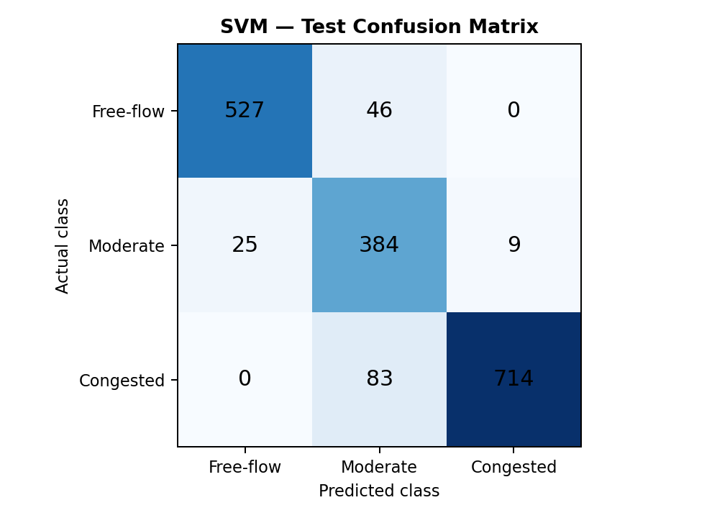
Three-Model Results and Interpretation
SVM performance on the held-out test set
SVM CONFUSION MATRIX
SVM CLASS-WISE TEST PERFORMANCE
Free-flow: precision 0.96 | recall 0.92
Moderate: precision 0.75 | recall 0.92
Congested: precision 0.99 | recall 0.90
TEST SUPPORT
Free-flow: 573 records
Moderate: 418 records
Congested: 797 records
Test total: 1,788 records
Accuracy: 90.88% • Macro F1: 90.04%
SVM correctly classified 1,625 of 1,788 test records. The confusion matrix summarizes errors across all three classes.
Rows = actual class | Columns = predicted class
BANGALORE TRAFFIC CONGESTION PREDICTION | MACHINE LEARNING CASE STUDY
09

Slide 10
Conclusion & Future Scope
What we completed, what the results tell us, and how this work can be extended
CONCLUSION | WHAT WE ACCOMPLISHED
FUTURE SCOPE | HOW TO TAKE IT FORWARD
01 | DATA TO PREDICTION
01
USE LIVE & RICHER DATA
The study analysed 8,936 records across 8 areas and 16 roads. Congestion scores were labelled using training-only 33rd and 66th percentile cut-offs.
Connect real-time traffic sensors, GPS speeds, incidents, weather, events and roadwork feeds so predictions reflect changing road conditions.
02
IMPROVE MINORITY-CLASS PREDICTION
02 | MODEL DEVELOPMENT
Tune models and use class-weighting or resampling to improve recognition of Free-flow and Moderate congestion, not only the dominant Congested class.
Three classifiers—Decision Tree, SVM and KNN—were trained to classify each record.
03
MODEL TIME & ROAD NETWORKS
Explore time-series and graph-based methods to learn rush-hour patterns and how congestion spreads between connected roads.
03 | EVALUATION & FINDING
On 1,788 held-out records, SVM achieved the best result among the three: 90.88% accuracy and 90.04% macro F1.
DEPLOY & VALIDATE IN PRACTICE
04
Build a live dashboard with confidence-aware alerts, then test on unseen roads and future dates with traffic-domain feedback.
FINAL TAKEAWAY | SVM performed best among the three selected models. This classifies each record; it is not a live or next-hour forecast.
BANGALORE TRAFFIC CONGESTION PREDICTION | MACHINE LEARNING CASE STUDY
10

