Slide 1

Digital Marketing Project Phase 2
Comprehensive Digital Marketing For Mother Dairy

Slide 2
CONTENT OF THIS PROJECT INDEX
SI NO | PARTICULARS
Chapter I | Brand Study ,Competiter Analysis& Buyer’s/Audience’s Persona
Chapter II | SEO & KeyWord Research
Chapter III | Content Ideas And Marketing Strategies
Chapter IV | Content Creation And Curation
Conclusion | conclusion Of the Project
Faculty Guid: TEAM MEMBERS
SK. K. ZELANI V.MAMATHA, M.SAMBA SIVA RAO ,K.RAVI KUMAR , N.PAVANI
MPES , GUNTUR

Slide 3

MOTHER DAIRY For Now we are Examine The Mother Dairy Company in India was Commissioned in 1974 as a wholly subsidairy of NDDB(National Dairy Development Board) . It manufactures The Milk products which has major share in Milk Dairy products
.

Slide 4
CHAPTER I

Slide 5
Brand Study , Competitor Analysis & Buyer’s/Audience’s Persona
Research Brand Identity
Competitor Analysis
Buyer’s/Audience’s Persona

Slide 6

Research Brand Identity
Mission/Values:
Commitment to Quality-Mother Dairy ensures that their products maintain high quality.
Consumer Trust - They continually aim to be a brand that consumers trust for everyday products.
Farmer Welfare - Mother Dairy proritizesthe welfare of tha farmers who are at the art heart of their suppy choice

Slide 7

Unique Selling Point:
Freshness and Purity:Mother Dairy is reowned for delivering fresh and pure dairy products directly from forms to consumers.
Farm to Fridge: Their integrated model of sourcing directly from Formers and then disributing products ensures minimal time between milk collection and it reaching the consumer , maintaining the products freshness .

Slide 8
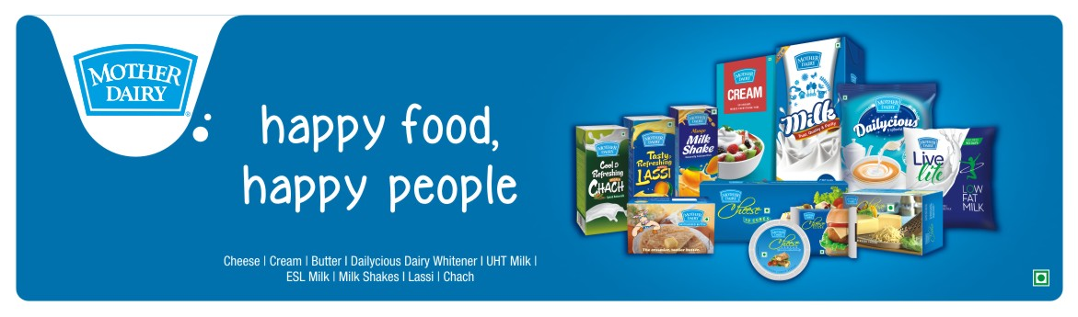
Analyze Brand Tone and Identity:
Mother Dairy has used taglines such has “Happy Food,Happy people ” which reiterates their commitement to providing quality food products to bring happiness and health to consumers

Slide 9
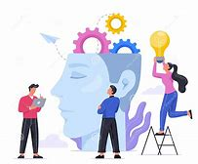
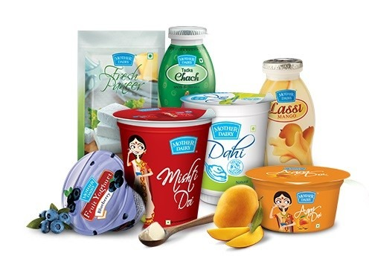

KEY PERFORMANCE INDICATOR
IDEA 1
Goal : Increase the sales of problotic yogurt by 15% over the next 12 months
KPI: Track monthly sales figures of problotic yogurt and monitor the accumulated increase over the 12 months period
IDEA 2
Goal : Expand the retail presence of Mother Dairy products to 200 new stores in untapped regions within the next 16 months
KPI: Maintain a monthly log of the numbers of new srores carrying Mother Dairy products and ensures a minimum addition of around 33 stores each month
IDEA 3
Goal: Introduce three new flavoured milk products and achieve a distribution in atleast 70% of existing retail outlets within 4 months
KPI: Track the number of retail outlets carrying the new flavoured milk products each month ,aiming for the 70% disribution milk by the end of the 4th month

Slide 10



COMPETITOR ANALYSIS
AMUL
BRITANNIA
KWALITY
USP:
Diverse Dairy Portfolio: Known for its cheese, ghee, and yogurt, but also for bakery products like biscuits and cakes
Quality and Taste: Emphasis on unique flavors
Online Communication
Engaging Website: Provides info and corporate initiatives.
Active Social Media: Uses platfo Facebook to engage with consu and campaigns
USP (Unique Selling Proposition)
Diversity of Products: Amul has a wide range of dairy products, from milk to ice cream, cheese. chocolates, and more.
Trust and Purity. Known as the "Taste of India" Amul has a strong reputation for quality and authenticity.
Cooperative Model: Sourcing directly from farmers emphasizing its cooperative model that supports local dairy farmers.
online Communication
Interactive Website: Detailed product information, recipes, and dairy industry insights.
Strong Social Media Presence Engaging advertisements, often revolving around current affairs, shared across platforms like Twitter, Instagram, and YouTube.
USP:
Variety in Milk Products: Offers a range of milk products, from full cream to toned milk, ghee. and curd.
Focus on Health Markets its products emphasizing health benefits, especially for growing children.
Online Communication
User-friendly Website: Focus on product benefits and health aspects.
Social Media Engagement Regular posts about product features, health benefits, and consumer engagement

Slide 11

SWOT ANALYSIS
Mother Dairy
Strengths:
Strong brand reputation in Northern India.
Wide distribution network. Diverse range of dairy products.
Weaknesses: Limited international presence. Dependence on local markets.
Opportunities:
Expansion to southern and western Indian markets. Launch of dairy alternatives (e.g., almond, oat milk).
Threats: Intense competition from local and national brands. Price volatility in the dairy industry.
Amul
Strengths:
Highly diversified product range. Strong cooperative model supporting Indian farmers.
Robust brand image and wide- scale recognition as the "Taste of India".
Weaknesses:
Challenges in maintaining consistent quality across such a diverse product range.Over-reliance on the Indian market.
Opportunities:
International market expansic Tapping into dairy-alternative segments.
Threats:
Counterfeit products using the Amul name.
Price wars with other major do players.

Slide 12
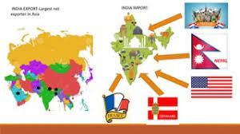
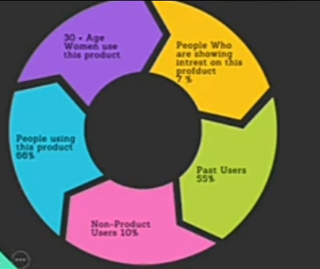
Buyer’s/Audience’s Persona
50k litre
66%
20 Cr+
per day
Market Share
Number of daily Customers

Slide 13
CHAPTER II

Slide 14
SEO & KEYWORD RESEARCH
SEO Audit
Keyword Research
On Page Optimization

Slide 15
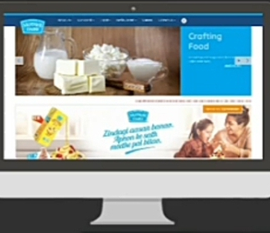
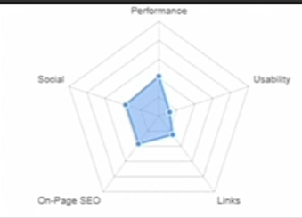
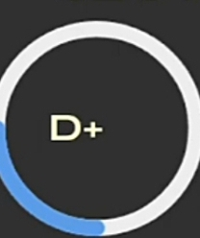
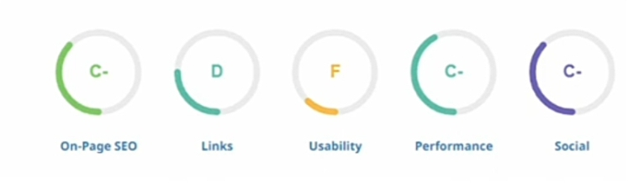
SEO AUDIT

Slide 16
Long & Tail Keyword Exploration
Related searches for Mother Dairy
Mother Dairy Login
Mother Dairy Official Website
Mother Dairy Products list
Mother Dairy Wikipedia
Mother Dairy Website
Mother Dairy Products
online purchases from Mother Dairy
Mother Dairy online digits

Slide 17
On Page Optimization
Meta Tag optimization
Optimized Title: “mothers Dairy” premium dairy products for moms and families
Title Tag
Optimized Meta Description: Explore our range of high - quality dairy products tailor-made for mothers and families Nutrition-packed&fresh from mother dairy
Meta Description

Slide 18




Content Optimization
Content Optimization
Keyword Usage
Content Quality&Relevance
Mobile Optimization
Call to Action

Slide 19
CHAPTER III

Slide 20
Content Idea Generation & Strategy
Content Calender
WEEK 01
SUMMER TIME WITH MOTHER DAIRY
WEEK 02
GLOBAL FLAVOURS,LOCAL DAITY
1
Sep 12th Instagram&Facebook: video
Sep 22nd Instagram: Story
1
2
Sep 19th whats App:Status
Oct 3rd Instagram:Story Poll
2
3
Sep 21st Google: Images Collection
Oct 6th Instagram:story Highlights
3

Slide 21
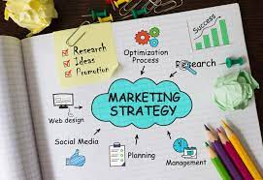
Marketing Strategies
Reflection on the Content Ideas
User Engagement
Storytelling Works
Consistency
Reflection on Marketing Strategies
Algorithm Challenges
Resource Allocation Feedback

Slide 22
CHAPTER IV

Slide 23
Content Creation and Curation
Post Creation
Designs/Video Editing
Social Media Ad Campaigns
Email Ad Campaigns

Slide 24
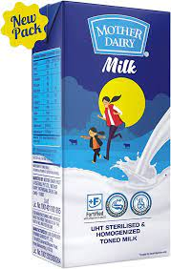
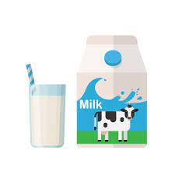
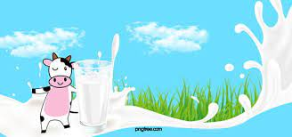
Post Creation & Design / Video Editing
identify three different content formats relevant to the chosen topic or industry. Research and Brainstorm: Research trending topics, industry news, or audience interests within each category, Brainstorm ideas for social media posts that align with each category.
FORMATE 1
FORMATE 2
FORMATE 3

Slide 25
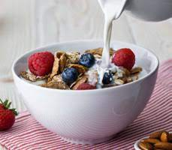
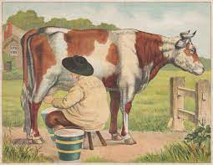
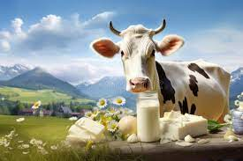
Posted Material

Slide 26
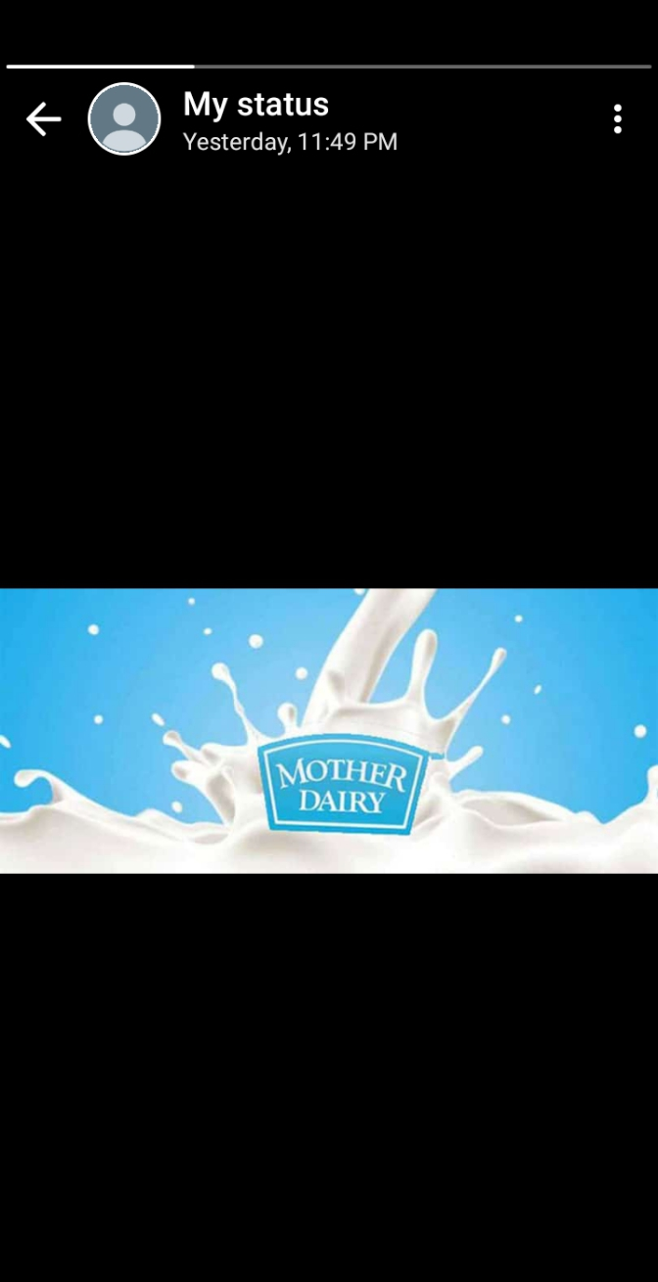
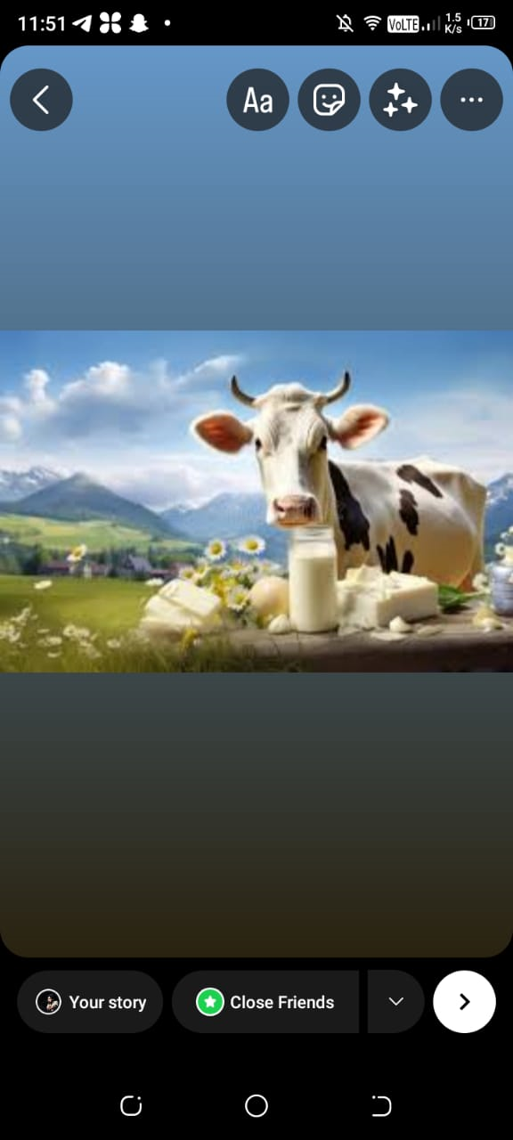
Instagram Story: Utilize the Stories feature on Instagram for three consecutive days, Share behind the scenes glimpses, polls, quizzes, or sneak peeks etc to encourage audience participation. Once uploaded use the story highlight feature on Instagram and save the 3 story with an appropriate name for each

Slide 27

Designs/ Video Editing

Slide 28



Social Media Ad Campaigns
Ad campaigns over social media Come up with 3 ad campaigns each covering one of the mentioned goals: brand awareness, driving website traffic, or generating leads
For every campaign clearly define:
Advertising Goals: increasing brand awareness,
driving website traffic, or generating leads. Audience Targeting: Define the target audience for the ad campaigns based on behavior.
Ad Creation: Create visually compelling ad copy and relevance

Slide 29
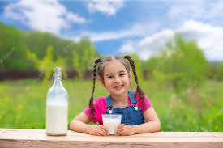
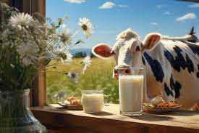
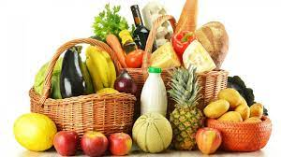
Image Ads with Related Description
1
Ad Campaigns
2
Ad Campaigns
Ad Compaigns
3
“Mother Dairy: Nourishing Families one glass at a time”
“Mother Dairy: The Taste of Love in Every Sip”
“Mothers Dairy: The Secrete of All Indians Energy

Slide 30
Conclusion
Thanks for providing is golden opportunity to perform this for Power point presentation and a very thanks for SMARTINTERNZ for providing this internship
From
SK. K. ZELANI . Faculty Member
Team Members:
Veeravalli Mamatha
Muthineni Samba
Kongari Ravi Kumar
Nagendla Pavani

