Slide 1






ATLIQ HARDWARES
AD-HOC ANALYSIS
Presented By : PavaniSai

Slide 2


TABLE OF CONTENT
1
COMPANY OVERVIEW
2
PROBLEM STATEMENT
3
OBJECTIVE
4
AD-HOC REQUESTS
5
RECOMMENDATIONS

Slide 3

COMPANY OVERVIEW
Atliq hardwares (an imaginary company) is one of the leading computer hardware producers in India and has expanded well in other countries too.

Slide 4
External Solid State Drives
Storage
USB Flash Drives
N & S
NetWorking
Wi fi extender
Accessories
Batteries
Keyboard
Mouse
P & A
Peripherals
Graphic Card
Internal HDD
Processors
MotherBoard
Desktop
Business Laptop
Personal Desktop
PC
NoteBook
Business Laptop
Gaming Laptop
Personal Laptop

Slide 5


PROBLEM STATEMENT
Atliq Hardware's management has realized a lack of actionable insights is slowing down smart and timely decision-making. To overcome this, they aim to expand their data analytics team by hiring junior analysts. Tony Sharma, Director of Data Analytics, intends to evaluate candidates' technical and soft skills through a structured SQL-based ad-hoc analysis challenge.

Slide 6

OBJECTIVE
To design and conduct an ad-hoc SQL analysis challenge that assesses candidates' ability to extract insights, communicate findings effectively, and support Atliq Hardware’s goal of faster, data-informed decision-making.

Slide 7
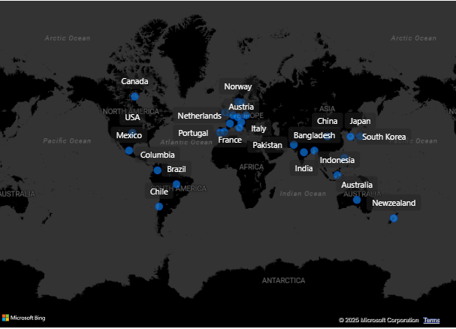

Slide 8


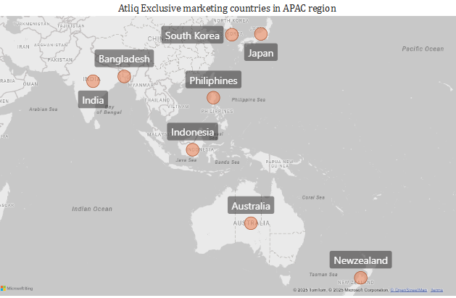
1.Provide the list of markets in which customer "Atliq Exclusive" operates its
business in the APAC region.

Slide 9

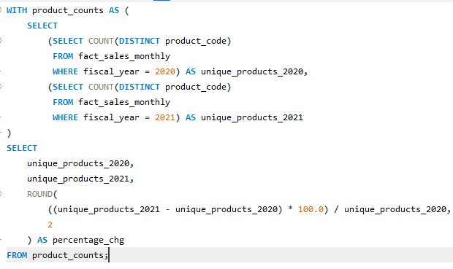
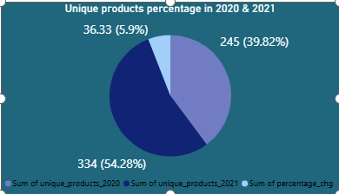
2.What is the percentage of unique product increase in 2021 vs. 2020? The final output contains these fields, unique_products_2020,unique_products_2021,percentage_chg
In 2020 the unique product count is 245 whereas in 2021 the count is 334 and has an increase of 89
The percentage change is 36.33
Overall, this is a positive trend reflecting strategic product expansion between 2020 and 2021.

Slide 10

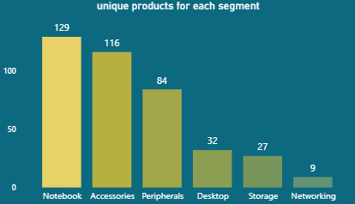
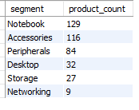
3.Provide a report with all the unique product counts for each segment and
sort them in descending order of product counts. The final output contains 2 fields,segment,product_count
NoteBook is the leading segment with 129 unique products followed by accessories with 116 unique products.
on the otherhand Desktop,storage,networking might be more focused or limited in scope.

Slide 11
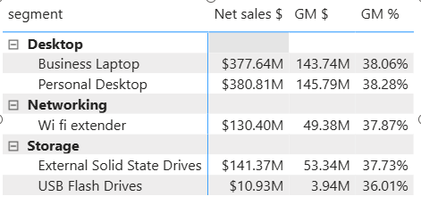
1. Show Why People Need Them
2. Promote Online & Social Media
3. Sell in the Right Places & offer deals
4. Liste to the customer feedbacks

Slide 12
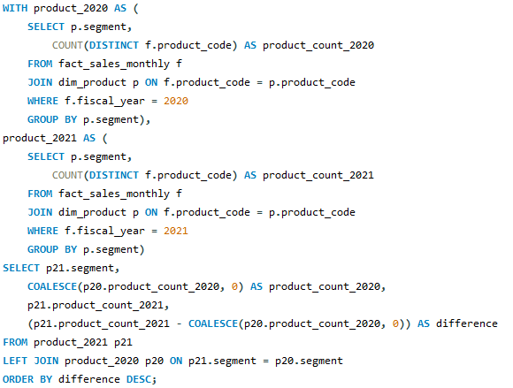
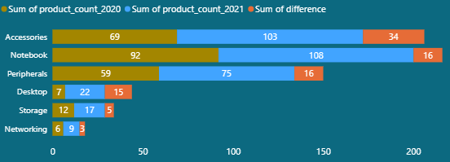
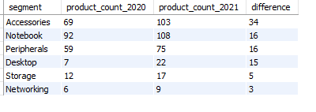
4. Which segment had the most increase in unique products in 2021 vs 2020?
The final output contains these fields, segment,product_count_2020,product_count_2021,difference
Accessories saw the largest growth, increasing from 69 to 103 products (+34)
Notebook also expanded significantly from 92 to 108 products
Desktop,Storage & Networking experiencing slower production growth than other segments

Slide 13
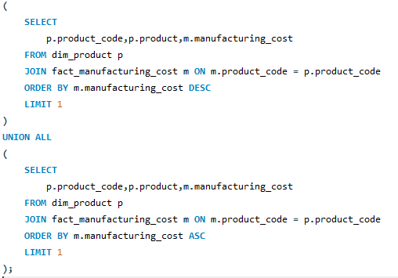



5.Get the products that have the highest and lowest manufacturing costs.
The final output should contain these fields, product_code product manufacturing_cost
Lowest Manufacturing Product
AQ Master wired x1 Ms
0.89
Highest Manufacturing Product
AQ HOME Allin1 Gen 2
240.53
Mouse
Desktop

Slide 14
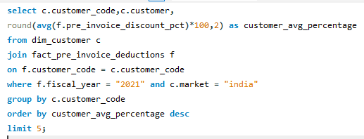
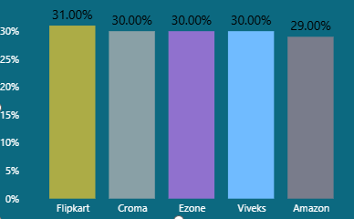
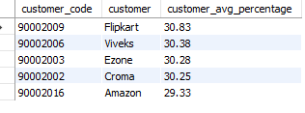
6.Generate a report which contains the top 5 customers who received an average high pre_invoice_discount_pct for the fiscal year 2021
and in the Indian market. The final output contains these fields, customer_code customer average_discount_percentage
Flipkart has the highest pre_invoice_discount_pct for the fiscal year 2021 on the otherhand amazon shows slower discounts

Slide 15
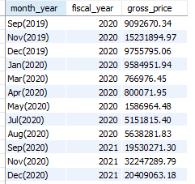
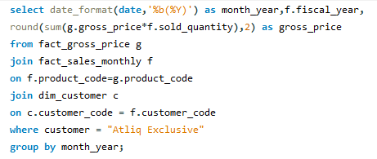
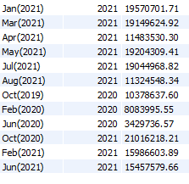
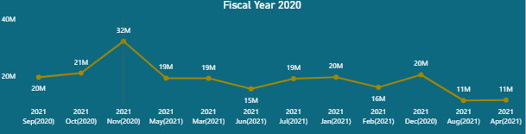
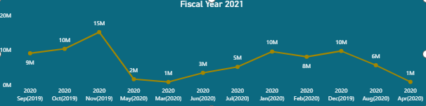
7.get the complete report of the Gross sales amount for the customer “AtliqExclusive” for each month .This analysis helps to get an idea of low and high-performing months and take strategic decisions. The final report contains these columns: Month, Year ,Gross sales Amount

Slide 16
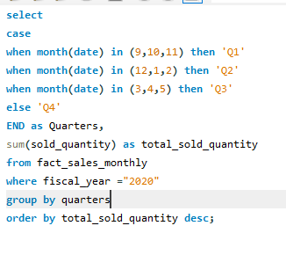
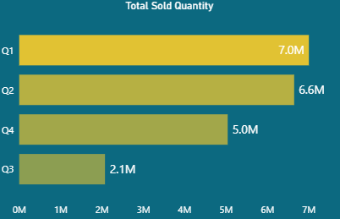
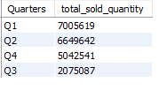
8.In which quarter of 2020, got the maximum total_sold_quantity? The final
output contains these fields sorted by the total_sold_quantity, Quarter,total_sold_quantity
Q1 and Q2 are our strongest sales periods.
Q3 is much weaker, and we might need to investigate why — maybe seasonality or lower demand

Slide 17
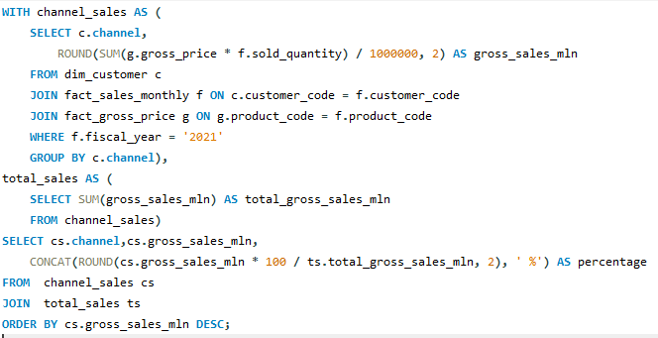
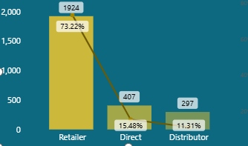

9. Which channel helped to bring more gross sales in the fiscal year 2021and the percentage of contribution? The final output contains these fields,channel, gross_sales_mln, percentage
Almost 3/4 of our sales come from Retailers. Direct and Distributor channels are smaller but have growth potential

Slide 18
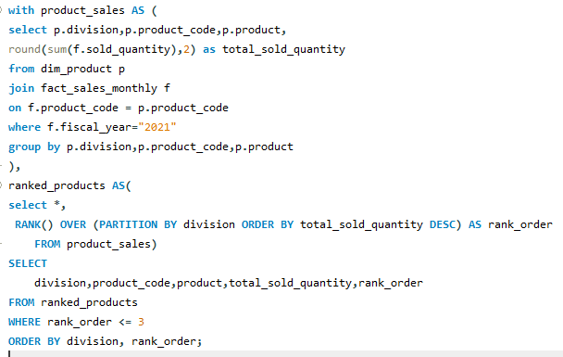
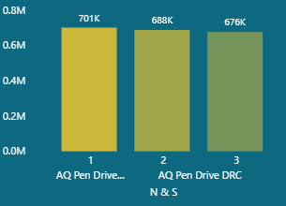
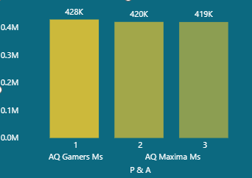
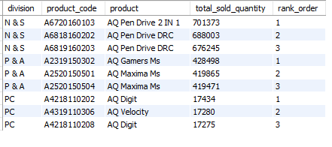
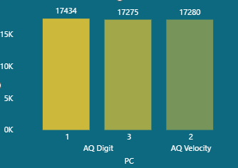
10. Get the Top 3 products in each division that have a high total_sold_quantity in the fiscal_year 2021? The final output contains these fields,division, product_code, product ,total_sold_quantity, rank_order

Slide 19


RECOMMENDATIONS
1.Identify underperforming stock keeping unit in desktops,storage & networking segments.
2. Launch targeted promotions and bundles to boost visibility and sales.
3. Gather and analyse customer feedback to realign product features and pricing.
4. Review distibutor performance reports segment wise quarterly.

Slide 20


THANK YOU

