Slide 1


Covid Stats
Presented By:
Pavani Singamshetty (U01028960)
Vaishnavi Velishetty (U01030860)
Hemanth Sai Chilukuri (U01031566)
Sashank Gullapalli (U01031718)

Slide 2

Problem Statement
Most of the population got affected due to lack of accuracy in covid statistics, there will be discrepancy in production of masks, medicines and availability of beds in the hospitals.

Slide 3
Proposed Solution
A web application
Displays the number of confirmed cases, deaths and recoveries.
Data is filtered with respective to the chosen country.
Notes:
provide statistics on number of confirmed, recovered and death cases based on real time data.

Slide 4
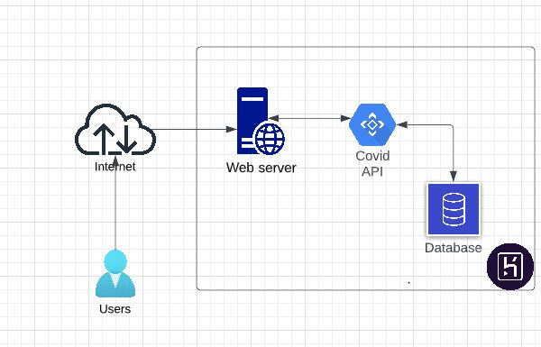
Conceptualization & Workflow
Client Server architecture
Deploy application on Heroku
Heroku – a cloud application platform

Slide 5
Market Research and Limitations
Existing application doesn't run on real-time datasets
No stats on recovered cases

Slide 6
Target Market & Value Propositions
Application is used by the public
Target market - Hospitals, Masks Companies
It helps people to take necessary precautionary steps.
Restricts travel
Alert medical team

Slide 7
Key Winning Features
API – updates every 15 minutes
Working on real time data
Number of recovered cases
Single Page Application

Slide 8
Capabilities
Based on country, renders all the stats
Statistics can be used by media, schools/universities, newspapers
Application updates for every 15 minutes.

Slide 9
Demo
Demo Link

Slide 10
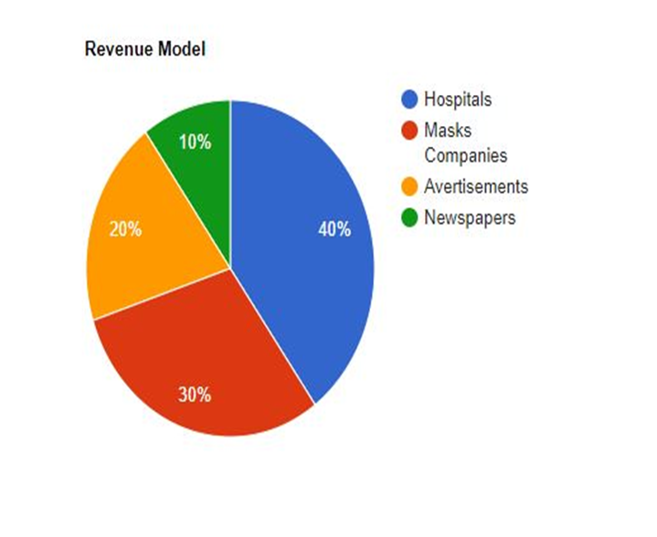
Business Model
Collaborate with hospitals, pharmacy centres
Increase supply chain for small scale industries
Marketing on website

Slide 11
Team Member Contributions
Pavani Singamshetty - Web Components, Deployment
Vaishnavi Velishetty - UI Design
Hemanth Sai Chilukuri - Web Components
Shashank Gullapalli - Deployment

Slide 12
Conclusion
Covid stats is built using React and is deployed on Heroku
Presents statistics on death, recovered and confirmed cases based on real time data
Initial Investment: 5k dollars
API : Covid API
Website Link: CovidStats Application
Notes:
Add team members, product logo

Slide 13

Thank You
Notes:
Add team members, product logo

