Slide 1


Covid Stats
Presented By:
Pavani Singamshetty (U01028960)
Vaishnavi Velishetty (U01030860)
Hemanth Sai Chilukuri (U01031566)
Sashank Gullapalli (U01031718)
Notes:
Add team members, product logo

Slide 2

Problem Statement
Most of the population got affected due to lack of accuracy in covid statistics, there will be discrepancy in production of masks, medicines and availability of beds in the hospitals.
Notes:
To provide statistics on number of confirmed, recovered and death cases based on real time data.

Slide 3
Proposed Solution
A web application
Displays the number of confirmed cases, deaths and recoveries.
Data is filtered with respective to the chosen country.

Slide 4

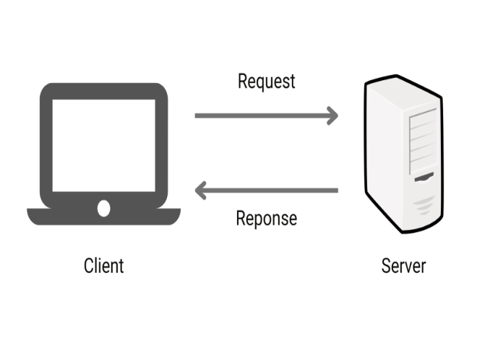
Conceptualization
Client Server architecture
Deploy application on Heroku
Heroku – a cloud application platform
Notes:
Add team members, product logo

Slide 5
Market Research and Limitations
Existing application doesn't run on real-time datasets
No stats on recovered cases

Slide 6
Target Market & Value Propositions
Application is used by the public
Target market - Hospitals, Public, Masks Companies
It helps people to take necessary precautionary steps.
Restricts travel
Alert medical team

Slide 7

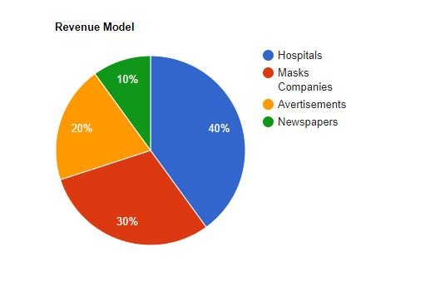
Business Model
Collaborate with hospitals, pharmacy centres
Increase supply chain for small scale industries
Marketing on website

Slide 8

Team Members Contributions
Pavani Singamshetty - Web Components, Deployment
Vaishnavi Velishetty - UI Design
Hemanth Sai Chilukuri - Web Components
Shashank Gullapalli - Deployment

Slide 9
Technology Stack
Reactjs
REST
Heroku
API: https://covid-api.mmediagroup.fr/v1/cases

Slide 10
Tools
GitHub
Microsoft Teams
Visual Studio Code

Slide 11
Thank You

