Slide 1
CSE3190-Fundamentals of Data Analytics
Module 1-Introduction to Data Analysis
Introducing Data, overview of data analysis: Data in the Real World, Data vs. Information, Many “Vs” of Data, Structured Data and Unstructured Data, Types of Data, Data Analysis Defined, Types of Variables, Central Tendency of Data, Scales of Data, Sources of Data, Data preparation: Cleaning the data, Removing variables, Data Transformations.
R Studio: Base R-R Studio IDE-Introduction to R Projects and R Markdown. Basic R: R as a calculator-Scripts and Comments-R Variables. Data I/O: Working Directories-Importing Data Exporting Data-More ways to save-Data I/O in Base R.

Slide 2
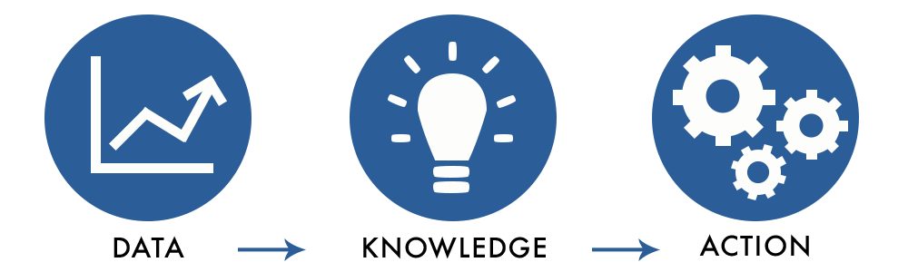
Introducing Data
Facts and statistics collected together for reference or analysis
Data has to be transformed into a form that is efficient for movement or processing.

Slide 3
Data Analysis Definition
Data analysis is defined as a process of cleaning, transforming, and modeling data to discover useful information for business decision-making.
Purpose: Extract useful information for business decision-making.
Example: Day-to-day decision-making based on past experiences or future expectations, Gathering memories (past data) or dreams (future data) to inform decisions
Business Application: Analysts apply data analysis techniques for business purposes and Data analysis informs business decision-making

Slide 4
Over view of Data Analysis

Slide 5
OVERVIEW
Data Collection and Importance
Various disciplines collect and store data digitally
Retail, insurance, and meteorological organizations use data for informed decisions
Timely decisions maximize sales, improve R&D, and reduce costs
Data Analysis Challenges
Fast-growing data production due to internet and operational systems
Increasing volume, complexity, and reliability concerns

Slide 6
Data Analysis Process
Define project and problem
Prepare data for analysis
Select and optimize data analysis approaches
Deploy and measure results for expected benefits.
Key Objectives:
Focus on converting raw data to meaningful information
Outlines major steps in data analysis projects from defining the problem to the deployment of the results.

Slide 7
Data in the Real World
Surveys or polls, interviews, and experiments are valuable approaches for gathering data to answer specific questions.
Data is collected from various sources, including:
Surveys and polls to understand opinions, preferences, and behavior
Example: Casting a vote before election.
Interviews to elicit information on people's opinions, preferences, and behavior.
Example: Conducted over the phone.

Slide 8
Experiments to measure and collect data in a highly controlled manner
Example: Double-blind drug study (one group gets the drug, other a placebo).
Operational databases containing ongoing business transactions
-Sensors monitoring operational processes.
-Stored in databases such as CRM, ERP, supply chain systems.
Data warehouses for making decisions
Databases used for Historical polls, surveys, and experiment.
External sources such as the web or literature
Data is used to answer specific questions, understand opinions and needs, and make informed decisions

Slide 9
Data vs. Information
Data refers to the raw, unprocessed facts and figures collected from various sources.
Information refers to the processed and analyzed data that provides meaning and insight.
Data becomes information when it is:
- Collected and stored
Processed and analyzed
Interpreted and understood
- Used to make informed decisions
In other words, data is the raw material
Information is the result of processing and analyzing that data to extract meaning and value.

Slide 10
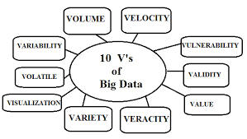
Many v’s of Data

Slide 11
A. Volume
The term Volume is meant for the Magnitude or Scale of data.
Data Sources and Repositories:-
Websites
Data Generation and Sharing:-
User clickstreams recorded and stored
Social media applications (Facebook, Twitter, etc.) become prosumers (producers and consumers) of data
Increased data shares and larger data elements
High-definition videos increase shared data.
Autonomous Data Streams:-
Video, Audio, Text
Data from: Social media sites , Websites , RFID applications

Slide 12
B. Velocity
Velocity refers to the speed at which the gigantic amount of data is being generated, collected and scrutinized.
Enhanced Data Movement:-
Faster data movement through the Internet
Quick transfer of E-mails, Social media, Video files
Cloud-Based Storage:-
Instantaneous sharing-
Easy accessibility from anywhere
Social Media and Data Sharing:-
Instant data sharing among people-
Mobile access for faster data generation and access

Slide 13
C. Variety
Types of Data:-
Structured data (numeric, text fields)-
Unstructured data (images, video, audio, etc.)
Sources of Data:-
Structured data: ERPs, operational systems-
Unstructured data: social media, web, RFID, machine data, etc.
Characteristics of Unstructured Data:-
Varying sizes and resolutions
Subject to different types of analysis
Examples: Video: tagging, playback (not computable)
Audio: playback (not computable)
Graphic: network distance analysis
Text (Facebook, tweets): sentiment analysis (not directly comparable)

Slide 14
D. Value
Value refers to convert our investigated data into values.
Value in Big data
Important characteristic of Big Data
Involves collecting and analyzing data to Boost organizational performance and Enhance customer understanding
With the access to this useful data, one must analyze great values in order to get amazing benefits.

Slide 15
E. Variability
Variability refers to unpredictable changes in the data.
It may happen because of multiple data types & the speed with which data is generating and being loaded into the database.

Slide 16
F. Veracity
Veracity refers to the term trustworthiness with reference to accurate data.
If the data is accurate, only then you could think of meaningful data.
For example, consider a dataset of thirty students on which we have to make an analysis about the reason they got distinction.
Being an analyzer, you can ask questions like:
what are the methodology you adopted to get good marks in all the subjects?

Slide 17
How much time you devote to individual subject?
Do you learn some subjects with the help of daily life activities like sports etc?
Have you ever been a scholar?
Be getting answers like this it would be easier to determine the accuracy of information which could easily be maintained in statistical form.

Slide 18
G. Validity
Two terms of big data veracity and validity seems to be alike but are quite different.
validity is meant for an accurate analysis in order to get optimized results.

Slide 19
H. Vulnerability
Vulnerability is one of the major challenge in big data as the data generated from multiple sources with such an erratic speed has high chances of being harmed by any intruder.
Currently, in a case of Facebook, where the Belgium court has threatened to fine a high amount on breaking privacy recently.

Slide 20
I. Volatility
Volatility refers to how long the perceived data remains to be useful for us and how it is to be kept.
For analyzing the same, it is necessary to develop some new rules and techniques through which rapid access to information is possible.

Slide 21
J. Visualization
Data Visualization is one of the most complex challenge in big data.
In this information age, data is not only going beyond the limits but also is composed of different data types.
So, there is a need of communicate the information by visualizing it through some special ways with special functionalities like a web-based approach, statistical analysis etc.

Slide 22
Traditional tools of data visualization face severe challenges like low response time, complex methods of scalability, precision in reporting time etc.
So, it is a challenge to work with the concept which way of communication with data is most suitable in order to make visualization more effective.

Slide 23
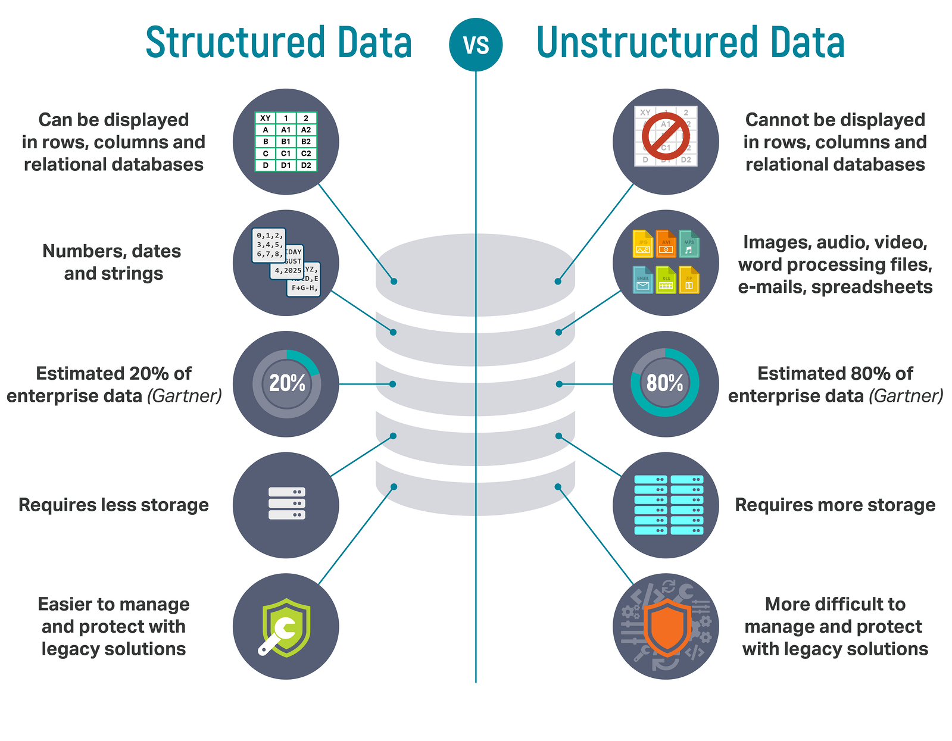

Slide 24
Typical human-generated unstructured data includes
Text files: Word processing, spreadsheets, presentations, email, logs.
Email: Email has some internal structure thanks to its metadata, and we sometimes refer to it as semi-structured. However, its message field is unstructured and traditional analytics tools cannot parse it.
Social Media: Data from Facebook, Twitter, LinkedIn.
Website: YouTube, Instagram, photo sharing sites.
Mobile data: Text messages, locations.
Communications: Chat, IM, phone recordings, collaboration software.
Media: MP3, digital photos, audio and video files.
Business applications: MS Office documents, productivity applications

Slide 25
Typical machine-generated unstructured data includes:
Satellite imagery: Weather data, land forms, military movements.
Scientific data: Oil and gas exploration, space exploration, seismic imagery, atmospheric data.
Digital surveillance: Surveillance photos and video.
Sensor data: Traffic, weather, oceanographic sensors.

Slide 26
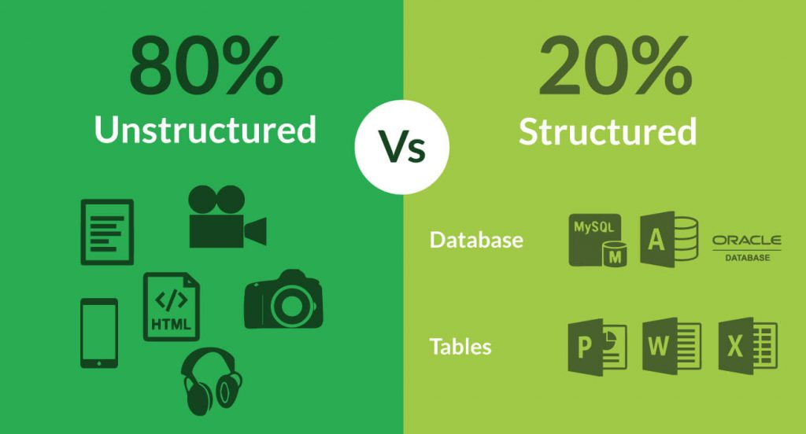

Slide 27
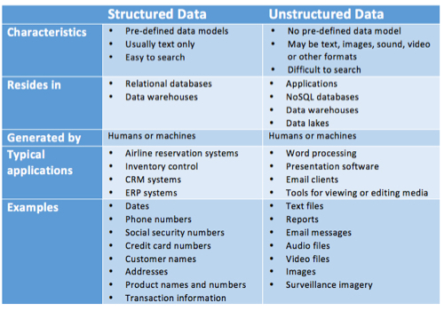

Slide 28
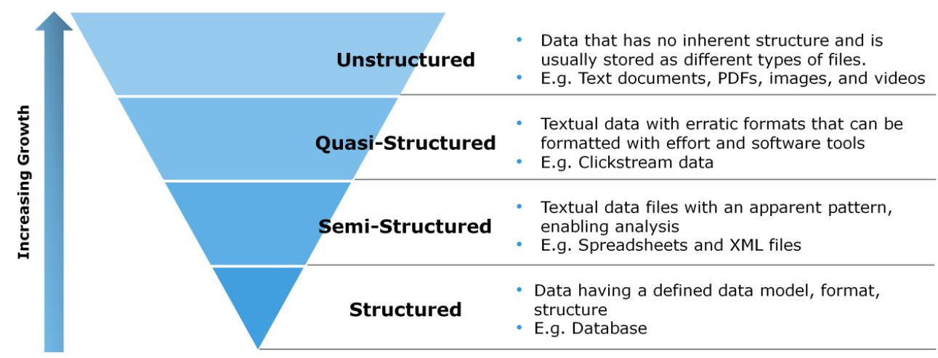
Types of Digital Data

Slide 29
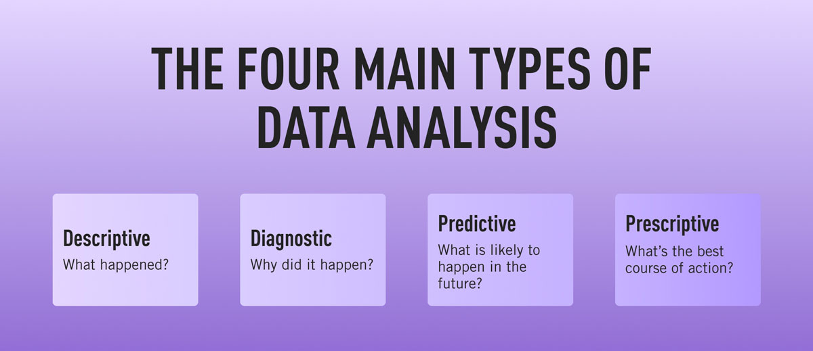
Data Analysis-Types

Slide 30
Statistical Analysis
Statistical Analysis shows "What happen?" by using past data in the form of dashboards.
Statistical Analysis includes collection, Analysis, interpretation, presentation, and modeling of data.
Analyses a sample of data.
There are two categories of this type of Analysis - Descriptive Analysis
Inferential Analysis.

Slide 31
Descriptive Analysis
Analyses complete data or a sample of summarized numerical data.
It shows mean and deviation for continuous data whereas percentage and frequency for categorical data.
Inferential Analysis
Analyses sample from complete data. In this type of Analysis, you can find different conclusions from the same data by selecting different samples.

Slide 32
Diagnostic Analysis
Diagnostic Analysis shows "Why did it happen?" by finding the cause from the insight found in Statistical Analysis. This Analysis is u
Useful to identify behavior patterns of data.
If a new problem arrives in your business process, then you can look into this Analysis to find similar patterns of that problem.
May have chances to use similar prescriptions for the new problems.

Slide 33
Predictive Analysis
Predictive Analysis shows "what is likely to happen" by using previous data.
The simplest data analysis example is like if last year I bought two dresses based on my savings and if this year my salary is increasing double then I can buy four dresses. But of course it's not easy like this because you have to think about other circumstances like chances of prices of clothes is increased this year or maybe instead of dresses you want to buy a new bike, or you need to buy a house!
Predictive Analysis makes predictions about future outcomes based on current or past data.
Forecasting is just an estimate. Its accuracy is based on how much detailed information you have and how much you dig in it.

Slide 34
Prescriptive Analysis
Prescriptive Analysis combines the insight from all previous Analysis to determine which action to take in a current problem or decision.
Data-driven companies are utilizing Prescriptive Analysis because predictive and descriptive Analysis are not enough to improve data performance.
Based on current situations and problems, they analyze the data and make decisions.

Slide 35
Types of Variable
Categorized based on type of values variable has.
Discrete Variables:
Contain a fixed number of distinct values
Finite number of possible values
Example: Industrial sector variable values are telecommunication industry, retail industry with finite number of possible values.
Continuous Variables:
Can take any numeric value within a range
Infinite number of possible values
Example: Patient's weight (e.g., 153.2 lb, 98.2 lb)

Slide 36
Ratio Scale:
Intervals and ratios of values can be compared
Natural zero point
Example: Bank account balance ($5, $10, $15)
Special Types of Variables:-
Dichotomous Variable:
Only two possible values
Example: Gender (male, female)
Binary Variable: Dichotomous variable with values 0 or 1
Example: Purchase (0 = no, 1 = yes), Fuel Efficiency (0 = low, 1 = high)

Slide 37
Scales of Data
Variables classified according to the scale on which they are measured.
Nominal Scale:
Variable with Limited number of values
Values cannot be ordered
Example: Industry (financial, engineering, retail)
Ordinal Scale:
Variable whose Values can be ordered or ranked
Values are assigned to fixed categories
Example: Low, Medium, High
Interval Scale:
Intervals between values can be compared
Values share same unit of measurement
Example: Fahrenheit scale (5◦F, 10◦F, 15◦F)

Slide 38
Central Tendency of Data
Definition: Value that characterizes the center of a set of values
Purpose: Quantify the middle or central location of a variable such as average.
Many observations values lie around central value.
Approaches to Calculating Central Tendency:- Mode, Median and Mean

Slide 39
Mode:
The mode is the most commonly reported value for a particular variable.
It is illustrated using the following variable whose values are: 3, 4, 5, 6, 7, 7, 7, 8,8,9
The mode is 7 since there are three occurrences of 7.
The following values, both 7 and 8 are reported three times: 3, 4, 5, 6, 7,7, 7, 8, 8, 8, 9
The mode may be reported as {7, 8} or 7.5.

Slide 40
Median
The median is the middle value of a variable
Sort values from low to high.
For variables with an even number of values, the mean of the two values closest to the middle is selected.
The following set of values will be used to illustrate: 3, 4, 7, 2, 3, 7,4, 2, 4, 7, 4.
Before identifying the median, the values must be sorted: 2, 2, 3, 3, 4, 4, 4, 4, 7,7, 7

Slide 41
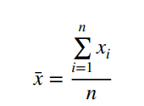
Mean:
Referred to as the average.
Commonly used central tendency for variables measured on the interval or ratio scales. S
Sum of all the values divided by the number of values.
For example, for the following set of values: 3, 4, 5, 7, 7, 8, 9, 9, 9
Calculate mean using the formula

Slide 42
Source of Data
External data- may be incomplete, varying quality and accuracy
Internal data -higher quality, from within the organization
Main Sources of Data:-
Social Media: Web and social media activities, Email, Google searches, Facebook posts, Tweets, YouTube videos, blogs generate data for people.
Organizations: Major source are Business and government data, ERP systems, e-commerce systems, user-generated content, web access logs
Machines: Internet of Things (IoT) is evolving, Autonomous data from connected machines such as RFID tags, telematics, phones, refrigerators.

Slide 43
Metadata: Enormous data about data itself
Web crawlers and web-bots scans the web for new webpages, html structure, and metadata
Used by applications like web search engines.
Data Quality:-
Varies depending on purpose and collection methods
Internal data generally higher quality
Publicly available data includes trustworthy sources e.g. government data.

Slide 44
Data Preparation
Preparing data is a time-consuming step in data analysis.
Data preparation involves merging, characterizing, cleaning, and transforming data
Required Steps
Merge data into a table from multiple sources
Characterize data
Clean data by:
- Resolving ambiguities and errors
- Removing redundant and problematic data
Eliminating irrelevant columns
Calculate new columns of data (if necessary)
Divide data into subsets (if appropriate)

Slide 45
Important Considerations
Record details of data preparation steps and rationale
Provide documentation for future reference and validation of results
Ensure consistency in data preparation methodology
Data Preparation Tasks
Identify and clean up errors
Remove certain variables or observations
Generate consistent scales across observations
Generate new frequency distributions
Convert text to numbers and vice versa
Combine variables
Generate groups
Prepare unstructured data

Slide 46
Cleaning the Data
Since the data available for analysis may not have been originally collected with this project’s goal in mind, it is important to spend time cleaning the data.
It is also beneficial to understand the accuracy with which the data was collected as well as correcting any errors.
For variables measured on a nominal or ordinal scale (where there are a fixed number of possible values), it is useful to inspect all possible values to uncover mistakes and/or inconsistencies.
Any assumptions made concerning possible values that the variable can take should be tested.

Slide 47
For example, a variable Company may include a number of different spellings for the same company such as:
General Electric Company
General Elec. Co
GE
Gen. Electric Company
General electric company
G.E. Company

Slide 48
These different terms, where they refer to the same company, should be consolidated into one for analysis.
In addition, subject matter expertise may be needed in cleaning these variables.
For example, a company name may include one of the divisions of the General Electric Company and for the purpose of this specific project it should be included as the ‘‘General Electric Company.’’

Slide 49
Removing Variables
On the basis of an initial categorization of the variables, it may be possible to remove variables from consideration at this point.
For example, constants and variables with too many missing data points should be considered for removal.
Further analysis of the correlations between multiple variables may identify variables that provide no additional information to the analysis and hence could be removed.

Slide 50
Data Transformation
Normalization
Normalization is a process where numeric columns are transformed using a mathematical function to a new range. It is important for two reasons.
First, analysis of the data should treat all variables equally so that one column does not have more influence over another because the ranges are different.
For example, when analyzing customer credit card data, the Credit limit value is not given more weightage in the analysis than the Customer’s age.
Second, certain data analysis and data mining methods require the data to be normalized prior to analysis, such as neural networks or k-nearest neighbors

Slide 51

Min-Max Normalization
Linear transformation is performed on the original data.
Minimum and maximum value from data is fetched and each value is replaced according to the following formula.
Where A is the attribute data, Min(A), Max(A) are the minimum and maximum absolute value of A respectively. v’ is the new value of each entry in data. v is the old value of each entry in data. new_max(A), new_min(A) is the max and min value of the range(i.e boundary value of range required) respectively.

Slide 52
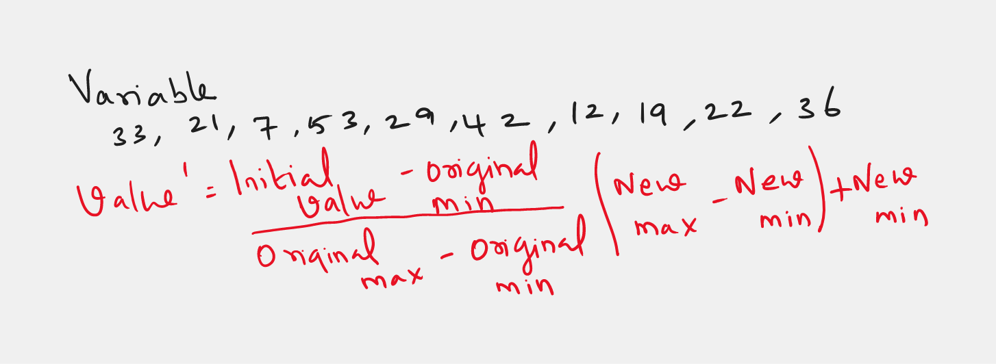
Problem

Slide 53
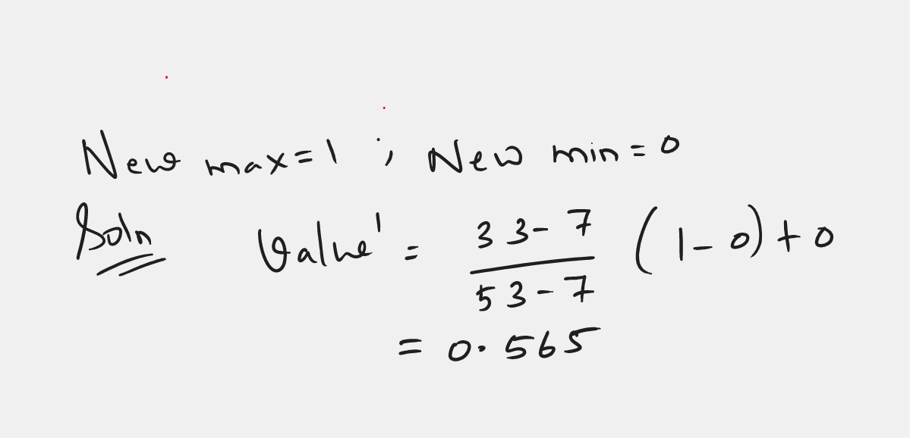
Solution

Slide 54


