Slide 1
Module 2: Data Analysis and Visualization
Data Summarization: One Quantitative and Categorical Variable. Data Classes: One Dimensional Data Classes-Data Frames and Matrices-Lists. Data Cleaning: Dealing with Missing Data-Strings and Recoding Variables. Manipulating Data in R: Reshaping Data-Merging Datasets. Data Visualizations: Plotting with ggplot2- Plotting with Base R

Slide 2
Data Analysis and Visualization
Data Summarization: One Quantitative and Categorical Variable.
Data Classes: One Dimensional Data Classes-Data Frames and Matrices-Lists.

Slide 3
Data Summarization
In any statistical analysis, data is defined as a collection of information, which may be used to prove or disprove a hypothesis or data set.
Although data can take on any form, however, it’s classified into two main categories depending on its nature - categorical and numerical data.
Understanding different data types helps you to choose which method is best for any situation.

Slide 4
Key Takeaways:
Quantitative or numerical data and categorical data are both incredibly important for statistical analysis.
There are different types of both data that can result in unique (and very useful) data analysis results.
Data collection methods are easier to conduct than you may think.

Slide 5
Variables
If we have specified the population of interest for a specific research question, we can think of what is of interest about our observations.
A particular feature of these observations can be collected in a statistical variable X. Any information we are interested in may be captured in such a variable.
For example, if our observations refer to human beings, X may describe marital status, gender, age, or anything else which may relate to a person.

Slide 6
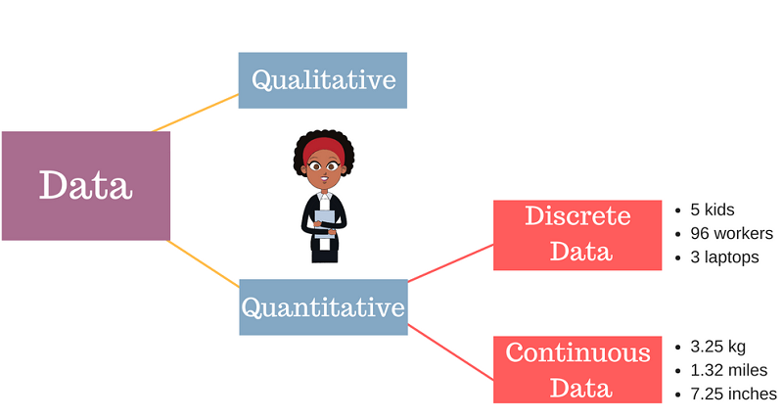
Contd

Slide 7
Contd
Of course, we can be interested in many different features, each of them collected in a different variable Xi, i = 1,2,...,p.
Each observation ω takes a particular value for X. If X refers to gender, each observation, i.e. each person, has a particular value x which refers to either “male” or “female”.
The formal definition of a variable is
X : Ω →S
ω→x
This definition states that a variable X takes a value x for each observation ω ∈ Ω, whereby the number of possible values is contained in the set S

Slide 8
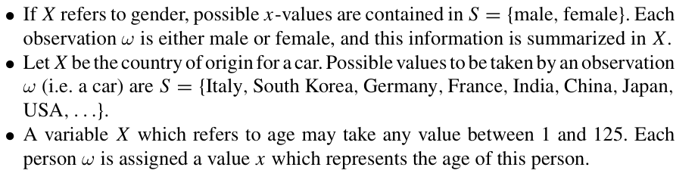
Example of Variable

Slide 9
Qualitative Variable
Qualitative variables are the variables which take values x that cannot be ordered in a logical or natural way.
For example,
the color of the eye
the name of a political party
the type of transport used to travel to work

Slide 10
Quantitative Variable
Quantitative variables represent measurable quantities.
The values which these variables can take can be ordered in a logical and natural way.
Examples of quantitative variables are
size of shoes,
price for houses,
number of semesters studied
weight of a person

Slide 11


Slide 12
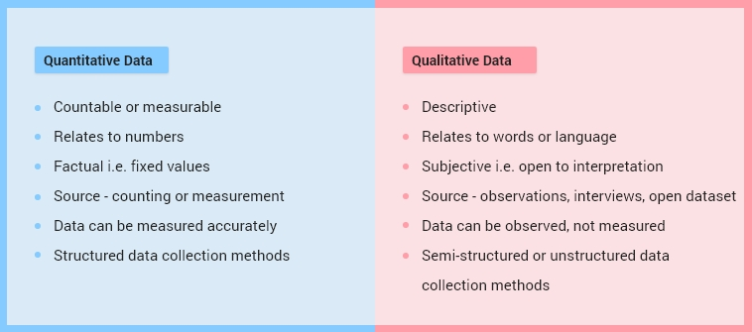

Slide 13
Discrete and Continuous Variables
Discrete Variables:
Variables which can only take a finite number of values.
All qualitative variables are discrete, like:
1. the colour of the eye or
2. the region of a country
Quantitative variables can be discrete:
1. the size of shoes or
2. the number of semesters studied would be discrete because the number of values these variables can take is limited.

Slide 14
Continuous Variable
Variables which can take an infinite number of values are called continuous variables.
Examples are:
the time it takes to travel to university,
the length of an antelope, and
the distance between two planets. Sometimes, it is said that continuous variables are variables which are “measured rather than counted”.

Slide 15
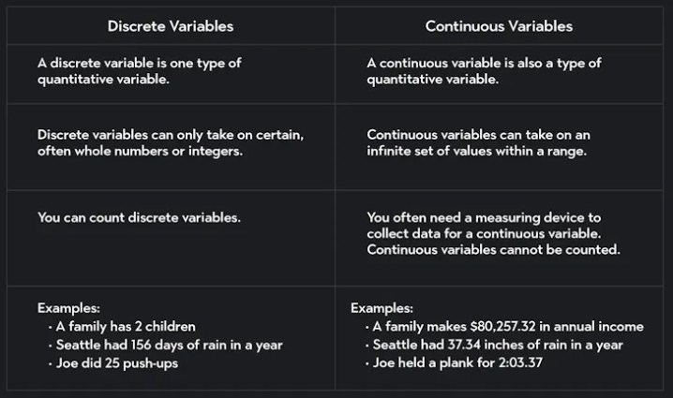

Slide 16
Data Classes: One Dimensional Data Classes
A data class is a list of data set allocation attributes and their values.
Data Frames
Matrices
Lists

Slide 17
Data Frames
Data frames are used to store tabular data in R.
They are an important type of object in R and are used in a variety of statistical modeling applications.
Most data sets are stored in R as data frames. They are like matrices, but with the columns having their own names.
Unlike matrices, data frames can store different classes of objects in each column. Matrices must have every element be the same class.

Slide 18
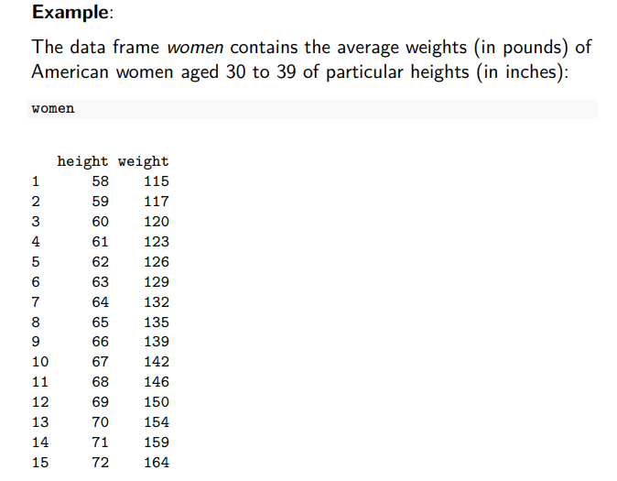

Slide 19
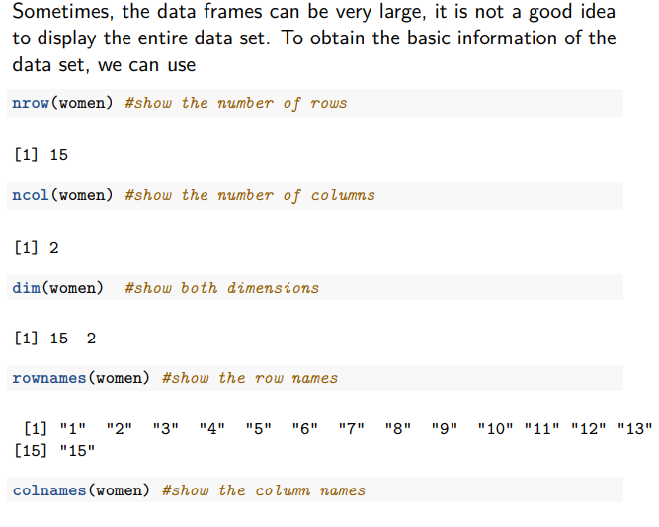

Slide 20
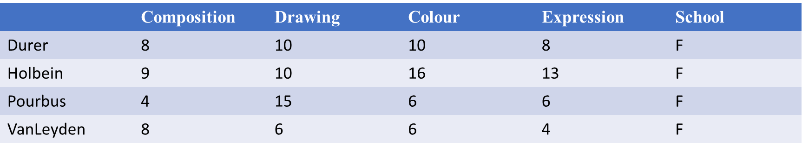
Accessing Subgroups in Data Frames
Subgroups , i.e. groups of observations which share the same feature(s) of one or several variables, can be accessed using the subset command.
subset(painters , School=="F")
Accesses all painters for which School==‘‘F’’ holds.

Slide 21
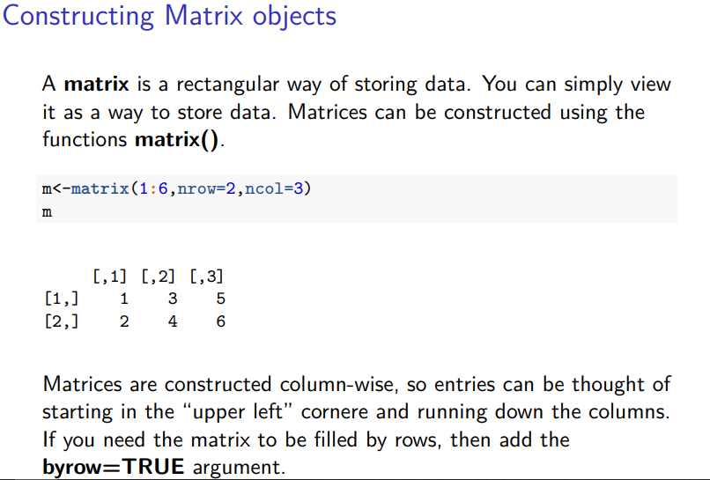

Slide 22
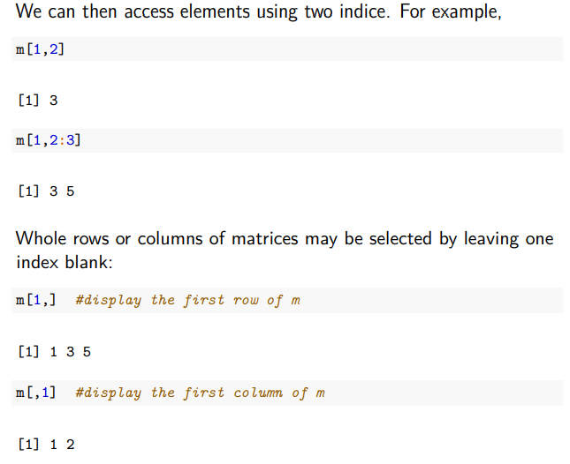

Slide 23
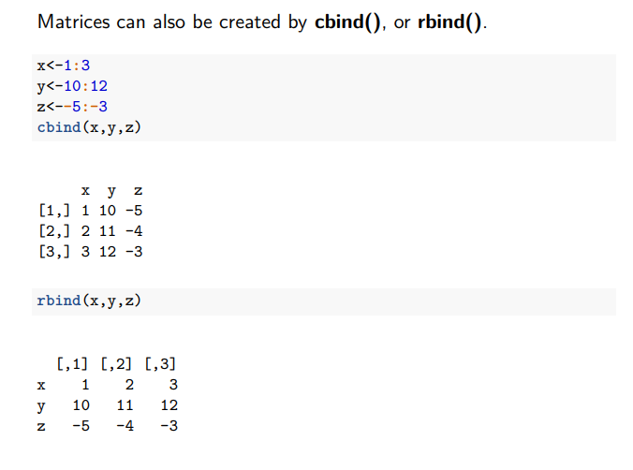

Slide 24
Lists
A list can contain objects of different types.
For example, a list element can be a vector or matrix.
Lists can be initialized by the command list and can grow dynamically.
It is important to understand that list elements should be accessed by the name of the entry via the dollar sign or using double brackets

Slide 25
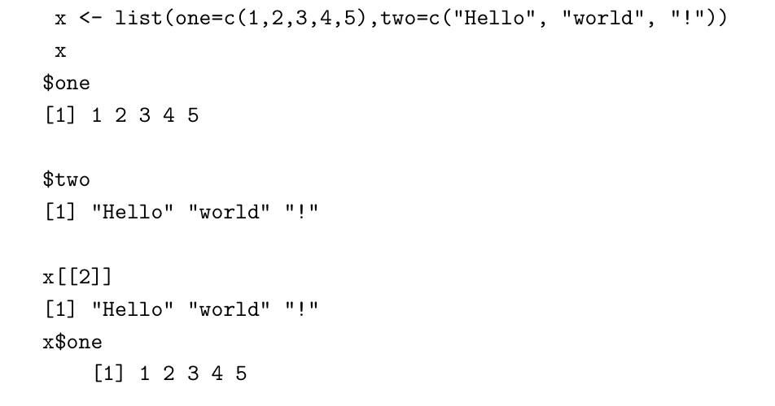

Slide 26
Indexing
The standard ways of accessing / indexing elements in a vector, matrix, list, or data frame have discussed, but R allows a lot more flexible accessing of elements.
1. Selecting elements using vectors of positive numbers (letters and LETTERS show the 26 letters of the alphabet)
letters[1:3]
letters[ c(2,4,6) ]
[1] "a" "b" "c"
[1] "b" "d" "f"

Slide 27
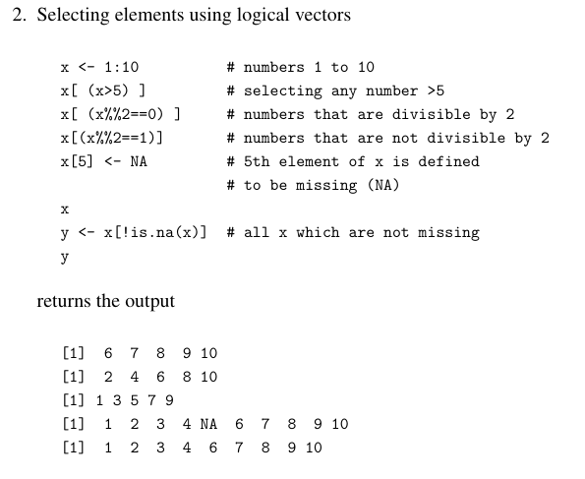

Slide 28
3. Selecting (deleting) elements using negative numbers
x <- 1:10
x[-(1:5)] # x, but delete first five entries of x
returns the output
[1] 6 7 8 910
because the first five elements have been removed.

Slide 29
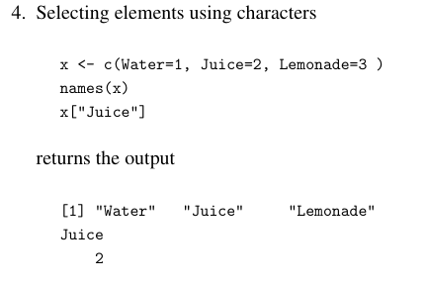

Slide 30
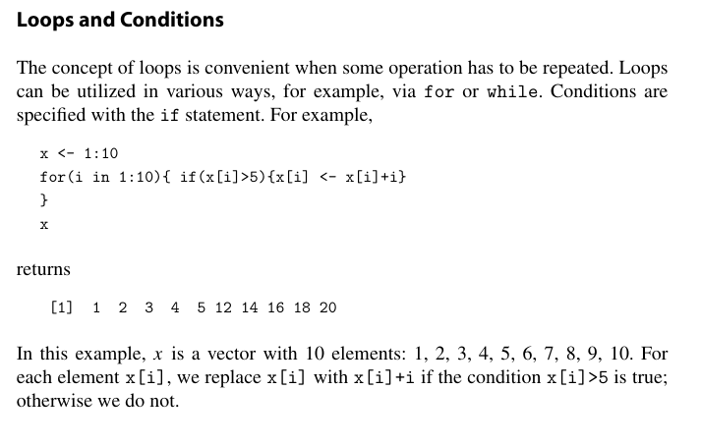

Slide 31
Data Cleaning
Data cleaning refers to the process of detecting and fixing errors, inconsistencies, and inaccuracies in a dataset to enhance its overall quality and reliability.
This process typically involves addressing missing data, correcting entry mistakes, standardizing data formats, eliminating duplicate records, and resolving any discrepancies.
The goal is to ensure that the dataset is accurate, complete, and properly structured for effective analysis or modeling.

Slide 32
Dealing with Missing Data
Missing values indicate that data is absent or not recorded for a particular entry in the dataset.
They are not same as zero or an empty string; they explicitly signify that no data is available for that specific cell.
In R, missing values are represented by the special value NA, which stands for "Not Available" or "Not Applicable."

Slide 33
Common Causes of Missing Data
Human Error: Typos or missed entries during data collection.
Incomplete Responses: Participants skipping questions in surveys or forms.
Data Corruption: Loss or corruption of data during transmission or storage.
Inconsistent Data Collection: Different methods or instruments used to collect data may result in missing information.

Slide 34
There are several types of missing data:
Missing Completely at Random (MCAR): The missingness is completely random and unrelated to both observed and unobserved data.
For example, if data is missing due to a random malfunction in data collection equipment, it’s MCAR.
2. Missing at Random (MAR): The missingness is related to the observed data but not to the missing data itself.
For example, if people with lower income levels are more likely to skip questions about income, but the likelihood of missing data is unrelated to their income levels, it's MAR.

Slide 35
3. Missing Not at Random (MNAR): The missingness is related to the value of the missing data itself.
For instance, if individuals with higher incomes are more likely to skip questions about their income, the missing data is MNAR

Slide 36
Identify the missing data in a dataset using functions
Here are the commonly used functions to identify missing data:
is.na(): This function checks for missing values (NA) in a dataset and returns a logical matrix (TRUE for missing values and FALSE otherwise).
sum(is.na()): You can use sum() with is.na() to count the total number of missing values in a dataset.

Slide 37
3. anyNA():This function returns TRUE if any missing value is present in the dataset or FALSE if none are missing.
4. complete.cases():This function identifies complete cases (rows with no missing values) and returns a logical vector (TRUE for rows without missing values and FALSE for rows with missing values).
5. colSums(is.na()) and rowSums(is.na()): These functions allow you to compute the number of missing values per column or row in the dataset.

Slide 38
6. Using sapply(): to Detect Missing Data by Columnsapply() can be used to apply sum(is.na()) to each column and provide a column-wise summary of missing values.

Slide 39
Review the missing data in a dataset using functions
Function | Purpose
is.na() | Identifies missing values (returns TRUE/FALSE)
sum(is.na(data)) | Total count of missing values in the dataset
colSums(is.na(data)) | Missing values per column
rowSums(is.na(data)) | Missing values per row
complete.cases() | Identifies rows with no missing values
aggr() (VIM) | Visualize missing data patterns
md.pattern() (mice) | Shows a matrix of missing data combinations

Slide 40
Apply techniques to handle the missing values
Here are several techniques in R to handle missing values using appropriate functions.
Remove Missing Values
You can remove rows with missing values using the na.omit() or drop_na() (from the tidyr package) functions.
Remove Columns with Many Missing Values: If a column has a high percentage of missing values, then we can drop the column.

Slide 41
2.Impute Missing Values
Mean Imputation: Replace missing values with the mean of the corresponding column.
Median Imputation: Replace missing values with the median of the column, which is less sensitive to outliers.
Mode Imputation: For categorical variables, replace missing values with the most frequent category (mode).

Slide 42
3. Predictive Imputation
K-Nearest Neighbors (KNN) Imputation: Impute missing values based on the nearest neighbors using the DMwR package.
Multiple Imputation: Impute missing values multiple times using the mice package. This is useful for more complex imputation based on multiple variables.
Interpolation (For Time Series Data): For time series data, missing values can be filled using interpolation techniques like linear or spline interpolation.

Slide 43
Recoding Variables
Recoding is the process of transforming or reclassifying the values of a variable into new values or categories.
This is commonly used in data cleaning and preparation to make variables more meaningful or suitable for analysis.

Slide 44
Purpose of Recoding
Simplify Data: Recoding can reduce the complexity of a variable, making it easier to analyze or interpret.
For example, collapsing a multi-level categorical variable into fewer levels.
Prepare Data for Analysis: Recoding may be necessary to meet the requirements of certain statistical models or visualizations.
Create New Insights: Grouping values or transforming continuous variables into categorical bins can uncover new patterns in the data.

Slide 45
Use Cases of Recoding Collapsing
Categorical Variables: Converting multiple categories into a smaller set of meaningful categories (e.g., recoding education levels into "High School," "Undergraduate," and "Graduate").
Binarization: Converting a continuous or categorical variable into a binary format (e.g., recoding a variable based on a threshold, such as age > 18 being recoded as "Adult").
Creating Ranges or Bins: Dividing a continuous variable into a set of discrete categories or intervals (e.g., converting age into age groups like "Young," "Middle-aged," "Senior").

Slide 46
R functions for recoding
Function | Purpose | Example
ifelse() | Simple conditional recoding | Replace age values above 30 with "Above 30"
case_when() | Multiple conditions (requires dplyr) | Recode age into "Young", "Adult", and "Senior"
factor() | Recode categorical variables and factor levels | Recode gender from 1, 2 to "Male", "Female"
replace() | Replace specific values | Replace 0 with NA
cut() | Recodes continuous variables into categories | Divide income into "Low", "Medium", and "High" groups
within() | Recoding variables inside a data frame | Create a new variable age_category within a data frame

Slide 47
Manipulating Data in R
Manipulating data in R involves transforming and organizing your data to suit your analysis needs.
This process often includes identifying the need for reshaping, filtering, grouping, summarizing, and joining datasets. R's robust data structures and libraries enable efficient execution of these tasks.

Slide 48
Key Data Manipulation Techniques:
Reshaping Data:
Pivoting: Converting data between wide and long formats.
Stacking and Unstacking: Rearranging hierarchical data structures.
Melting and Casting: Transforming data between different formats.
Filtering Data:
Subset: Selecting specific rows or columns based on conditions.
Filtering: Removing rows or columns that don't meet certain criteria.

Slide 49
Grouping Data:
Grouping: Combining rows based on common values in a specific column.
Summarizing: Calculating aggregate statistics for each group.
Joining Data:
Merging: Combining datasets based on common columns.
Concatenating: Appending datasets row-wise or column-wise.
Transforming Data:
Creating New Variables: Deriving new columns from existing ones.
Modifying Existing Variables: Changing the values of existing columns.

Slide 50
R functions to Reshape and merge Datasets
Function | Package | Description
pivot_wider() | dplyr | Converts data from long to wide format.
pivot_longer() | dplyr | Converts data from wide to long format.
melt() | reshape2 | Converts data from wide to long format.
cast() | reshape2 | Converts data from long to wide format.
join() | dplyr | Combines datasets based on common columns.
merge() | Base R | Combines datasets based on common columns.
rbind() | Base R | Combines datasets row-wise.
cbind() | Base R | Combines datasets column-wise.

Slide 51
R Functions for Reshaping and Merging Datasets
Function | Description | Example
reshape() | Reshapes data between wide and long formats. | df_long <- reshape(df_wide, idvar = "id", timevar = "time", direction = "long")
merge() | Joins datasets based on common columns. | merged_df <- merge(df1, df2, by = "id")
rbind() | Combines datasets row-wise. | combined_df <- rbind(df1, df2)
cbind() | Combines datasets column-wise. | combined_df <- cbind(df1, df2)

Slide 52
Code snippet for reshape and merge function
library(reshape)
# Sample data
df_wide <- data.frame( id = c(1, 2),
time1 = c(10, 8), time2 = c(12, 9) )
# Reshaping from wide to long format
df_long <- reshape(df_wide, idvar = "id", timevar = "time", direction = "long")
cont

Slide 53
# Merging datasets
df2 <- data.frame( id = c(1, 2),
category = c("A", "B"))
merged_df <- merge(df_long, df2, by = "id")

Slide 54
Data Visualization
R is a powerful tool for data visualization, offering a wide range of packages and functions to create informative and visually appealing plots.

Slide 55
Key Considerations for Data Visualization:
Clarity: Ensure that the plot is easy to understand and interpret.
Relevance: Choose visualizations that effectively convey the message you want to communicate.
Aesthetics: Use appropriate colors, fonts, and themes to enhance the visual appeal of the plot.
Interactivity: Consider using interactive plots to allow users to explore the data more deeply.
Accessibility: Make sure your visualizations are accessible to people with disabilities.

Slide 56
Here are some of the most popular R packages for data visualization:
Core R Graphics
plot(): A versatile function for creating basic plots like scatter plots, line plots, and histograms.
barplot(): Creates bar charts.
pie(): Creates pie charts.
boxplot(): Creates box plots.

Slide 57
Specialized Packages
ggplot2: A grammar of graphics approach, providing a flexible and customizable framework for creating various types of plots.
plotly: Creates interactive plots that can be explored and zoomed in on.
ggvis: An interactive grammar of graphics package.
lattice: A package for creating trellis graphics, which are useful for visualizing relationships between multiple variables.
cartogram: Creates cartograms, which are maps where the size of geographic areas is distorted to represent a specific variable.
leaflet: Creates interactive maps.

Slide 58
Plotting with ggplot2
ggplot2 is a powerful and versatile package in R for creating a wide range of static and interactive visualizations.
It follows a grammar of graphics approach, allowing you to build plots layer by layer, providing great flexibility and customization.

Slide 59
Basic Structure of a ggplot2 Plot
A typical ggplot2 plot consists of the following components:
Data: The dataset you want to visualize.
Aesthetic Mappings: Linking variables in your data to visual properties like color, size, shape, and alpha.
Geometries: The visual elements used to represent your data (e.g., points, lines, bars).
Facets: Dividing the plot into subplots based on a variable
Scales: Controlling the appearance of axes, legends, and other plot elements.
Coordinates: Transforming the coordinate system (e.g., log scale, polar coordinates).
Theme: Customizing the overall appearance of the plot.

Slide 60
Key ggplot2 Functions:
ggplot(): Creates a basic ggplot object.
geom_*(): Adds geometric objects to the plot (e.g., geom_point(), geom_line(), geom_bar()).
aes(): Specifies aesthetic mappings.
labs(): Sets labels for the plot title, axes, and legend.
scale(): Controls the appearance of scales (e.g., scale_x_continuous(), scale_color_manual()).
facet(): Creates facets (e.g., facet_wrap(), facet_grid()).
theme(): Customizes the overall appearance of the plot.

Slide 61
Code snippet
library(ggplot2)
x <- c(1, 2, 3, 4, 5)
y <- c(10, 20, 30, 40, 50)
df <- data.frame(x, y)
ggplot(data = df) + geom_point(aes(x = x, y = y))

Slide 62
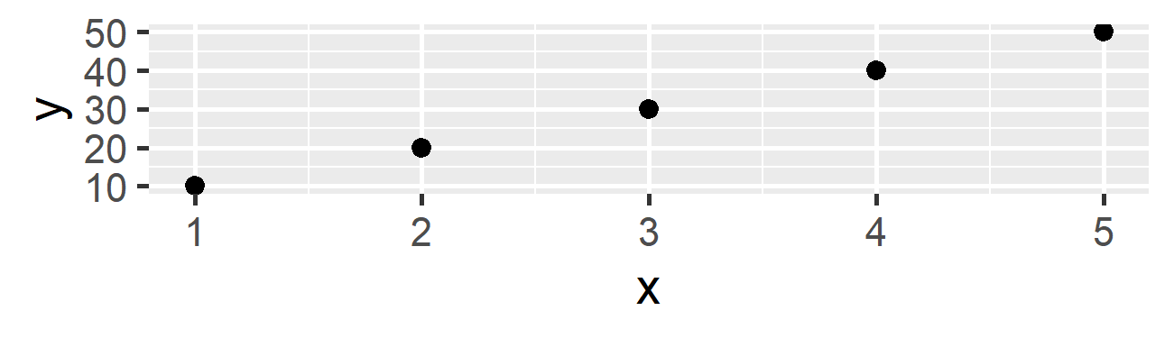

Slide 63
Creating Simple Plots with ggplot2
Scatter plot
library(ggplot2)
# Sample data
df <- data.frame( x = 1:10, y = rnorm(10)) #Create a scatter plot
ggplot(df, aes(x, y)) + geom_point() + labs(title = "Scatter Plot", x = "X-axis", y = "Y-axis")

Slide 64
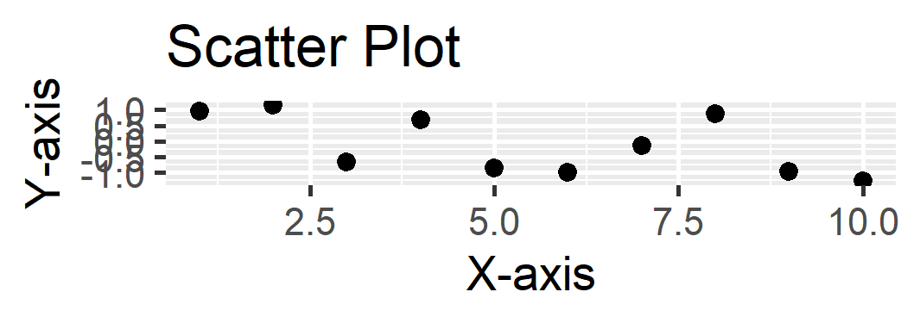

Slide 65
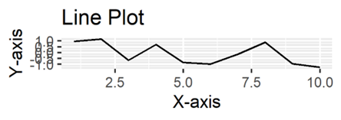
# Create a line plot
ggplot(df, aes(x, y)) + geom_line() + labs(title = "Line Plot", x = "X-axis", y = "Y-axis")

Slide 66
# Create a bar plot
df_bar <- data.frame(
category = c("A", "B", "C"),
value = c(10, 15, 20)
)
ggplot(df_bar, aes(category, value)) +
geom_bar(stat = "identity") +
labs(title = "Bar Plot", x = "Category", y = "Value")

Slide 67
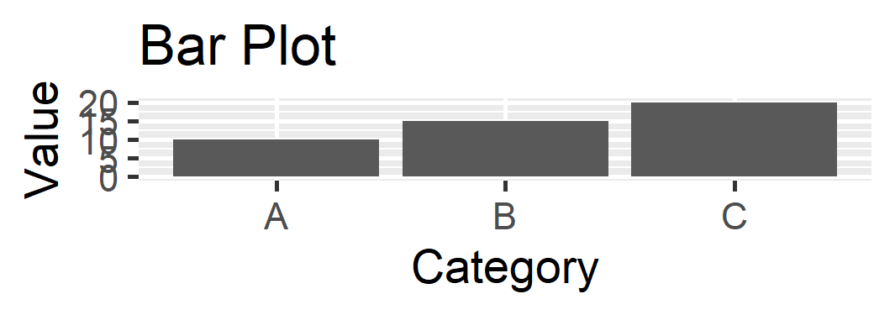

Slide 68
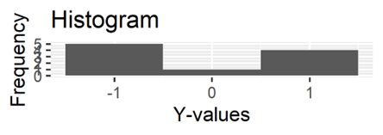
# Create a histogram
ggplot(df, aes(y)) +
geom_histogram(binwidth = 1) +
labs(title = "Histogram", x = "Y-values", y = "Frequency")

Slide 69
# Create a box plot
df_box <- data.frame(
group = c("A", "B", "C"),
value = c(10, 12, 8, 9, 15, 18, 20, 22, 25)
)
ggplot(df_box, aes(group, value)) +
geom_boxplot() +
labs(title = "Box Plot", x = "Group", y = "Value")

Slide 70
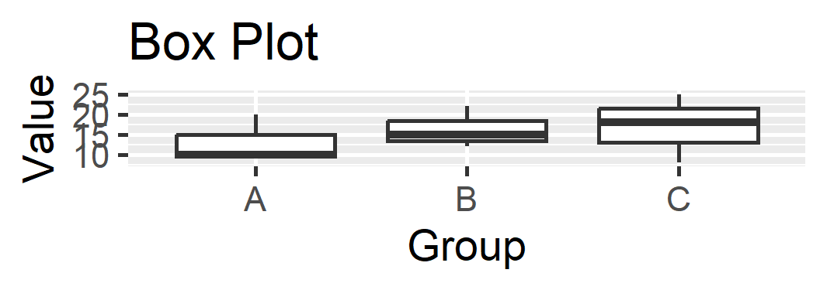

Slide 71
Plotting with Base R
While ggplot2 is a popular choice for data visualization in R, base R also offers a wide range of plotting functions that can be used to create various types of plots.

Slide 72
Basic Plotting Functions:
plot(): A versatile function for creating scatter plots, line plots, and histograms.
barplot(): Creates bar charts.
pie(): Creates pie charts.
hist(): Creates histograms.
boxplot(): Creates box plots.

Slide 73
Additional Plotting Functions:
pairs(): Creates scatter plots for all pairs of variables in a data frame.
matplot(): Creates multiple line plots on a single graph.
image(): Creates heatmaps.
contour(): Creates contour plots.

Slide 74
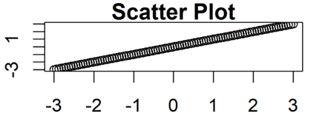
Creating Basic Plots with Base R Functions
Scatter Plot
par(mar = c(2, 2, 1, 1))
# Create a scatter plot
Plot(x, y, main = "Scatter Plot", xlab = "X-axis", ylab = "Y-axis")

Slide 75
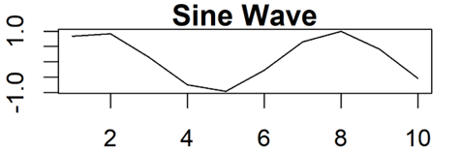
#Line plot
par(mar = c(2, 2, 1, 1))
# Create a line plot
x <- 1:10
y <- sin(x)
plot(x, y, type = "l", main = "Sine Wave", xlab = "X-axis", ylab = "Y-axis")

Slide 76
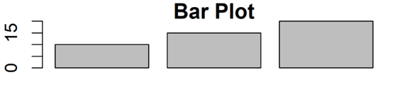
#Bar plot
data <- c(10, 15, 20)
barplot(data, main = "Bar Plot", xlab = "Categories", ylab = "Values")

Slide 77
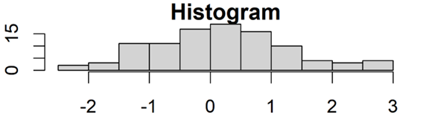
#histogram
hist(rnorm(100), main = "Histogram", xlab = "Values", ylab = "Frequency")

Slide 78
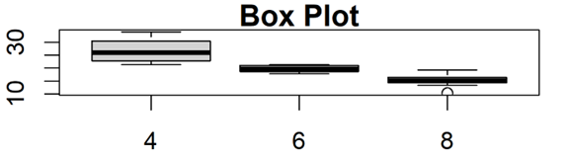
#boxplot
boxplot(split(mtcars$mpg, mtcars$cyl), main = "Box Plot", xlab = "Cylinders", ylab = "Miles Per Gallon")

Slide 79

#pie
pie(c(25, 20, 35, 20), labels = c("A", "B", "C", "D"), main = "Pie Chart")

Slide 80
#contour
x <- seq(-3, 3, length.out = 100)
y <- seq(-3, 3, length.out = 100)
z <- outer(x, y, function(x, y) x^2 + y^2)
contour(x, y, z, main = "Contour Plot")

Slide 81
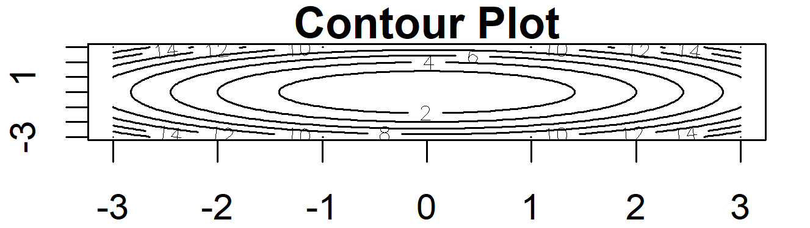

Slide 82
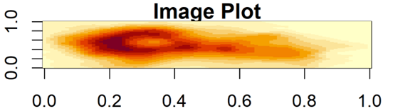
#imageplot
image(volcano, main = "Image Plot")

Slide 83
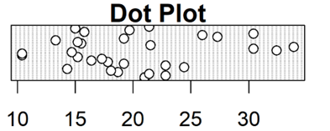
#dot
dotchart(mtcars$mpg, labels = rownames(mtcars), main = "Dot Plot")

