Slide 1
NATURAL LANGUAGE PROCESSING AND TEXT CLASSIFICATION

Slide 2
LEARNING OBJECTIVES
NATURAL LANGUAGE PROCESSING AND TEXT CLASSIFICATION
Define natural language processing
List common tasks associated with
use-cases
tokenization
tagging
parsing
Demonstrate how to classify text or documents using scikit-learn

Slide 3
INTRODUCTION
NATURAL LANGUAGE PROCESSING

Slide 4
WHAT IS NATURAL LANGUAGE PROCESSING (NLP)?
Natural language processing is the task of extracting meaning and information from text documents.
There are many types of information we might want to extract.
These tasks may range from simple classification tasks, such as deciding what category a piece of text falls into, to more complex tasks like translating or summarizing text.
For most tasks, a fair amount of pre-processing is required to make the text digestible for our algorithms. We typically need to add structure to our unstructured data.

Slide 5

WHAT IS NATURAL LANGUAGE PROCESSING (NLP)?
Many AI assistant systems are typically powered by fairly advanced NLP engines.
A system like Siri uses voice-to-transcription to record a command and then various NLP algorithms to identify the question asked and possible answers.

Slide 6
TOKENIZATION
Tokenization is the task of separating a sentence into its constituent parts, or tokens.
Determining the “words” of a sentence seems easy but can quickly become complicated with unusual punctuation (common in social media) or different language conventions.

Slide 7
TOKENIZATION
What sort of difficulties can you find in the following sentence?
The L.A. Lakers won the NBA championship in 2010, defeating the Boston Celtics.

Slide 8
TOKENIZATION EXAMPLES
My house is located in Uptown. → [My, house, is, located, in, Uptown]
The Lakers are my favorite team. → [The, Lakers, are, my, favorite, team]
Data Science is the future! → [Data, Science, is, the, future]
GA has many locations. → [GA, has, many, locations.]

Slide 9
LEMMATIZATION AND STEMMING
How would you describe the relationship between the terms ‘bad’ and ‘badly’ or ‘different’ and ‘differences’?
Stemming and lemmatization help identify common roots of words.
Stemming is a crude process of removing common endings from sentences, such as ‘s’, ‘es’, ‘ly’, ‘ing’, and ‘ed’.

Slide 10
LEMMATIZATION AND STEMMING
Lemmatization is a more refined process that uses specific language and grammar rules to derive the root of a word.
This is useful for words that do not share an obvious root such as ‘better’ and ‘best’.
What are some other examples of words that do not share an obvious root?

Slide 11
LEMMATIZATION AND STEMMING EXAMPLES
Lemmatization
shouted → shout
best → good
better → good
good → good
wiping → wipe
hidden → hide
Stemming
badly → bad
computing → comput
computed → comput
wipes → wip
wiped → wip
wiping → wip

Slide 12

ACTIVITY: KNOWLEDGE CHECK
ANSWER THE FOLLOWING QUESTIONS
EXERCISE
What other words or phrases might cause problems with stemming? Why?
What other words or phrases might cause problems with lemmatization? Why?
DELIVERABLE
Answers to the above questions

Slide 13
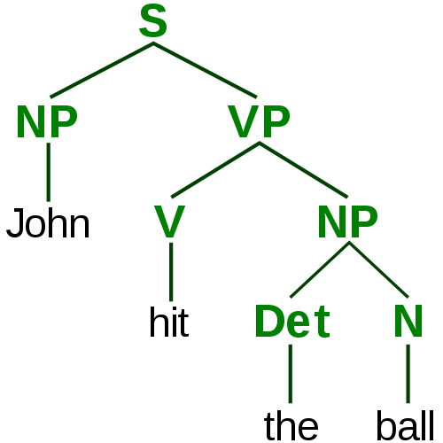
PARSING AND TAGGING
In order to understand the various elements of a sentence, we need to tag important topics and parse their dependencies.
Our goal is to identify the actors and actions in the text in order to make informed decisions.

Slide 14
PARSING AND TAGGING
If we are processing financial news, we might need to identify which companies are involved and which actions they are taking.
If we are writing an assistant application, we might need to identify specific command phrases in order to determine what is being asked:
e.g. “Siri, when is my next appointment?”

Slide 15
PARSING AND TAGGING
Tagging and parsing is made up of a few overlapping subproblems:
“Parts of speech” tagging: What are the parts of speech in a sentence (e.g. noun, verb, adjective, etc)?
Chunking: Can we identify the pieces of the sentence that go together in meaningful chunks (e.g. noun or verb phrases)?
Named entity recognition: Can we identify specific proper nouns? Can we pick out people and locations?

Slide 16
ACTIVITY: KNOWLEDGE CHECK
ANSWER THE FOLLOWING QUESTIONS
EXERCISE
How might NLP be applied within your current jobs or final projects?
What are some other potential NLP use-cases?
DELIVERABLE
Answers to the above questions

Slide 17
INTRODUCTION
TEXT CLASSIFICATION

Slide 18
TEXT CLASSIFICATION
Text classification is the task of predicting which category or topic a text sample is from.
For example, we may want to identify whether an article is a sports or business story. Or whether an article has positive or negative sentiment.
Typically, this is done by using the text as features and the label as the target output. This is referred to as bag-of-words classification.
To include text as features, we usually create a binary feature for each word, i.e. does this piece of text contain that word?

Slide 19
TEXT CLASSIFICATION
To create binary text features, we first create a vocabulary to account for all possible words in our universe.
As we do this, we need to consider several things.
Does order of words matter?
Does punctuation matter?
Does upper or lower case matter?

Slide 20
TEXT CLASSIFICATION
This table illustrates features created from the following passage.
“It’s a great advantage not to drink among hard drinking people.”
Feature | Value
it’s | 1
great | 1
good | 0
advantage | 1
not | 1
think | 0
drink | 1
from | 0
hard | 1
drinking | 1
Feature | Value
people | 1
withhold | 0
random | 0
smoke | 0
among | 1
whenever | 0
thoughtful | 0
inexhaustible | 0
men | 0
Nick | 0

Slide 21
ACTIVITY: KNOWLEDGE CHECK
ANSWER THE FOLLOWING QUESTIONS
EXERCISE
Discuss your answers to the following questions and explain your reasoning.
Does word order matter?
Does word case (e.g. upper or lower) matter?
Does punctuation matter?
DELIVERABLE
Answers to the above questions

Slide 22
ACTIVITY: KNOWLEDGE CHECK
ANSWER THE FOLLOWING QUESTIONS
EXERCISE
What is “bag-of-words” classification and when should it be used?
What are some benefits to this approach?
DELIVERABLE
Answers to the above questions

Slide 23
DEMO
TEXT PROCESSING IN SCIKIT-LEARN

