Slide 1
Bootstrap-RAG
Unlock Smarter AI Quick and Fast

Slide 2
Features v0.0.4
Summary of Key Highlights and Features of Bootstrap-RAG:
Enhanced Search Capabilities with Qdrant (Version 0.0.4):
Improved simple search functionality.
Hybrid search using dense and sparse vectors.
Advanced search with dense, sparse, and late interaction models.
Advanced Query Support:
Queries with named vectors.
Support for Reciprocal Rank Fusion (RRF) and prefetching.
Full integration with Qdrant for seamless operation.
Improved RAG Models with Observability:
Enhanced Simple Retrieval-Augmented Generation (RAG).
Self-Correction RAG with added observability features.
No Boilerplate Code Needed:
Allows you to focus on innovation rather than setup.
Configuration-Driven Components:
Easy configuration for all components to suit your needs.
Local Setup with Cloud Scalability:
Designed for local deployment with easy scaling to cloud infrastructure.
FastAPI-Based APIs:
Provides out-of-the-box API functionality for immediate use.
Integration with Arize Phoenix for Observability:
Simplifies system monitoring and observability.
Dockerized Deployment:
Ready to deploy and scale using Docker containers.
Powered by LlamaIndex and Qdrant (Version 0.0.1):
Leverages LlamaIndex and Qdrant for immediate, powerful performance.

Slide 3
Demo

Slide 4
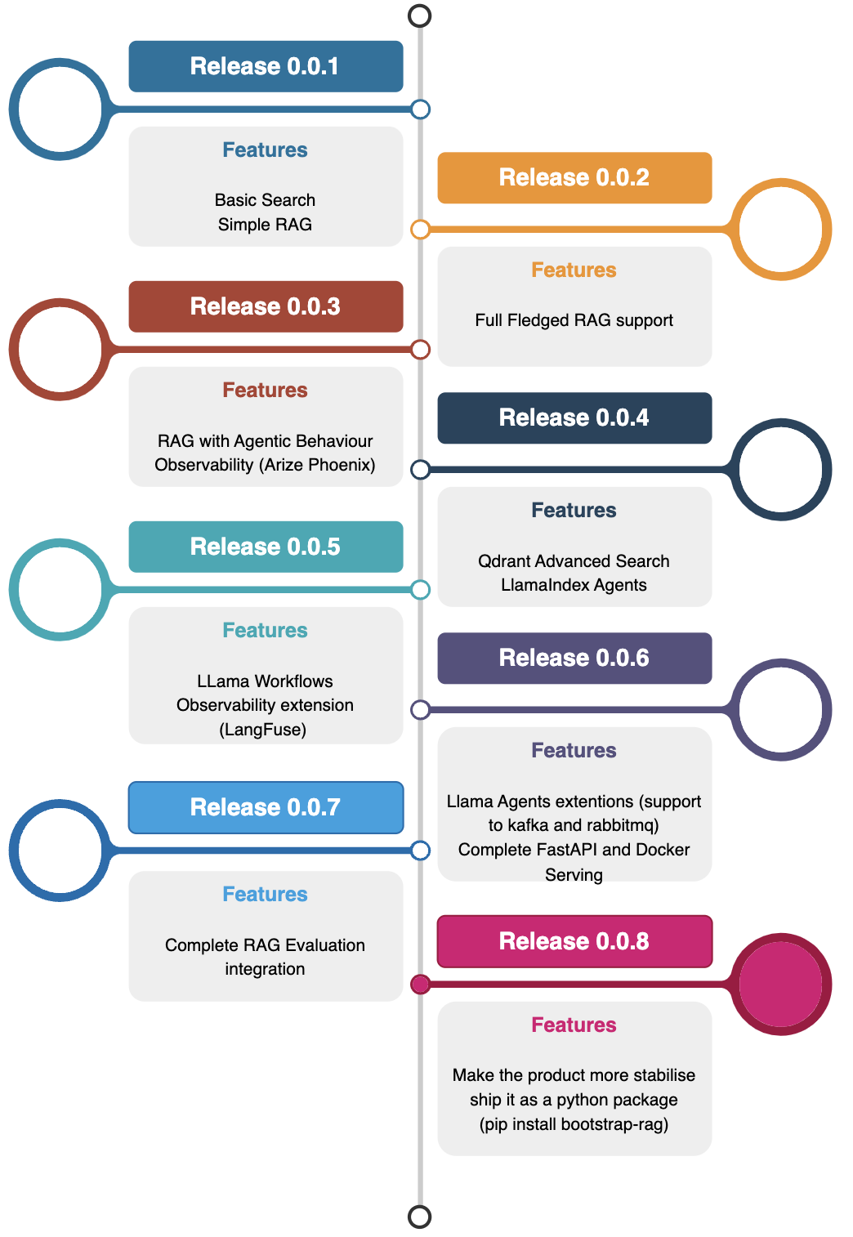
Roadmap

