Slide 1
Context Aware Agentic Workflows
Let Agents execute the process – by M K Pavan Kumar

Slide 2
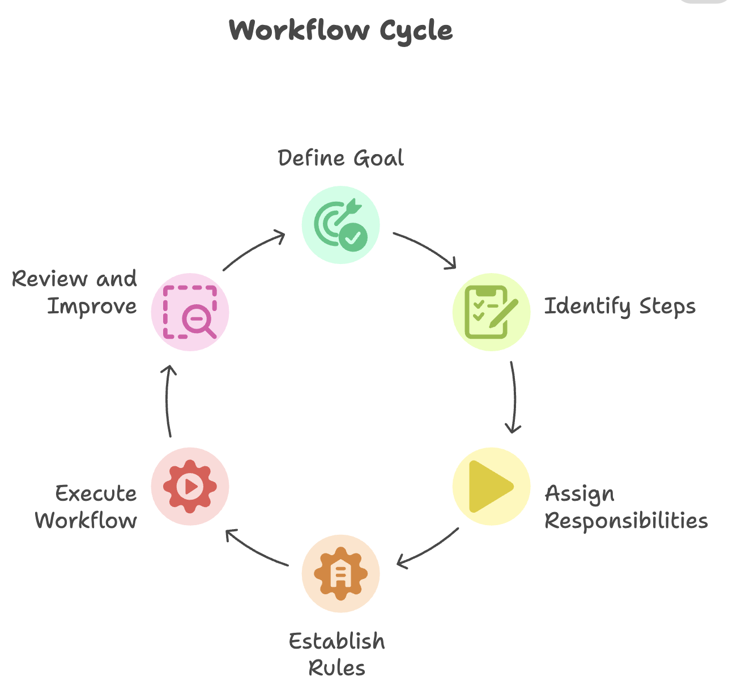
What are Workflows
A workflow is a series of steps, activities, or tasks performed in a specific order to complete a goal. It defines the process from start to finish, dictating what needs to be done, who is responsible for each part, and the rules that govern the process.

Slide 3
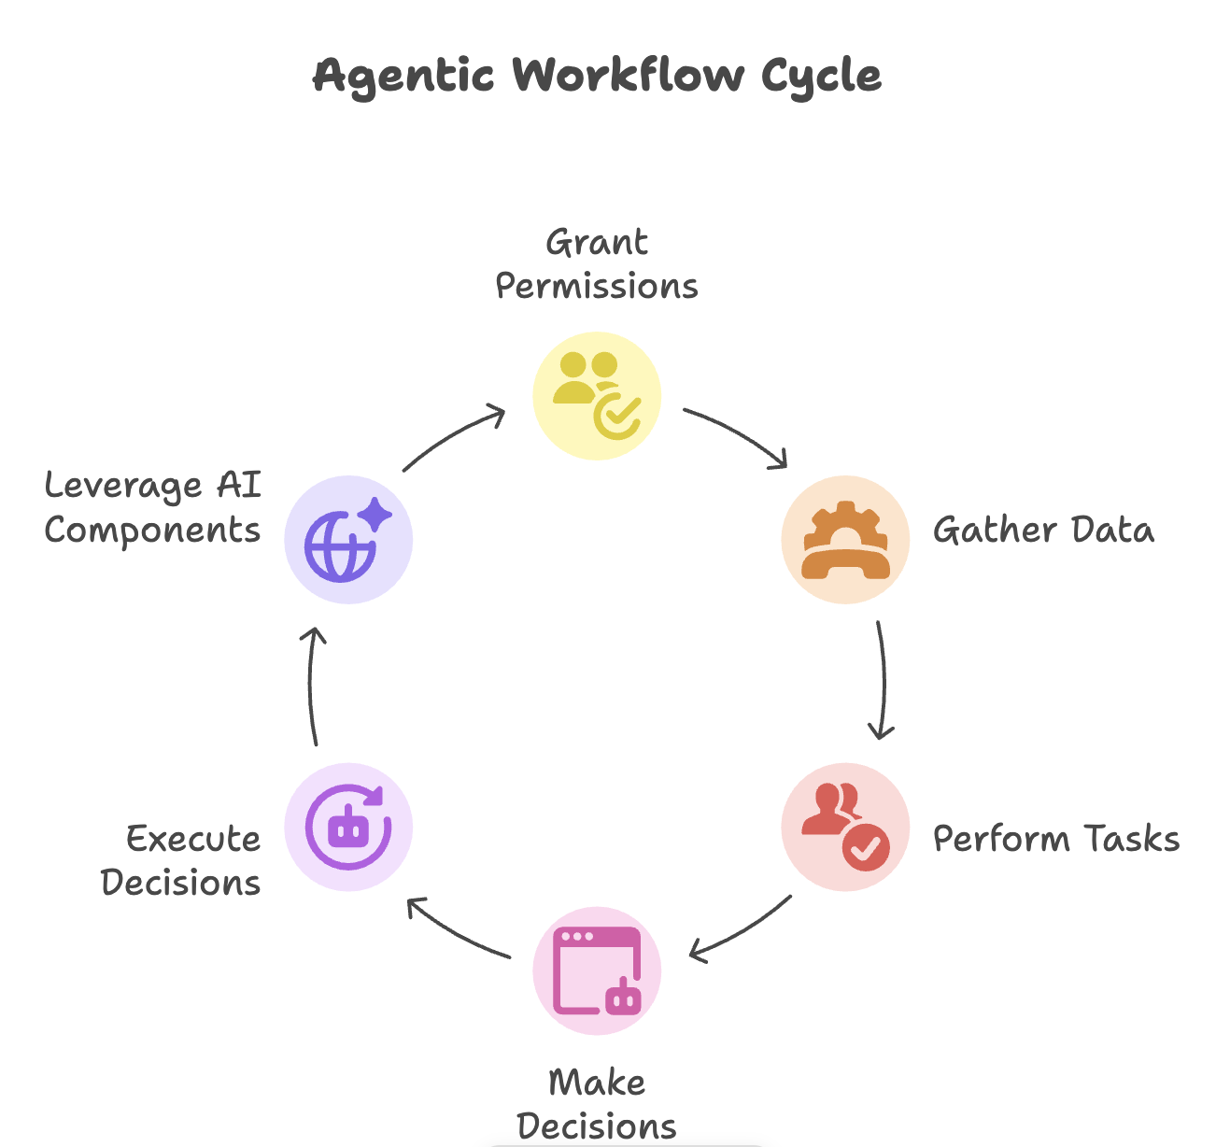
What are Agentic Workflows
An agentic workflow is a series of connected steps dynamically executed by an agent, or series of agents, to achieve a specific task or goal. Agents are granted permissions by their users, which give them a limited degree of autonomy to gather data, perform tasks, and make decisions to be executed in the real-world. Agentic workflows also leverage the core components of AI agents including, their capacity for reasoning, ability to use tools to interact with their environment, and persistent memory to completely transform traditional workflows into responsive, adaptive, and self-evolving processes.

Slide 4
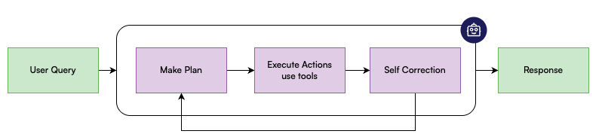
What are Agentic Workflows

Slide 5
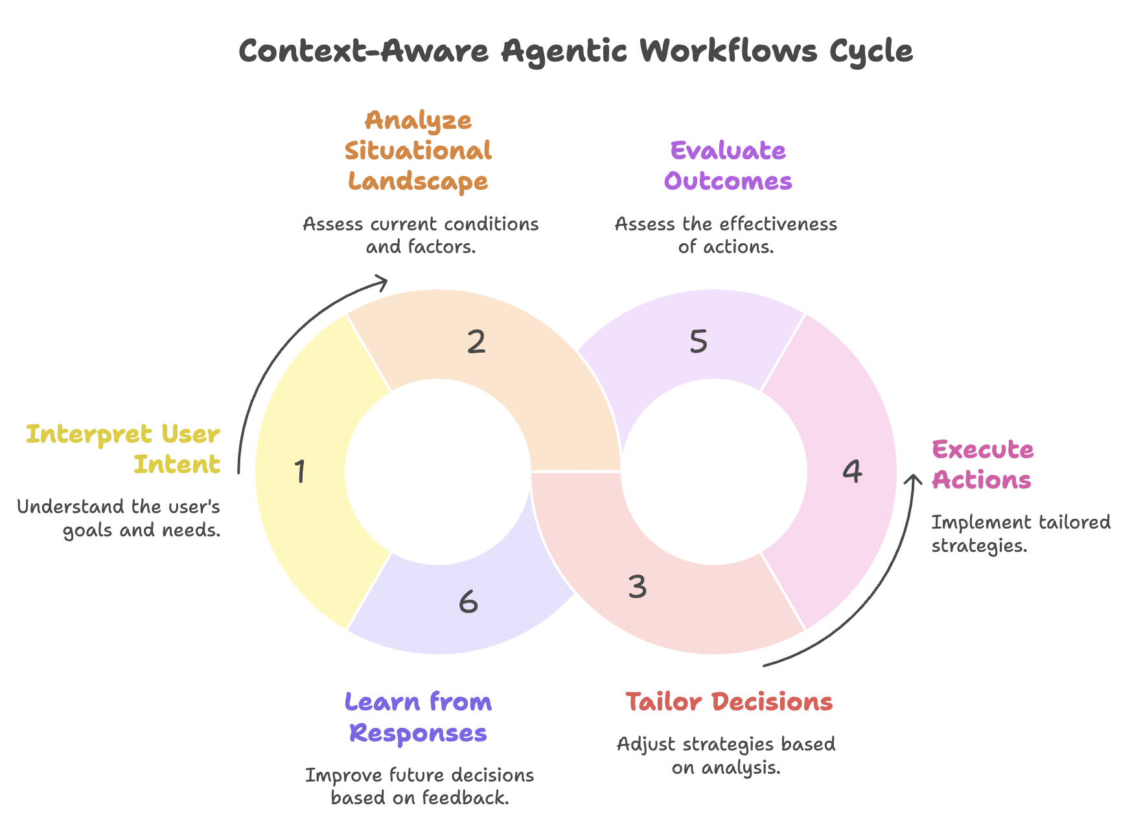
What are Context Aware Agentic Workflows
Context-Aware Agentic Workflows are intelligent processes where AI agents dynamically tailor their decisions, actions, and strategies by continuously interpreting and responding to the full situational landscape—including user intent, previous agent responses, historical responses, and real-time changes.

Slide 6
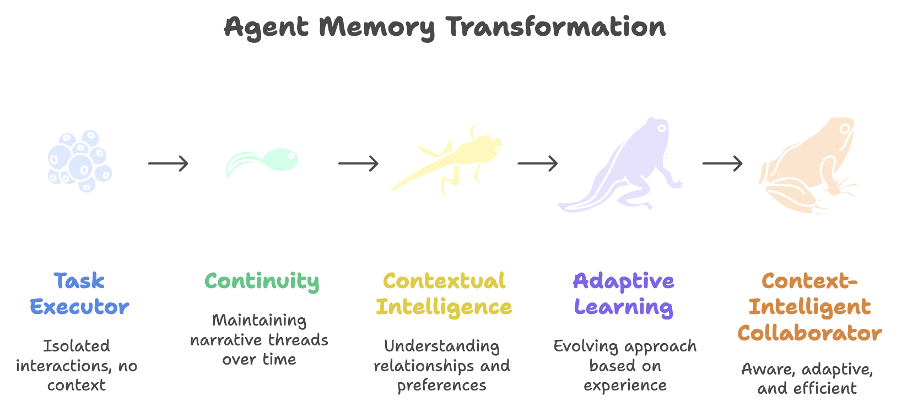
Role of Memory in Context Aware Agentic Workflows
Memory serves as the foundation that transforms agents from task executors into context-intelligent collaborators. Without memory, agents are perpetually starting from zero—every interaction is isolated, every decision is made in a vacuum. Memory is what makes context-awareness possible.

Slide 7
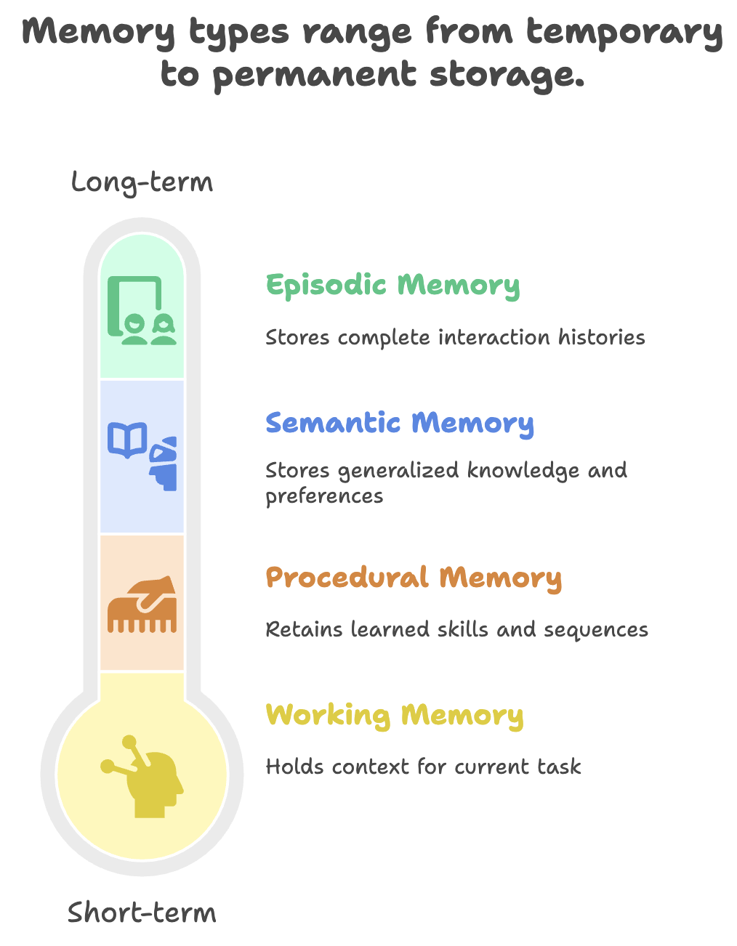
Memory Types in Agentic Workflows
Short-term (Working Memory): Maintains context within a single workflow execution—tracking intermediate results, decisions made, and current state.
Long-term (Episodic Memory): Stores complete interaction histories—what tasks were performed, what outcomes resulted, what problems emerged.
Semantic Memory: Accumulates generalized knowledge—your preferences, organizational rules, domain expertise, successful patterns.
Procedural Memory: Retains learned skills—which tool combinations work best, optimal sequences for complex tasks, efficient problem-solving approaches.

Slide 8
Benefits of Agentic Workflows
Flexibility, adaptability, and customizability: Static, deterministic workflows struggle to adapt to evolving situations and unexpected difficulties. Agentic workflows, on the other hand, offer the flexibility to adjust and evolve based on the task difficulty, ensuring they always stay relevant and give the best solution. They can also be customized by combining different patterns, enabling a modular design that allows iterative upgrades as needs and complexity grows.
Improved performance on complex tasks: By breaking down complex tasks into smaller manageable steps (through task decomposition and planning), agentic workflows significantly outperform deterministic, zero-shot approaches.
Self-correcting and continuous learning: The reflection pattern allows agentic workflow to evaluate their own actions, refine strategies, and improve outcomes over time. Utilizing both short- and long-term memory, they learn from past experiences to become more effective and personalized with each iteration.
Operational efficiency and scalability: Agentic workflows can automate repetitive tasks with high accuracy (if built right), reducing manual effort and operational costs in specific scenarios. They can also scale easily, making them ideal for handling larger workloads or complex systems.

Slide 9
Limitations of Agentic Workflows
Despite their benefits and innovative features, AI agents also come with a number of challenges and limitations. Because of their probabilistic nature, AI agents inherently add complexity to workflows. And just because agents can be used to automate processes, doesn’t mean that they should be used. Here are a few of the most notable challenges and limitations of agentic workflows:
Unnecessary complexity for simple tasks: AI agents can add overhead when used for straightforward workflows like form entry or basic data extraction. In cases where deterministic, rules-based automation is sufficient, introducing agents may lead to inefficiencies, extra expense, and possibly reduced performance.
Reduced reliability as a result of increased autonomy: As agents gain more decision-making power within a workflow, their probabilistic nature can introduce unpredictability, making outputs less reliable and harder to control. Implementing and actively maintaining guardrails for agents and continually reviewing their granted permissions is critical.

Slide 10
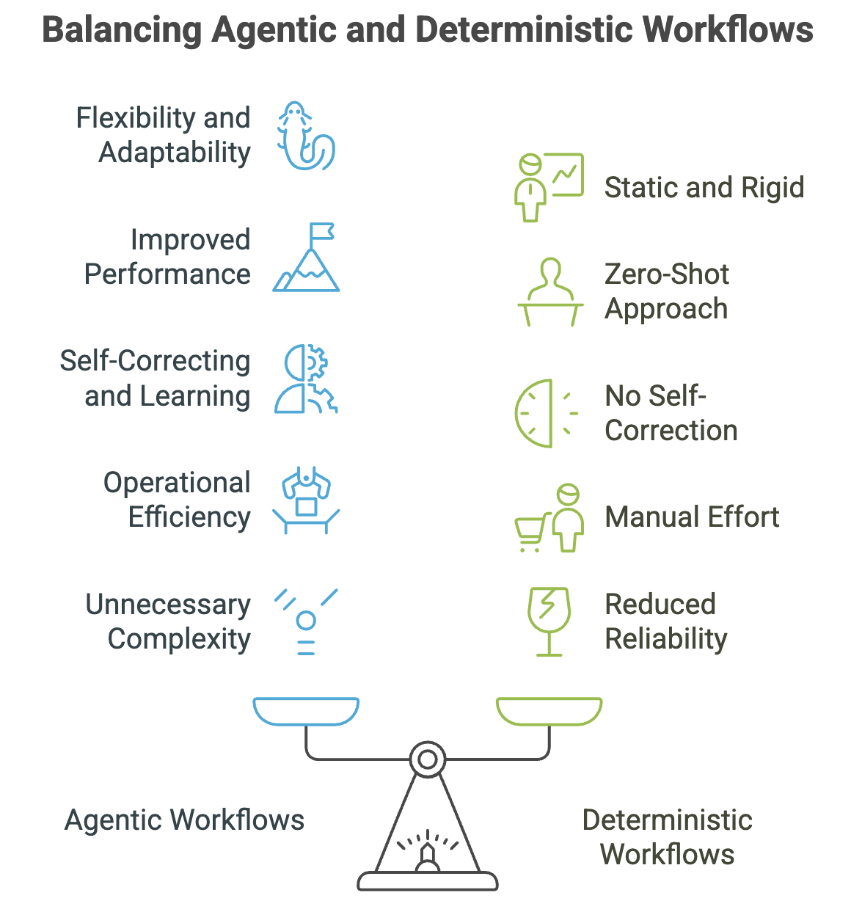
When to choose Agentic Workflows

Slide 11
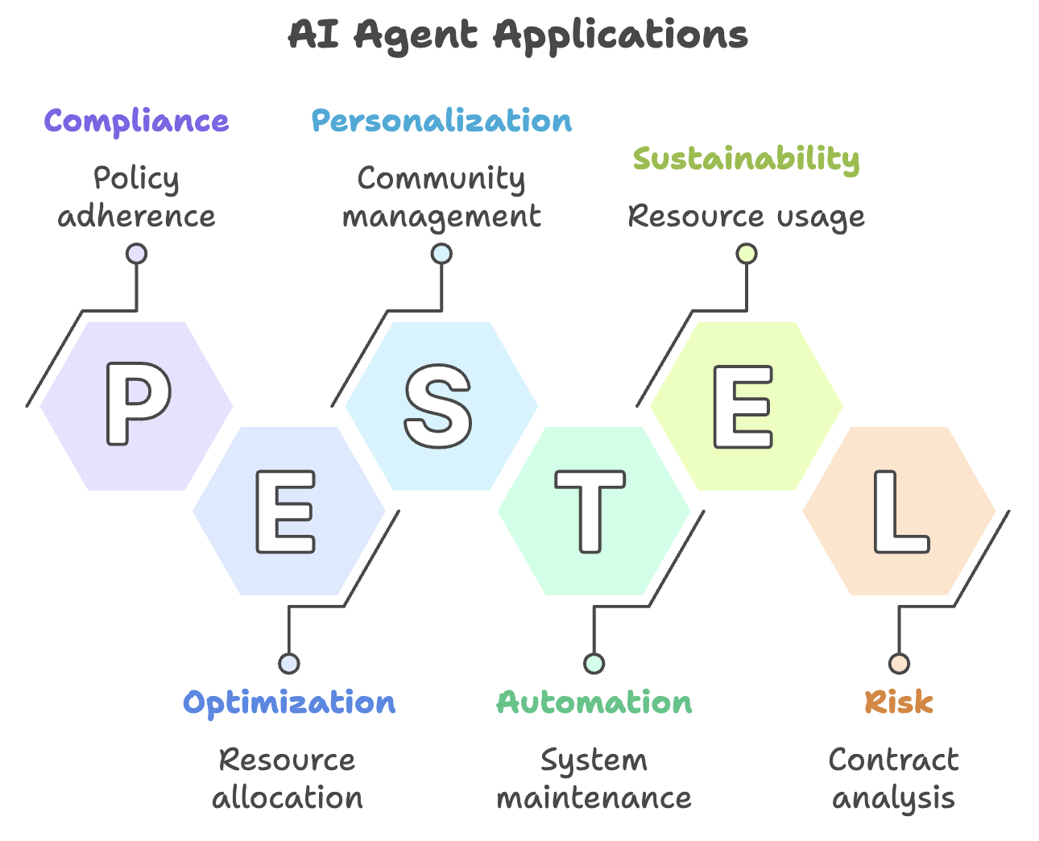
Few Examples of Agentic Workflows
Service Now
Zen Desk
Salesforce
Agentic RAG
Clinical Support System
Legal Support System
Financial Support System

Slide 12

HandsOn

Slide 13

Thank You

