Slide 1
Building Multi-Agent Systems
By M K Pavan Kumar

Slide 2
Agenda
Session 1: Foundations of AI Agents
What are Agents?
Categories of AI Agents
Design Patterns in AI Agents
How Agents Work
Hands-On: Building your first single agent with Agno
Session 2: Multi-Agent Systems & Protocols
Multi-Agent Systems
Agent2Agent (A2A) & Model Context Protocol (MCP)
Use Cases of AI Agents
Architectures of RAG
Latest Market Trends — A2A, MCP, ACP
Hands-On: Multi-agent team with tools and an MCP server
Session 3: Context-Aware Agentic Workflows
Workflows vs. Agentic Workflows
What makes a workflow Context-Aware
Role of Memory — short-term, episodic, semantic, procedural
Benefits and Limitations of Agentic Workflows
When to choose an Agentic Workflow
Real-world examples — enterprise platforms, Agentic RAG,
clinical/legal/financial support systems
Hands-On: Context-aware workflow with Qdrant-backed memory
Wrap-up & Q&A

Slide 3

Download the code

Slide 4

Create Qdrant Account

Slide 5
Foundations of AI Agents

Slide 6
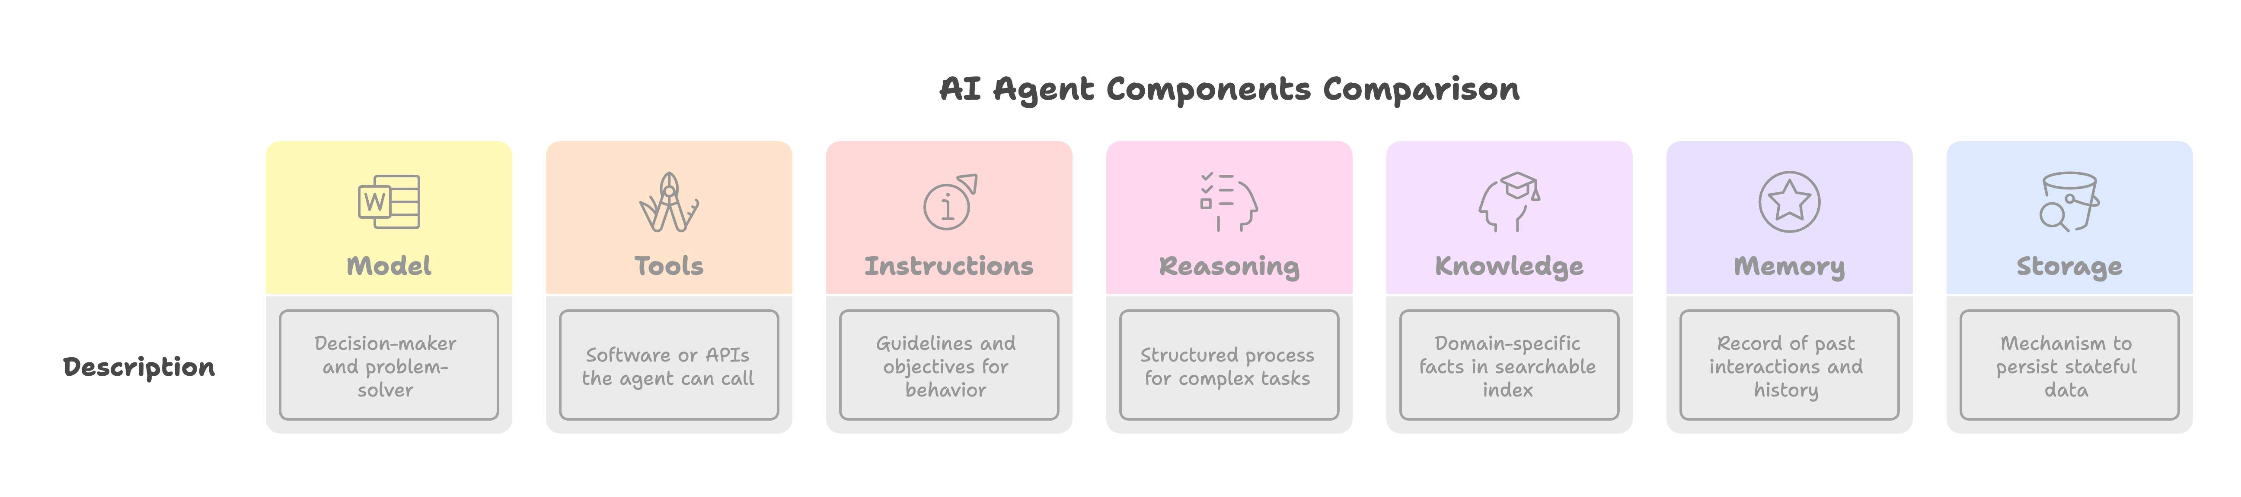
What are Agents?

Slide 7
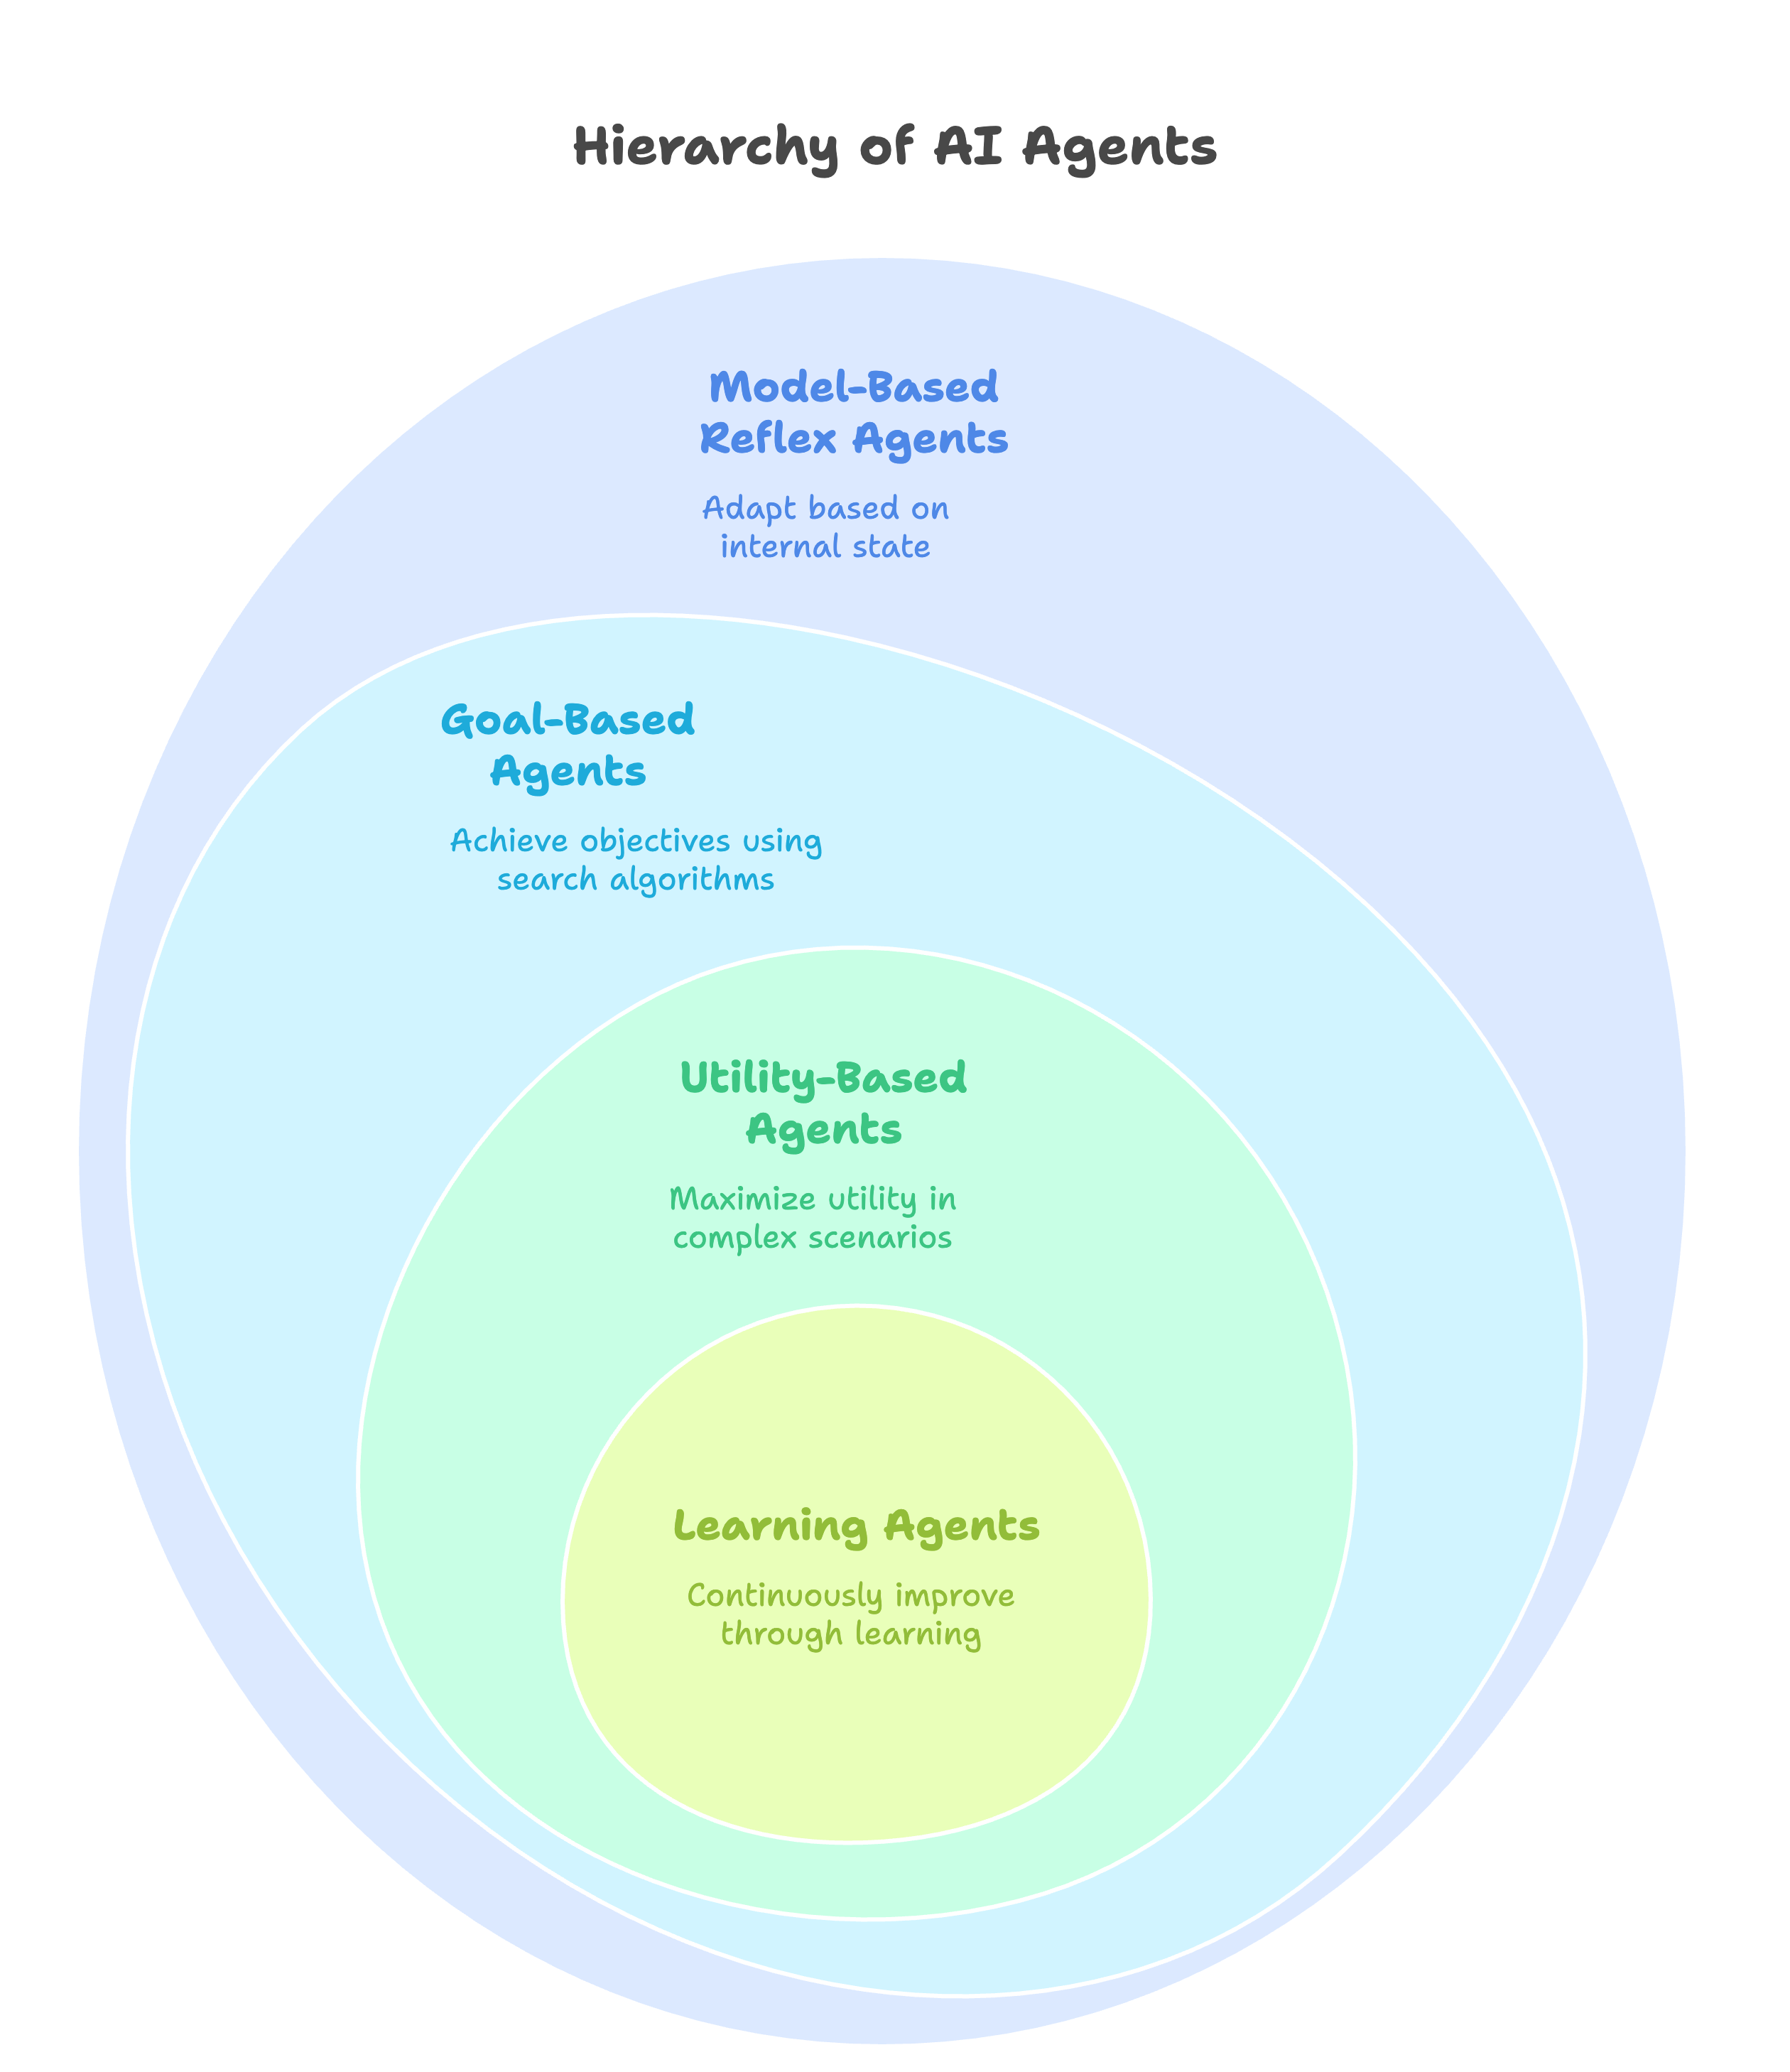
Categories of AI Agents

Slide 8
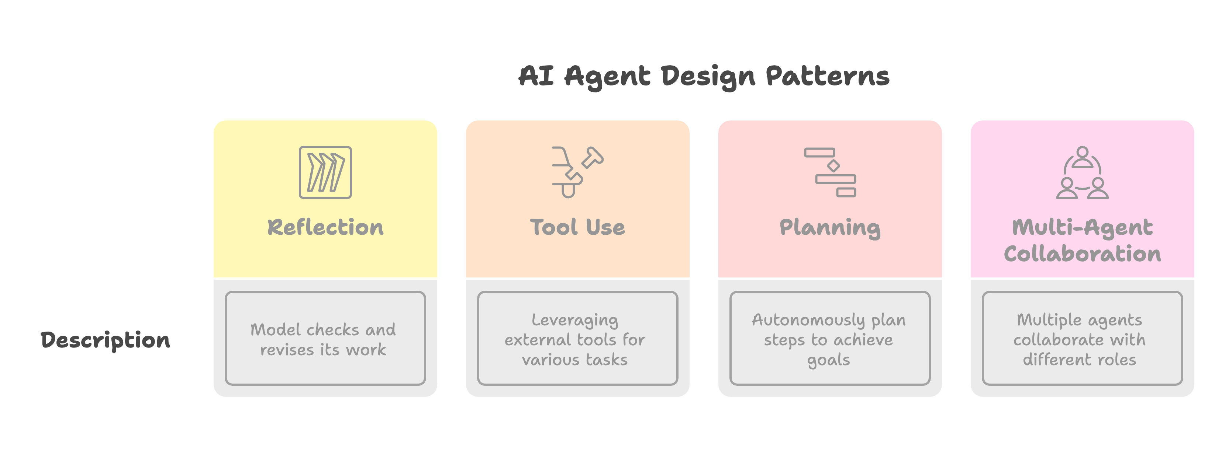
Design Patterns in AI Agents

Slide 9
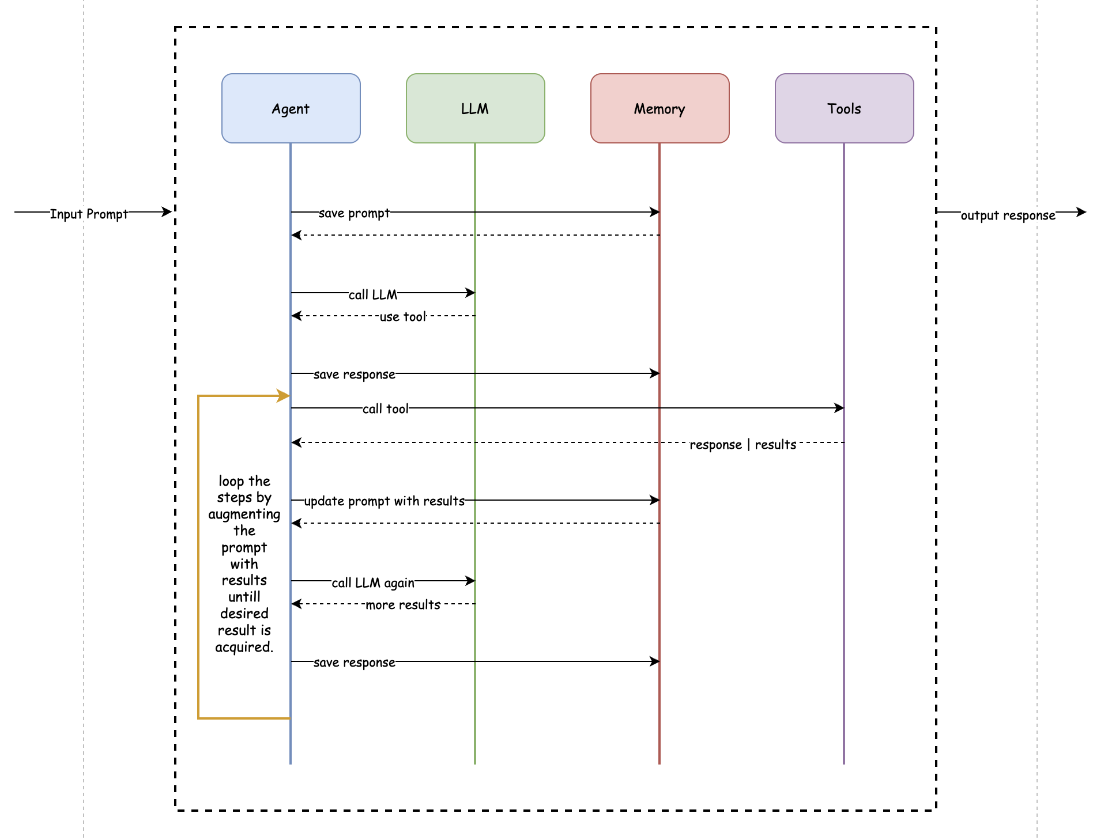
How Agents Work ?

Slide 10
Demo Time

Slide 11
Multi-Agent System and Protocols

Slide 12
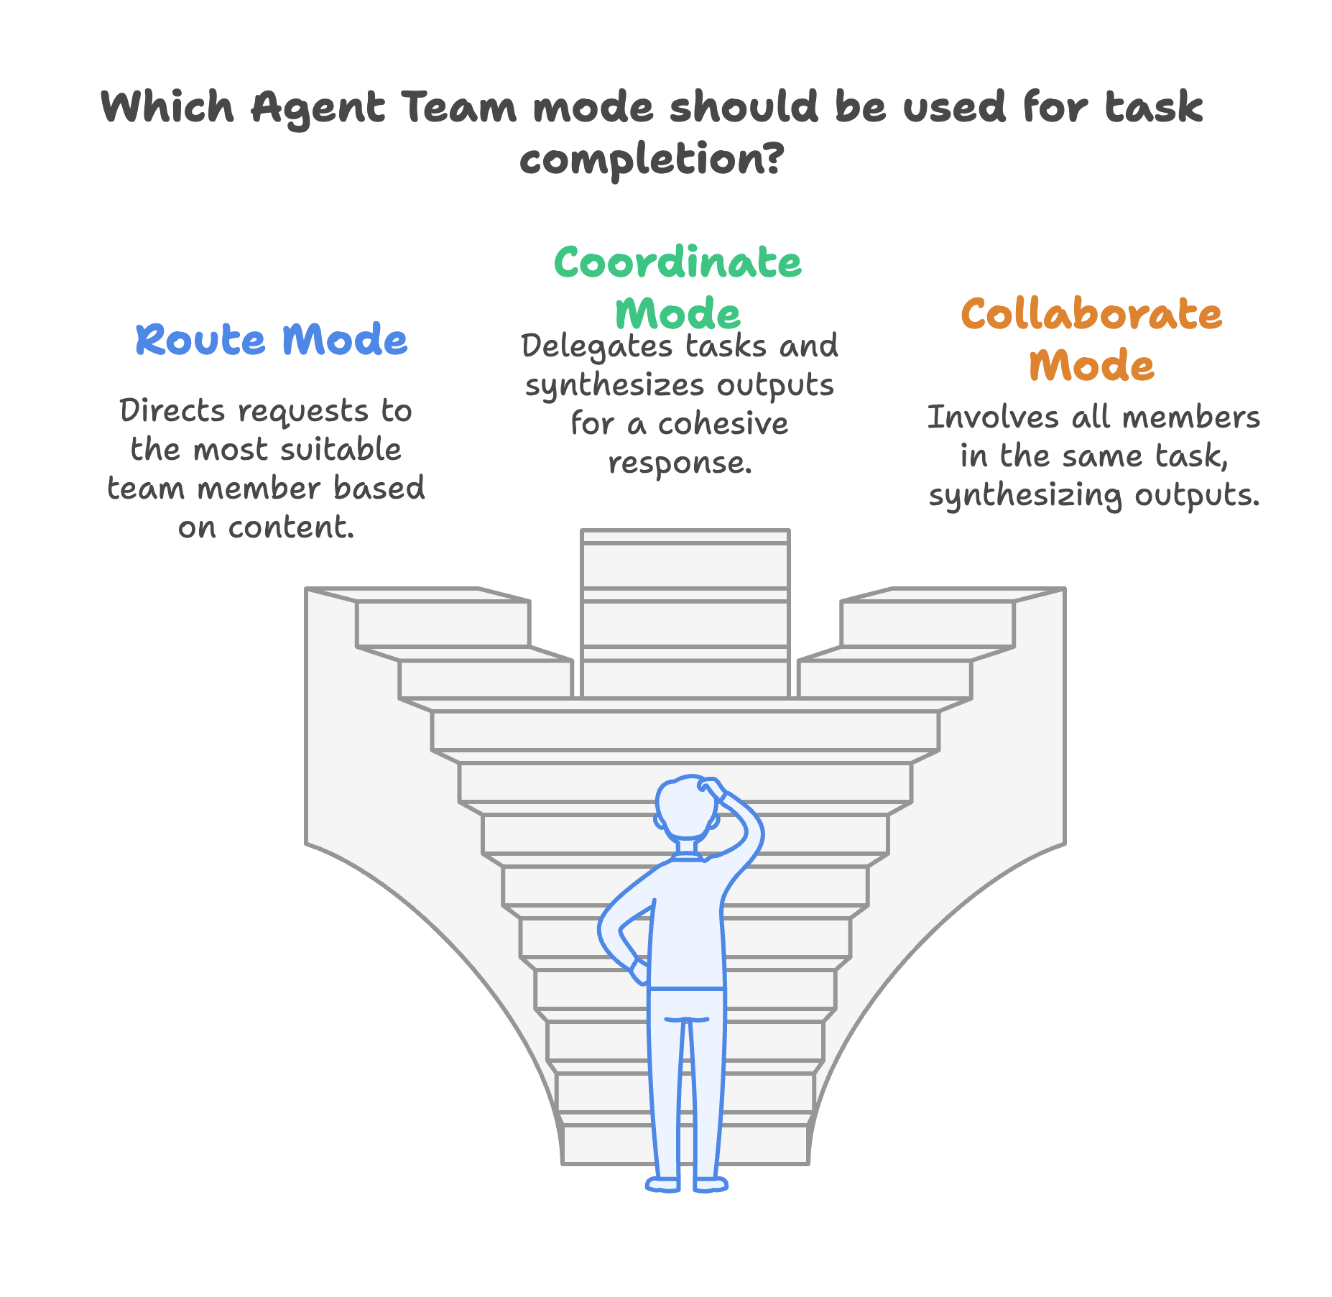
Multi Agent Systems

Slide 13
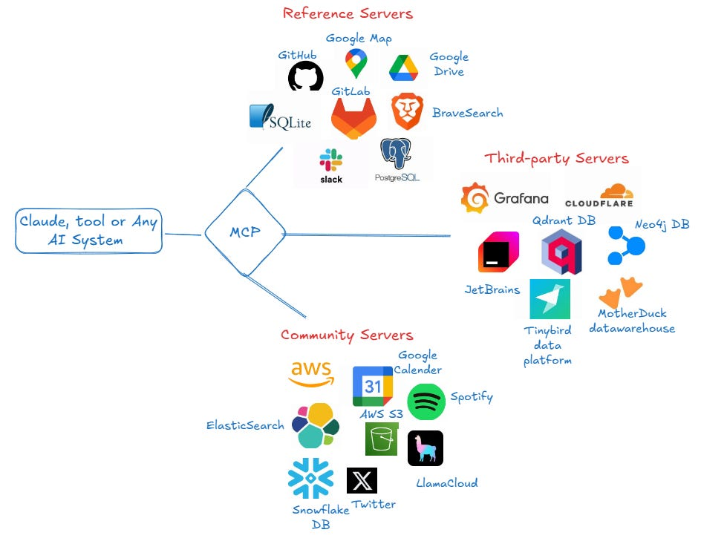
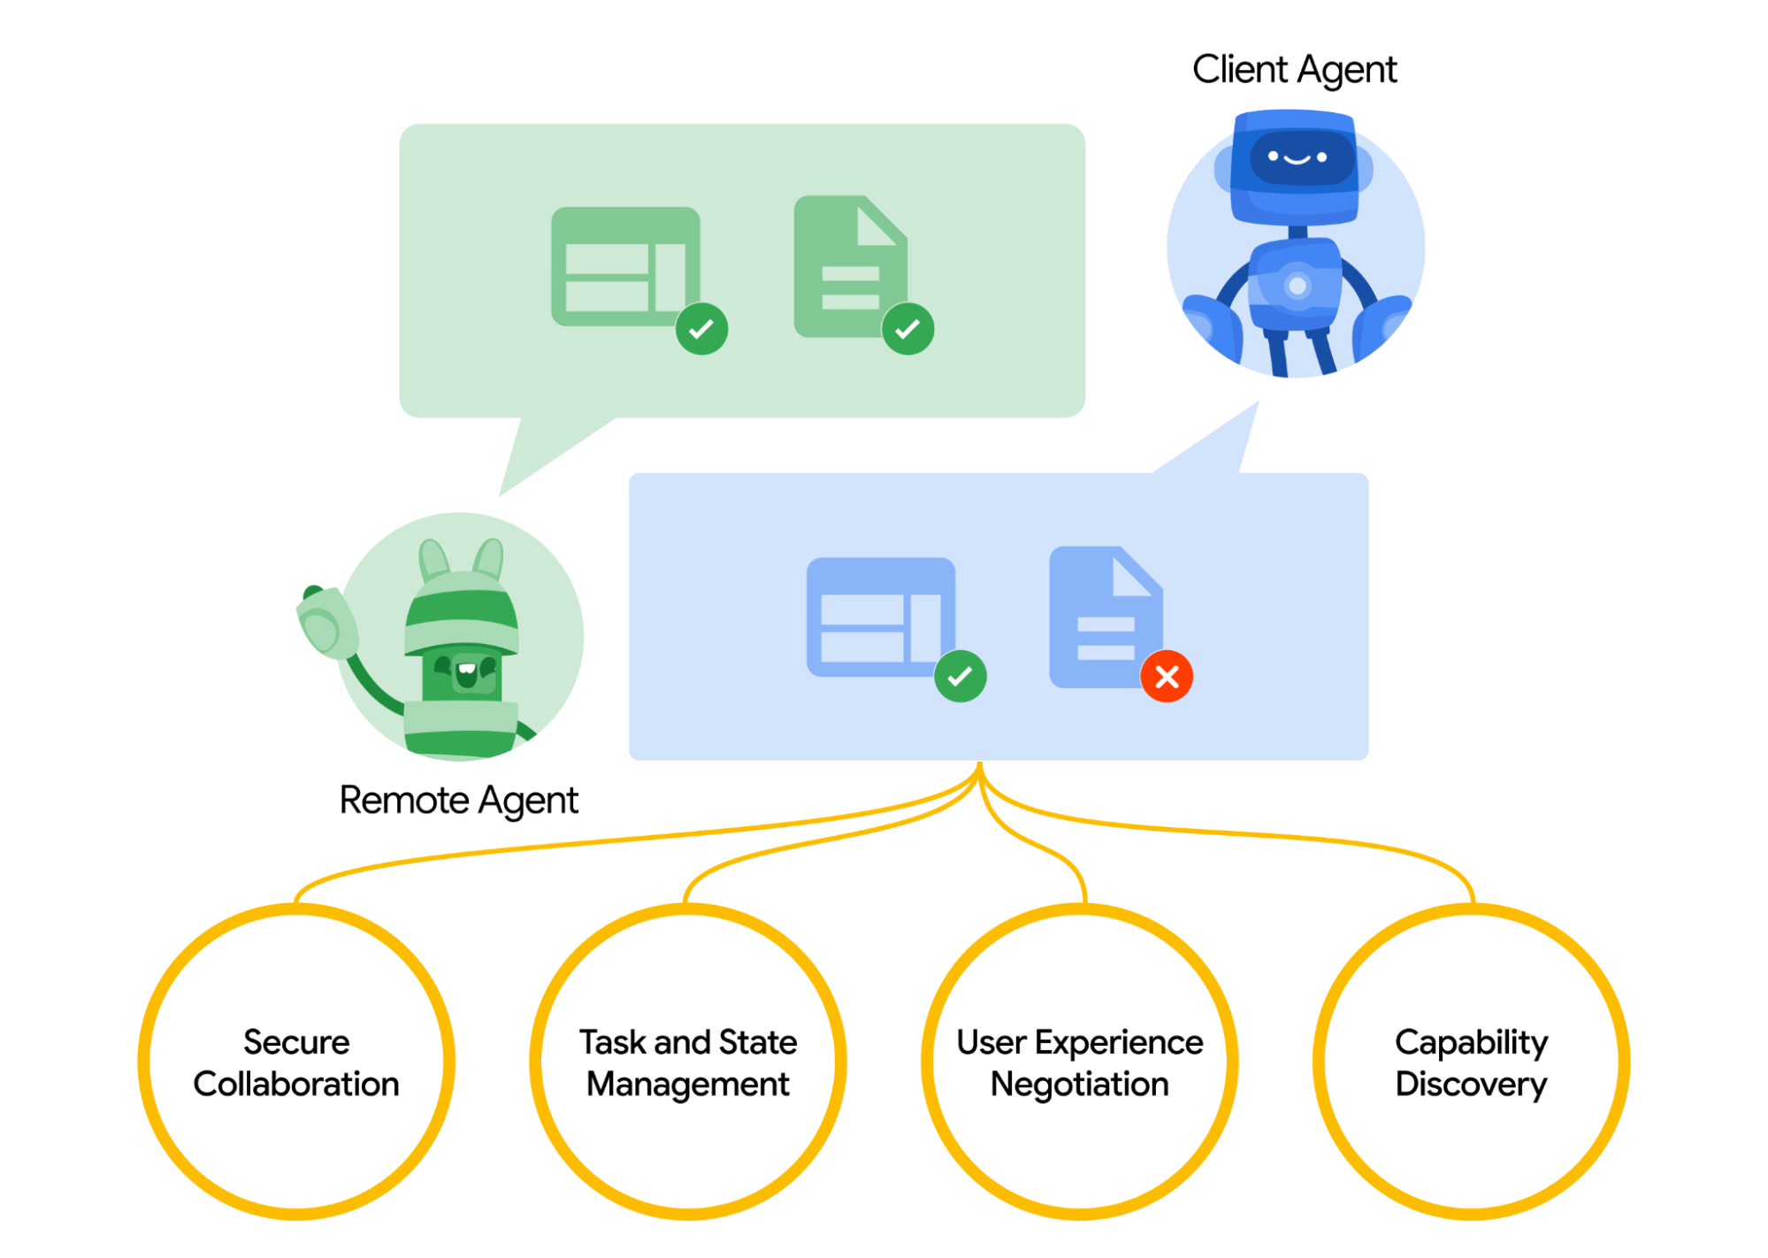
Agent2Agent & MCP
Credits: google docs and internet

Slide 14
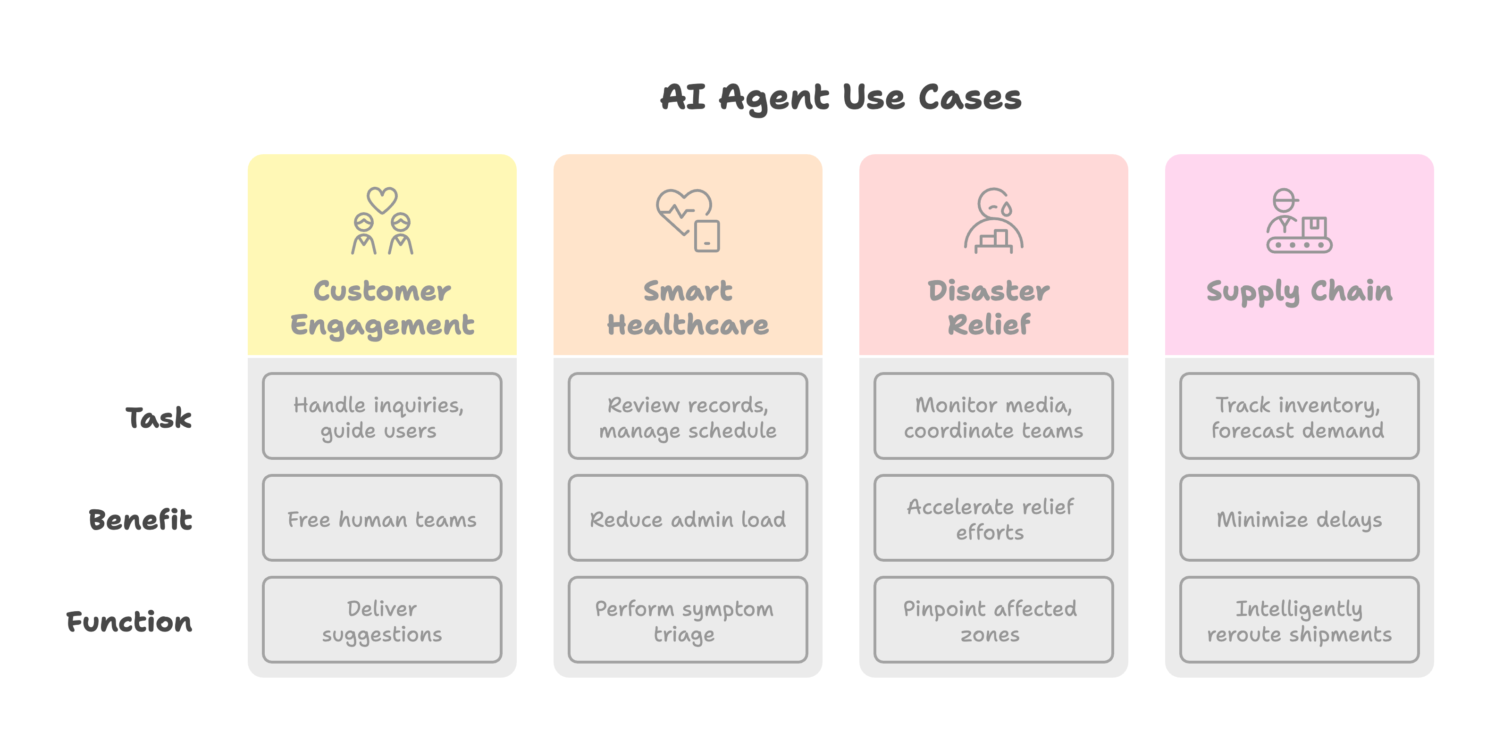
Use Cases of AI Agents

Slide 15
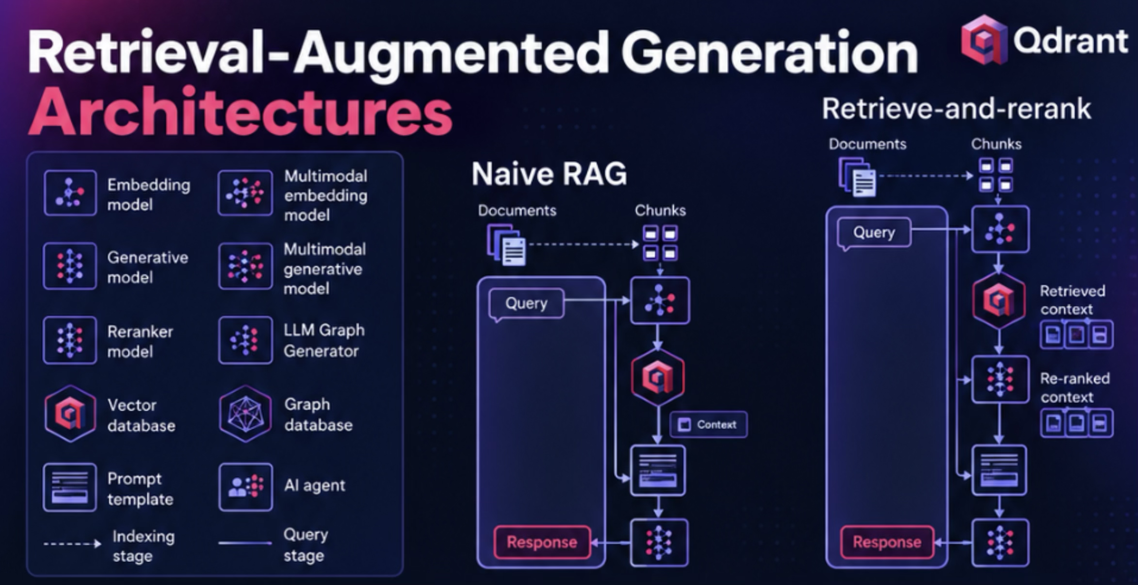
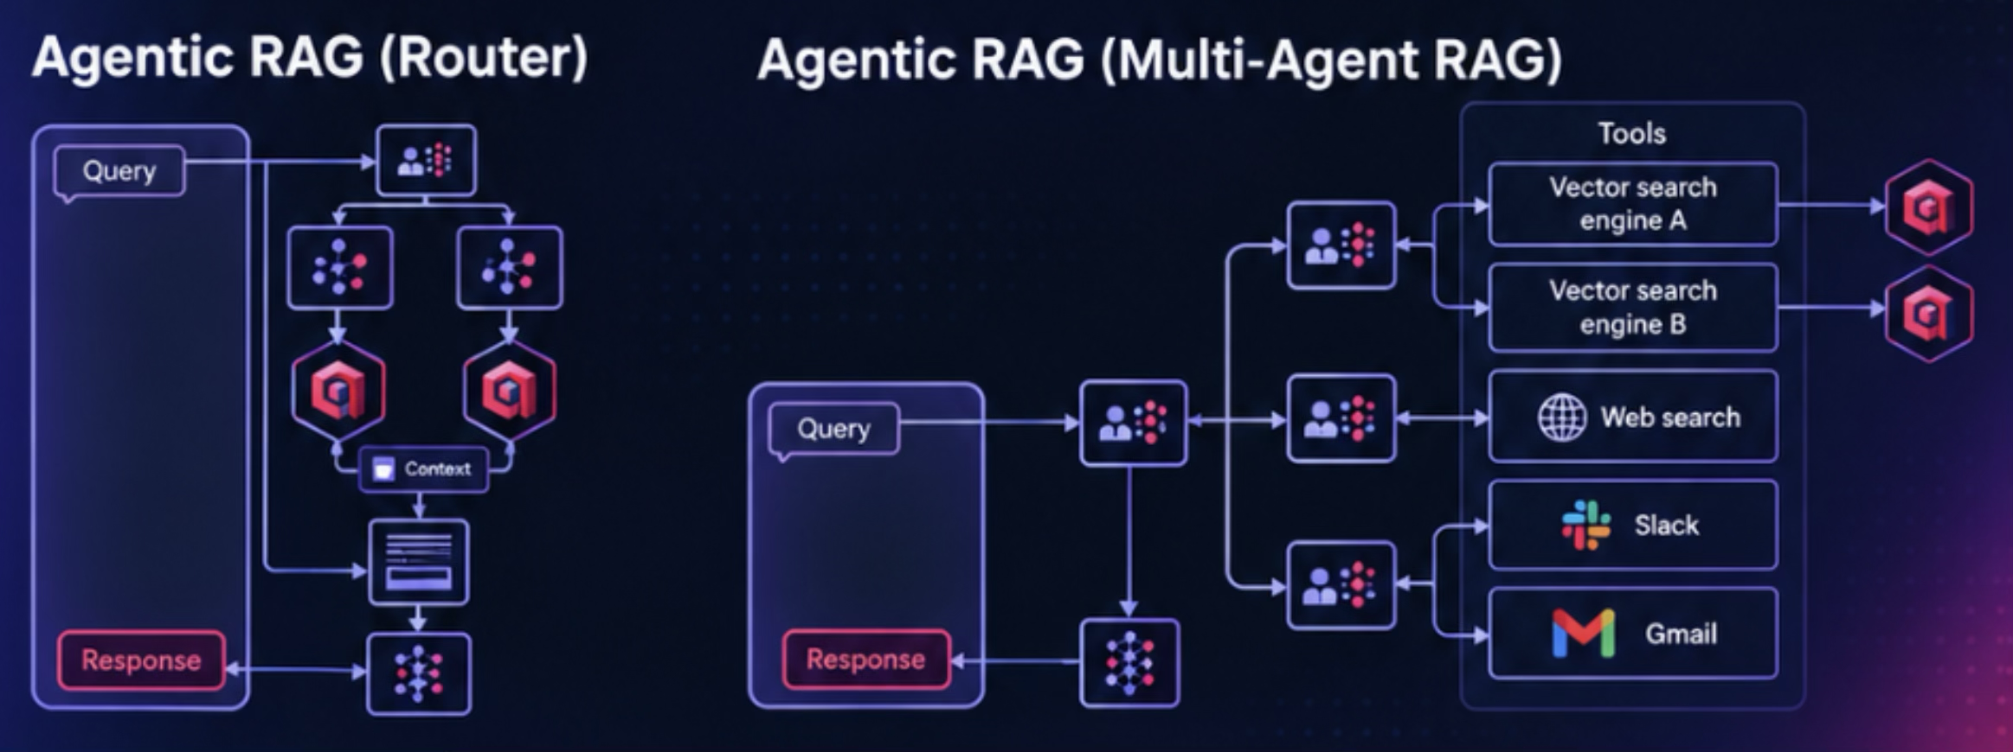
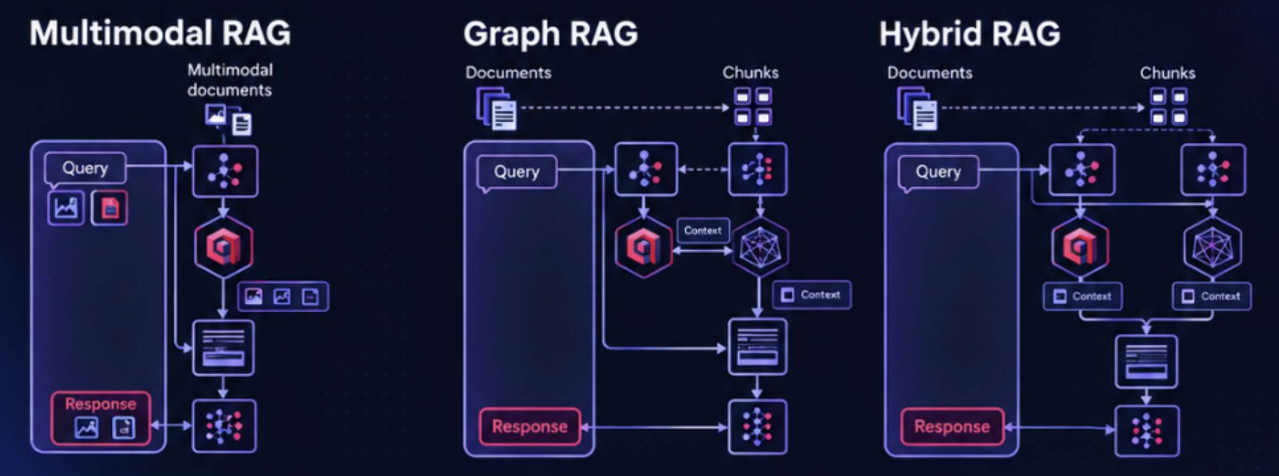

Slide 16
Latest Market Trends
Protocol | Primary role | Latest measurable signal | Market direction
MCP | Agent ↔ tools, APIs, data, context | ~500M Tier-1 SDK downloads/month; Python and TypeScript SDKs have each crossed 1B cumulative downloads | 🔥 Dominant tool/context standard
A2A | Agent ↔ agent | 150+ supporting organizations, 25.7K GitHub stars, 5 production-ready SDK languages | 🔥 Rapid enterprise standardization
ACP, Agent Communication Protocol | Agent ↔ agent | Development ended as standalone protocol; merged into A2A in Aug 2025 | ⛔ Consolidated into A2A
AG-UI | Agent ↔ application/user | 15.4K GitHub stars, ~1.4K forks | 📈 Strong emerging UI layer
A2UI | Agent-generated UI | 16.3K GitHub stars, ~1.3K forks | 📈 Rapid developer interest
AP2 | Agent ↔ payments | 60+ organizations involved at launch; ~3K GitHub stars | 🚀 Agentic payments emerging
UCP | Agent ↔ commerce | Backed by Google + Shopify, with 20+ ecosystem partners | 🚀 Commerce standardization
ACP, Agentic Commerce Protocol | Agent ↔ merchant/checkout | ~1.5K GitHub stars, maintained by OpenAI + Stripe, currently beta | 📈 Competing/complementary commerce layer
ANP | Open agent-network communication/discovery | ~1.3K GitHub stars | 🧪 Experimental / niche
ANS / DNS-AID | Agent identity + discovery | Linux Foundation projects launched in 2026 | 🌱 Infrastructure layer emerging

Slide 17
Demo Time

Slide 18
Context Aware Workflows

Slide 19
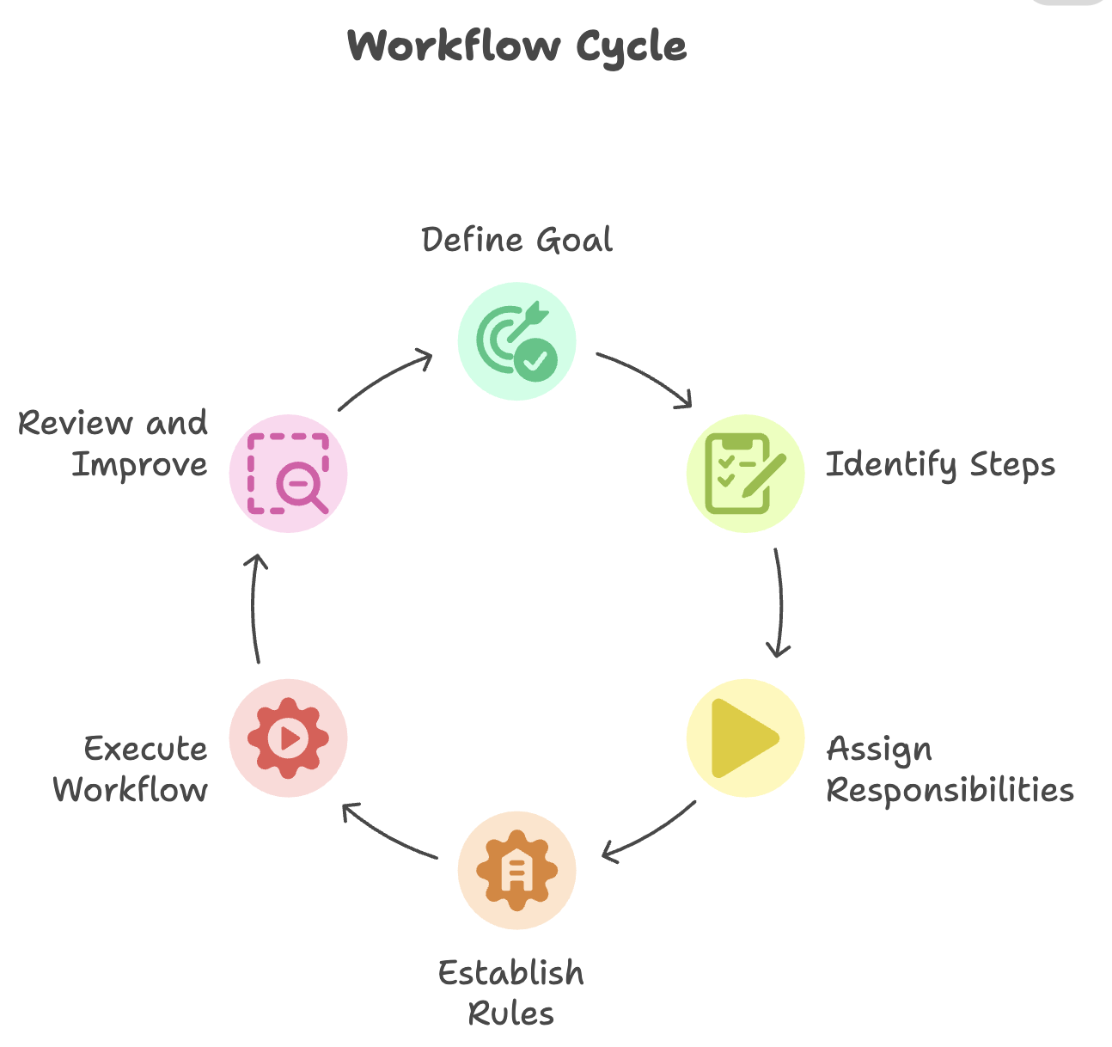
What are Workflows
A workflow is a series of steps, activities, or tasks performed in a specific order to complete a goal. It defines the process from start to finish, dictating what needs to be done, who is responsible for each part, and the rules that govern the process.

Slide 20
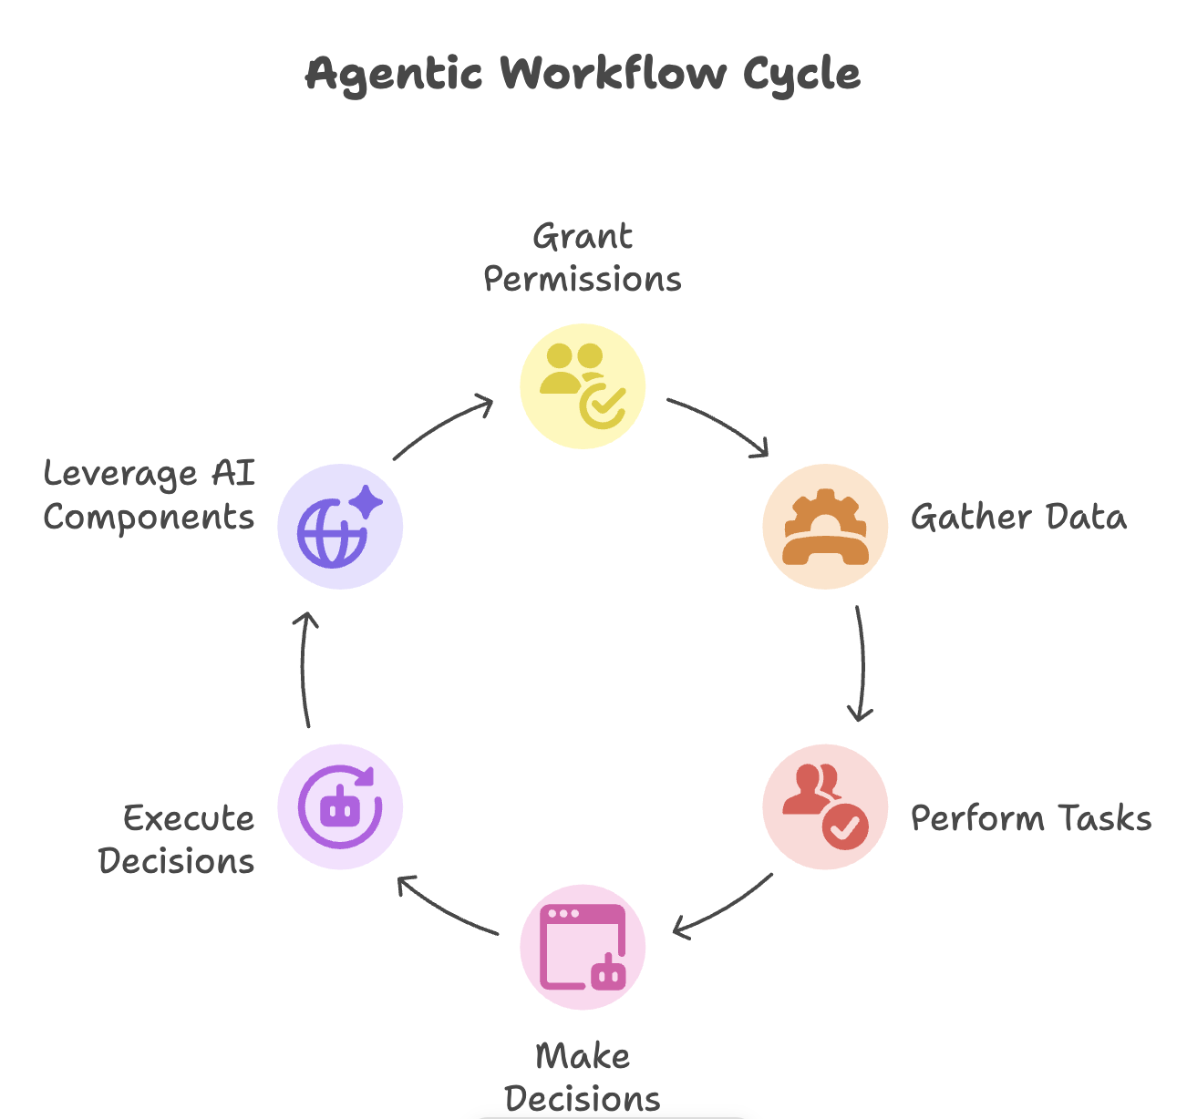
What are Agentic Workflows
An agentic workflow is a series of connected steps dynamically executed by an agent, or series of agents, to achieve a specific task or goal. Agents are granted permissions by their users, which give them a limited degree of autonomy to gather data, perform tasks, and make decisions to be executed in the real-world. Agentic workflows also leverage the core components of AI agents including, their capacity for reasoning, ability to use tools to interact with their environment, and persistent memory to completely transform traditional workflows into responsive, adaptive, and self-evolving processes.

Slide 21
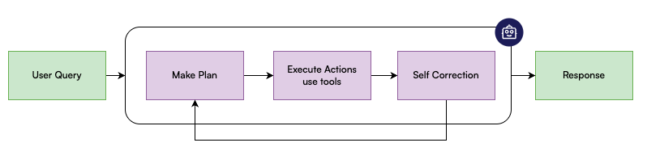
What are Agentic Workflows

Slide 22
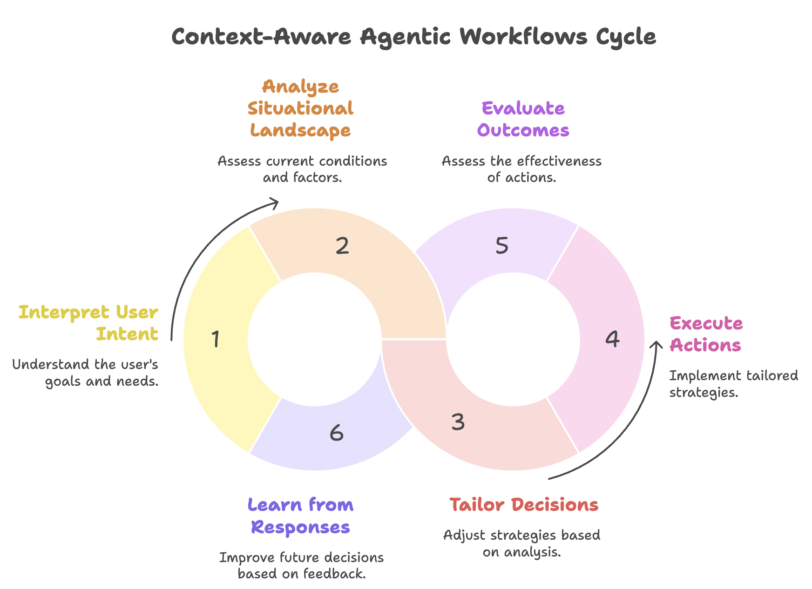
What are Context Aware Agentic Workflows
Context-Aware Agentic Workflows are intelligent processes where AI agents dynamically tailor their decisions, actions, and strategies by continuously interpreting and responding to the full situational landscape—including user intent, previous agent responses, historical responses, and real-time changes.

Slide 23
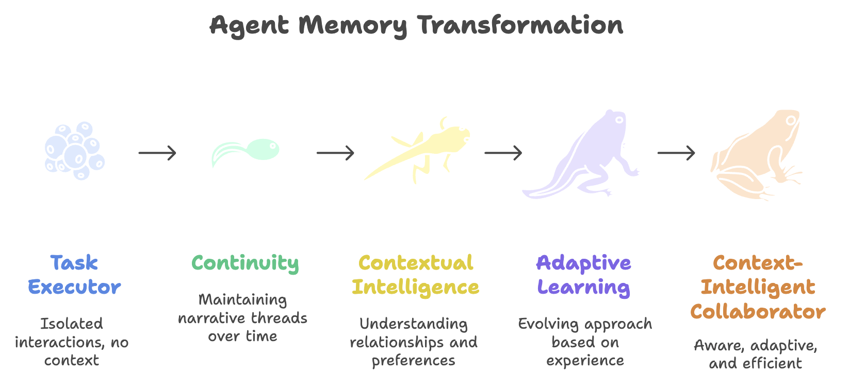
Role of Memory in Context Aware Agentic Workflows
Memory serves as the foundation that transforms agents from task executors into context-intelligent collaborators. Without memory, agents are perpetually starting from zero—every interaction is isolated, every decision is made in a vacuum. Memory is what makes context-awareness possible.

Slide 24
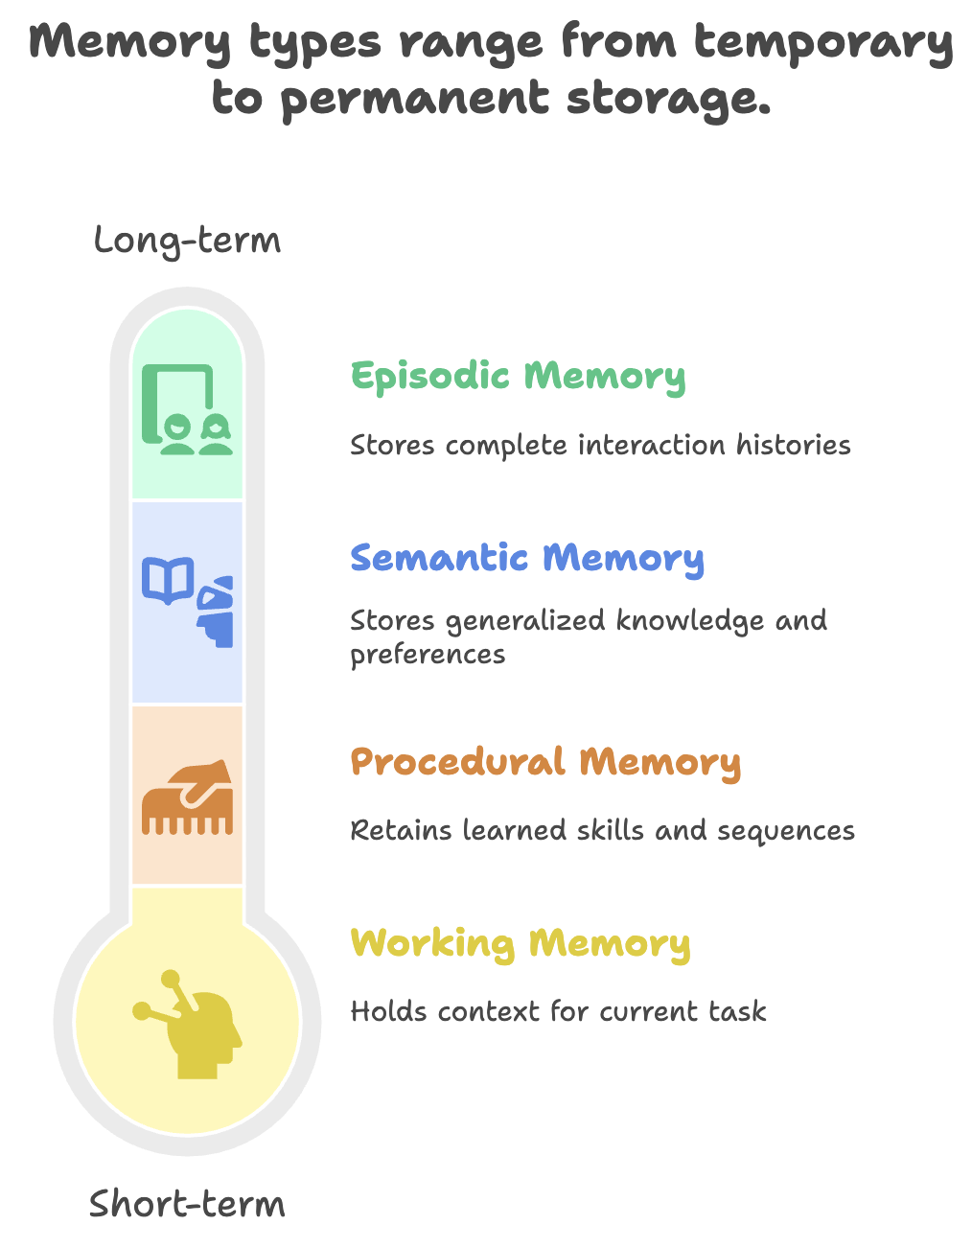
Memory Types in Agentic Workflows
Short-term (Working Memory): Maintains context within a single workflow execution—tracking intermediate results, decisions made, and current state.
Long-term (Episodic Memory): Stores complete interaction histories—what tasks were performed, what outcomes resulted, what problems emerged.
Semantic Memory: Accumulates generalized knowledge—your preferences, organizational rules, domain expertise, successful patterns.
Procedural Memory: Retains learned skills—which tool combinations work best, optimal sequences for complex tasks, efficient problem-solving approaches.

Slide 25
Benefits of Agentic Workflows
Benefit | Description
Flexibility, Adaptability & Customizability | Unlike static deterministic workflows, agentic workflows can adapt to changing situations and task complexity. Different agentic patterns can be combined to create modular workflows that evolve as requirements grow.
Improved Performance on Complex Tasks | Agentic workflows break complex problems into smaller, manageable steps using planning and task decomposition, often producing better results than simple deterministic or zero-shot approaches.
Self-Correction & Continuous Learning | Through reflection and memory, agents can evaluate their actions, refine strategies, learn from previous experiences, and improve outcomes over time.
Operational Efficiency & Scalability | Agentic workflows can automate repetitive and multi-step tasks, reducing manual effort and operational overhead. They can also scale to handle larger workloads and increasingly complex processes.

Slide 26
Challenge / Limitation | Description
Unnecessary Complexity for Simple Tasks | Agentic workflows can introduce unnecessary overhead for straightforward tasks such as form entry, simple data extraction, or rule-based processing. In these cases, traditional deterministic automation may be faster, cheaper, and more reliable.
Reduced Reliability with Increased Autonomy | As agents gain more autonomy and decision-making capability, their probabilistic behavior can make outcomes less predictable and harder to control. Strong guardrails, permission management, monitoring, and continuous evaluation are essential.
Higher Workflow Complexity | AI agents introduce additional components such as planning, reasoning, memory, tool usage, and orchestration. This can make systems more difficult to design, debug, observe, and maintain.
Cost & Operational Overhead | Multi-step reasoning, repeated LLM calls, tool interactions, and validation loops can increase latency and infrastructure costs compared with deterministic workflows.
Limitations of Agentic Workflows

Slide 27
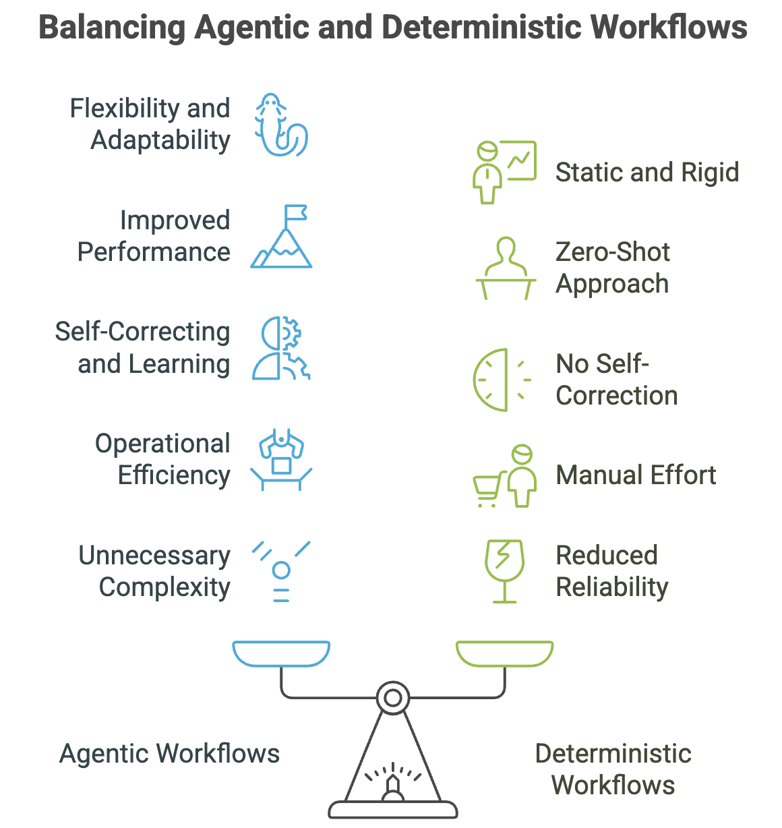
When to choose Agentic Workflows

Slide 28
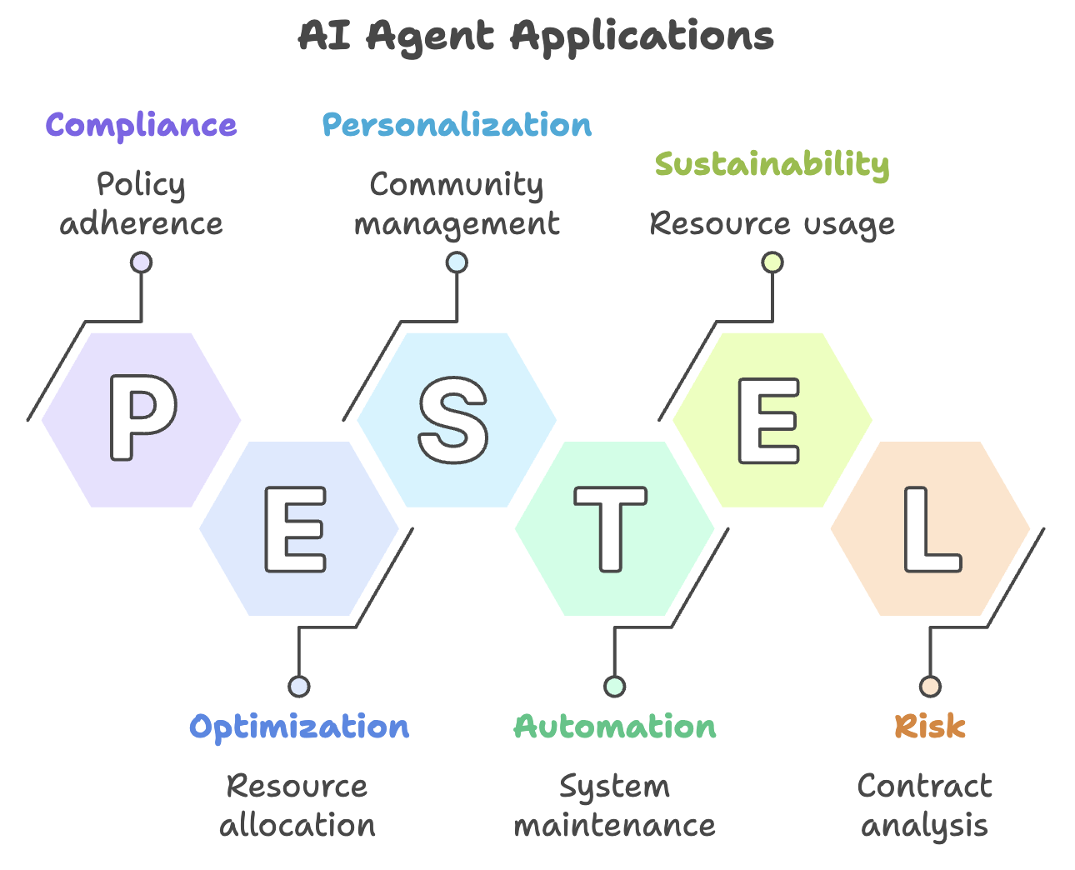
Few Examples of Agentic Workflows
Service Now
Zen Desk
Salesforce
Agentic RAG
Clinical Support System
Legal Support System
Financial Support System

Slide 29
Resources Needed for HandsOn
Qdrant Documentation: https://qdrant.tech/documentation/
Agno Documentation: https://docs.agno.com/introduction
Mlflow Documentation: https://mlflow.org/docs/latest/
Register & Login to Qdrant Cloud: https://login.cloud.qdrant.io/

Slide 30
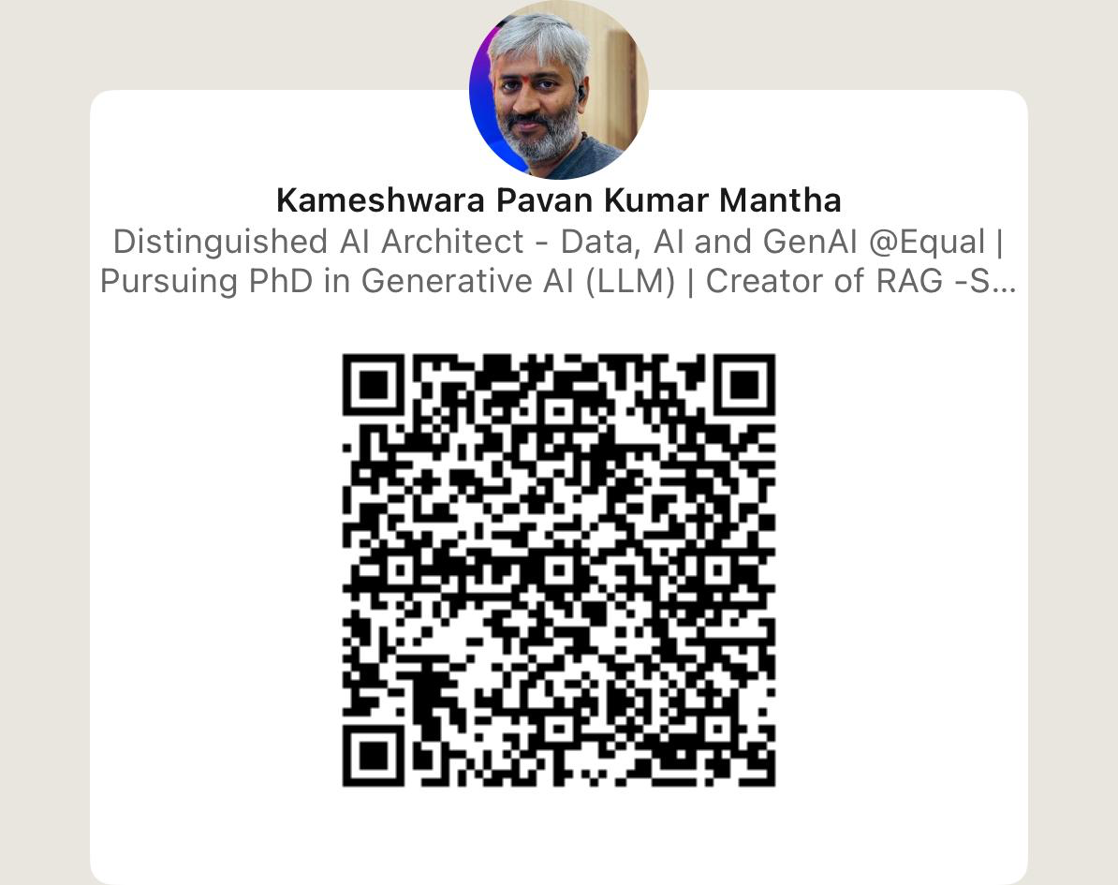
Thank You
Notes:
Credits: Content is taken from Weaviate Agents guide

