Slide 1

The Power of Vertical AI Agents
KM
by Kameshwara Pavan Kumar Mantha

Slide 2
Defining Vertical AI: Precision Over Breadth
Horizontal AI
Vertical AI
General-purpose tools attempting to serve multiple industries broadly. They offer wide applicability but may lack the in-depth understanding required for highly specialized tasks.
Deeply tailored AI systems designed for specific industries, domains, or business functions. They excel by leveraging specialized knowledge and integration.
Niche expertise
Broad functionality
Industry-specific solutions
Cross-industry application
High domain understanding
Less domain-specific
The core distinction lies in their approach: horizontal AI aims for versatility across many fields, while vertical AI prioritizes profound specialization within a single domain. This focused development allows vertical agents to address complex industry challenges with greater accuracy and efficiency, leading to more impactful outcomes.

Slide 3



Key Characteristics: Deep Domain Expertise
Specialized Training
Industry Vocabulary
Contextual Understanding
Vertical AI agents are rigorously trained on extensive datasets specific to their target industry. This ensures they grasp the nuances of terminology, historical data, and contextual understanding crucial for effective operation.
They inherently understand and utilize the precise vocabulary and jargon unique to their domain, facilitating seamless communication and accurate interpretation of industry-specific queries and data.
Beyond mere data processing, these agents comprehend the underlying context of operations, enabling them to make informed decisions and provide relevant insights tailored to industry practices.
Domain expertise is the bedrock of vertical AI agents. By ingesting and processing vast amounts of industry-specific data, they develop an intricate understanding of the field, enabling them to navigate complex scenarios and provide highly accurate, contextually relevant assistance, much like a seasoned human expert.

Slide 4
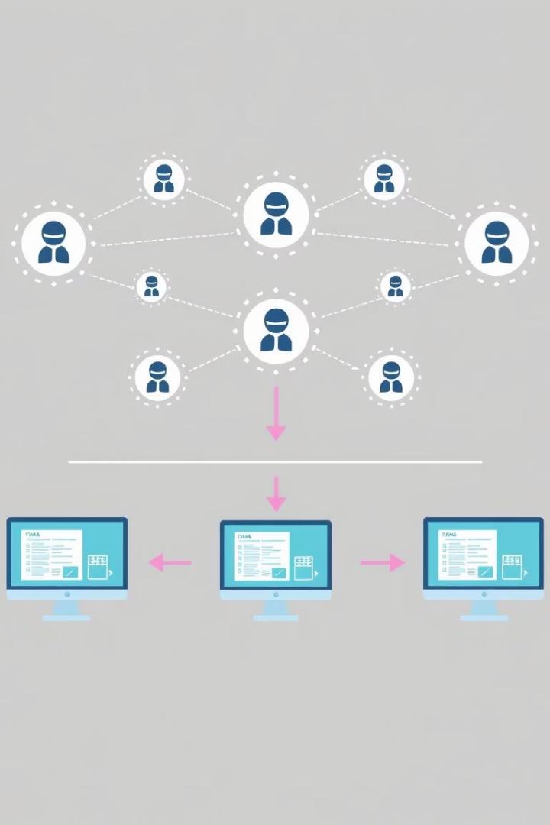



Seamless Workflow Integration
Process Mapping
Designed to understand existing business processes.
System Compatibility
Built to integrate smoothly with current systems and platforms.
Automated Steps
Can automate specific steps within complex workflows.
One of the most critical aspects of vertical AI agents is their ability to integrate seamlessly into existing business processes. They are not designed to disrupt but to enhance, understanding the typical steps, decision points, and stakeholders involved in domain-specific workflows. This allows for a smoother transition and quicker adoption within organizations.

Slide 5

Specialized Capabilities for Targeted Value
Legal Review
Medical Diagnosis
Financial Risk Assessment
Automates the review of contracts and legal documents, identifying key clauses and potential risks.
Assists healthcare professionals by analyzing patient data and suggesting potential diagnoses.
Evaluates financial data to predict risks and identify fraudulent activities in real-time.
Rather than offering broad functionality, vertical AI agents intensely focus on tasks that are particularly valuable within their vertical. For example, a legal AI agent might specialize in contract analysis, while a healthcare AI agent could focus on medical diagnosis assistance. This dedicated focus ensures that the AI provides highly relevant and actionable insights for specific industry challenges.

Slide 6








Navigating Regulatory Complexities
Compliance Adherence
Legal Frameworks
Ensuring operations meet all required regulatory standards.
Understanding and applying industry-specific legal requirements.
Reporting Standards
Data Security
Automating adherence to specific reporting guidelines like HIPAA or SOX.
Implementing protocols to protect sensitive industry data.
Regulatory awareness is a crucial differentiator for vertical AI. Many industries operate under stringent compliance requirements, and these agents are built with an inherent understanding of relevant regulations, such as HIPAA for healthcare, SOX for financial reporting, or FDA guidelines for pharmaceuticals. This built-in compliance capability minimizes risk and ensures legal adherence, a major concern for business leaders.

Slide 7

Demonstrating Industry-Specific ROI
30%
15%
Efficiency Gains
Cost Reduction
Average reduction in manual processing time.
Typical savings on operational expenditures.
20%
Accuracy Improvement
Enhanced precision in tasks like fraud detection or diagnosis.
Because vertical AI agents are purpose-built for particular use cases, they often deliver more immediate and measurable return on investment than general-purpose AI tools. By directly addressing specific pain points and streamlining daily tasks for industry professionals, they offer tangible benefits that translate into significant efficiency gains and cost reductions.

Slide 8
The Future is Specialized: Key Takeaways and Next Steps
Deeper Specialization
Vertical AI agents offer unparalleled depth in domain expertise, leading to more accurate and relevant outcomes.
Seamless Integration
Their design prioritizes fitting into existing workflows, minimizing disruption and accelerating adoption.
Tangible ROI
Purpose-built solutions provide clear, measurable value by addressing specific industry pain points.
Explore Use Cases
Identify specific areas within your organization where vertical AI can address critical challenges or enhance efficiency.
Pilot Programs
Consider initiating small-scale pilot projects to evaluate the impact and effectiveness of vertical AI agents in your domain.
The shift towards vertical AI signifies a mature phase in artificial intelligence adoption, where generalized tools give way to highly specialized, impactful solutions. For business leaders and technology professionals, understanding and leveraging these agents is key to unlocking new levels of efficiency, compliance, and competitive advantage within their respective industries. The next step is to explore specific use cases relevant to your organization and consider pilot programs to witness the transformative power of vertical AI firsthand.

Slide 9
Workshop
Qdrant: https://login.cloud.qdrant.io/
MongoDB: https://account.mongodb.com/account/login
LiteLLM: https://docs.litellm.ai/docs/proxy/docker_quick_start
Github: https://github.com/pavanjava/vertical_agents_workshop.git
Vertical Agents
(Agno)
Qdrant
MongoDB
LiteLLM

Slide 10
Thank You
KM
LinkedIn

