Slide 1
LLM Inference at Scale
M K Pavan Kumar

Slide 2
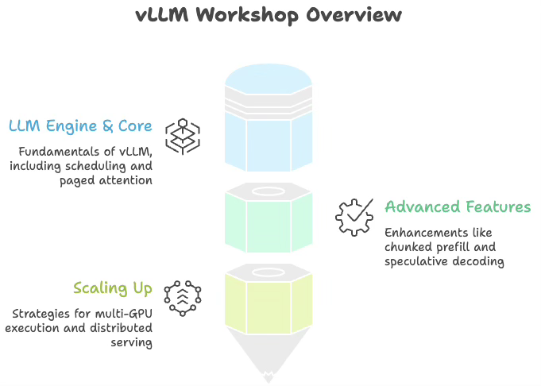
Session Overview
Kickoff
KV Cache and Paged Attention
vLLM Scheduler and Continuous Batching
Adv features like Prefix Cache, Speculative Decoding
Different Inference Engines and NVIDIA GPU Family
Online Serving and Benchmarking
Single node muti-GPU inferencing (TP, PP)
Recap

Slide 3
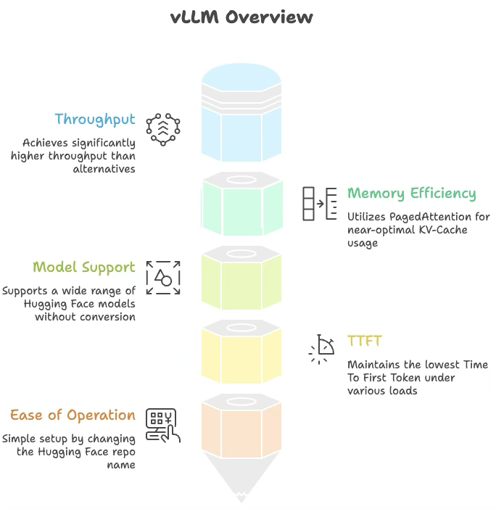
What and Why of vLLM ?
vLLM is a high-performance inference engine designed to serve Large Language Models efficiently, with native support for a wide range of Hugging Face models including decoder, embedding, and modern architectures like Mamba.
vLLM achieves significantly higher throughput using its core innovation called PagedAttention, which optimizes KV-Cache memory allocation and reduces memory waste from nearly 60–80% down to under 4%.
Better memory efficiency means fewer GPUs are required for the same workload, resulting in lower infrastructure cost, improved scalability, and faster token generation for production AI systems.
Compared to alternatives like TensorRT-LLM and LMDeploy, vLLM offers broader model compatibility and simpler operations because most models can be deployed directly from Hugging Face without complex conversion pipelines.
vLLM is widely preferred for real-world AI services because it balances high throughput with low TTFT (Time To First Token), delivering faster perceived response times and a smoother user experience in chatbots, copilots, RAG systems, and AI agents.
Notes:
What is vLLM?
vLLM is an open-source LLM inference and serving engine that utilizes a novel memory allocation algorithm called PagedAttention. It can run your models with up to 24x higher throughput than HuggingFace Transformers (HF) and up to 3.5x higher throughput than HuggingFace Text Generation Inference (TGI).
How does vLLM achieve this throughput improvement? Existing systems waste 60%-80% of the KV-Cache (LLM memory), whereas vLLM achieves near-optimal memory usage with a mere waste of under 4%. Because of this improved memory usage, we require fewer GPUs to achieve the same output, so the throughput is significantly higher than that of other inference engines.
Most people initially interact with cloud-based LLMs such as GPT / Gemini / Claude. They deliver the best performance available without worrying about model operations — you simply need a URL and an API key. But API usage incurs continuous cost and data must be transmitted externally, introducing security risks for personal or internal corporate data. When usage scales up, a natural question arises:
“Wouldn’t it be better to just deploy the model on our own servers…?”
There are many local LLMs available such as Alibaba’s Qwen and Meta’s LLaMA. As the open-source landscape expands, newer high-performance models are being released at a rapid pace, and the choices are diverse. However, applying them to real services introduces several challenges.
Running an LLM as-is results in very slow inference. This is due to the autoregressive nature of modern LLMs. There are optimizations like KV Cache and Paged Attention that dramatically reduce inference time. Several open-source serving engines implement these ideas — We uses vLLM. Each engine differs in model support and ease of use. Let’s explore why EVA chose vLLM.
2. Why vLLM?
When evaluating LLM serving engines, we focused on three criteria:
Supports many models
Operates easily
Provides reasonable performance for real services
Among many serving engines, we shortlisted vLLM, LM Deploy, and TensorRT-LLM, and ultimately selected vLLM. vLLM supports the largest variety of Hugging Face models and provides stable performance without model conversion. We also considered LM Deploy and TensorRT-LLM, which score higher in external benchmarks, but:
LM Deploy supports fewer models
TensorRT-LLM requires dedicated model conversion
When comparing serving engines, the main criteria are:
Throughput
TTFT (Time To First Token)
Throughput measures how many tokens/requests per second the GPU can generate — “how much the GPU worked within a second.”
TTFT (Time To First Token) is the time between sending a request and receiving the first token. This directly affects user-perceived latency — often the most important UX metric.
vLLM has a strong advantage in maintaining low TTFT. In a benchmark by BentoML using Llama 3 8B/70B under identical conditions:
LM Deploy provided higher throughput
vLLM kept the lowest TTFT under every load condition1
Other benchmarks also show:
Each engine has strengths depending on the metric and situation23
EVA continuously updates its selection of cost-efficient open-source models. Among the three engines, vLLM supports the most LLM architectures, including Embedding models and Mamba4.
Finally, ease of operation matters:
With vLLM, just change the HF repo name
Other engines → conversion and extra operational burden

Slide 4
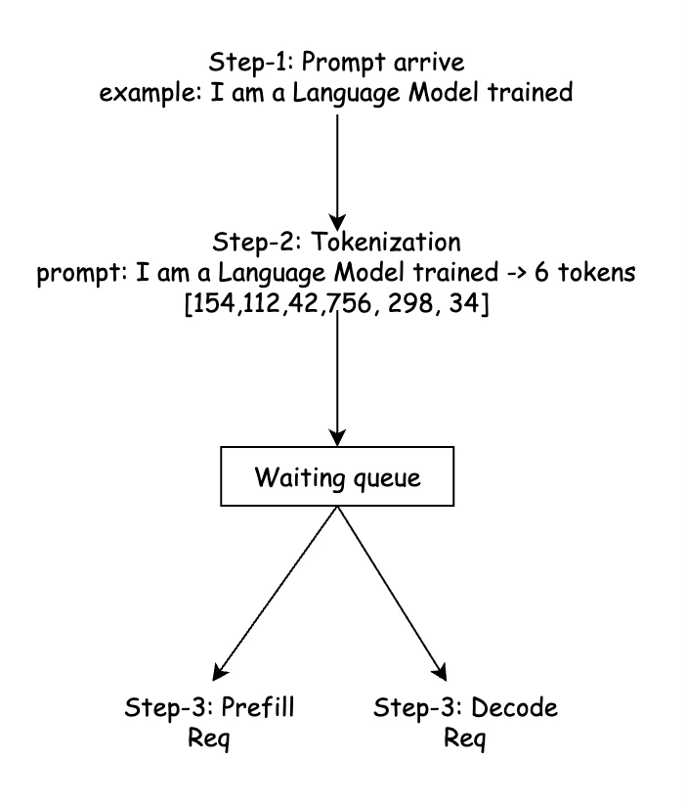
The Journey of Prompt

Slide 5
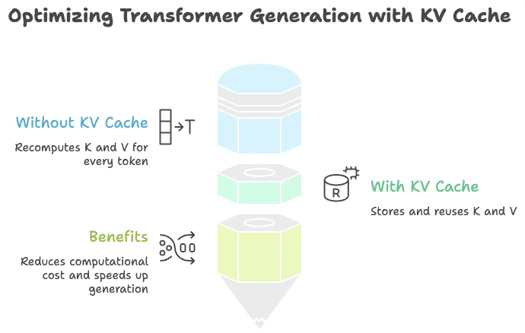
KV Cache & PagedAttention
In a Transformer, during the attention mechanism, for every new token generated, the model needs to attend over all previous tokens. Without caching, the model would recompute the Key (K) and Value (V) vectors for every past token at every step.
Without KV Cache (step 5 of generation):
Recompute K,V for token 1
Recompute K,V for token 2
Recompute K,V for token 3
Recompute K,V for token 4
Compute K,V for token 5 ← new token
This is extremely wasteful. KV Cache solves this by storing K and V once they are computed, so they can be reused.
With KV Cache (step 5 of generation):
Load K,V for tokens 1-4 from cache ← reuse
Compute K,V for token 5 ← only this is new

Slide 6
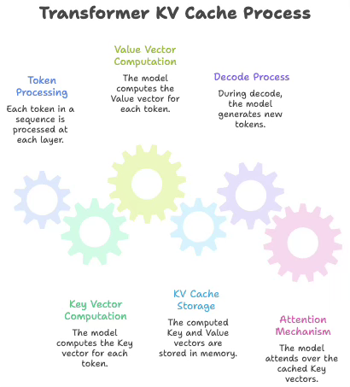
What is KV Cache?
For each token in a sequence, at each Transformer layer, the model computes:
K (Key vector) — what this token "offers"
V (Value vector) — what information this token holds
These are stored in GPU memory so they don't need to be recomputed.
Sentence: "today we are going to learn"
After prefill, KV Cache contains:
Token 1 "today" → K1, V1
Token 2 "we" → K2, V2
Token 3 "are" → K3, V3
Token 4 "going" → K4, V4
Token 5 "to" → K5, V5
Token 6 "learn" → K6, V6
During decode, when the model generates token 7 (e.g., ”model"), it only computes K7, V7 and attends over the cached K1–K6.

Slide 7
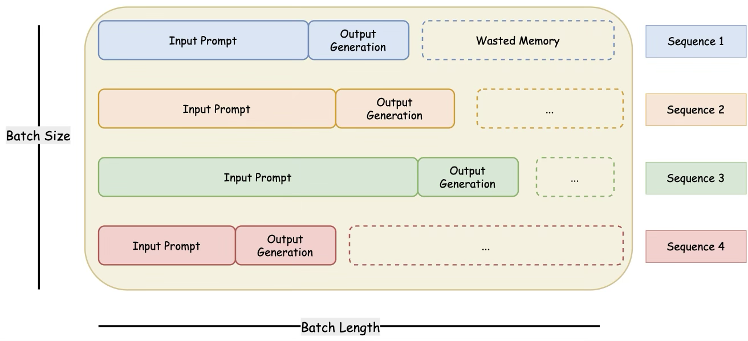
Problem of traditional KV Cache!
Traditional systems pre-allocate a single large contiguous block of GPU memory per request, sized for the maximum possible sequence length.
max_seq_len = 2048 tokens
Sequence 1 (actual: 200 tokens):
[████████░░░░░░░░░░░░░░░░░░░░░░░░░░░░░░░░░░░]
used=200 wasted=1848 tokens worth of memory
Sequence 2 (actual: 500 tokens):
[████████████░░░░░░░░░░░░░░░░░░░░░░░░░░░░░░░]
used=500 wasted=1548 tokens
█ = used memory ░ = wasted (pre-allocated but unused)
Problems:
Internal fragmentation — memory reserved but unused within each allocation
External fragmentation — after many requests complete, free memory exists in scattered chunks too small for new requests
Low GPU utilization — studies show only 20–38% of allocated KV cache memory is actually used
Low concurrency — fewer requests can run simultaneously

Slide 8
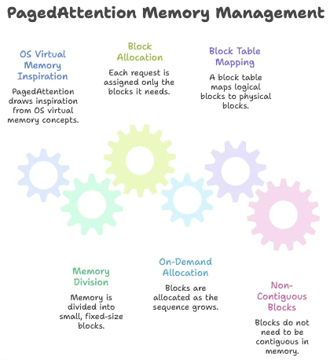
Paged Attention
PagedAttention is inspired by OS virtual memory and paging. Instead of one giant contiguous allocation, memory is divided into small fixed-size blocks (pages), and each request is assigned only the blocks it actually needs — allocated on demand as the sequence grows.
OS Concept → PagedAttention Equivalent
────────────────────────────────────────────────────
Page → Block
Page Size → Block Size (N tokens per block)
Page Frame → Physical Block (in GPU VRAM)
Virtual Address → Logical Block Index
Page Table → Block Table
Free Page Pool → Free Block Pool
Process → Sequence / Request
Key insight: Blocks do NOT need to be contiguous in GPU memory. A sequence's logical blocks are mapped to physical blocks via a block table, just like OS virtual memory maps virtual pages to physical frames.

Slide 9
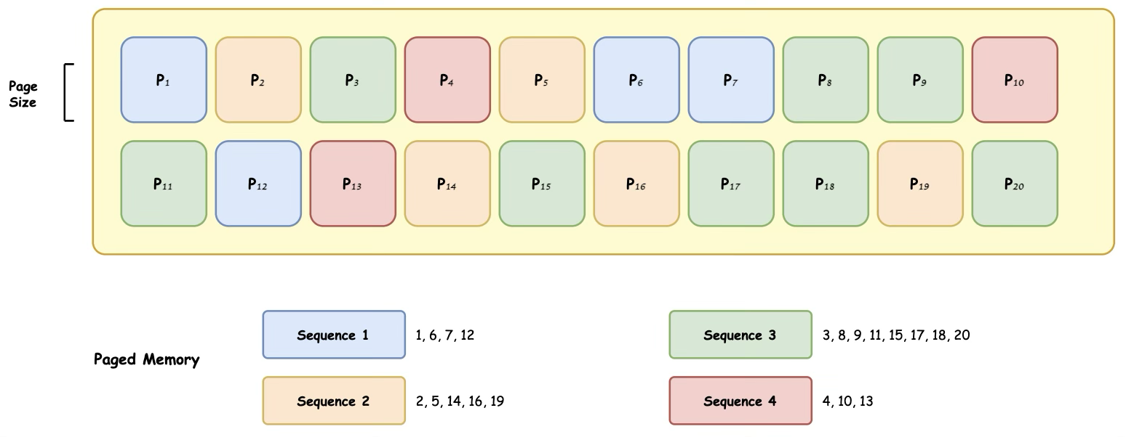
Paged Attention

Slide 10
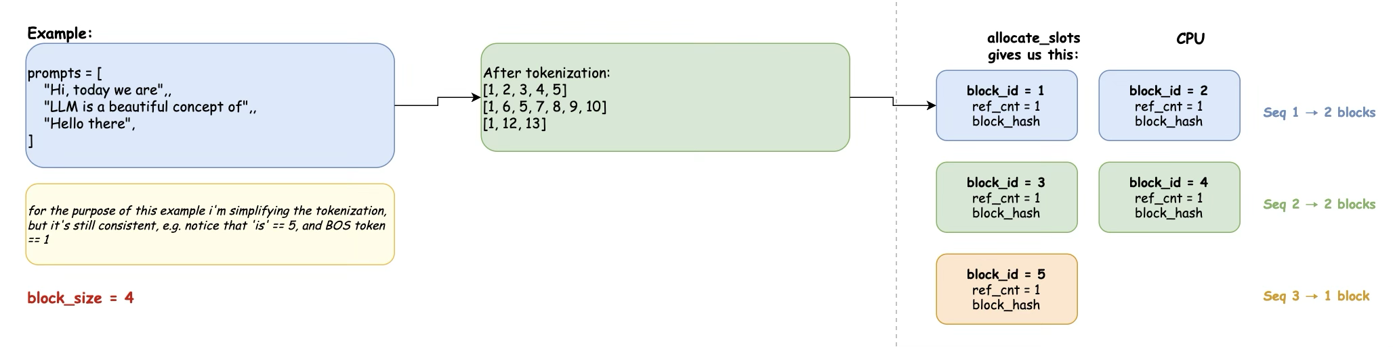
PagedAttention: Prompts, Tokenization & Block Allocation

Slide 11
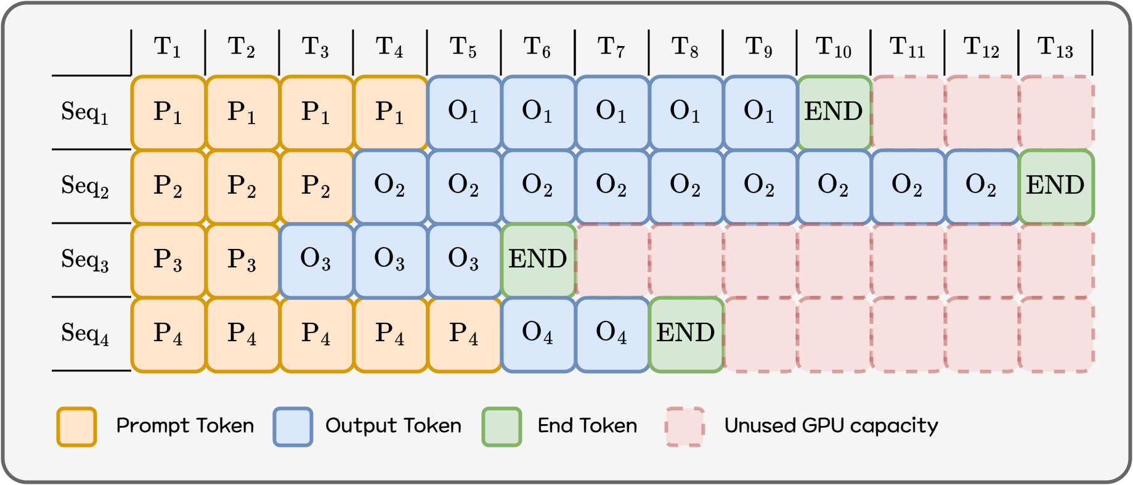
Continuous Batching
If Paged Attention improves memory efficiency, Continuous Batching maximizes GPU computation efficiency.
Traditional batch inference:
Collect requests → form a batch → process the entire batch → then move to the next batch But LLM requests differ in completion time (due to different output lengths). Thus, while a slow request continues, faster requests remain stuck waiting, wasting GPU compute capacity.

Slide 12
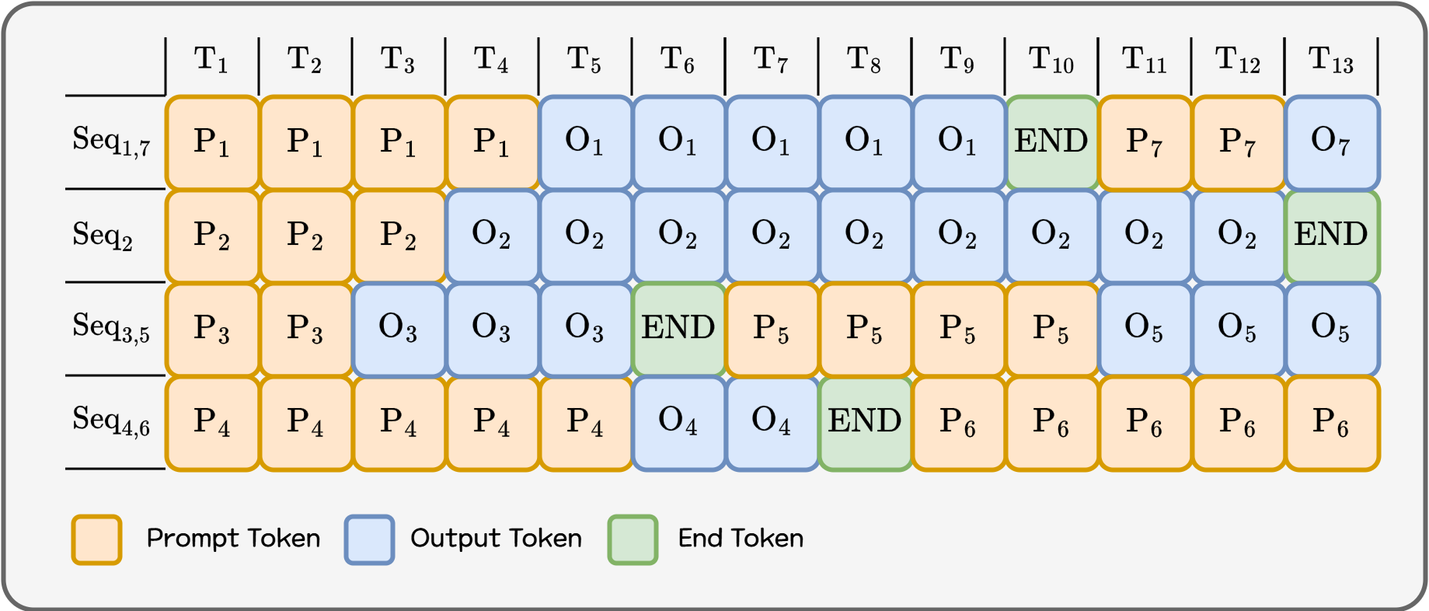
Continuous Batching
Continuous Batching breaks the process into token-generation iterations. After each iteration:
Finished requests exit the batch immediately
Newly arrived requests join the batch instantly
This makes the batch a continuously updating structure rather than a fixed one.
This reduces GPU idle time and allows far more requests to be processed within the same timeframe. In particular, for environments with many short requests mixed with long ones, user-perceived latency improves dramatically.
With:
Paged Attention → efficient memory use, and
Continuous Batching → maximal compute utilization,

Slide 13
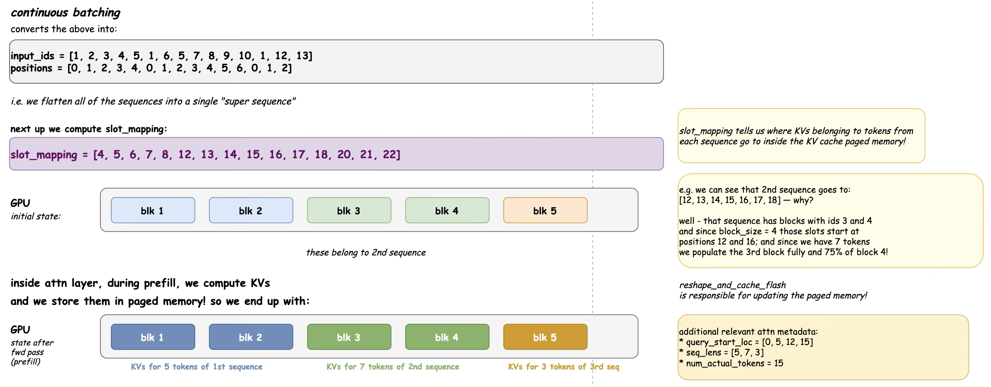
Continuous Batching

