Slide 1

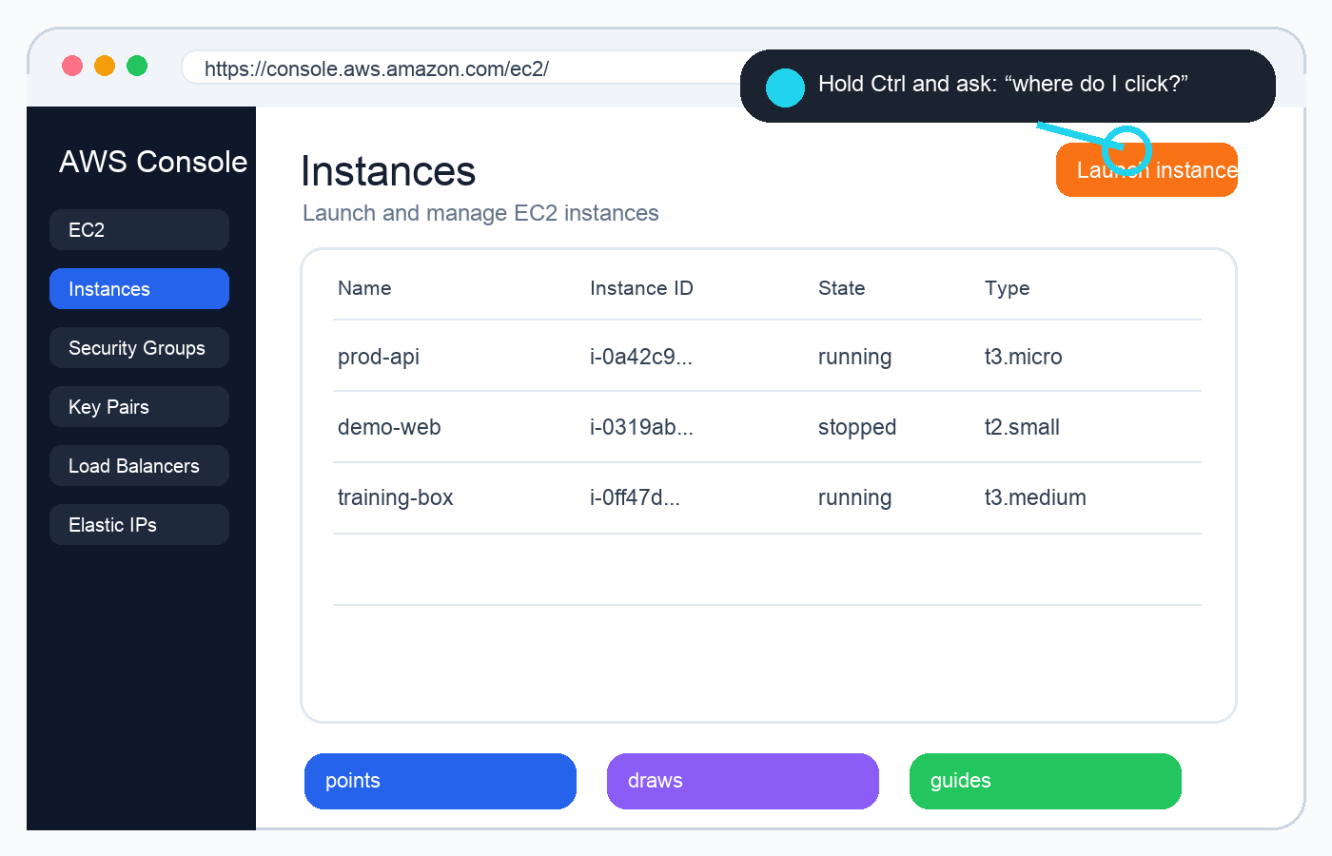
Hackathon pitch
Ctrl+Teach
Meet TARS.
The AI tutor that lives next to your cursor and helps while you actually use real tools.
Yes, we generate courses on demand. But that’s becoming the usual part. The unusual part is the tutor we ship with them.
Screenshot slot
Replace with TARS next to cursor

Slide 2

The shift
Cprime has always been about learning. The delivery model is the part that needs to evolve.
From trainer-led sessions
to a tutor-led product
Scheduled classes
TARS stays beside every learner
Human trainers repeat the same steps
→
Guidance happens inside the real tool
Static slides/videos
Courses + labs + live help
Learners get stuck after class
Proof of completion, not just attendance
The course is content. TARS is the experience.

Slide 3

The AWS moment everyone recognizes
Day one: create an EC2 instance and deploy the app. The trainer showed it once. Then the UI got real.
What happened
We forgot which button to click, jumped between ChatGPT and AWS, and kept losing our place.
Why normal AI failed
ChatGPT said the button was “top left,” but AWS had already changed the UI. The answer was technically plausible and practically useless.
The TARS version
Hold Ctrl, point at the screen, ask naturally. TARS understands this exact screen and points to the right place.

Slide 4
Meet TARS
Small, present, and right beside the cursor — more like a trainer than a chatbot.
If the learner is lost:
hold Ctrl
point, circle, or underline
ask out loud or type
Screenshot: TARS beside cursor
TARS answers in context
Drop your floating TARS UI here
“Where do I click now?”

Slide 5
TARS capabilities
This is where it stops feeling like a normal AI assistant.
Point at screen
Draw over the browser
TARS can place the pointer exactly where the learner needs to look.
It can sketch, underline, circle, and visually explain workflows.
Circle-to-ask
Take browser actions
Learner marks any region with Ctrl and TARS understands what they mean.
Scroll, switch tabs, navigate pages, and help through multi-step labs.
Screenshot strip: pointing / drawing / circle search
Add 3 product screenshots here

Slide 6
The Ctrl gesture is the magic interaction
Instead of describing the UI in words, the learner can simply refer to the screen.
Hold Ctrl + point
TARS sees the region you mean, grounds it to screen coordinates, and explains the exact next step.
Why it matters:
Screenshot: Ctrl trail / region selection
Show the fading trail + selected area
No screenshot upload loop
No stale “top left button” advice
No guessing what the learner meant

Slide 7

Real browser labs, right after the lesson
If the lesson is about a real web platform, we let the learner practice in the real place.
Example
AWS lesson → open AWS Console → create EC2 → deploy app → verify cleanup.
TARS watches progress
It can guide the learner, track evidence, and send proof back to the backend.
Completion means done
The lab is only complete after the task is correct and cleanup steps are confirmed.

Slide 8
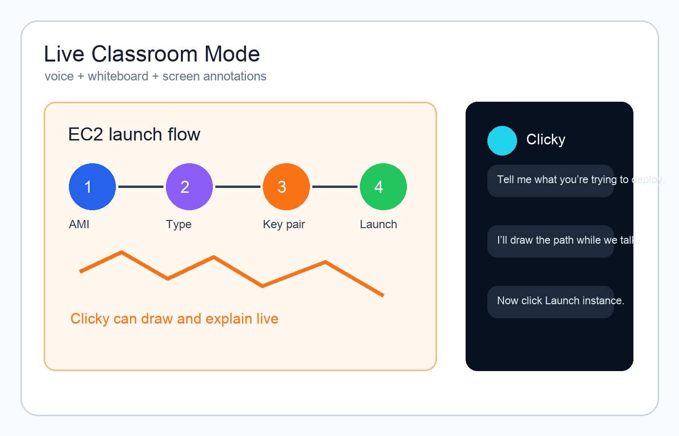
Two modes: normal study and Live Classroom Mode
Cprime already does live classrooms with humans. This brings that feeling into the product.
Regular text mode
For course reading, summaries, quizzes, and quick questions.
Best when the learner wants to understand.
Live Classroom Mode

Slide 9
It’s not just help — it’s measurable training
Every lab can produce evidence that the learner actually completed the task.
1
2
3
4
→
→
→
Lesson
Lab
TARS
Backend
Learner studies the concept
Opens the real platform
Guides + observes
Verifies task + cleanup
For enterprise training, this turns “attendance” into actual proof of skill.

Slide 10
Why this is a big deal for Cprime
A scalable learning product that still feels human.
Lower delivery cost
Faster rollout
One tutor can support many learners at once.
New tools and UI changes can be handled immediately.
More practice
Higher retention
Learners work in the actual platforms, not only slides.
People remember more when help arrives exactly where they’re stuck.
TARS scales the feeling of having a trainer beside you.

Slide 11
Demo in 90 seconds
The AWS EC2 story makes the value obvious fast.
1
2
3
4
5
Open EC2 lab
Learner gets stuck
Hold Ctrl + ask
TARS points/draws
Task verified
Screenshot / GIF strip
Drop your end-to-end demo sequence here
The wow moment: TARS points to the exact AWS button.

Slide 12
Ctrl+Teach
Courses on demand.
A tutor that feels alive.
Training that happens where the work actually happens.
Final product screenshot
Use your strongest TARS visual here
Meet TARS

