Slide 1
Problem Statement Name: AI based connected solution for Vehicle & Driver Profiling
Team Name: vagabonds
Campus Name: Vellore Institute of Technology

Slide 2
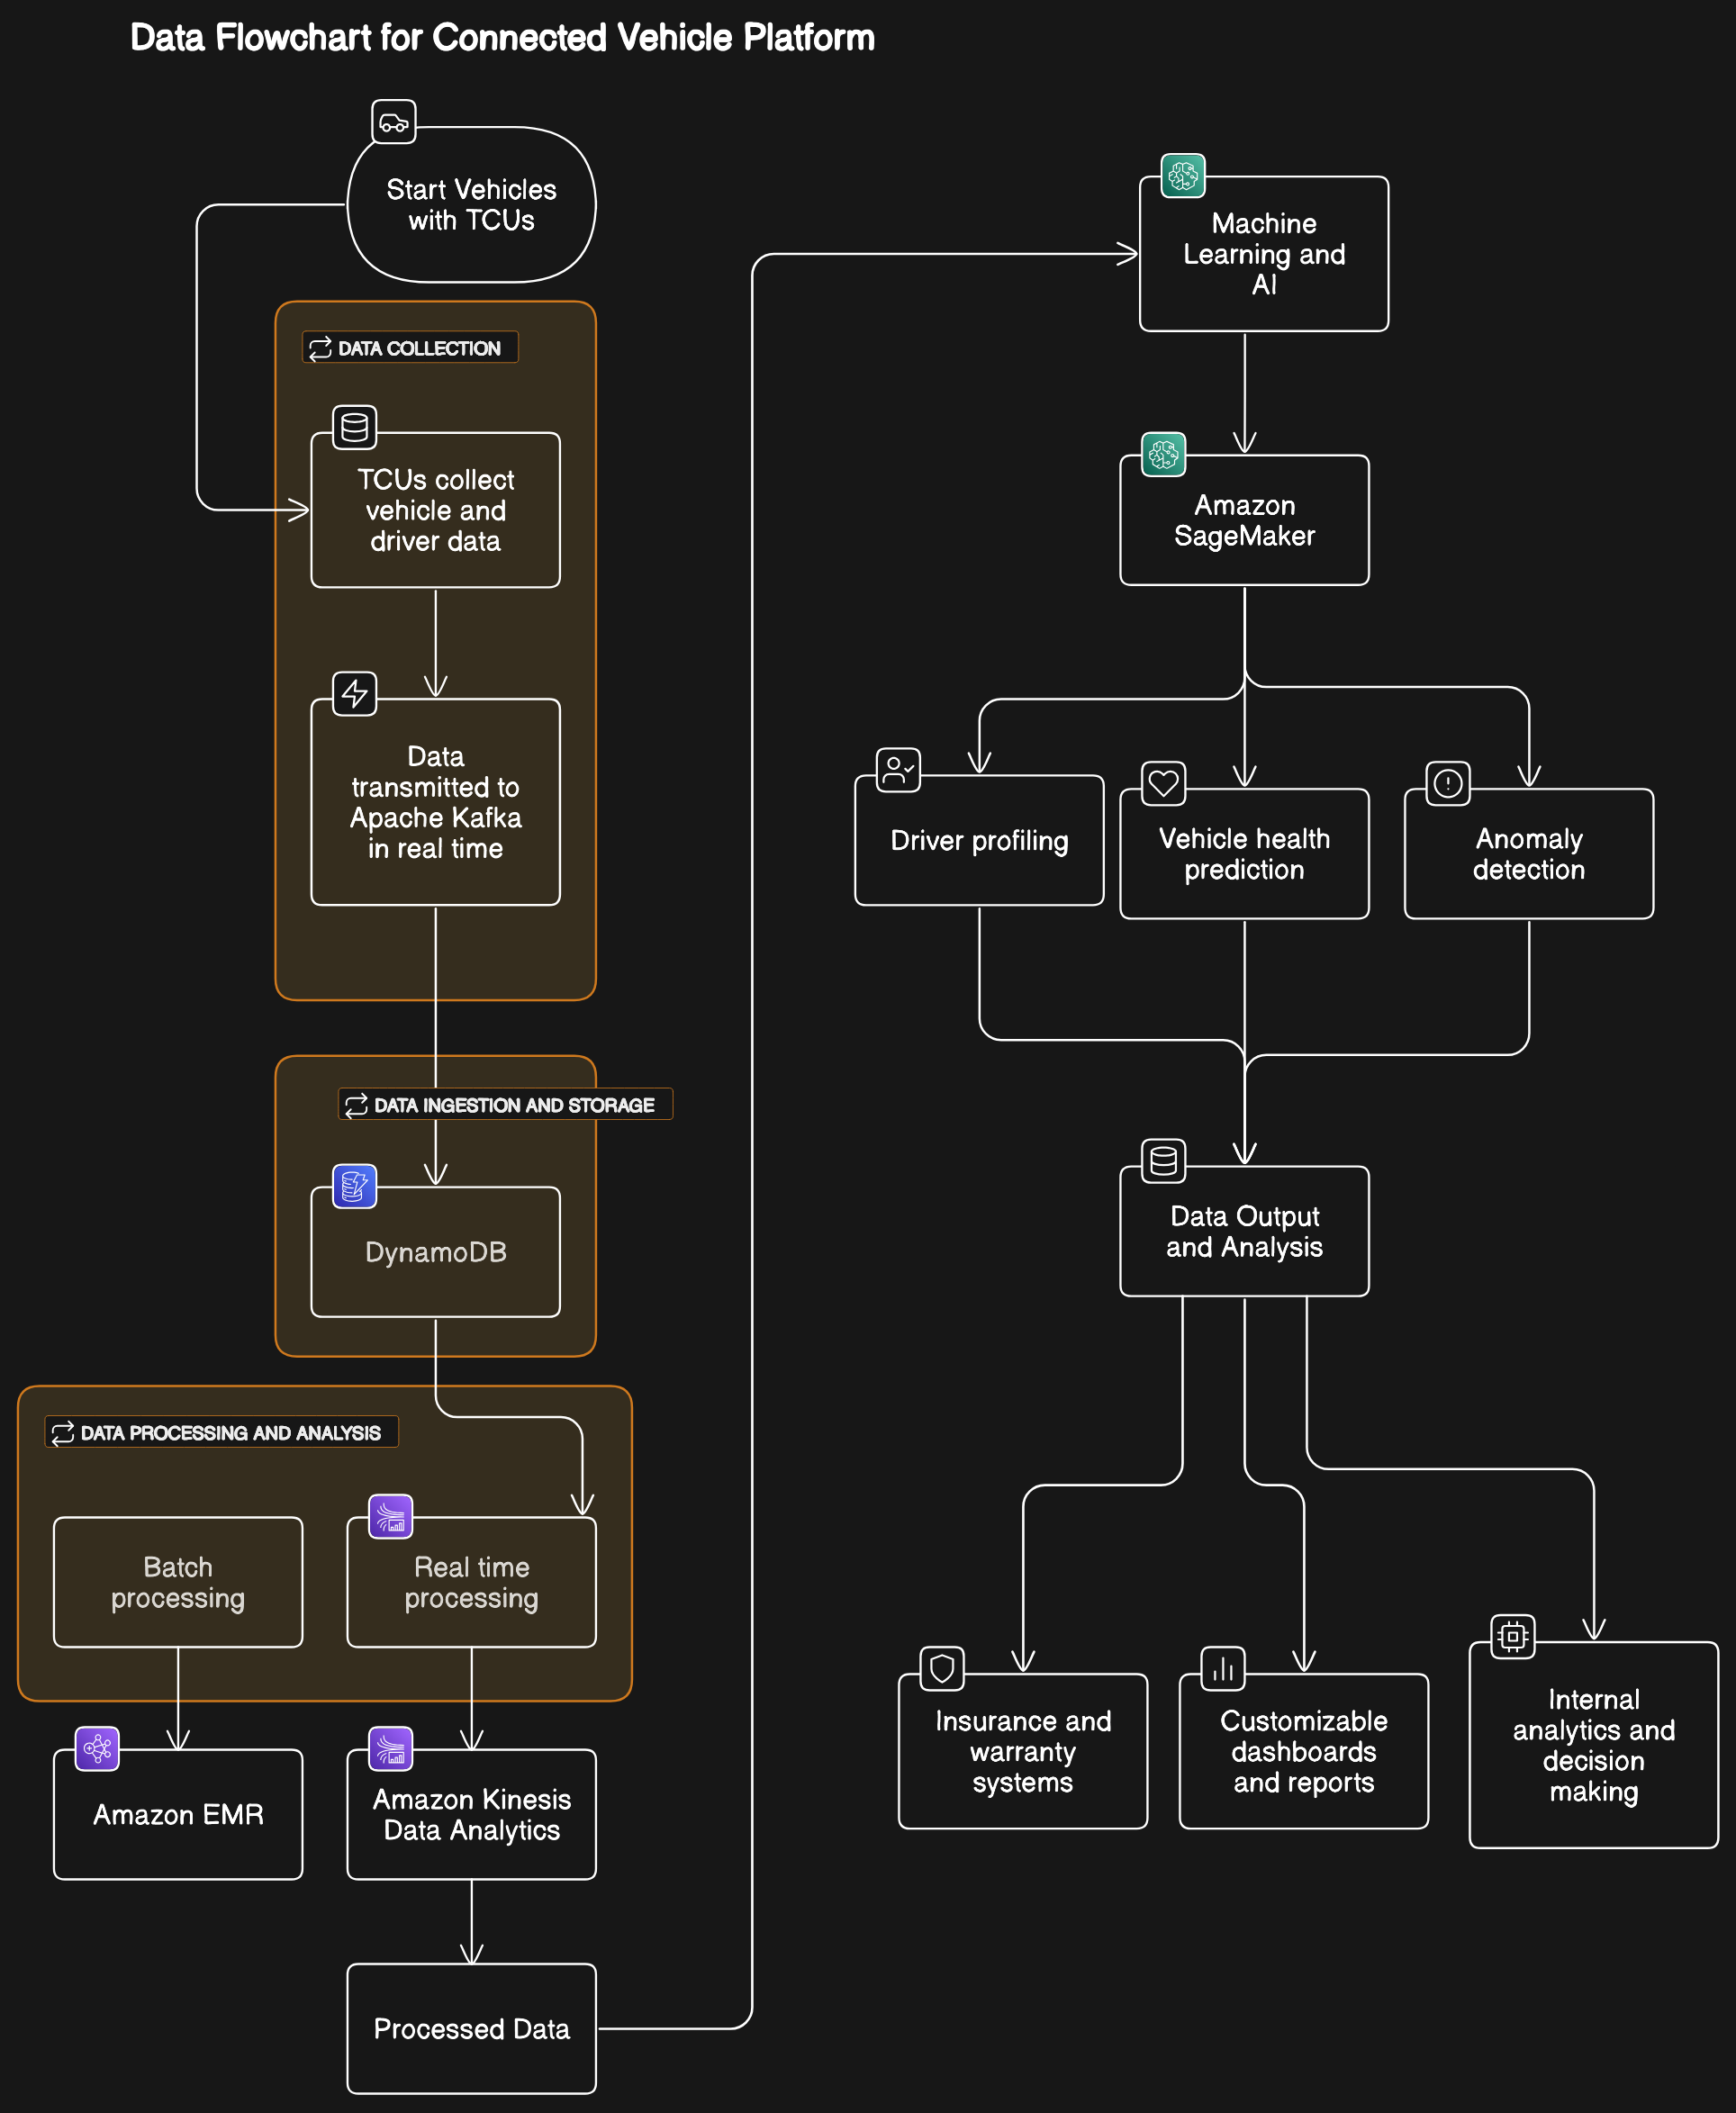
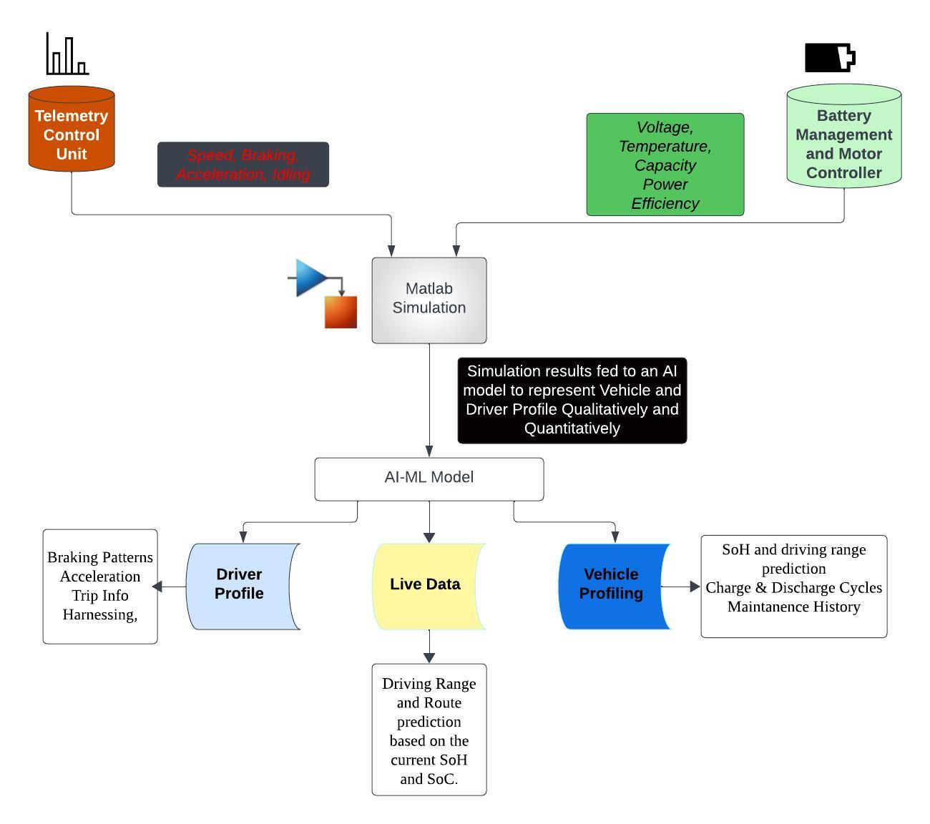
Cloud-Based Data Streaming Platform and AI based profiling
Cloud Platform
AI Platform

