Slide 1
Welcome…!

Slide 2

A Mini-Project on
“ Stock Price Prediction Model ”

Slide 3
Project Guide: Mrs. S.P. Pawar Madam
Presented by :
Sr. No. | Name of Student | PRN
1 | Umesh Vikas Sathe | 2019032500207151
2 | Gorakshnath Balkrushna Shejal | 2019032500209037
3 | Sanket Sambhaji Kondubhairy | 2019032500209915
4 | Pavan Pandurang Kakade | 2019032500210211
5 | Mayur Vijaykumar Ghadage | 2019032500210002
Presented to :
Department of Computer Science and Technology,
SHRI VITTHAL EDUCATION and RESEARCH INSTITUTES’s, COLLEGE OF ENGINEERING, PANDHARPUR

Slide 4
Presentation Flow
Introduction
Proposed Workflow
LSTM Model
Dataset,Implementationand Results
Tools & Technologies
Future Enhancements
Conclusion

Slide 5
Introduction
~ Due to the high profit of the stock market, it is one of the most
popular investments.
~ People investigated for methods and tools that would increase their
gains while minimizing the risk, as the level of trading and
investing grew.
~ Stock market prediction is basically defined as trying to determine
the stock value after particular period of time and offer a robust
idea for the people to know and predict stock prices.
~ Sensex and Nifty are the two prominent Indian Market Indexes.
~ Stock Price Prediction by Machine Learning uses machine learning
technique LSTM(Long Short Term Memory)for existing work. This
machine-learning algorithm is to perform the best predicting result
of the stock future price.
~ LSTM is capable to catching the modifications in the behaviour of
the stock price for the indicated period in this proposed system.

Slide 6
Proposed Workflow
Dataset
Pre-Processing
Data Splitting
Build LSTM & Model Training
Predicted Results

Slide 7
1] Dataset :
~ A Dataset is a collection of related, discrete items of related data
that may be accessed individually or in combination or managed as a whole
entity.
~ It contains various data like date, open price, close price, low price,
high price etc.
~ To use the dataset in our code, we usually put it into a CSV file.
~ Dataset used : NSE TATA
-------------------------------------------------------------------------------------------------------------
2] Preprocessing:
~ A real-world data generally contains noises, missing values, and maybe
in an unusable format which cannot be directly used for machine learning
models. So that Data preprocessing is the first important step in making of
Machine Learning Model.
~ Data preprocessing is a data mining technique which is used to transform the
raw data in a useful and efficient format.

Slide 8
3] Data Splitting :
~ Now we have divided the dataset into training set and test set.
Training Set: A subset of dataset to train the machine learning model, and we
already know the output.
Test set: A subset of dataset to test the machine learning model, and by using
the test set, model predicts the output.
~ Suppose, if we have given training to our machine learning model by a dataset
and we test it by a completely different dataset. Then, it will create difficulties
for our model to understand the correlations between the models.
~ So we always try to make a machine learning model which performs well with
the training set and also with the test dataset.
4] Build LSTM and Model Training :
~ We will see this part in upcoming slides.
5] Predicted Results

Slide 9
LSTM Model
Neural Network :
~ An artificial neural network is a layered structure of connected
neurons that resembles human brain.
~ It is not one algorithm but combinations of various algorithms which allows us to
do complex operations on data.
~ Neural Network can help computers to make intelligent decisions with limited
human assistance. Because, It creates an adaptive system that computers use to
learn from their mistakes and improve continuously.
~ A neural network has interconnected artificial neurons in three layers:
1)Input Layer: Information from the outside world enters the artificial neural
network from the input layer. Input nodes process the data, analyze or
categorize it, and pass it on to the next layer.
2)Hidden Layers: Hidden layers take their input from the input layer or other
hidden layers. It can have a large number of hidden layers.
Each hidden layer analyzes the output from the previous layer, processes it
further, and passes it on to the next layer.
3)Output Layers: The output layer gives the final result of all the data processing
by the artificial neural network.
Cont…

Slide 10
Recurrent Neural Network:
~ A recurrent neural network (RNN) is a type of artificial neural network which
uses sequential data or time series data.
~ This Neural Network is called Recurrent because it can repeatedly perform
the same task or operation on a sequence of inputs.
~The logic behind an RNN is to save the output of the particular layer and feed
it back to the input in order to predict the output of the layer.
LSTM(Long Short Term Memory):
~ Long Short Term Memory is a kind of recurrent neural network.
~ In RNN output from the last step is fed as input within the present step.
~ LSTM will by default retain the knowledge for a long period of time. It is used
for processing, predicting and classifying on the basis of time-series data
~ LSTM has a new structure called a memory cell.
~ The memory cell makes the decisions about what information to store, and
when to allow reading, writing and forgetting.
~ A memory cell contains three main gates:
1.Input gate- a new value flows into the memory cell.
2.Forget gate- a value remains in the memory cell.
3.Output gate- value in the memory cell is used to compute the output.

Slide 11
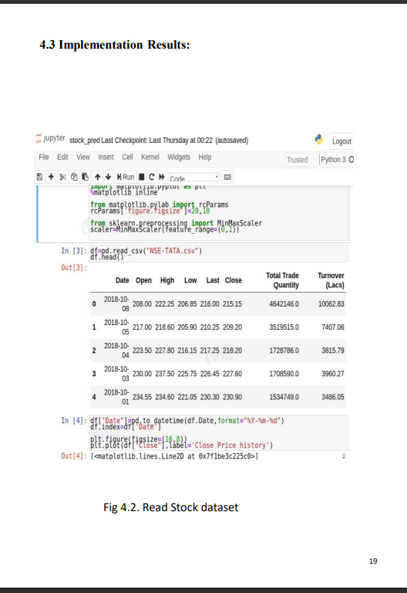
Datasets, Implementation ,Results

Slide 12
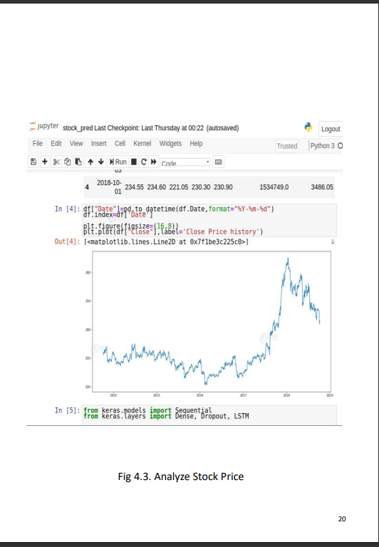

Slide 13
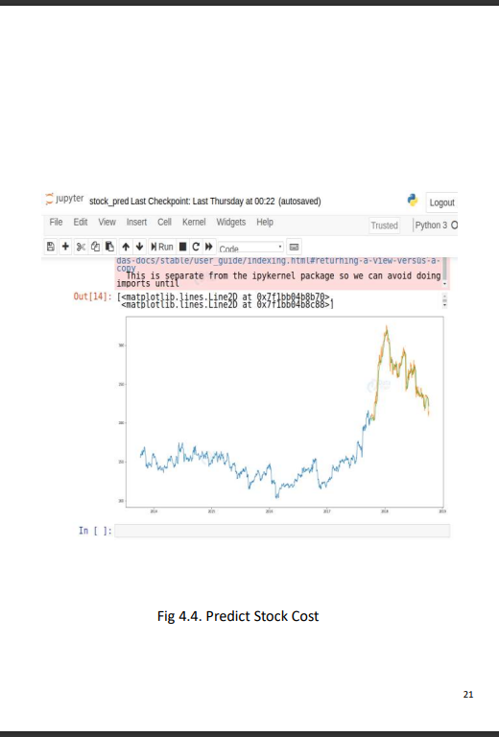
Train
Prediction
Val

Slide 14
Tools & Technologies
~ Programming Language : Python
~ Libraries : * Numpy
* Scikit Learn
* Tensorflow
* Keras
* Pandas
* Datetime
* Matplotlib
~ IDE : Google Colab ,
Jupyter Notebook

Slide 15
Future Enhancements
~ Future scope of this project will involve adding more parameters and factors
like the financial ratios, multiple instances, etc.
~ The more the parameters are taken into account more will be the accuracy.
~ The algorithms can also be applied for analyzing the contents of public
comments and thus determine patterns/relationships between the customer
and the corporate employee.
~ The use of traditional algorithms and data mining techniques can also help
predict the corporation‟s performance structure as a whole.

Slide 16
Conclusion
~ By measuring the accuracy of the different algorithms, we found that the
suitable algorithm for predicting the market price of a stock based on various
data points from the historical data is the LSTM(Long Short Term Memory).
~ It will be a great asset for brokers and investors for investing money
in the stock market since it is trained on a huge collection of historical data and
has been chosen after being tested on a sample data.
~ The project demonstrates the machine learning model to predict the stock value
with more accuracy as compared to other machine learning
models.

Slide 17
Thank you…!

