Slide 1

A Mini-Project Report on
“Stock Price Prediction Model”
Submitted by:
Mr. Umesh V. Sathe
Mr. Sanket S. Kondubhairy
Mr. Gorakshanath B. Shejal
Mr. Mayur V. Ghadage
Mr. Pavan P. Kakade
(PRN:2019032500207151) (PRN:2019032500209915)
(PRN:2019032500209037)
(PRN:2019032500210002)
(PRN:2019032500210211)
UNDER THE GUIDANCE OF
Mrs. S. P. Pawar Madam
in partial fulfillment for the award of the degree of
BACHELOR OF TECHNOLOGY
DEPARTMENT OF COMPUTER SCIENCE AND ENGINEERING
at
SHRI VITHAL EDUCATION and RESEARCH INSTITUTES’s, COLLEGE OF ENGINEERING, PANDHARPUR
AFFILIATED TO PUNYASHLOK AHILYADEVI HOLKAR SOLAPUR UNIVERSITY, SOLAPUR
2021-22

Slide 2
SVERI’s COLLEGE OF ENGINEERING, PANDHARPUR
CERTIFICATE
This is to certify that the project report entitled “ STOCK PRICE PREDICTION MODEL ’” is submitted for partial fulfillment of Bachelor Degree in Computer Science and Engineering as per requirement of Punyashlok Ahilyadevi Holkar Solapur University, Solapur for the academic year 2021-22
(Mrs. S. P. Pawar)
Project Guide
(Mr. P. D. Mane)
Project Coordinator
(Mrs. A. S. Budhewar) HOD, CSE
(Dr. B. P. Ronge ) PRINCIPAL
EXTERNAL EXAMINAR

Slide 3
Abstract
Researchers have been studying different methods to effectively predict the stock market price. Useful prediction systems allow traders to get better insights about data such as: future trends. Also, investors have a major benefit since the analysis give future conditions of the market. One such method is to use machine learning algorithms for forecasting. This project’s objective is to improve the quality of output of stock market predicted by using stock value. A number of researchers have come up with various ways to solve this problem, mainly there are traditional methods so far, such as artificial neural network is a way to get hidden patterns and classify the data which is used in predicting stock market. This project proposes a different method for prognosting stock market prices. It does not fit the data to a speciﬁc model; rather we are identifying the latent dynamics existing in the data using machine learning architectures. In this work we use Machine learning architectures Long Short-Term Memory (LSTM) for the price forecasting of NSE listed companies and differentiating their performance. On a long term basis, sling window approach has been applied and the performance was assessed by using root mean square error.
i

Slide 4
Acknowledgement
We are pleased to acknowledge Mrs. A. S. Budhewar Madam(HOD CSE) for her valuable guidance during the course of this project work. We extend our sincere thanks to Mrs. S. P. Pawar madam who continuously helped us throughout the project and without his guidance, this project would have been an uphill task.
We are also grateful to other members of the CSE faculty members and technical staff who cooperated with us regarding some issues.
.
I would also like to thank my parents and friends who helped me a lot in executing this project within the limited time frame.
Signature
(Mr. Sathe U. V.
(Mr. Kondubhairy S. S.
(Mr. Shejal G. B.
(Mr. Ghadage M. V.
(Mr. Kakade P. P.
Sign. ................... )
Sign. ................... )
Sign. ................... )
Sign. ...................
Sign. ...................)
ii

Slide 5
TABLE OF CONTENTS
SR. NO. | TOPIC | PAGE NO.
 | Abstract…………………………………………………………… | I
 | Acknowledgements……………………………………………….. | II
 | Table of Contents…………………………………………………. | III
 | List of Figures…………………………………………………….. | IV
 | List of Table………………………………………………………. | V
1. | Introduction……………………………………………………… | 1
 | 1.1 Stock Price Prediction………………………………………… | 1
 | 1.2 Application …………………………………………………… | 3
 | 1.3 Objectives……………………………………………………... | 3
 | 1.4 Motivation…………………………………………………...... | 3
 | 1.5 Organization of Report…………………………….………….. Problem Definition………………………………………………... | 3 4
2. | Literature Survey………………………………………………… | 5
3. | Existing work…….…………………....………………………….. | 11
 | 3.1 Overview of Existing work….………………………………… | 11
 | 3.2 Proposed work…………………………………………………. | 12
 | 3.2 1 Working of LSTM model……………………………….…… | 13
4. | Dataset, Implementation and Results…………………….…….. | 15
 | 4.1 Dataset Details………………………………………………… | 15
 | 4.2 Tools & Technology used…………………………………….. | 16
 | 4.3 Implementation Results……………..……………………..….. | 19
5. | Conclusion and Future Enhancements.………..…..…………… | 32
Bibliography and References……………………………………………33
APPENDIX A: ABBRAVIATION……………………………………….36
iii

Slide 6
 | LIST OF FIGURES
FIGURE NO | TITLE | PAGE NO
3.1 | Proposed Work Flow | 12
3.2 | LSTM Architecture | 13
4.1 | Stock Dataset Information | 15
4.2 4.3 4.4 4.5 4.6 | Read stock Dataset Analyze Stock Price Predict Stock Price Stock Dataset Information Read Dataset | 19 20 21 22 22
4.7 | Graph of Close Price history | 23
4.8 | Data Scaling | 23
4.9 | LSTM Summary | 24
4.10 | Training Process | 25
4.11 | Predicted Close Price | 26
4.13 | Plot for Real vs Predicted value for ICICI Bank using LSTM | 27
4.14 4.15 | Plot for Real vs Predicted value for SUN PHARMA using LSTM Plot for Real vs. Predicted value for SSOFTWARE using LSTM | 28 29
4.16 | Plot for Real vs Predicted value for GSFC using LSTM | 30
4.17 | Plot for Real vs Predicted value for VARDMANPOLY using LSTM | 31
iv

Slide 7
 | LIST OF TABLES
TABLE NO | TITLE | PAGE NO
4.1 | Dataset Details | 15
4.12 | Accuracy | 26
v

Slide 8
Chapter 1. Introduction
Stock Price Prediction
Due to the high profit of the stock market, it is one of the most popular investments. People investigated for methods and tools that would increase their gains while minimizing the risk, as the level of trading and investing grew. Two stock exchanges namely- the National Stock Exchange (NSE) and the Bombay Stock Exchange (BSE), which are the most of the trading in Indian Stock Market takes place. Sensex and Nifty are the two prominent Indian Market Indexes. Since the prices in the stock market are dynamic, the stock market prediction is complicated.
From gradually the very past years some forecasting models are developed for this kind of purpose and they had been applied to money market prediction. Generally, this classification is done by:
Time series analysis
Fundamental analysis
Technical analysis
Time Series Analysis
The definition of forecasting can be like this the valuation of some upcoming result or results
by analysing the past data. It extents different areas like industry and business, economics and finance, environmental science. Forecasting problems can be classified as follows:
Long term forecasting (estimation beyond 2 years)
Medium-term forecasting (estimation for 1 to 2 years)
Short term forecasting (estimation for weeks or months, days, minutes, few seconds)
The analysis [1] of time consist of several forecasting problems. The designation of a time series is a linear classification of observations for a selected variable. The variable of the stock price in our case. Which can weather multivariate or univariate? Only particular stock is included in the univariate data while more than one company for various instances of time is added in multivariate. For investigating trends, patterns and cycle or periods the analysis of time series advantages in the present data. In spending money wisely an early data of the bullish or bearish in the case of the stock market. Also, for categorizing the best-performing companies the analysis of patterns plays its role for a specific period. This makes forecasting as well as time series analysis an important research area.

Slide 9
Fundamental analysis
Fundamental Analysts are concerned with the business that reasons the stock itself. They assess
a company's historical performance as well as the reliability of its accounts. Different performance shares are created that aid the fundamental forecaster with calculating the validity of a stock, such as the P/E ratio. Warren Buffett is probably the foremost renowned of all Fundamental Analysts.
What fundamental analysis within the stock market is making an attempt to reach, is organizing the true value of a stock, that then will be matched with the worth it is being listed on stock markets and so finding out whether or not the stock on the market is undervalued or not. Find out the correct value will be completed by numerous strategies with primarily a similar principle. The principle is that an organization is price all of its future profits. Those future profits has to be discounted to their current value. This principle goes on the theory that a business is all about profits and nothing else. Differing to technical analysis, the fundamental analysis is assumed as further as a long approach.
Fundamental analysis is created on conviction that hominoid society desires capital to make progress and if the company works well, than it should be rewarded with an additional capital and outcome in a surge in stock price. Fundamental analysis is usually used by the fund managers as it is the maximum sensible, objective and prepared from openly existing data like financial statement analysis.
One more meaning of fundamental analysis is on the far side bottom-up business analysis, it discusses the top-down analysis since initial analysing the world economy, followed by country analysis and also sector analysis, and last the company level analysis.
Technical analysis
Chartists or the technical analysts are not involved with any other of the fundamentals of the
company. The long run price of a stock based generally exclusively on the trends of the past value (a form of time series analysis) that is set by them. The head and shoulders or cup and
saucer are various numerous patterns that are employed. Also the techniques, patterns are used just like the oscillators, exponential moving average (EMA), support and momentum and volume indicators. Candlestick patterns, believed to have been initial developed by Japanese rice merchants, are nowadays widely used by technical analysts. For the short-term approaches, the technical analysis is used compare to long-run ones. So, in commodities and forex markets it is more predominant wherever traders target short-term price movements. There are basic rules are used in this analysis, first all significant about a company is already priced into the

Slide 10
stock, another being that the value changes in trends and finally that history (of prices) tends to repeat itself that is especially due to the market science.
Applications
Business
Companies
Insurance company
Government Agency
This application is helpful for stock investors, sellers, buyers, brokers.
Objectives
A stock market prediction is described as an action of attempting to classify the future value of the company stock or other financial investment traded on the stock exchange. The forthcoming price of a stock of the successful estimation is called the Yield significant profit. This helps you to invest wisely for making good profits.
Motivation
The future price of a stock is the main motivation behind the stock price prediction. In various cases like business and industry, environmental science, finance and economics motivation can be useful. The future value of the company’s stock can be determining.
Organization of Report
Chapter 2 contains a literature survey that provides a summary of individual paper.
Chapter 3 provides an overview of existing work for stock price prediction that has been done using LSTM.
Chapter 4 presents Implementation and its results, tools and technology used to achieve this
and dataset detail.
Chapter 5 contains a conclusion about stock price prediction and future work about what you are wanted to do in future.

Slide 11
Problem Definition:
Stock market prediction is basically defined as trying to
determine the stock value and offer a robust idea for the
people to know and predict the market and the stock prices.
It is generally presented using the quarterly financial ratio
using the dataset. Thus, relying on a single dataset may not
be sufficient for the prediction and can give a result which is
inaccurate. Hence, we are contemplating towards the study
of machine learning with various datasets integration to
predict the market and the stock trends.
The problem with estimating the stock price will remain a
problem if a better stock market prediction algorithm is not
proposed. Predicting how the stock market will perform is
quite difficult. The movement in the stock market is usually
determined by the sentiments of thousands of investors.
Stock market prediction, calls for an ability to predict the
effect of recent events on the investors. These events can be
political events like a statement by a political leader, a piece
of news on scam etc. It can also be an international event
like sharp movements in currencies and commodity etc. All
these events affect the corporate earnings, which in turn
affects the sentiment of investors. It is beyond the scope of
almost all investors to correctly and consistently predict
these hyperparameters. All these factors make stock price
prediction very difficult. Once the right data is collected, it
then can be used to train a machine and to generate a predictive result.
4

Slide 12
Chapter 2. Literature Survey
Stock Price Forecasting Using Data From Yahoo Finance and Analysing Seasonal and Nonseasonal Trend:
Publication Year: 2018
Author: Jai Jagwani, Hardik Sachdeva, Manav Gupta, Alka Singhal
Journal Name: 2018 IEEE
Summary: To identify the [2] relationship between different existing time series algorithms namely ARIMA and Holt Winter and the stock prices is the main objective of the proposed work, for the investments a good risk-free range of stock prices are analyzed and therefore
better accuracy of the model can be seen. To find distinguished results for shares in the stock market, the combination of two different time series analysis models is opted by producing a range of prices to the consumer of the stocks. Not complex in nature and estimation of values which are purely based on the past stock prices for non-seasonal or seasonal is the main advantage of these models. In this experiment, some limitations are, the work that never takes into consideration and other circumstances like news about any new market strategy or media release relevant to any company which may get affected by the prices of stocks.
Stock Market Prediction Using Machine Learning:
Publication Year: 2018
Author: Ishita Parmar, Ridam Arora, Lokesh Chouhan, Navanshu Agarwal, Shikhin Gupta, Sheirsh Saxena, Himanshu Dhiman
Journal Name: 2018 IEEE
Summary: In this paper studies, the use [3] of Regression and LSTM based Machine learning to forecast stock prices. Factors measured are open, close, low, high and volume. This paper was an attempt to determine the future prices of the stocks of a company with improved accuracy and reliability using machine learning techniques. LSTM algorithm resulted in a positive outcome with more accuracy in predicting stock prices.
5

Slide 13
Multi-Category Events Driven Stock Price Trends Prediction: Publication Year: 2018
Author: Youxun Lei, Kaiyue Zhou, Yuchen Liu
Journal Name: 2018 IEEE
Summary: In this paper, [4] multi-category news events are used as features to develop stock price trend prediction, model. The multi-category events are based on already defined feature
word dictionary. And we have employed both neural networks and SVM models to analyse the relationship between stock price movements and specific multi-category news. Experimental results showed that the predefined multi-category news events are more improved than the baseline bag-of-words feature to predict stock price trend. As compared to long term prediction, short term prediction is better based on this study.
Share Price Prediction using Machine Learning Technique:
Publication Year: 2018
Author: Jeevan B, Naresh E, Vijaya kumar B P, Prashanth Kambli
Journal Name: 2018 IEEE
Summary: This paper is mostly [5] based on the approach of predicting the share price using Long Short Term Memory (LSTM) and Recurrent Neural Networks (RNN) to forecast the
stock value on NSE data using various factors such as current market price, price-earning ratio, base value and other anonymous events. The efficiency of the model is analysed by comparing the true data and the predicted data using an RNN graph. Machine learning to predict stock price as see the model is able to predict the stock price very close to the actual price where this model captures the detailed feature and uses different strategies to make a prediction. The model train for all the NSE data from the internet and recognize the input and group them and provide input according to the user configuration this RNN based architecture proved very efficient in forecasting the stock price by changing the configuration accordingly which also use backpropagation mechanism while gathering and grouping data to avoid mixing of data.

Slide 14
Stock Market Prediction Using Machine Learning Techniques: Publication Year: 2016
Author: Mehak Usmani, Syed Hasan Adil, Kamran Raza, Syed Saad Azhar Ali
Journal Name: 2016 IEEE
Summary: The prominent aim of this study is to [6] forecast the market performance of the Karachi Stock Exchange (KSE) on day closing using machine learning algorithms. A variety
of attributes as an input and forecasts market as Positive & Negative is predicted by using the predictions model. The features employed in the model are contains Oil rates, Gold & Silver rates, Interest rate, Foreign Exchange (FEX) rate, NEWS and social media feed. The machine learning algorithms including Single Layer Perceptron (SLP), Multi-Layer Perceptron (MLP), Radial Basis Function (RBF) and Support Vector Machine (SVM) are compared. The algorithm MLP that is multi-layer perceptron performed best as compared to different methods. The foremost helpful feature in predicting the market was the oil rate attribute. The end results of this research confirm that machine learning techniques have the ability to predict the stock market performance. The Multi-Layer Perceptron algorithm of machine learning predicted 70% correct market performance.
Forecasting stock price in two ways based on LSTM neural network: Publication Year: 2019
Author: Jingyi Du, Qingli Liu, Kang Chen, Jiacheng Wang
Journal Name: 2019 IEEE
Summary: The [7] LSTM neural network is used to predict Apple stocks by consuming single
feature input variables and multi-feature input variables to verify the forecast effect of the model on stock time series. The experimental results show that the model has a high accuracy of 0.033 for the multivariate input and is accurate, that is in line with the actual demand. For the univariate feature input, the predicted squared absolute error is 0.155, which is inferior to the multi-feature variable input.
7

Slide 15
Share Price Trend Prediction Using CRNN with LSTM Structure: Publication Year: 2018
Author: Shao-En Gao , Bo-Sheng Lin ,Chuin-Mu Wang
Journal Name: 2018 IEEE
Summary: The [8] entire financial market majorly runs by the stock market and one of the most attractive research issues is predicting stock price volatility. The information of historical
stocks for assuming the future stock price as well deep learning method is applied to find approximate trend value of stock prices which are mentioned in this paper. This paper not only stores the data of historical stock with the time scale but also estimates prices of the future stock by a designed neural network, this is due to the fact that the trend of stocks is usually connected to the previous information of stock price. In this paper, the design of the neural network proposed then with the memory performance the convolutional recurrent neural network (CRNN) and for improving the long-term dependency of traditional RNN the Long Short-term memory (LSTM) are the major components. Also to enhance the accuracy as well as stability of prediction of the RNN LSTM architecture is put. This paper accumulates a total of ten stock historic data to test and accomplish an average error rate of 3.449 RMSE. [3]
Applying Long Short Term Memory Neural Networks for Predicting Stock Closing Price:
Publication Year: 2017
Author: Tingwei Gao, Yueting Chai, Yi Liu
Journal Name: 2017 IEEE
Summary: To [9] assess the scheme that merges RNNs with informative input variables which can give an improved and effective method to forecast the next-day market is the main objective of this paper. The stock prediction model analyses using long-short memory (LSTM) and stock basic trading data. On Standard & Poor’s (S&P500) and NASDAQ, the case study relies. The stock closing price is more precisely predicted using their forecasting system for the next day, which outperforms the comparison models. This is the main discovery of the case study. Five various models namely – moving average (MA), exponential moving average (EMA), support vector machine (SVM) and LSTM are tested by them to demonstrate the utility of the system. The closing value of the next day is the predicting target.

Slide 16
Developing a Prediction Model for Stock Analysis:
Publication Year: 2017
Author: R. Yamini Nivetha, Dr. C. Dhaya
Journal Name: 2017 IEEE
Summary: A [10] relative study of the three algorithms namely - Multiple Linear Regression (MLR), Support Vector Machine (SVM) and Artificial Neural Network (ANN) is the main aim
of this study. To predict the coming day market price, the prediction will be determined by monthly prediction and daily prediction. Sentiment analysis with the best prediction algorithm forecast the stock price. The less-developed algorithm is the Multiple Linear Regression algorithm which calculates the correlation between volume and the stock price. The result of the study shows that deep learning algorithms are more developed than MLR algorithms and SVM algorithm.
Stock Price Prediction Based on Information Entropy and Artificial Neural Network: Publication Year: 2019
Author: Zang Yeze, Wang Yiying
Journal Name: 2019 IEEE
Summary: One of the most important components of the financial system is the stock market.
[11] For supporting the activity and evolvement, money is directed by the investors of the associated frim. Along with information theory and Artificial Neural Network (ANN) the combination of machine learning framework is formed. Information entropy for non-linear causality and stock relevance also to facilitate ANN time series modelling are creatively used by this method. The feasibility of this machine learning framework is analysed with Amazon, Apple, Google and Facebook prices. A time series analysis method based on information theory as well as LSTM to model the stock price dynamics are outlined in this paper. The transfer entropy between relevant variables to help LSTM time series prediction is merged in this modelling infrastructure, thus the accuracy of the assumption outcome is broadly granted. Modelled and real stock price is highly correlated while differ slightly in terms of Mean Absolute Error (MAE) and Root Mean Square Error (RMSE) which are investigated by the outcomes.

Slide 17
Summary of Literature Survey:
Here, I have reviewed various approaches for Stock price prediction. All approaches have their own advantages and disadvantages. CNN & LSTM is a most popular algorithm to prediction the stock price but there are some challenges in this method like use to need a lot of training data, High computational cost, without GPU data quite slow to train, depend on any previous information for prediction. A hybrid approach can be used to overcome these issues. While machine learning is able to provide highly accurate prediction result using standards tools and also outperforms all standard prediction methods.

Slide 18
Chapter 3. Existing Work and Proposed Work
3.1 Overview of Existing Work
Stock Price Prediction by Machine Learning present to estimate the stock future value and machine learning technique like LSTM for existing work. This machine-learning algorithm is to perform the best predicting result of the stock future price. LSTM is capable to catching the modifications in the behaviour of the stock price for the indicated period in this proposed system.
Propose [3] a machine learning-based normalization for stock price prediction. The dataset utilized for analysis was selected from Yahoo Finance. It consists of approximately 9 lakh records of the required Stock price and other relevant data. The data reflected the stock price at some time intervals for every day of the year. It contains various data like date, symbol, open price, close price, low price, high price and volume. Here, the data for only one company was considered. All the data was available in a file of CSV format which was first read and transformed into a data frame using the Pandas library in Python. The normalization of the data was performed through the sklearn library in Python and the data were divided into training and testing sets. The experiment set was kept as 20% of the available dataset. This paper focuses on two architecture Regression-based Model and LSTM. The Regression-based Model is employed for predicting unbroken values through some given autonomous values Regression uses a given linear function for predicting continuous values of the most important amongst them and made the predictions using these. LSTM architecture is able to identify the changes in trends which show evident from the result. LSTM is identified as the best model for the proposed methodology. This shows that the proposed system is capable of identifying some interrelation within the data. In the stock market, there may not always follow the same cycle or may not always be in a regular pattern for the changes that are occurred. The period of the existence will differ and the existence of the trend is based on the companies and the sectors. For investors, this type of analysis of trends and cycles will obtain more profit. We must use networks like LSTM as they rely on the current information to analyse various information.

Slide 19
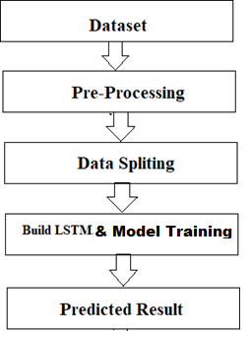
3.2 Proposed Work
Fig 3.1 Proposed Workflow
The system presented here composes of five modules:-
Input as Dataset
Pre processing
Data splitting
Build & Model training
Output as Predicted Result
Attribute such as: price of open, high, low, close, adjusted close price taken from huge dataset are fed as input to the models for training to pre-process the data techniques like normalization & one hot encoding in applied on dataset. After this data is divided in two sets namely training & testing which are ratio of 80:20 respectively. Then, this set are used to train a model using 3 different approaches: LSTM. Finally, all these modules are evaluated using Root mean square error.

Slide 20
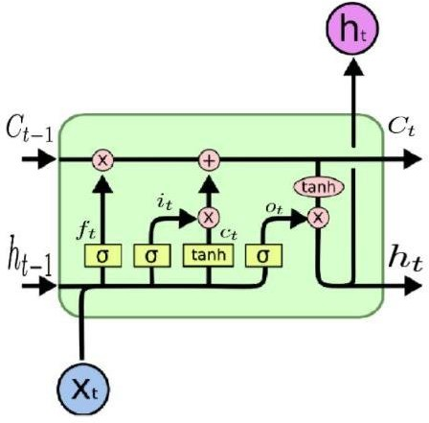
3.2.1 Working of LSTM model
Fig 3.2: LSTM Architecture [12]
Long Short Term Memory is a kind of recurrent neural network. In RNN output from the last step is fed as input within the present step. It tackled the matter of long-term dependencies of RNN within which the RNN will not predict the word hold on within the long term memory however can offer additional accurate forecasts from the recent info. Because the gap length will increases RNN does not offer an economical performance. LSTM will by default retain the knowledge for a long period of time. It is used for processing, predicting and classifying on the basis of time-series data.
Structure of LSTM:
LSTM has a chain organization that contains four neural networks and different memory blocks called cells.
LSTM has a new structure called a memory cell. The memory cell makes the decisions about what information to store, and when to allow reading, writing and forgetting.
A memory cell contains three main gates:
Input gate- a new value flows into the memory cell.
Forget gate- a value remains in the memory cell.
Output gate- value in the memory cell is used to compute the output.

Slide 21
Applications of LSTM includes:
Language Modelling
Machine Translation
Image Captioning
Handwriting generation
Question Answering Chatbot

Slide 22
Chapter 4. Dataset, Implementation and Result
4.1 Dataset Detail
The dataset consists of the stock historical data from the National stock exchange (NSE) and captures the daily information of each stock from the National Stock Exchange. It collects different sectors of stock data, including Banking, Pharma, Petroleum, Software and Textiles and it including the opening price, the highest price, the lowest price, the closing price, the adjusted closing price and the volume of stock [18].
Sector | Stock Name
Banking | ICICI Bank
Pharma | Sun Pharma
Petroleum | GSFC
Software | RS Software
Textiles | Vardmn Ploy
Table 4.1 Dataset Details

Slide 23
Tool & Technologies
PYTHON
The language of select for this project was Python. This was a straightforward call for many reasons.
Python [19] as a language has a vast community behind it. Any problems which may be faced is simply resolved with visit to Stack Overflow. Python is the foremost standard language on the positioning that makes it is very straight answer to any question.
Python [19] is an abundance of powerful tools ready for scientific computing Packages. The packages like NumPy, Pandas and SciPy area unit freely available and well documented. These Packages will intensely scale back, and variation the code necessary to write a given program. This makes repetition fast.
Python is a language as [19] forgiving and permits for the program that appear as if pseudo code. This can be helpful once pseudo code give in tutorial papers should be required and verified. Using python this step is sometimes fairly trivial.
However, Python is [19] not without its errors. The python is dynamically written language
and packages are area unit infamous for Duck writing. This may be frustrating once a package technique returns one thing that, for instance, looks like an array instead of being an actual array. Plus the standard Python documentation did not clearly state the return type of a method, this can’t lead without a lot of trials and error testing otherwise happen in a powerfully written language. This is a problem that produces learning to use a replacement Python package or library more difficult than it otherwise may be.
4.2.2 NUMPY
Numpy is python package which provide scientific and higher level mathematical abstractions wrapped in python. It is [20] the core library for scientific computing, that contains a provide tools for integrating C, strong n-dimensional array object, C++ etc. It is also useful in random number capability, linear algebra etc.
Numpy’s array type augments the Python language with an efficient data structure used for numerical work, e.g., manipulating matrices. Numpy additionally provides basic numerical routines, like tools for locating Eigenvectors

Slide 24
SCIKIT LEARN
Scikit-learn [21] could be a free machine learning library for Python. It features numerous classification, clustering and regression algorithms like random forests, k-neighbours, support vector machine, and it furthermore supports Python scientific and numerical libraries like SciPy and NumPy.
In Python Scikit-learn is specifically written, with the core algorithms written in Cython to get the performance. Support vector machines are enforced by a Cython wrapper around LIBSVM .i.e., linear support vector machines and logistic regression by a similar wrapper
around LIBLINEAR.
TENSORFLOW
In the TensorFlow [22]has an open source software library for numerical computation using data flow graphs. Inside the graph nodes represent mathematical formulae, the edges of graph represent the multidimensional knowledge arrays (tensors) communicated between them. The versatile architecture permits to deploy the computation to at least one or many GPUs or CPUs in a desktop, mobile device, servers with a single API. TensorFlow was firstly developing by engineers and researchers acting on the Google Brain Team at intervals Google's Machine Intelligence analysis organization for the needs of conducting deep neural networks research and machine learning, but, the system is generally enough to be appropriate in a wide range of alternate domains as well.
Google Brain's second-generation system is TensorFlow. Whereas the reference implementation runs on single devices, TensorFlow can run on multiple GPUs and CPUs. TensorFlow is offered on Windows, macOS, 64-bit Linux and mobile computing platforms
together with iOS and Android.

Slide 25
KERAS
Keras is [23] a high-level neural networks API, it is written in Python and also capable of running on top of the Theano, CNTK, or. TensorFlow. It was developed with attention on enabling quick experimentation. having the ability to travel from plan to result with the smallest amount doable delay is key to doing great research.Keras permits for straightforward and quick prototyping (through user-friendliness, modularity, and extensibility). Supports each recurrent networks and convolutional networks, also as combinations of the 2. Runs seamlessly on GPU and CPU. The library contains numerous implementations of generally used neural network building blocks like optimizers, activation functions, layers, objectives and a number of tools to create operating with text and image data easier. The code is hosted on GitHub, and community support forums embody the GitHub issues page, a Gitter channel and a Slack channel.
COMPILER OPTION
Anaconda is [19] free premium open-source distribution of the R and Python programming languages for scientific computing, predictive analytics, and large-scale process that aim is to modify package managing and deployment. Package versions unit managed by the package management system conda.
4.2.7. JUPITER NOTEBOOK
The Jupyter Notebook is an open-source web application that enables to making and sharing documents that contain visualizations, narrative text, live code and equations. Uses include: data , data visualization, data transformation, statistical modelling, machine learning, numerical simulation, data cleaning and much more [24].

Slide 26
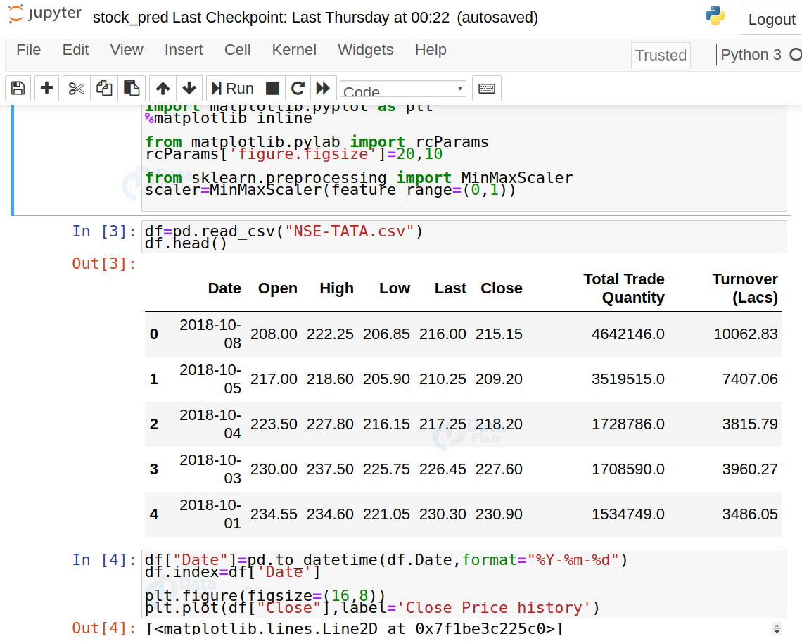
4.3 Implementation Results:
Fig 4.2. Read Stock dataset
19

Slide 27
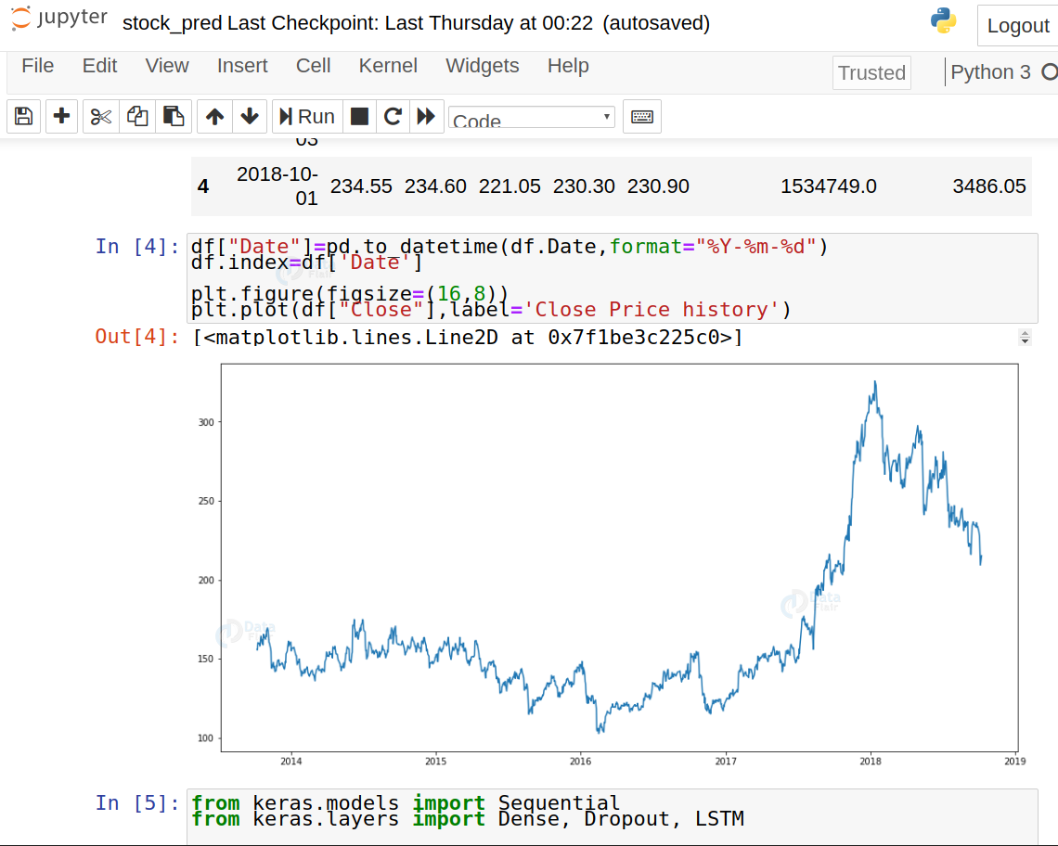
Fig 4.3. Analyze Stock Price
20

Slide 28
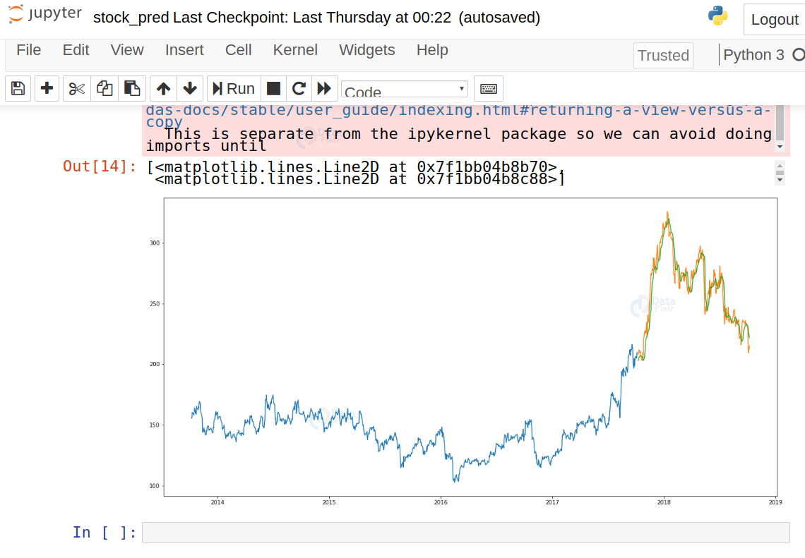
Fig 4.4. Predict Stock Cost
21

Slide 29
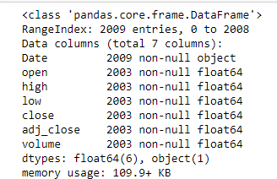
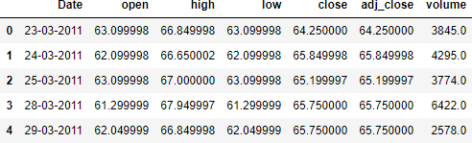
Step 1: Dataset Analysis
Fig 4.5: Stock Dataset Information
Firstly, I have performed Data analysis for stock price of companies. Fig. represent the date, open, close, high, low, adjusted close and volume of stocks details.
Step 2: Read Dataset
Fig 4.6: Read Dataset
After performing data analysis, I have read the dataset. It shows the dataset information table starting from the tail. There are 4274 data are available in each companies dataset.

Slide 30
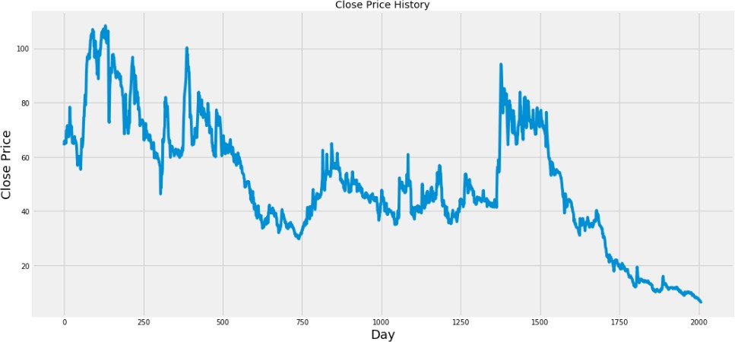
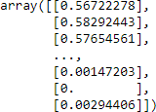
Step 3: Graph of Close Price history
Fig 4.7: Graph of Close Price history
Step 4: Preprocessing
Fig 4.8: Data Scaling
After Dataset reading, I have performed preprocessing operation on the dataset. Here I apply Min-Max Scaler to preprocess the dataset. In preprocessing operation removes the noise into the data and convert data into 0 to 1 form.
Step 5: Train test Split
After performing preprocessing, I have divided the dataset into training and testing set. 80% of the data is used for the training while the remaining 20% of the data is used for testing..

Slide 31
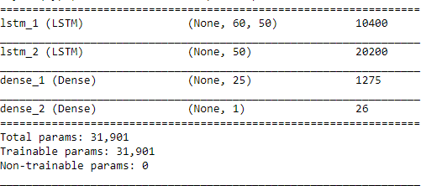
Step 6: Model fitting of Long Short Term Memory architecture[25] [26], Convolution Neural Network architecture[27] & Hybride Approach of LSTM+CNN.
Fig 4.9: LSTM Summary

Slide 32

Step 7: Apply Training
Fig 4.10: Training Process
To apply training, from the samples of Training data, 1543 samples are used for training and 460 samples are used for validation. Data is processed in a batch size of 1 and epoch is 1 for the entire training dataset.

Slide 33
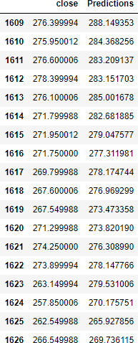
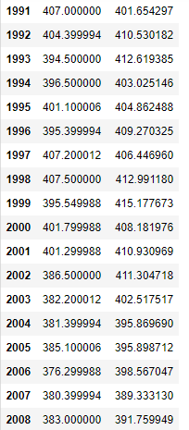
Step 8: Predicted Result
Fig 4.11: Predicted Close Price
Sector | Stock Name | RMSE
 |  | LSTM
Banking | ICICI Bank | 22.5409
Pharma | Sun Pharma | 19.4190
Petroleum | GSFC | 5.4396
Software | RS Software | 4.7152
Textiles | Vardmn Ploy | 1.3909
Table 4.12 Accuracy

Slide 34
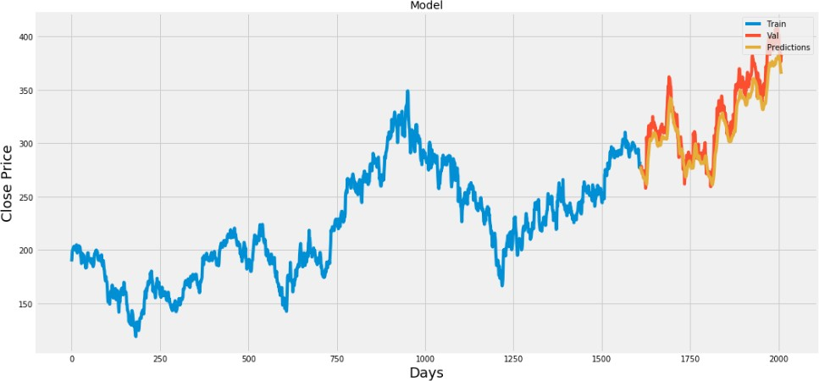
Step 9: Predicted Graph
Fig 4.13: Plot for Real vs Predicted value for ICICI Bank using LSTM

Slide 35
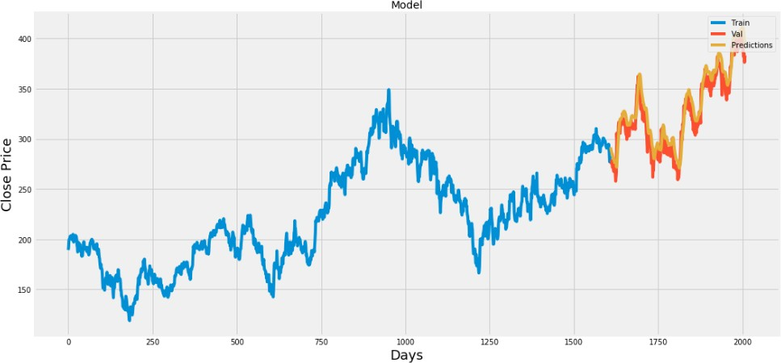
Fig 4.14: Plot for Real vs Predicted value for SUNPHARMA using LSTM

Slide 36
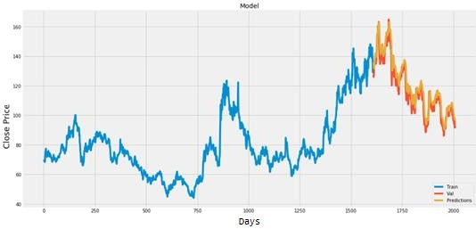
Fig 4.15: Plot for Real vs Predicted value for GSFC using LSTM

Slide 37
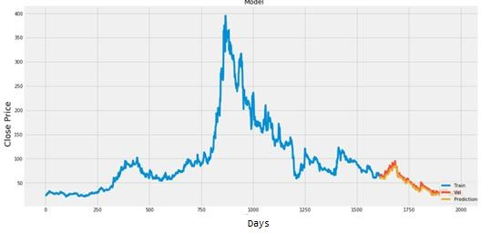
Fig 4.16: Plot for Real vs Predicted value for RSSOFTWARE using LSTM

Slide 38
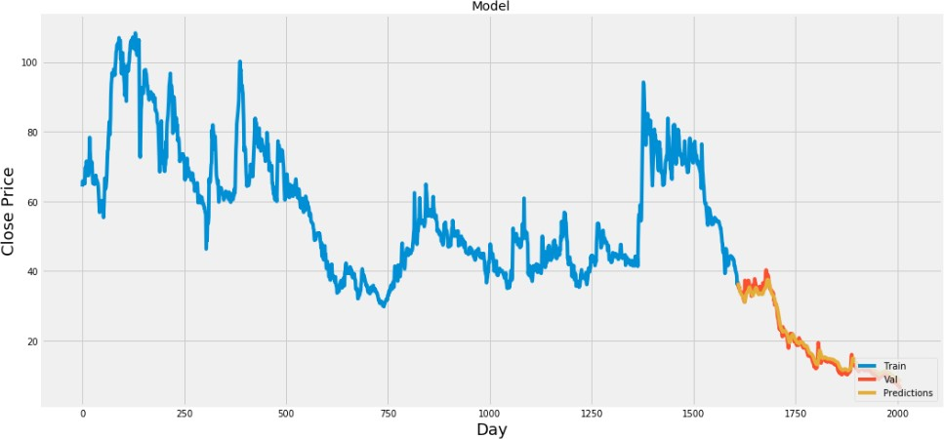
Fig 4.17: Plot for Real vs Predicted value for VARDMANPOLY using LSTM

Slide 39
Chapter 5. Conclusion and Future Enhancements
Conclusion
By measuring the accuracy of the different algorithms, we
found that the most suitable algorithm for predicting the
market price of a stock based on various data points from the historical data is the random forest algorithm. The
algorithm will be a great asset for brokers and investors for
investing money in the stock market since it is trained on a
huge collection of historical data and has been chosen after
being tested on a sample data. The project demonstrates the
machine learning model to predict the stock value with more
accuracy as compared to previously implemented machine
learning models.
Future Enhancements
Future scope of this project will involve adding more
parameters and factors like the financial ratios, multiple
instances, etc. The more the parameters are taken into
account more will be the accuracy. The algorithms can also
be applied for analyzing the contents of public comments
and thus determine patterns/relationships between the
customer and the corporate employee. The use of traditional
algorithms and data mining techniques can also help predict
the corporation‟s performance structure as a whole.

Slide 40
Bibliography and References
“Stock price prediction using LSTM, RNN and CNN-sliding window model - IEEE Conference Publication.” https://ieeexplore.ieee.org/document/8126078 (accessed Dec. 27, 2019).
J. Jagwani, M. Gupta, H. Sachdeva, and A. Singhal, “Stock Price Forecasting Using Data from Yahoo Finance and Analysing Seasonal and Nonseasonal Trend,” in 2018 Second International Conference on Intelligent Computing and Control Systems (ICICCS),
Madurai, India, Jun. 2018, pp. 462–467, doi: 10.1109/ICCONS.2018.8663035.
[3] I. Parmar et al., “Stock Dec. 2018, pp. 574–576, doi: 10.1109/ICSCCC.2018.8703332.
Y. Lei, K. Zhou, and Y. Liu, “Multi-Category Events Driven Stock Price Trends Prediction,” in 2018 5th IEEE International Conference on Cloud Computing and
Intelligence Systems (CCIS), Nanjing, China, Nov. 2018, pp. 497–501, doi: 10.1109/CCIS.2018.8691392.
B. Jeevan, E. Naresh, B. P. V. kumar, and P. Kambli, “Share Price Prediction using Machine Learning Technique,” in 2018 3rd International Conference on Circuits,
Control, Communication and Computing (I4C), Bangalore, India, Oct. 2018, pp. 1–4, doi: 10.1109/CIMCA.2018.8739647.
M. Usmani, S. H. Adil, K. Raza, and S. S. A. Ali, “Stock market prediction using machine learning techniques,” in 2016 3rd International Conference on computer and Information
Sciences (ICCOINS), 2016, pp. 322–327.
J. Du, Q. Liu, K. Chen, and J. Wang, “Forecasting stock prices in two ways based on LSTM neural network,” in 2019 IEEE 3rd Information Technology, Networking, Electronic and Automation Control Conference (ITNEC), Mar. 2019, pp. 1083–1086, doi:
10.1109/ITNEC.2019.8729026.
S. E. Gao, B. S. Lin, and C.-M. Wang, “Share Price Trend Prediction Using CRNN with LSTM Structure,” in 2018 International Symposium on Computer, Consumer and Control (IS3C), Dec. 2018, pp. 10–13, doi: 10.1109/IS3C.2018.00012.
T. Gao, Y. Chai, and Y. Liu, “Applying long short term momory neural networks for
predicting stock closing price,” in 2017 8th IEEE International Conference on Software Engineering and Service Science (ICSESS), Beijing, China, Nov. 2017, pp. 575–578, doi: 10.1109/ICSESS.2017.8342981.

Slide 41
R. Y. Nivetha and C. Dhaya, “Developing a Prediction Model for Stock Analysis,” in 2017 International Conference on Technical Advancements in Computers and Communications (ICTACC), Melmaurvathur, India, Apr. 2017, pp. 1–3, doi: 10.1109/ICTACC.2017.11.
Z. Yeze and W. Yiying, “Stock Price Prediction Based on Information Entropy and Artificial Neural Network,” in 2019 5th International Conference on Information
Management (ICIM), Cambridge, United Kingdom, Mar. 2019, pp. 248–251, doi: 10.1109/INFOMAN.2019.8714662.
“Basic LSTM Unit Transfer Function Diagram from [10] | Download Scientific Diagram.” https://www.researchgate.net/figure/Basic-LSTM-Unit-Transfer-Function-
Diagram-from-10_fig8_308804546 (accessed Jun. 03, 2020).
“Fig. 1: An example of CNN architecture.,” ResearchGate. https://www.researchgate.net/figure/An-example-of-CNN-architecture_fig1_320748406 (accessed Jun. 03, 2020).
Y. Kim, “Convolutional Neural Networks for Sentence Classification,” in Proceedings of the 2014 Conference on Empirical Methods in Natural Language Processing (EMNLP), Doha, Qatar, Oct. 2014, pp. 1746–1751, doi: 10.3115/v1/D14-1181.
B. Athiwaratkun and K. Kang, “Feature Representation in Convolutional Neural
Networks,” ArXiv150702313 Cs, Jul. 2015, Accessed: Apr. 14, 2020. [Online]. Available: http://arxiv.org/abs/1507.02313.
F. A. Gers, D. Eck, and J. Schmidhuber, “Applying LSTM to Time Series Predictable through Time-Window Approaches,” in Artificial Neural Networks — ICANN 2001,
Berlin, Heidelberg, 2001, pp. 669–676, doi: 10.1007/3-540-44668-0_93.
J. Han and C. Moraga, “The Influence of the Sigmoid Function Parameters on the Speed of Backpropagation Learning,” in Proceedings of the International Workshop on Artificial Neural Networks: From Natural to Artificial Neural Computation, Berlin,
Heidelberg, Jun. 1995, pp. 195–201, Accessed: Apr. 13, 2020. [Online].
“NSE Listed 1000+ Companies’ Historical Data.” https://kaggle.com/abhishekyana/nse- listed-1384-companies-data (accessed Jul. 07, 2020).
A. Tipirisetty, “Stock Price Prediction using Deep Learning,” p. 60.
“Python Numpy Tutorial | Learn Numpy Arrays With Examples,” Edureka, Jul. 14, 2017. https://www.edureka.co/blog/python-numpy-tutorial/ (accessed Apr. 21, 2020).
“Scikit-learn Tutorial: Machine Learning in Python – Dataquest.”
https://www.dataquest.io/blog/sci-kit-learn-tutorial/ (accessed Apr. 21, 2020).

Slide 42
J. Brownlee, “Introduction to the Python Deep Learning Library TensorFlow,” Machine Learning Mastery, May 04, 2016. https://machinelearningmastery.com/introduction- python-deep-learning-library-tensorflow/ (accessed Apr. 21, 2020).
“Home - Keras Documentation.” https://keras.io/ (accessed Apr. 21, 2020).
“Project Jupyter.” https://www.jupyter.org (accessed Apr. 19, 2020).
K. Team, “Keras documentation: Search Keras https://keras.io/search.html?query=lstm (accessed Jul. 07, 2020).
K. Joshi, kartik-joshi/Stock-predection. 2020.
documentation.”
[27] K. Team, “Keras documentation: The Sequential model.” https://keras.io/guides/sequential_model/ (accessed Jul. 07, 2020).
Market Prediction Using Machine Learning,” in 2018 First International Conference on Secure Cyber Computing and Communication (ICSCCC),

Slide 43
APPENDIX A: ABBRAVIATION
Sr. No. | Abbreviation | Meaning
1 | CNN | Convolutional Neural Network
2 | LSTM | Long Short Term Memory
3 | RNN | Recurrent Neural Network
4 | MLP | Multi-Layer Perceptron
5 | CRNN | Convolutional Recurrent Neural Network
6 | ANN | Artificial Neural Network
7 | KSE | Karachi Stock Exchange
8 | SVM | Support Vector Machine
9 | MSE | Mean Square Error
10 | RMSE | Root Mean Square Error
11 | MA | Moving Average
12 | EMA | Exponential Moving Average
13 | NSE | National Stock Exchange
14 | BSE | Bombay Stock Exchange
15 | P/E ratio | Profit per Earning ratio
16 | ARIMA | Auto Regressive Integrated Moving Average
17 | FEX | Foreign Exchange
18 | SLP | Single Layer Perceptron
19 | RBF | Radial Basis Function
20 | MLR | Multiple Linear Regression
21 | MAE | Mean Absolute Error
22 | GPU | Graphics Processing Units
23 | CPU | Control Processing Units
24 | CSV | Comma Separated Values
25 | GSFC | Gujarat State Fertilizers & Chemicals Limited
26 | NASDAQ | National Association of Securities Dealers Automated Quotations

