Slide 1
UK Online Retail - Customer Cohort Analysis
Understanding Customer Behavior and Revenue Patterns

Slide 2
Agenda
Business Context
Methodology
Key Findings
Recommendations
Next Steps

Slide 3
Business Context
UK-based online retail company
Specializes in unique all-occasion gifts
Customer base includes wholesalers
Need to understand:
Customer retention patterns
Revenue generation
Customer lifetime value

Slide 4
Methodology
Data Source: Transactional data
Time Period: Dec 2010 - Dec 2011
Analysis Approach:
Cohort analysis
Customer retention tracking
Revenue pattern analysis
Customer lifetime value calculation

Slide 5
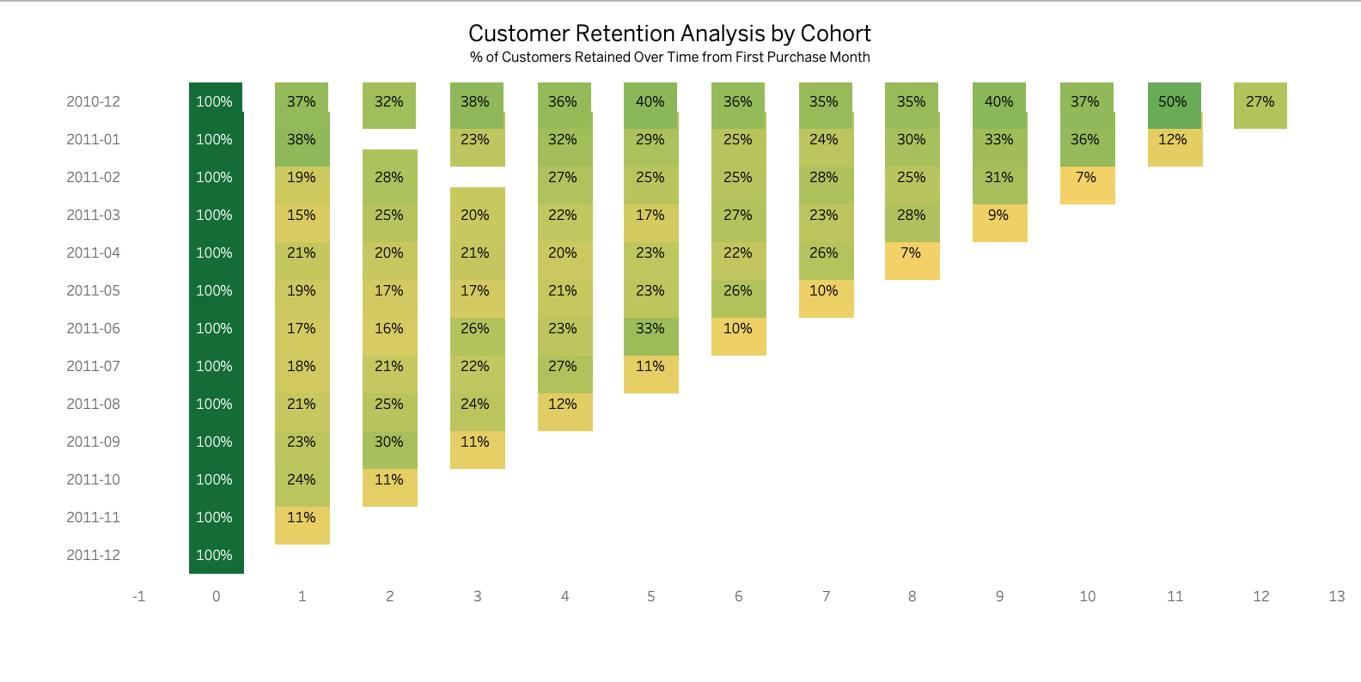
Customer Retention Analysis
Key Findings:
December 2010 cohort: Best performer (37% retention)
Significant first-month drop across cohorts
Seasonal impact on retention
Early cohorts show better long-term retention

Slide 6
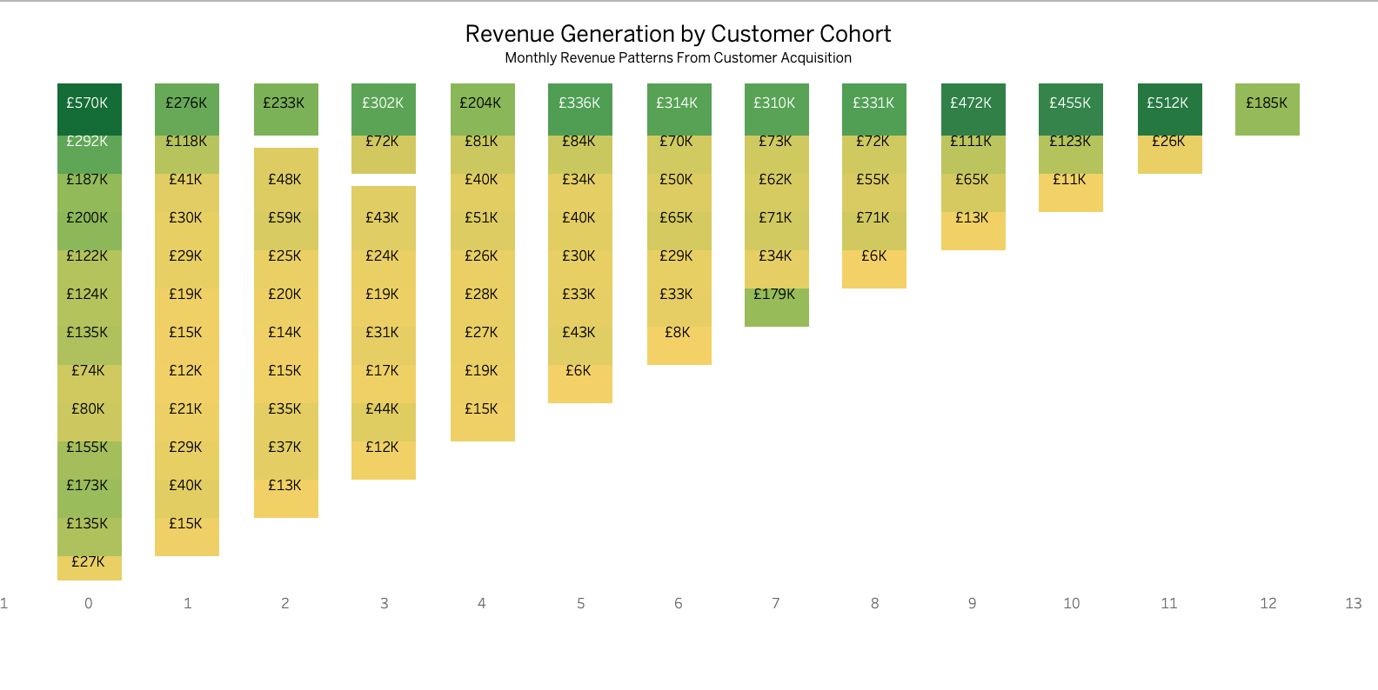
Revenue Analysis
Key Insights:
Highest initial revenue: £570K (Dec 2010)
Strong seasonal patterns
Early cohorts maintain better revenue
Clear revenue decay pattern

Slide 7
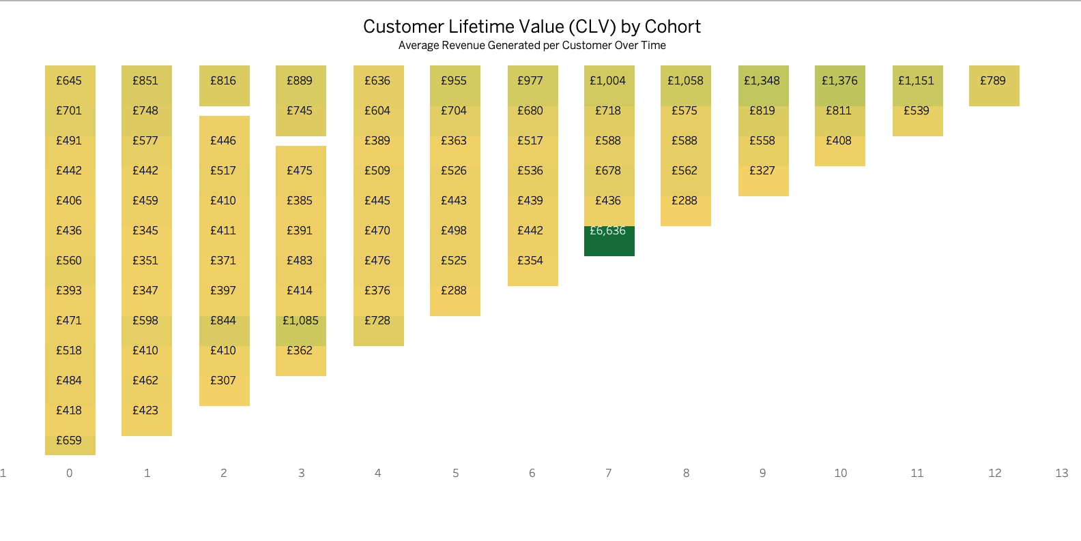
Customer Lifetime Value
Highlights:
December 2010 cohort: Highest sustained CLV
Average initial CLV: £400-£700
Seasonal impact on customer value
Early cohorts show better value progression

Slide 8
Key Findings Summary
Seasonal Impact
Winter months crucial for business
Higher initial values
Better retention rates
Customer Behavior
First-month retention critical
Early cohorts more valuable
Clear seasonal preferences
Revenue Patterns
Strong initial performance
Predictable decay patterns
Seasonal variations

Slide 9
Recommendations
Customer Acquisition
Focus on winter months
Improve summer strategies
Replicate successful cohort patterns
Retention Strategy
Enhanced onboarding
Loyalty programs
High-value customer focus
Revenue Optimization
Convert one-time buyers
Increase average order value
Strategic promotional timing

Slide 10
Implementation Roadmap
Short-term (0-3 months):
Launch enhanced onboarding
Implement customer feedback system
Develop winter campaign strategy
Medium-term (3-6 months):
Roll out loyalty program
Optimize promotional calendar
Enhance customer engagement
Long-term (6+ months):
Develop predictive models
Create personalized retention strategies
Build automated customer journey

Slide 11
Next Steps
Prioritize recommendations
Set KPI targets
Create implementation timeline
Assign responsibilities
Regular monitoring and adjustment

Slide 12
Q&A
Thank You
Questions?

