Slide 1
Employee Turnover Analysis: Insights & Recommendations
Company: Salifort Motors
Date: 2024

Slide 2
2: Business Context
Problem: High employee turnover
Goals: Predict & prevent turnover
Impact: Hiring costs, productivity

Slide 3
3: Data Overview
8 numeric variables
2 categorical variables
11,991 employee records
Key metrics tracked

Slide 4
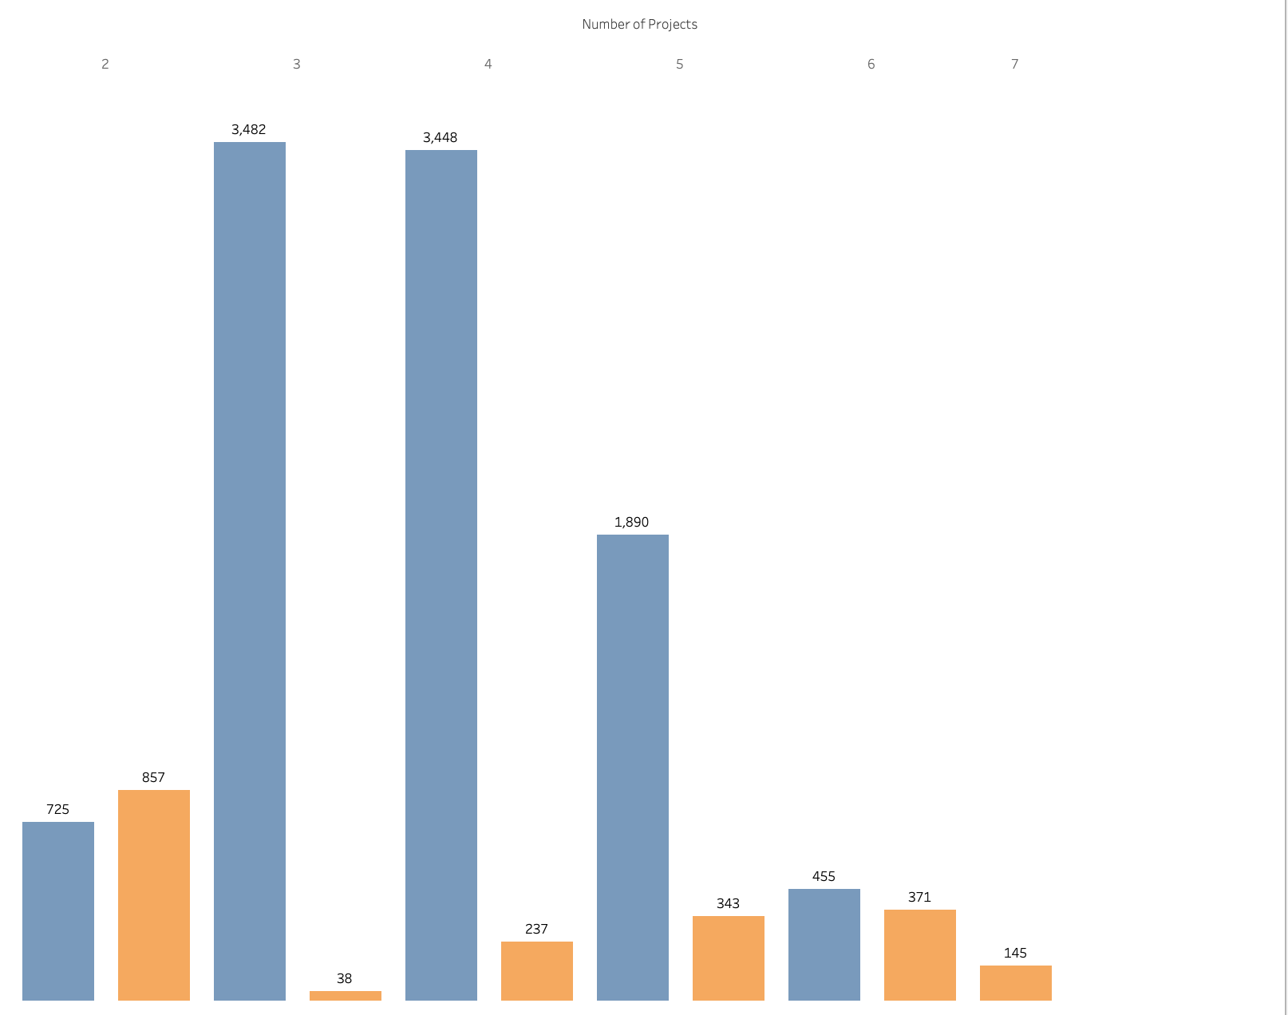
4. Workload Patterns
Project overload (7+ = 100% turnover)
Hours worked vs satisfaction
Department distribution

Slide 5
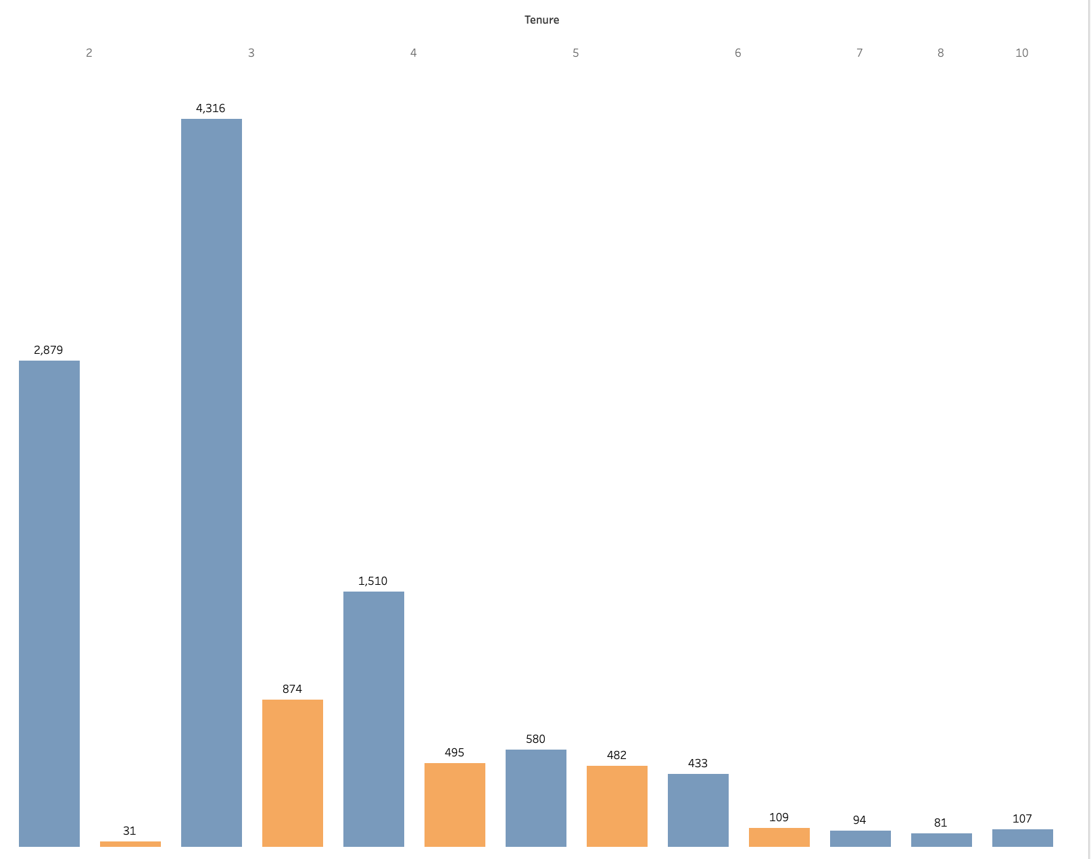
5. Satisfaction Drivers
Tenure impact
Salary correlation
Work hours effect

Slide 6
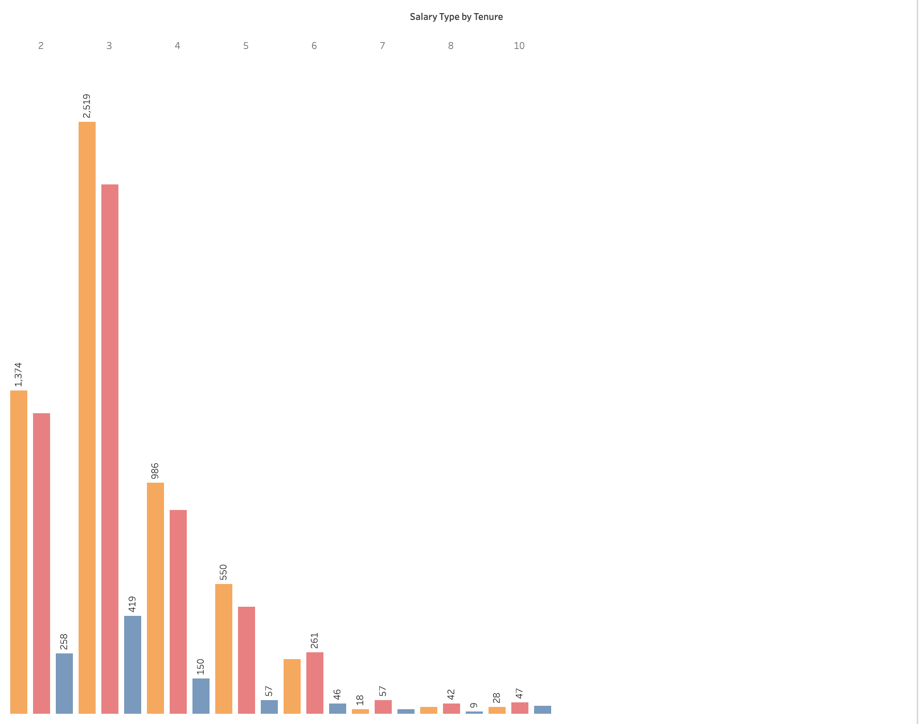
6. Performance Metrics
Evaluation patterns
Promotion rate (2%)
Hours vs performance

Slide 7
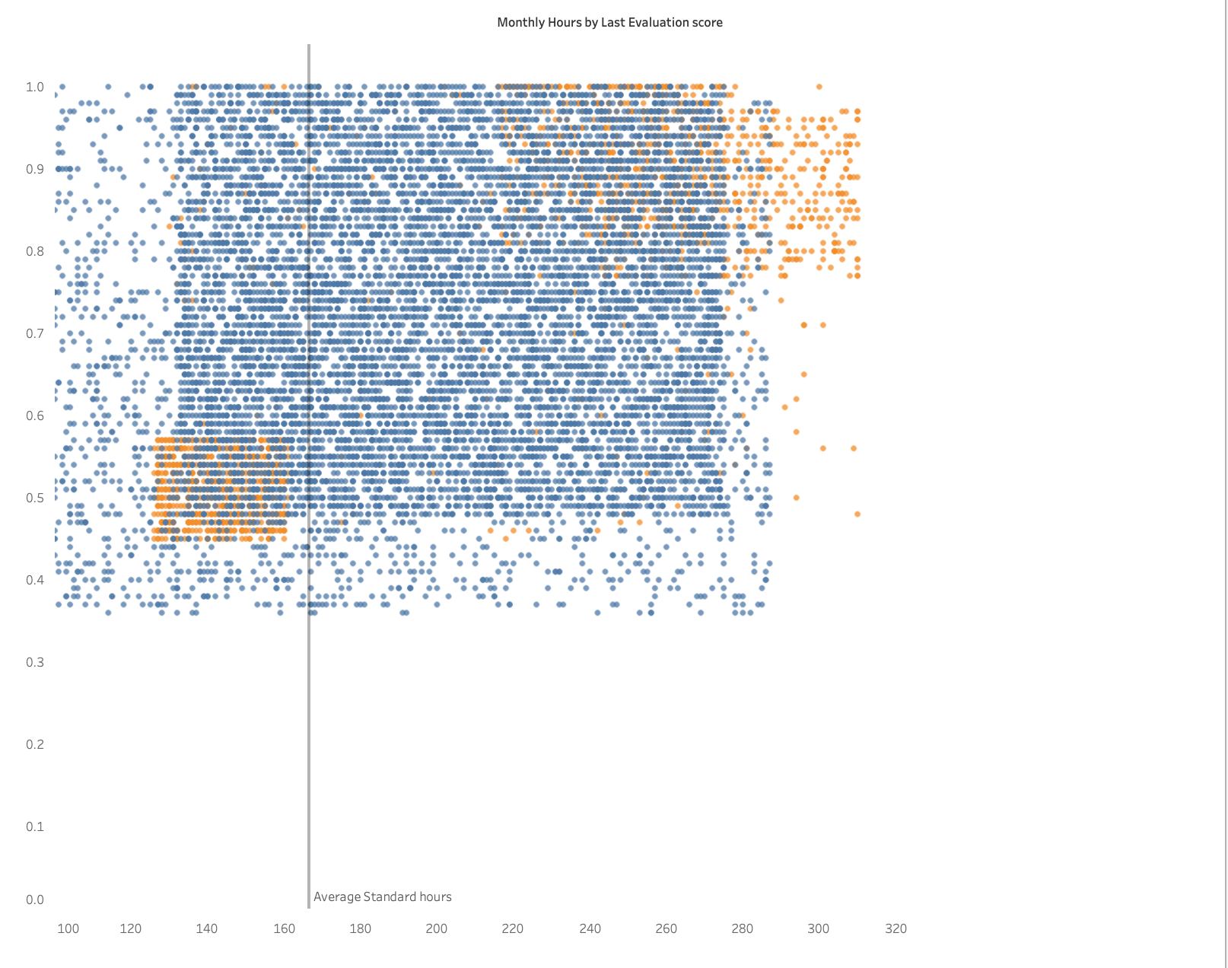
7. Critical Points
4-year tenure mark
166.67 monthly hours threshold
Project number threshold

Slide 8
8: Recommendations
Immediate Actions
Project cap implementation
Workload rebalancing
Career path development
Long-term Strategy
Promotion structure review
Work-life balance initiatives
Retention program development

