Slide 1
Inventory Optimization Through Data Analytics
A Strategic Analysis

Slide 2
Executive Summary
Business challenge: Inventory optimization
Key findings: Vendor concentration, supply patterns
Impact: $3.92M in top vendor spend

Slide 3
Methodology
Data sources: 6 key tables
Python for data cleaning
Tableau for visualization
Key metrics development

Slide 4
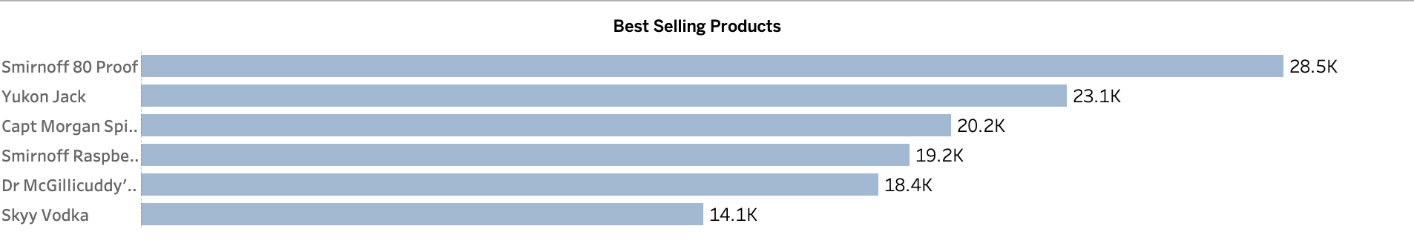
Vendor Analysis
Bar chart: Top 10 vendors
Key insight: DIAGEO NORTH AMERICA dominance
Purchase cost distribution

Slide 5
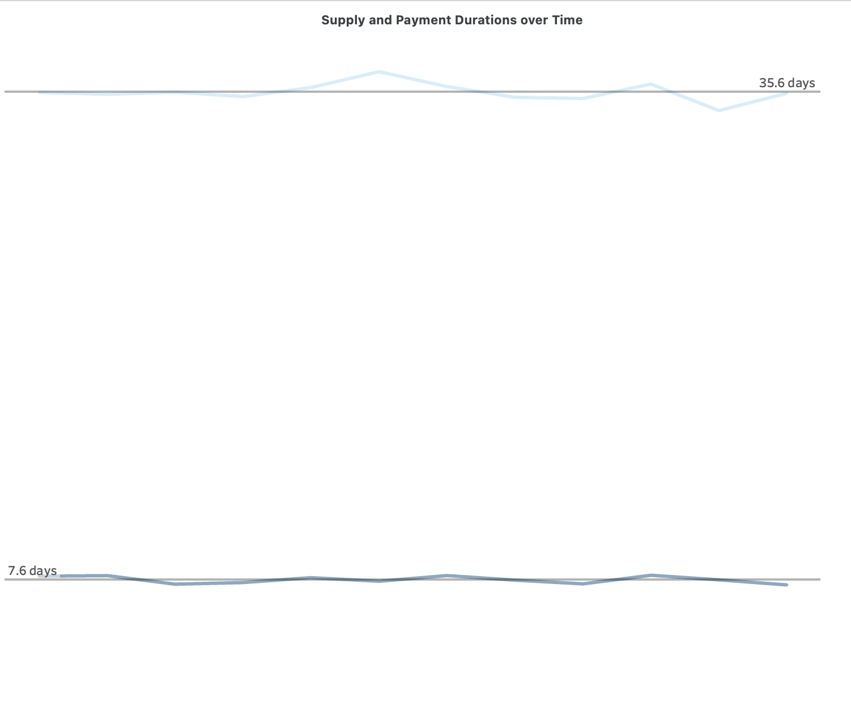
Supply Chain Metrics
Supply duration: 7.62 days average
Payment cycles: 35.66 days
Distribution patterns visualization

Slide 6
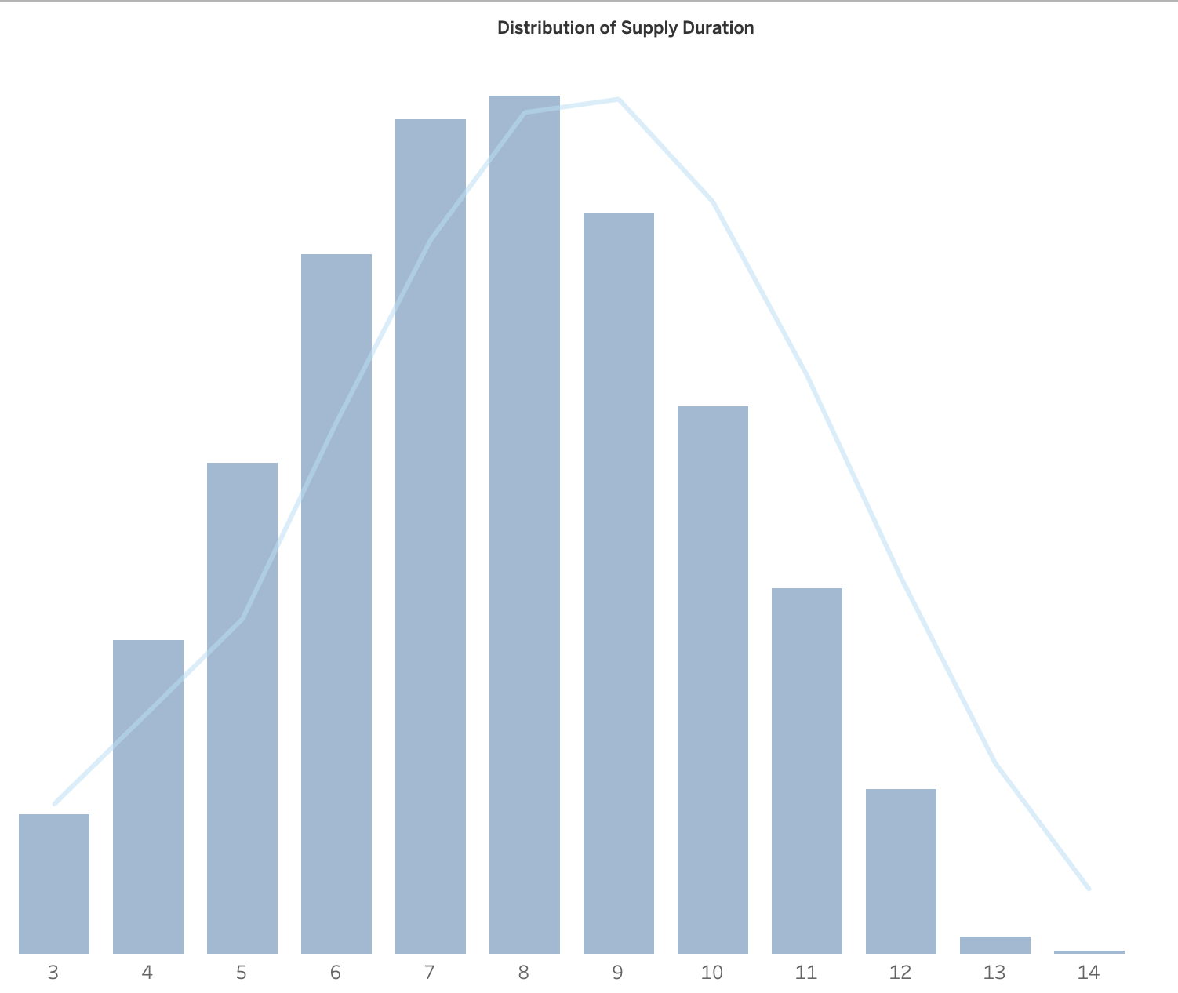
Product Performance
Best sellers analysis
Seasonal patterns
Critical stock points

Slide 7
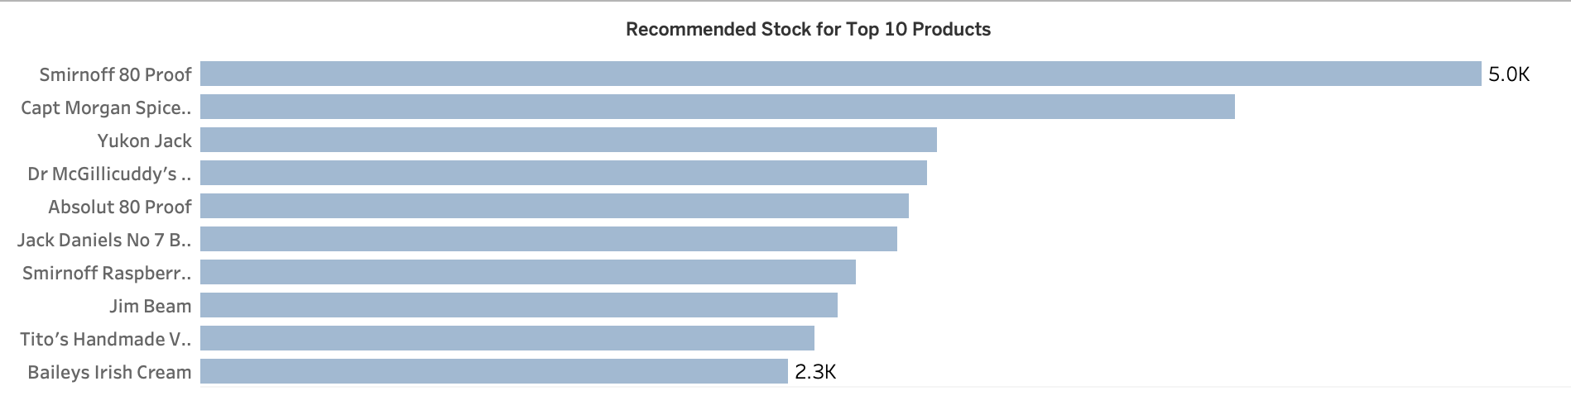
Key Findings
Vendor Concentration
Supply Chain Efficiency
Product Seasonality
Stock Recommendations

