Slide 1
Retail Customer Segmentation: RFM Analysis
A Data-Driven Approach to Customer Value Analysis
By
Pavan
Notes:
Welcome everyone. Today I'll present our retail customer segmentation analysis using the RFM methodology. This project demonstrates how we can transform raw transaction data into actionable customer insights to drive business growth.

Slide 2
Table of Content
Business Context
Methodology
Customer Distribution
Revenue Analysis
Temporal Analysis
Geographic Insights
Operational Analysis
Key Recommendations
Expected Impact

Slide 3
Business Context
Challenge:
Need for effective customer segmentation
Inefficient marketing resource allocation
Customer retention concerns
Objectives:
Develop data-driven segmentation
Identify high-value & at-risk customers
Optimize marketing strategies
Improve customer retention
Notes:
Our retail business faced several challenges in customer engagement and retention. We needed to move away from a one-size-fits-all approach to marketing and develop data-driven strategies for different customer segments. Our key objectives were to understand customer value, identify at-risk customers, and optimize our marketing resources effectively.

Slide 4
Methodology: RFM Framework
Recency: Last purchase timing
Frequency: Number of purchases
Monetary: Total customer spend
Segmentation Approach:
Champions (10-12)
Loyal Customers (7-9)
Regular Customers (6)
At Risk (4-5)
Lost Customers (3)
Notes:
We implemented the RFM analysis framework, which scores customers based on three key metrics: Recency - when was their last purchase, Frequency - how often they buy, and Monetary - how much they spend. Using these scores, we developed five distinct customer segments, ranging from Champions to Lost Customers, each requiring different engagement strategies.

Slide 5
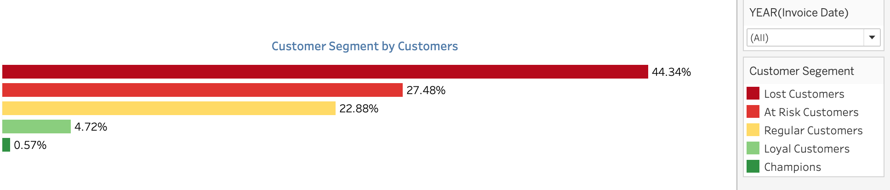
Customer Distribution
Key Findings:
Lost Customers: 44.34% of base
At Risk: 27.48%
Regular: 22.88%
Loyal: 4.72%
Champions: 0.57%
Notes:
This visualization shows our current customer distribution. A concerning 44.34% of our customers fall into the Lost Customer segment, while only 0.57% are Champions. This immediately highlights our retention challenges and the significant opportunity for customer reactivation and upgrade strategies.

Slide 6
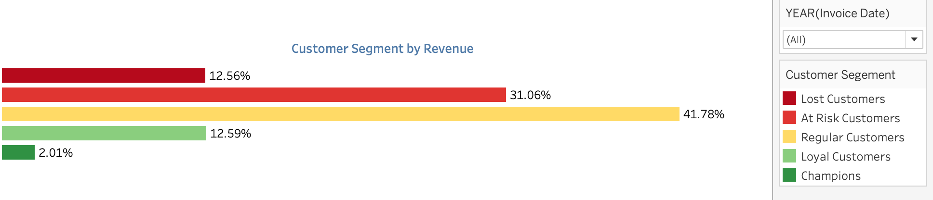
Revenue Analysis
Value Paradox:
Regular Customers (22.88%) → 41.3% revenue
Lost Customers (44.34%) → only 13.77% revenue
Champions (0.57%) → consistent high value
Notes:
Here's where it gets interesting. Despite being only 22.88% of our customer base, Regular Customers generate 41.3% of our revenue. This reveals a crucial opportunity - our most valuable customers aren't necessarily in our top segments. Champions, though less than 1% of customers, show consistently high-value transactions.

Slide 7
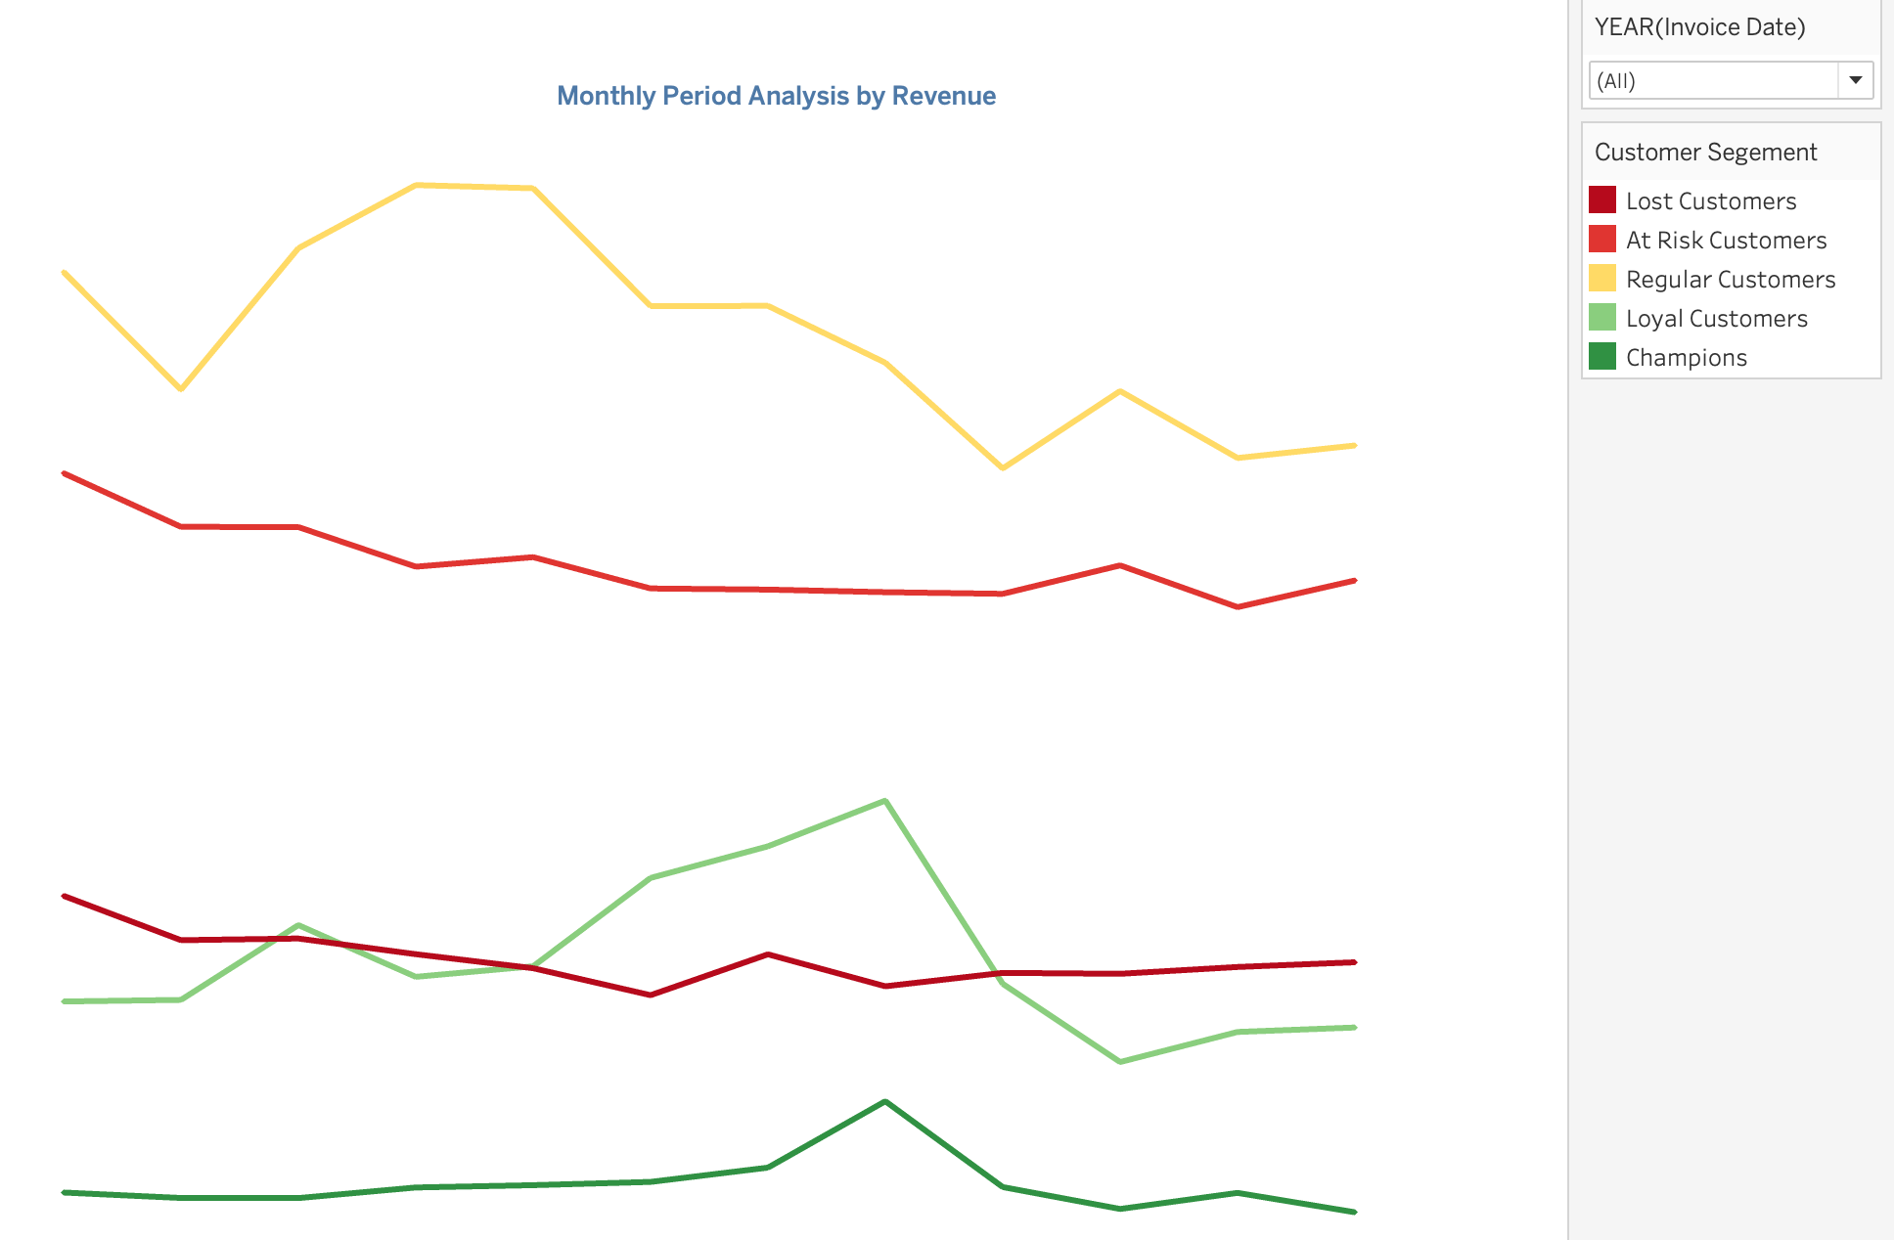
Temporal Analysis
Critical Period (June-August):
Champions tripled to 132
Loyal Customers doubled to 580
Regular Customers peaked at 1,467
Notes:
Looking at our monthly trends, we identified a critical period from June to August. During this time, we saw remarkable growth across all segments - Champions tripled, Loyal Customers doubled. Understanding what drove this success is key to replicating it in other periods.

Slide 8
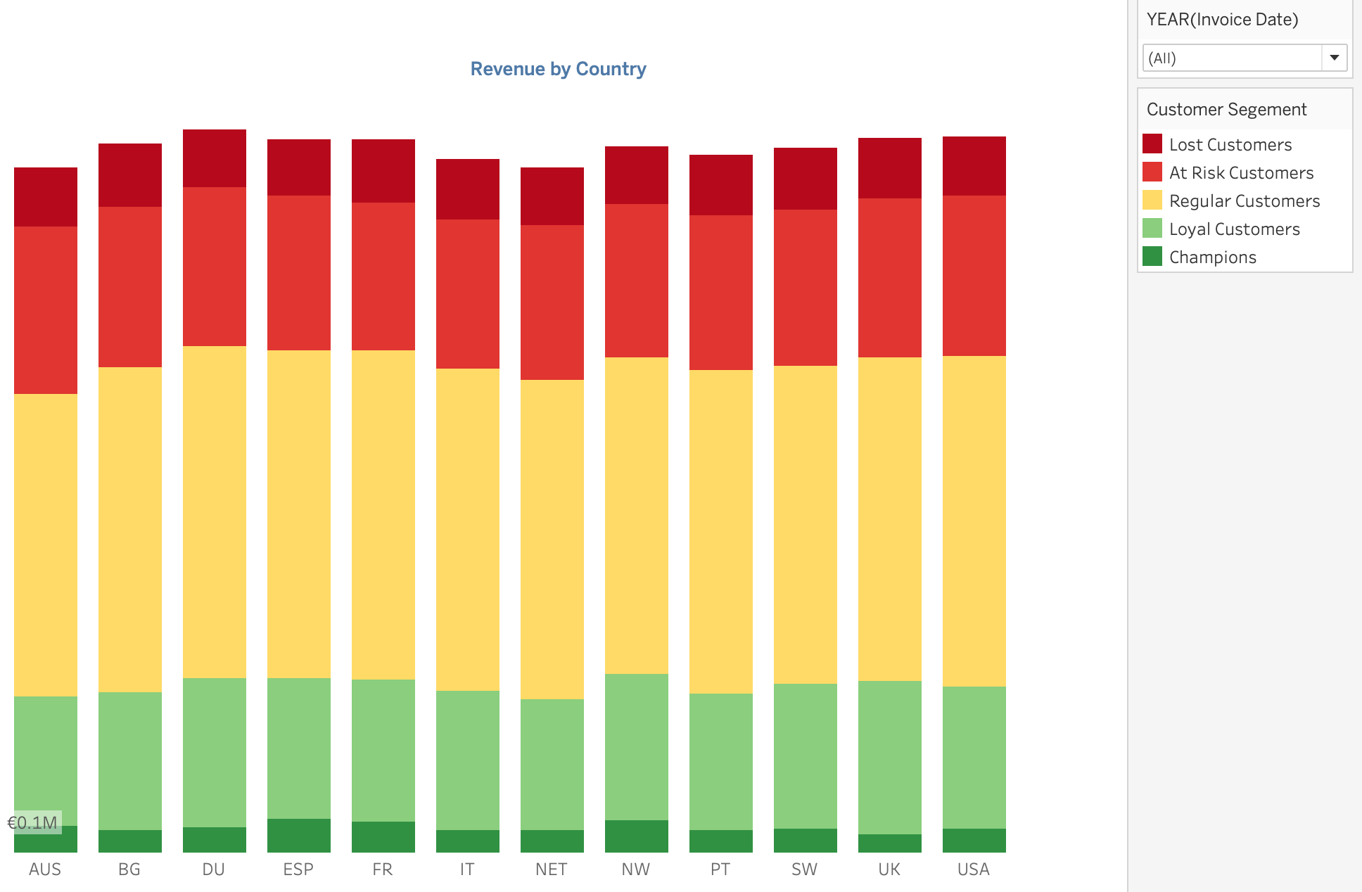
Geographic Insights
Key Markets:
France, Norway, Spain: 2x Champion performance
Consistent Regular Customer revenue (2.5M)
Uniform market penetration
Notes:
Our geographic analysis revealed some fascinating patterns. While most markets show consistent performance, France, Norway, and Spain stand out with double the Champion segment revenue. This suggests there might be best practices in these markets that we could implement elsewhere.

Slide 9
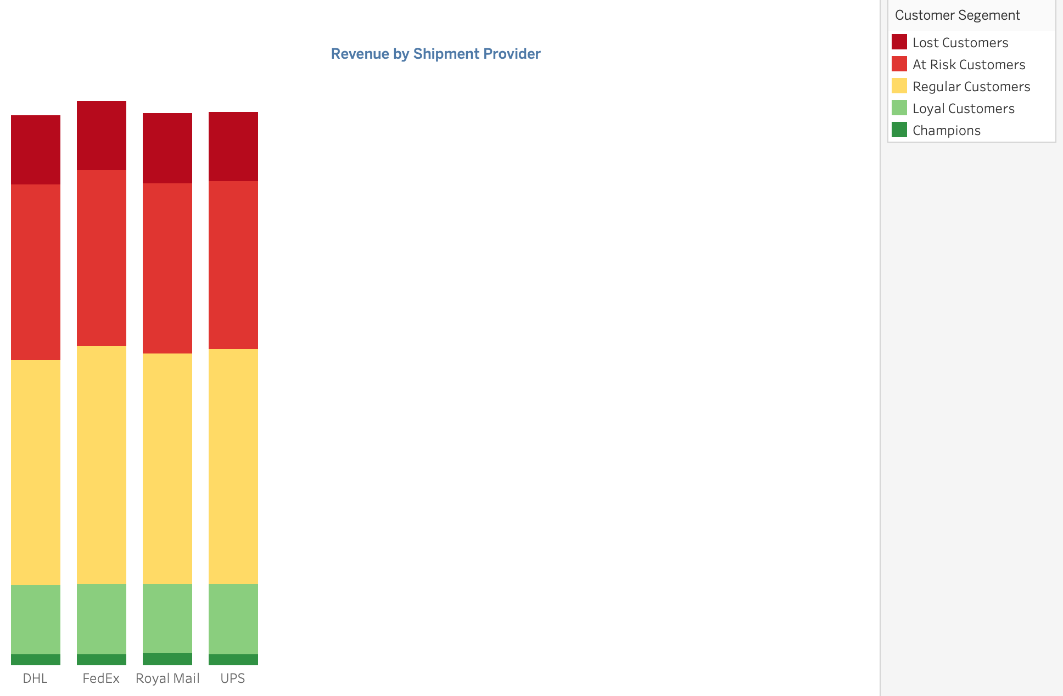
Operational Analysis
Findings:
FedEx dominates Regular segment
Uniform payment method distribution
Opportunity for operational optimization
Notes:
On the operational side, we found that FedEx is the preferred carrier for our Regular Customers, who are our highest revenue generators. Payment methods show uniform distribution, suggesting our customers value payment flexibility. This presents opportunities for operational optimization and cost reduction.

Slide 10
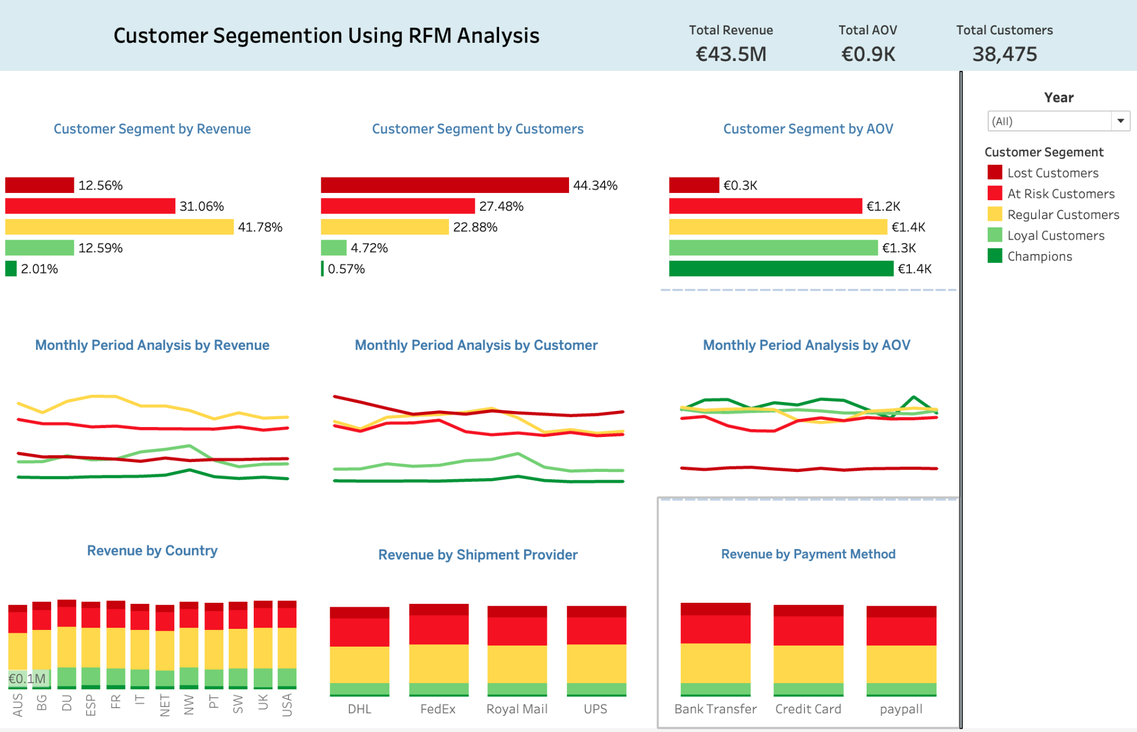
Key Recommendations
Short-term (0-3 months):
- Q4 decline mitigation
- Regular Customer retention program
- Shipping cost optimization
Medium-term (3-6 months):
- Segment upgrade pathways
- Geographic expansion strategy
- Seasonal acquisition planning
Long-term (6-12 months):
- Customer base rebalancing
- Market expansion
- Seasonal optimization
Notes:
Based on our analysis, we've developed a three-tiered recommendation strategy. In the short term, we need to focus on Q4 performance improvement and Regular Customer retention. Medium-term, we'll develop segment upgrade pathways and geographic expansion. Long-term focus will be on rebalancing our customer base and optimizing seasonal patterns.

Slide 11
Expected Impact
Targets:
15% reduction in Lost Customers
10% increase in Regular to Loyal conversion
20% improvement in Q4 performance
Notes:
We've set ambitious but achievable targets: reducing our Lost Customer segment by 15%, increasing Regular to Loyal customer conversion by 10%, and improving Q4 performance by 20%. These targets directly address our main challenges while building on our identified opportunities.

Slide 12
Thank You
Notes:
Thank you for your attention. You can explore our interactive dashboard on Tableau Public for more detailed insights. I welcome any questions about our analysis or implementation approach.

