Slide 1
Apache Kafka

Slide 2
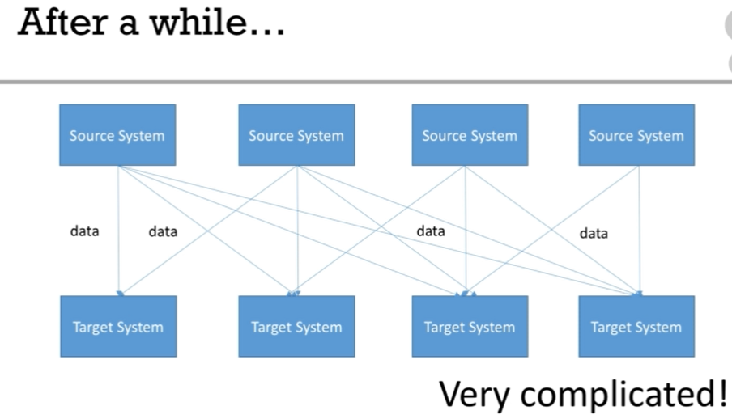
Why do we need Kafka?

Slide 3
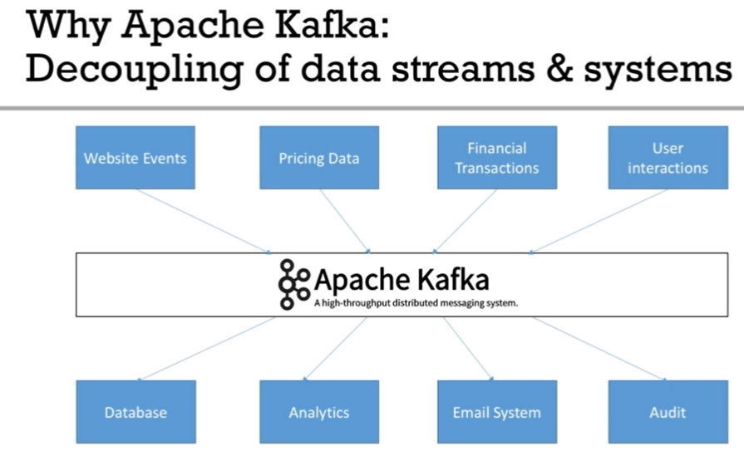
Why do we need Kafka?

Slide 4
Use cases
Messaging System
Activity Tracking
Gather metrics from many different locations
Application Logs gathering
Stream processing
De-coupling of system dependencies
Integrations with Spark, Flirk, Storm, Hadoop and many big data technologies

Slide 5
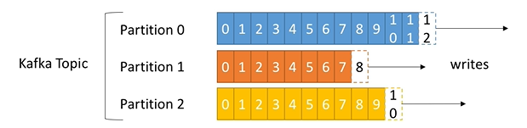
Kafka Concepts
Topic
A particular stream of data, similar to table in database.
Partition
Topics are split in partitions.
Each partition is ordered
Offset
Each message within a partition gets an incremental id, called offset
Offset only have a meaning for a specific partition
Order of messages is guaranteed only within a partition (not across partitions)
Data is assigned randomly to a partition unless a key is provided
Data is kept only for a limited time (default is one week).
Once the data is written to partition, it can’t be changed (immutability).
Data is assigned randomly to a partition unless a key is provided

Slide 6
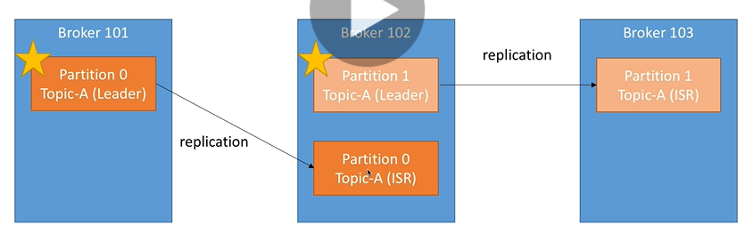
Kafka Concepts (continues…)
Brokers
Brokers are nothing but nodes which holds Kafka Topics
A Kafka cluster is composed of multiple brokers
Each broker is identified with its ID (integer).
Each broker contains certain topic partitions.
After connecting to any broker, you will be connected to the entire cluster
Topic Replication
Topic should have a replication factor > 1 (usually between 2 and 3).
Replication factor of 2 means you have 2 copied of each topic
Leader for a partition:
At any time only ONE broker can be a leader for a given partition.
Only that leader can receive and serve data for a partition.
The other brokers will synchronize the data.
Therefore each partitions has one leader and multiple ISR (in-sync replica).
Leader and ISR are determined by Zookeeper

Slide 7
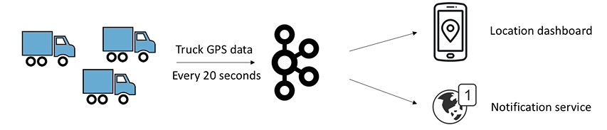
Example
Say you have a fleet of trucks, each truck reports its GPS positions to Kafka.
You can have a topic trucks_gps that contains the position of all trucks.
Each truck will send a message to Kafka every 20 seconds; each message will contain the truck ID and the truck position (latitude and longitude).

Slide 8
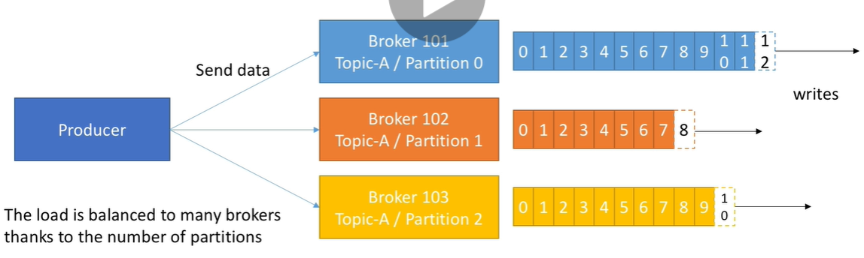
Producer and Message Keys
Producers write data to topics
Producers automatically know to which broker and partition to write to, we don’t have to specify that
Producers can choose to receive acknowledgment of data writes:
acks=0: Producer won’t wait for acknowledgment (possible data loss)
acks=1; Producer will wait for leader acknowledgment (limited data loss)
acks=all: Leader + replicas acknowledgment (no data loss)
acks=all must be used in conjunction with min.insync.replicas
min.insync.replicas=2 implies that at least 2 brokers that are ISR (including leader) must respond that they have the data

Slide 9
Producer: Message Keys (continues…)
Producers can choose to send a key with the message (string, number, etc..)
If key=null, data is sent round robin (broker 1 then 2 then 3 …)
If a key is sent, then all messages for that key will always go to the same partition.
A key is basically sent if you need message ordering for a specific field (ex: truck_id).
Mechanism of key to partition is called key hashing, which depends on the number of partitions.

Slide 10
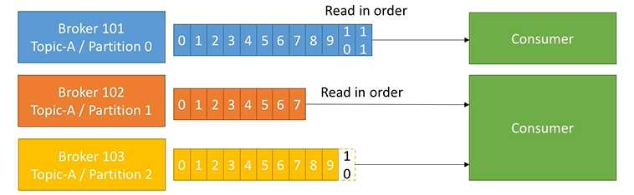
Consumer
Consumers read data from a topic (identified by name).
Consumers know which broker to read from
Data is read in order within each partition

Slide 11
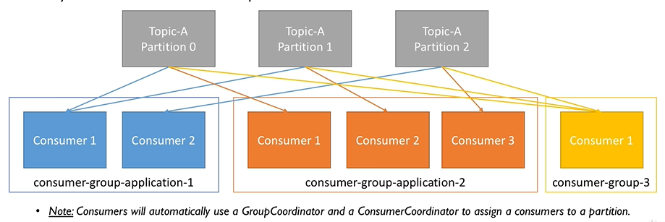
Consumer Groups
Consumers read data in consumer groups.
Each consumer within a group reads from exclusive partitions.
If you have more consumers than partitions, some consumers will be inactive.

Slide 12
Consumer Offsets and Delivery Semantics
Kafka stores the offsets at which a consumer group has been reading.
The offsets committed live in a Kafka topic named __consumer_offsets.
When a consumer in a group has processed data received from Kafka, it should be committing the offsets. This is done automatically by Kafka.
Why do we need this? => If a consumer dies, it will be able to read back from where it left off thanks to the committed consumer offsets!
Delivery Semantics
Consumers choose when to commit offsets. There are 3 delivery semantics:
At most once:
offsets are committed as soon as the message is received
If the processing goes wrong, the message will be lost (it won’t be read again).
At least once:
offsets are committed after the message is processed
If the processing goes wrong, the message will be read again.
This can result in duplicate processing of messages. Make sure your processing is idempotent
Exactly once:
Can be achieved for Kafka => kafka workflows using Kafka Streams API
For Kafka => External System workflows, use an idempotent consumer

Slide 13
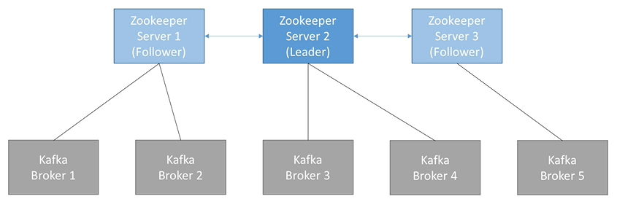
Zookeeper
Zookeeper manages brokers
Zookeeper helps in performing leader election for partitions.
Zookeeper sends notifications to Kafka in case of changes (e.g. new topic, broker dies, broker comes up, delete topics, etc….)
Kafka can’t work without Zookeeper.

Slide 14
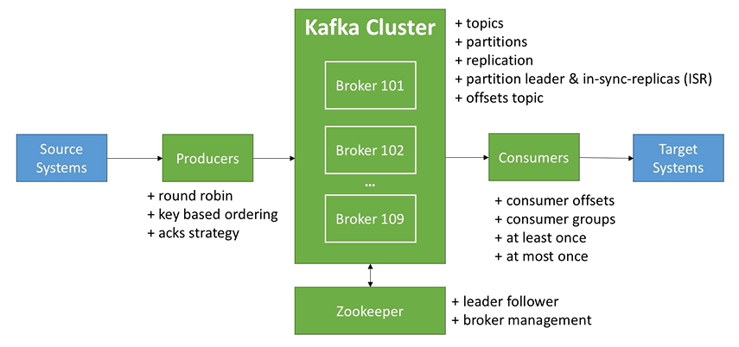
Kafka Cluster

Slide 15
Download and Setup Kafka on Linux, Start Zookeeper and Kafka
Download and Setup Java 8 JDK: sudo apt install openjdk-8-jdk
Download & Extract the Kafka binaries from https://kafka.apache.org/downloads
Try Kafka commands using bin/kafka-topics.sh (for example)
Edit PATH to include Kafka (in ~/.bashrc for example) PATH="$PATH:/your/path/to/your/kafka/bin"
Edit Zookeeper & Kafka configs using a text editor
zookeeper.properties: dataDir=/your/path/to/data/zookeeper
server.properties: log.dirs=/your/path/to/data/kafka
Start Zookeeper in one terminal window: zookeeper-server-start.sh config/zookeeper.properties
Start Kafka in another terminal window: kafka-server-start.sh config/server.properties

Slide 16
Download and Setup Kafka on Windows, Start Zookeeper and Kafka
Download and Setup Java 8 JDK
Download the Kafka binaries from https://kafka.apache.org/downloads
Extract Kafka at the root of C:\
Setup Kafka bins in the Environment variables section by editing Path
Try Kafka commands using kafka-topics.bat
Edit Zookeeper & Kafka configs using NotePad++
zookeeper.properties: dataDir=C:/kafka_2.12-2.0.0/data/zookeeper (yes the slashes are inversed)
server.properties: log.dirs=C:/kafka_2.12-2.0.0/data/kafka (yes the slashes are inversed)
Start Zookeeper in one command line: zookeeper-server-start.bat config\zookeeper.properties
Start Kafka in another command line: kafka-server-start.bat config\server.properties

Slide 17
Kafka Topic CLI commands
Create topic
kafka-topics.sh --zookeeper 127.0.0.1:2181 --topic first_topic --create --partitions 3 --replication-factor 1
List topics
kafka-topics.sh --zookeeper 127.0.0.1:2181 –list
Describe topic
kafka-topics.sh --zookeeper 127.0.0.1:2181 --topic first_topic –describe
Delete topic
kafka-topics.sh --zookeeper 127.0.0.1:2181 --topic second_topic –delete

Slide 18
Kafka Console Producer CLI
Produce for topic
kafka-console-producer.sh --broker-list 127.0.0.1:9092 --topic first_topic
kafka-console-producer.sh --broker-list 127.0.0.1:9092 --topic first_topic --producer-property acks=all

Slide 19
Kafka Console Consumer CLI
kafka-console-consumer.sh --bootstrap-server 127.0.0.1:9092 --topic first_topic
kafka-console-consumer.sh --bootstrap-server 127.0.0.1:9092 --topic first_topic --from-beginning

Slide 20
Kafka Consumers in Group CLI (Very Imp)
kafka-console-consumer.sh --bootstrap-server 127.0.0.1:9092 --topic first_topic --group my-first-application
If you start three consumers using group option (in three window) and produce messages using producer, messages will get split among three consumers
If one consumer goes down, partitions will be re-assigned among running consumers
kafka-console-consumer.sh --bootstrap-server 127.0.0.1:9092 --topic first_topic --group my-second-application --from-beginning
If you run this command twice, you will not get any message second time because group is specified so offsets has been committed in Kafka. So (--from-beginning) is of no use from second time.
If you kill the application and then produce some messages using producer, then again start the consumer, it will give all the messages

Slide 21
Kafka Consumer Groups CLI (continue…)
List consumer groups
kafka-consumer-groups.sh --bootstrap-server 127.0.0.1:9092 –list
Describe consumer group
kafka-consumer-groups.sh --bootstrap-server 127.0.0.1:9092 --describe --group my-second-application

Slide 22
Resetting offsets
Resetting offset to beginning for a topic
kafka-consumer-groups.sh --bootstrap-server 127.0.0.1:9092 --group my-first-application --reset-offsets --to-earliest --execute --topic first_topic
Resetting offset by number-of-offsets for a topic
kafka-consumer-groups.sh --bootstrap-server 127.0.0.1:9092 --group my-first-application --reset-offsets --shift-by -2 --execute --topic first_topic

Slide 23
Producer and Consumer with keys CLI
Producer with keys
kafka-console-producer --broker-list 127.0.0.1:9092 --topic first_topic --property parse.key=true --property key.separator=,
> key,value
> another key,another value
Consumer with keys
kafka-console-consumer --bootstrap-server 127.0.0.1:9092 --topic first_topic --from-beginning --property print.key=true --property key.separator=,

Slide 24
Kafka Java Programming
Kafka documentation: https://kafka.apache.org/documentation/
Configure producer: https://kafka.apache.org/documentation/#producerconfigs
Configure consumers: https://kafka.apache.org/documentation/#consumerconfigs

Slide 25
Producer retries, timeouts, warning
retries
default to Integer.MAX_INT (2147483647) for Kafka >= 2.1
retry.backoff.ms (default 100ms)
Every 100 ms Kafka producer retry a send to Kafka
delivery.timeout.ms
This means for 2-minute, producer will re-try and re-try to resend the messages to Kafka. After 2 minutes you will get timeout, and you have to handle error message in producer callback.
max.in.flight.requests.per.connection
This controls how many producer requests can be made in parallel to the broker

Slide 26
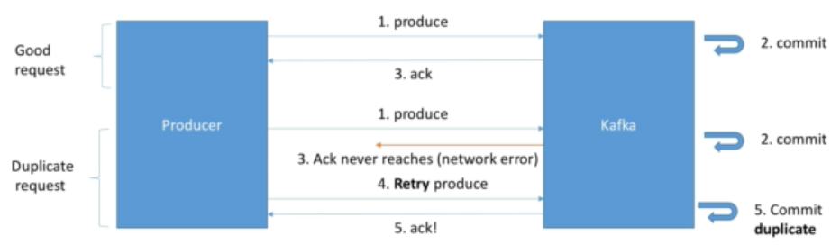
Idempotent Producer
The Producer can introduce duplicate messages in Kafka due to network errors.

Slide 27
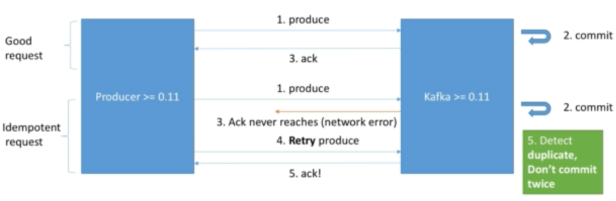
Idempotent Producer (continues )
When producer retries, it send produce request id, kafka broker detect duplicate request id. Kafka is smart enough to not process same request id again and send ack message to producer.
Idempotent producers are great way to guarantee a stable and safe pipeline!

Slide 28
Indempotent Producer (continues)
Kafka < 0.11
acks=all (Producer level)
min.insync.replicas=2 (broker/topic level)
Ensure two brokers in ISR at least have the data after an ack
retries=MAX_INT (producer level)
Ensures transient errors are retried indefinitely
max.in.flight.requests.per.connections=1 (producer level)
Ensures only one request is tried at any time, preventing message re-ordering in case of retries
Kafka >= 0.11
enable.idempotence=true (producer level) + min.insync.replicas=2 (broker/topic level)
Implies acks=all,retries=MAX_INT,max.in.flight.requests.per.connection=1 if Kafka 0.11 or 5 if Kafka >=1.0

Slide 29
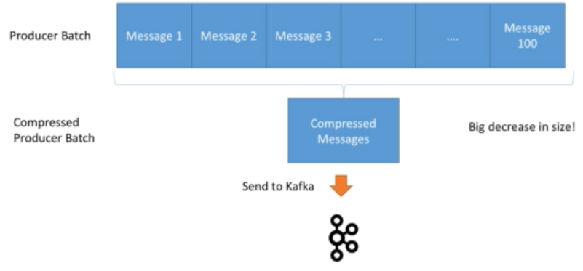
Producer Compression
Compression is enabled at the Producer level and does not require any configuration change in the Brokers or in the Consumers.
compression.type can be none (default), gzip, lz4, snappy
Overall: Consider testing snappy or lz4 for optimal speed/compression ratio
Compression is more effective the bigger the batch of message being sent to Kafka!

Slide 30
Producer Batching
By default, Kafka tries to send records as soon as possible
It will have up to 5 requests in flight, meaning up to 5 messages individually sent at the same time.
After that, if more messages have to be sent while others are in flight, Kafka is smart and will start batching them while they waits to send then all at on
linger.ms (default 0)
Number of milliseconds a producer is willing to wait before sending a batch out.
By introducing some lag (for example linger.ms=5), we increase the chances of message being sent together in a batch
batch.size
Maximum number of bytes that will be included in a batch. The default is 16 KB.
Increasing the batch size to something like 32KB or 64 KB can help increasing the compression, throughput and efficiency of the requests
Any message that is bigger than the batch size will not be batched
A batch is allocated per partition, so make sure that you don’t set it to number that is too high, otherwise you will run waste memory!
You can monitor the average batch size metric using Kafka Producer metrics

Slide 31
Producer default partitions and key hashing
By default, your keys are hashed using the murmur2 algorithm.
It is most likely preferred to not override the behaviour of the partitioner, but it is possible to do so (partitioner.class).
The formula is: targetPartition= Utils.abs(Utils.murmur2(record.key())) % numPartitions;
This means that same key will go to the same partitions and adding partitions to a topic will completely alter the formula.

Slide 32
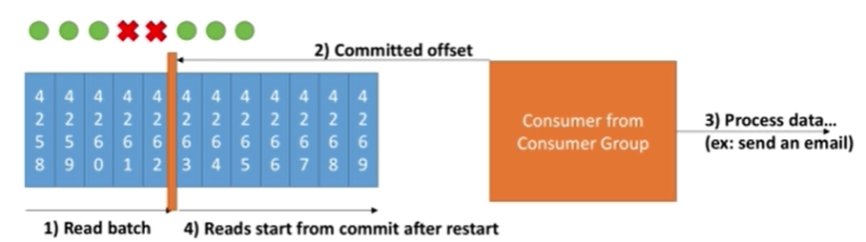
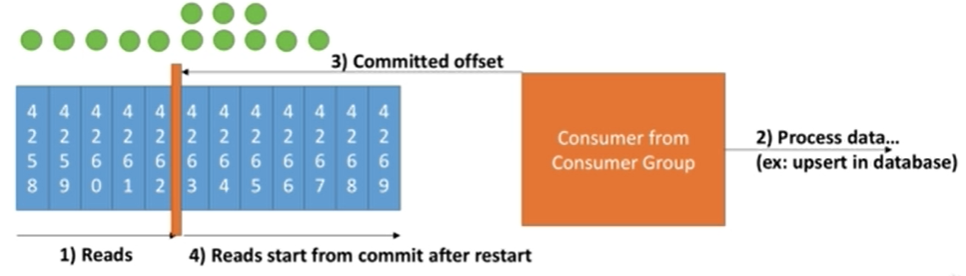
Delivery Semantics for Consumers
At most once
Default. Offsets are committed as soon as the message batch is received. If the processing goes wrong, the message will be lost (it won’t be read again).
At least once
Offsets are committed after the message is processed. If the processing goes wrong, the message will be read again. This can result in duplicate processing of messages. Make sure your processing is idempotent (i.e. processing again the messages won’t impact your systems)

Slide 33
Consumer Poll Model
fetch.min.bytes (default 1)
Controls how much data you want to pull at least on each request
max.poll.records (default 500)
Controls how many records to receive per poll request
max.partitions.fetch.bytes (default 1MB)
Maximum data returned by the broker per partition
fetch.max.bytes (default 50 MB)
Maximum data returned for each fetch request (covers multiple partitions)

Slide 34
Consumer offset commits strategy
enable.auto.commit=true and synchronous processing of batches
With auto commit, offsets will be committed automatically for you at regular interval (auto.commit.interval.ms=5000 by default) every-time you call .poll()
enable.auto.commit=false and manually commit of offsets
You control when you commit offsets and what’s the condition for committing them.
Example: accumulating records into a buffer and then flushing the buffer to a database + committing offsets then

Slide 35
Kafka offset reset behaviour
If Kafka has retention of 7 days, and your consumer is down for more than 7 days, the offsets are “invalid”.
This can be controlled by the broker setting offset.retention.minutes
The behaviour for the consumer is to then use:
auto.offset.reset=latest => Will read from the end of the log
auto.offset.reset=earliest => Will read from the start of the log
auto.offset.reset=none => Will throw exception if no offset is found
To replay data for a consumer group:
Take all the consumers from a specific group down
Use ‘kafka-consumer-groups’ command to set offset to what you want
Restart consumers

Slide 36
Consumer internal threads
Controlling consumer liveliness
Consumers in a group talk to a Consumer Groups Coordinator
To detect consumers that are “down”, there is a “heartbeat” and a “poll” mechanism
Consumer heartbeat thread
session.timeout.ms (default 10 seconds)
Heartbeats are sent periodically to the broker. If no heartbeat is sent during that period, the consumer is considered dead
heartbeat.interval.ms (default 3 seconds)
How often to send heartbeats
Consumer Poll Thread
max.poll.interval.ms (default 5 minutes)
Maximum amount of time between 2 .poll() calls before declaring the consumer dead

Slide 37
Kafka Topics Naming Convention
https://riccomini.name/how-paint-bike-shed-kafka-topic-naming-conventions

Slide 38
Kafka Monitoring and Operations
Kafka Monitoring and Operations: https://kafka.apache.org/documentation/#monitoring
Confluent documentation: https://docs.confluent.io/current/kafka/monitoring.html
Datadog blog Kafka monitoring: https://www.datadoghq.com/blog/monitoring-kafka-performance-metrics/
Kafka exposes metrics through JMS.
These metrics are highly important for monitoring Kafka and ensuring the systems are behaving correctly under load.

Slide 39
Changing a topic configuration
Why should I care about topic configuration?
Brokers have defaults for all the topic configuration parameters.
These parameters impact performance and topic behavior
Some topics may need different values that the defaults like Replication factor, # of partitions, Message size, Compression level, Log cleanup policy, Min insync replicas etc
Add config to a topic
kafka-configs –zookeeper 127.0.0.1:2181 –entity-type topics –entity-name configured-topic –alter –add-config min.insync.replicas=2
Delete config of a topic
kafka-configs –zookeeper 127.0.0.1:2181 –entity-type topics –entity-name configured-topic –alter –delete-config min.insync.replicas=2

Slide 40
Starting a multi-broker Kafka cluster using binaries
Create copies of server.properties as server0.properties, server1.properties and server2.properties
Edit following properties in server1.properties: broker.id, log.dirs, listeners
Do same for server2.properties
Create directories as modified in above steps
Example
kafka-topic –zookeeper 127.0.0.1:2181 –topic third-topic –create –partitions 6 replication-factor 3
kafka-topic –zookeeper 127.0.0.1:2181 –topic third-topic –describe
kafka-console-producer –broker-list 127.0.0.1:9092,127.0.0.1:9093,127.0.0.1:9094 –topic third-topic
kafka-console-consumer –bootstrap-server 127.0.0.1:9093 –topic third-topic –from-beginning

Slide 41
Twitter Producer and Elastic Search Consumer Example
Twitter Producer
The Twitter Producer gets data from Twitter based on some keywords and put them in a Kafka topic of your choice
Twitter Java Client: https://github.com/twitter/hbc
Twitter API Credentials: https://developer.twitter.com/
ElasticSearch Consumer
The ElasticSearch Consumer gets data from your twitter topic and inserts it into ElasticSearch
ElasticSearch Java Client: https://www.elastic.co/guide/en/elasticsearch/client/java-rest/6.4/java-rest-high.html
ElasticSearch setup:
https://www.elastic.co/guide/en/elasticsearch/reference/current/setup.html
OR https://bonsai.io/

Slide 42
Kafka Connect Source/Sink
Four common use cases:
Source = > Kafka Producer API Kafka Connect Source
Kafka => Kafka Consumer, Producer API Kafka Streams
Kafka => Sinc Consumer API Kafka Connect Sink
Kafka => App Consumer API
Why Kafka Connect?
Programmers always want to import data from the same sources: DBs, SAP, MongoDb, Salesforce, Twitter etc.
Programmers always want to store data in the same sink: S3, Cassandra, MangoDB, Twitter, ElasticSearch etc.
It is tough to achieve Fault tolerant, Idempotent, Distribution, Ordering
Other programmers may already have done a very good job!

Slide 43
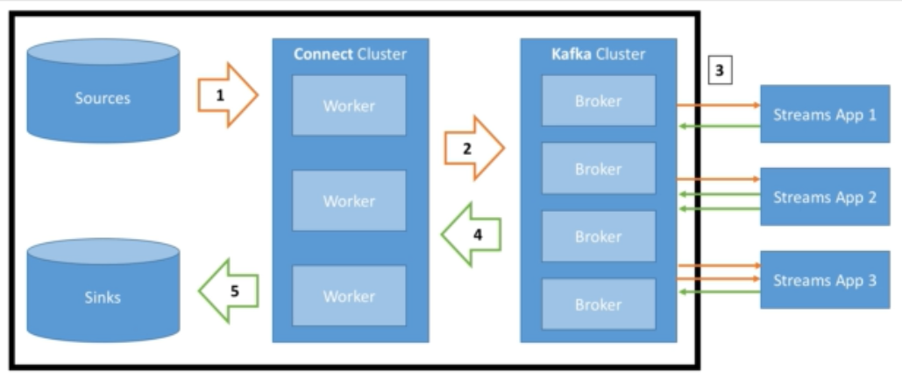
Kafka Connect Source/Sink (continue…)
Architecture design
Source Connectors to get data from Common data sources.
Sink connectors to publish that data in Common data stores.
Make it easy for not experienced dev to quickly get their data reliably into Kafka
Part of your ETL pipeline
Scaling made easy from small pipelines to company-wide pipelines
Re-usable code!

Slide 44
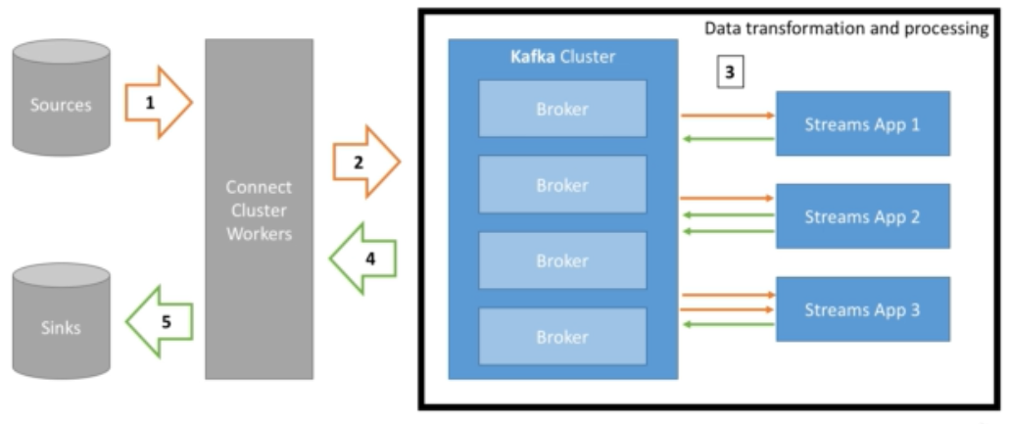
Kafka Stream
Easy data processing and transformation library within Kafka
Standard Java application
No need to create a separate cluster
Exactly once capabilities

Slide 45
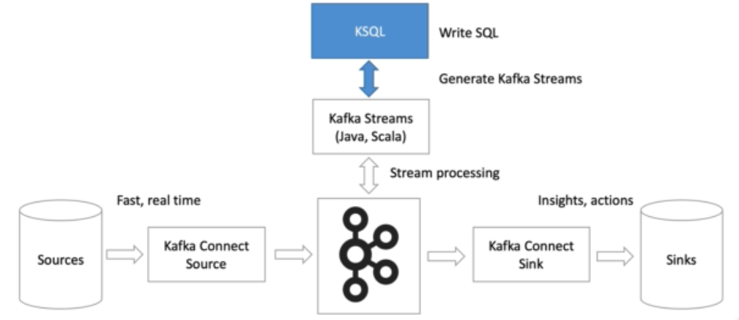
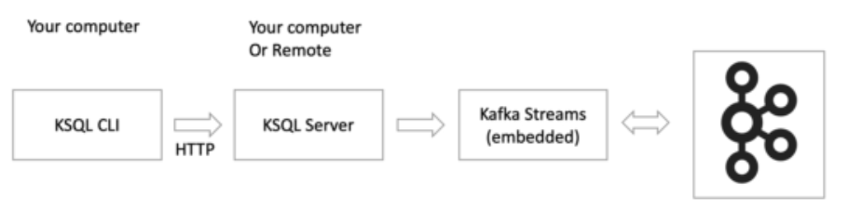
KSQL
How does KSQL works?

Slide 46
KSQL commands…
list topics;
print ‘<topic>’;
print ‘<topic>’ from beginning;
To query data from kafka topics, you need to create Kafka Streams. A Stream in Kafka is the full history from the start of time.
create stream users_stream (name VARCHAR, countrycode VARCHAR) WITH (KAFKA_TOPIC='USERS', VALUE_FORMAT='DELIMITED’);
list streams;
select name, countrycode from users_stream emit changes;
Reset offset: SET ‘auto.offset.reset’=‘earliest’;
select countrycode, count(*) from users_stream group by countrycode emit changes;
drop stream if exists users_stream delete topic;
CREATE STREAM userprofile (userid INT, firstname VARCHAR, lastname VARCHAR, countrycode VARCHAR, rating DOUBLE) WITH (VALUE_FORMAT = 'JSON', KAFKA_TOPIC = 'USERPROFILE’);
describe userprofile;
CREATE TABLE COUNTRYTABLE (COUNTRYCODE VARCHAR, COUNTRYNAME VARCHAR) WITH (KAFKA_TOPIC='COUNTRY_CSV', VALUE_FORMAT='DELIMITED', KEY='countrycode’);
show tables;
describe countrytable;
select countrycode, countryname from countrytable emit changes;

Slide 47
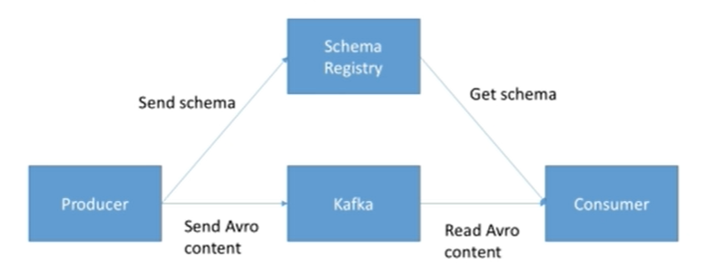
Kafka Schema Registry
Kafka takes bytes as an input and publishes them, no data verification
What if the producer sends bad data? What if a field gets renamed? What if the data format changes from one day to another? => The Consumers Break!
What if the Kafka Brokers were verifying the messages they receive? => It would break what makes Kafka so good (speed).
So, The Schema Registry (verification) has to be a separate components and it must be able to reject bad data.
Schema Registry Purpose
Store and retrieve schemas for Producers/Consumers
Enforce backward/Forward/Full compatibility on topics
Decrease the size of the payload of data sent to Kafka

Slide 48
Thanks

Slide 49
Elastic Search concepts
Node
Single running instance of ElasticSearch
Single physical and virtual server can accommodates multiple node
Cluster
Collection of one or more nodes
Index
Collection of different types of documents and their properties
PUT /schools
DELETE /colleges
GET /colleges
GET /colleges/_settings
GET /_stats
Document
It is a collection of fields in a specific manner defined in JSON format
Every document is associated with a unique identifier called the UID.
PUT schools/_doc/5
{“name":"City School", "description":"ICSE", "street":"West End"}
Shard
Indexes are horizontally subdivided into shards. This means each shard contains all the properties of document but contains less number of JSON objects than index.
The horizontal separation makes shard an independent node, which can be store in any node.
Replicas
Elasticsearch allows a user to create replicas of their indexes and shards.

Slide 50
Elastic search (continues…)
POST /index1,index2,index3/_search
{ "query":{ "query_string":{ "query":"any_string“ } } }
POST /_all/_search
POST /school*/_search
POST /school*,-schools_gov /_search
GET /_all/_search?q=city:paprola

