Slide 1
Chapter 3
Arithmetic for Computers

Slide 2
Arithmetic for Computers
§3.1 Introduction
Operations on integers
Addition and subtraction
Multiplication and division
Dealing with overflow
Floating-point real numbers
Representation and operations

Slide 3
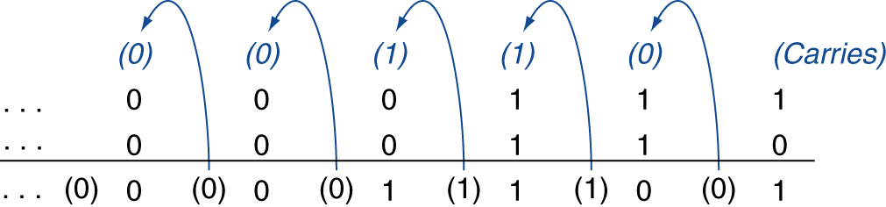
Integer Addition
Example: 7 + 6
§3.2 Addition and Subtraction
Overflow if result out of range
Adding +ve and –ve operands, no overflow
Adding two +ve operands
Overflow if result sign is 1
Adding two –ve operands
Overflow if result sign is 0
Notes:
- The rightmost bit adds 1 to 0, resulting in the sum of this bit being 1 and the carry out from this bit being 0. Hence, the operation for the second digit to the right is 0 + 1 + 1. This generates a 0 for this sum bit and a carry out of 1. The third digit is the sum of 1 + 1 +1, resulting in a carry out of 1 and a sum bit of 1. The fourth bit is 1 + 0 + 0, yielding a 1 sum and no carry.
When can overflow occur in addition? When adding operands with different signs, overflow cannot occur. The reason is the sum must be no larger than one of the operands. For example, -10 + 4 = -6. Since the operands fit in 32 bits and the sum is no larger than an operand, the sum must fit in 32 bits as well. Therefore, no overflow can occur when adding positive and negative operands.
- Knowing when overflow cannot occur in addition and subtraction is all well and good, but how do we detect it when it does occur? Clearly, adding or subtracting two 32-bit numbers can yield a result that needs 33 bits to be fully expressed. The lack of a 33rd bit means that when overflow occurs, the sign bit is set with the value of the result instead of the proper sign of the result. Since we need just one extra bit, only the sign bit can be wrong. Hence, overflow occurs when adding two positive numbers and the sum is negative, or vice versa. This spurious sum means a carry out occurred into the sign bit.

Slide 4
Integer Subtraction
Add negation of second operand
Example: 7 – 6 = 7 + (–6)
+7: 0000 0000 … 0000 0111 –6: 1111 1111 … 1111 1010 +1: 0000 0000 … 0000 0001
Overflow if result out of range
Subtracting two +ve or two –ve operands, no overflow
Subtracting +ve from –ve operand
Overflow if result sign is 0
Subtracting –ve from +ve operand
Overflow if result sign is 1
Notes:
- There are similar restrictions to the occurrence of overflow during subtract, but it’s just the opposite principle: when the signs of the operands are the same, overflow cannot occur. To see this, remember that c - a = c + (-a) because we subtract by negating the second operand and then add. Therefore, when we subtract operands of the same sign we end up by adding operands of different signs. From the prior paragraph, we know that overflow cannot occur in this case either.

Slide 5
Dealing with Overflow
Some languages (e.g., C) ignore overflow
Use MIPS addu, addui, subu instructions
Other languages (e.g., Ada, Fortran) require raising an exception
Use MIPS add, addi, sub instructions
On overflow, invoke exception handler
Save PC in exception program counter (EPC) register
Jump to predefined handler address
mfc0 (move from coprocessor reg) instruction can retrieve EPC value, to return after corrective action
Notes:
What about overflow with unsigned integers? Unsigned integers are commonly used for memory addresses where overflows are ignored.
The computer designer must therefore provide a way to ignore overflow in some cases and to recognize it in others.
The MIPS solution is to have two kinds of arithmetic instructions to recognize the two choices:
■ Add (add), add immediate (addi), and subtract (sub) cause exceptions on overflow.
■ Add unsigned (addu), add immediate unsigned (addiu), and subtract unsigned (subu) do not cause exceptions on overflow.
MIPS detects overflow with an exception, also called an interrupt on many computers. An exception or interrupt is essentially an unscheduled procedure call.
The address of the instruction that overflowed is saved in a register, and the computer jumps to a predefined address to invoke the appropriate routine for that exception. The interrupted address is saved so that in some situations the program can continue after corrective code is executed.
MIPS includes a register called the exception program counter (EPC) to contain the address of the instruction that caused the exception.
The instruction move from system control (mfc0) is used to copy EPC into a general-purpose register so that MIPS software has the option of returning to the offending instruction via a jump register instruction.

Slide 6
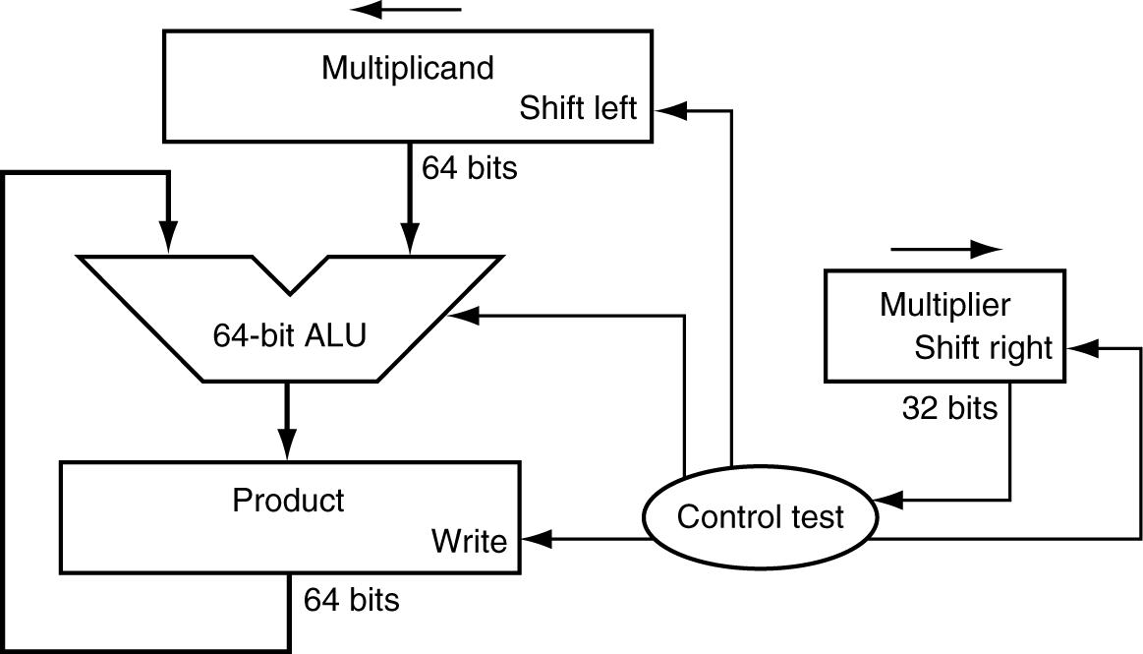
Multiplication
§3.3 Multiplication
Start with long-multiplication approach
multiplicand
1000
× 1001
1000
0000
0000
1000
1001000
multiplier
product
Length of product is the sum of operand lengths

Slide 7
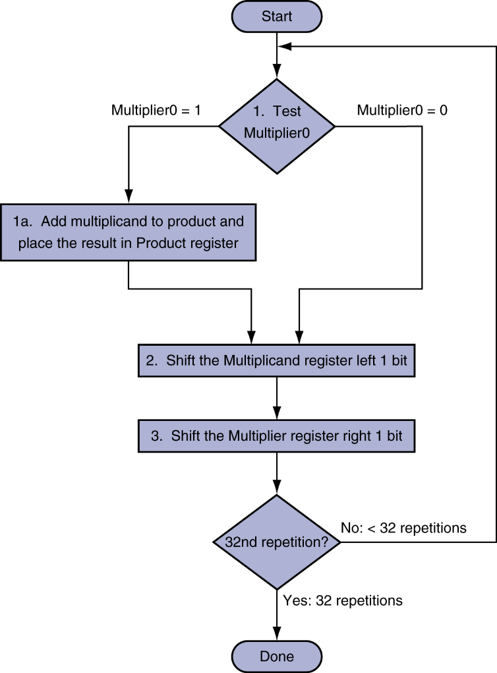
Multiplication Hardware
Initially 0
Notes:
Let’s assume that the multiplier is in the 32-bit Multiplier register and that the 64- bit Product register is initialized to 0.
From the paper-and-pencil example above, it’s clear that we will need to move the multiplicand left one digit each step, as it may be added to the intermediate products. Over 32 steps, a 32-bit multiplicand would move 32 bits to the left. Hence, we need a 64-bit Multiplicand register, initialized with the 32-bit multiplicand in the right half and zero in the left half. This register is then shifted left 1 bit each step to align the multiplicand with the sum being accumulated in the 64-bit Product register.
Figure shows the three basic steps needed for each bit
The least significant bit of the multiplier (Multiplier0) determines whether the multiplicand is added to the Product register. The left shift in step 2 has the effect of moving the intermediate operands to the left, just as when multiplying with paper and pencil. The shift right in step 3 gives us the next bit of the multiplier to examine in the following iteration. These three steps are repeated 32 times to obtain the product. If each step took a clock cycle, this algorithm would require almost 100 clock cycles to multiply two 32-bit numbers.
If the least significant bit of the multiplier is 1, add the multiplicand to the product. If not, go to the next step. Shift the multiplicand left and the multiplier right in the next two steps. These three steps are repeated 32 times.

Slide 8
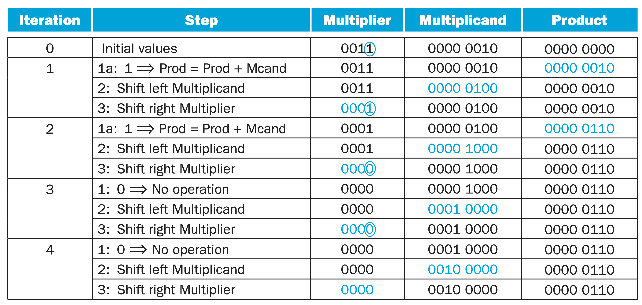
4-bit Mul, 2 x 3 = 0010 x 0011
Notes:
The bit examined to determine the next step is circled in color.

Slide 9
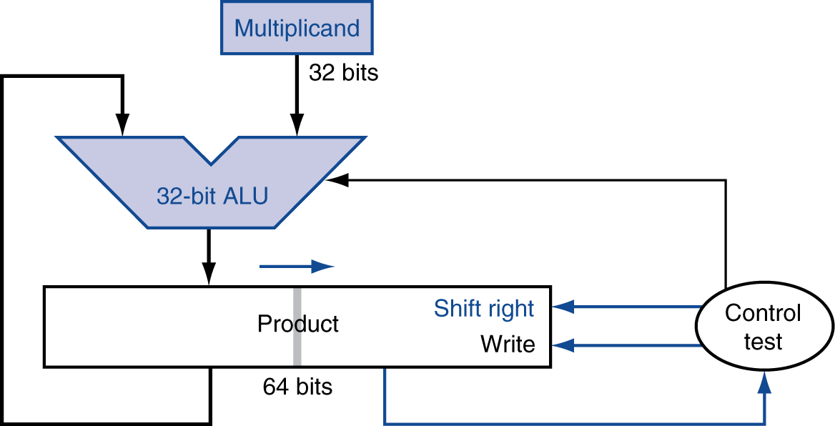
Optimized Multiplier
Perform steps in parallel: add/shift
One cycle per partial-product addition
That’s ok, if frequency of multiplications is low
Notes:
Refined version of the multiplication hardware: Compare with the first version, the Multiplicand register, ALU, and Multiplier register are all 32 bits wide, with only the Product register left at 64 bits. Now the product is shifted right. The separate Multiplier register also disappeared. The multiplier is placed instead in the right half of the Product register. These changes are highlighted in color. (The Product register should really be 65 bits to hold the carry out of the adder, but it’s shown here as 64 bits to highlight the evolution from first version before.)

Slide 10
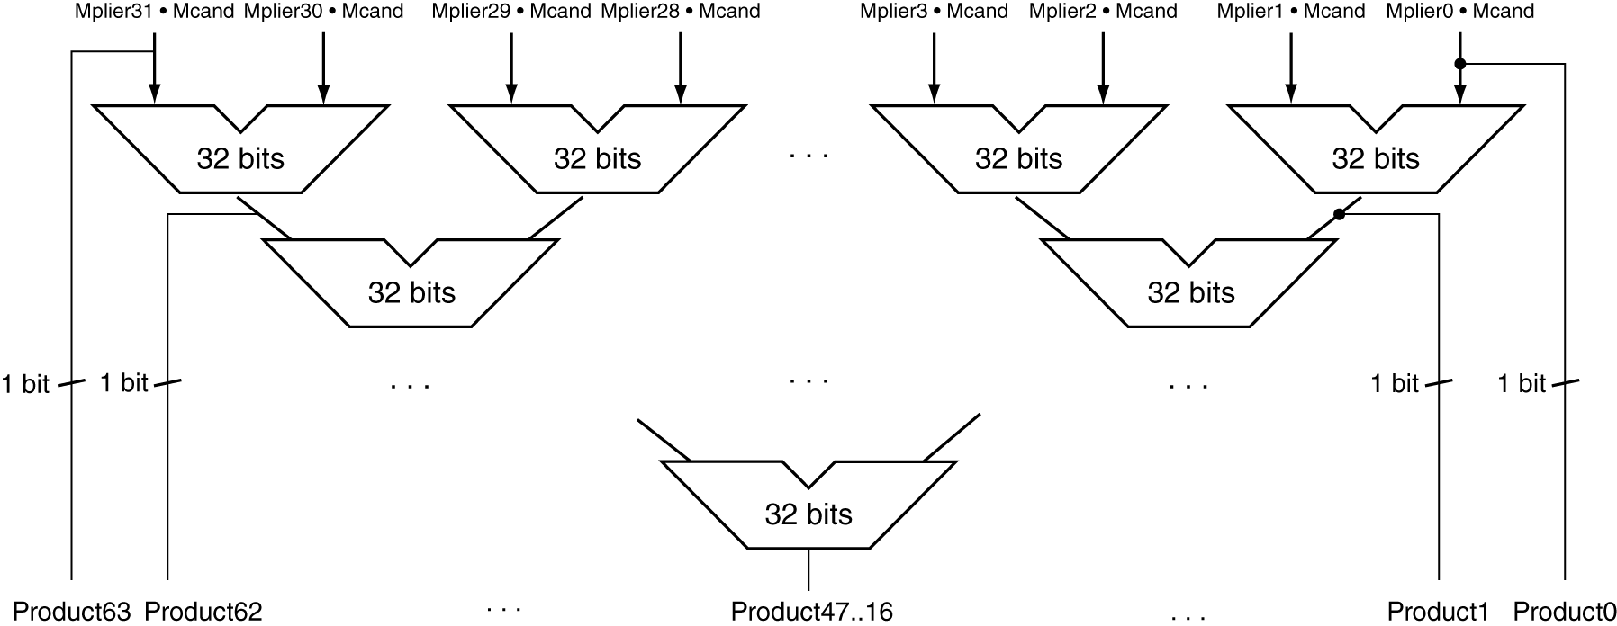
Faster Multiplier
Uses multiple adders
Cost/performance tradeoff
Can be pipelined
Several multiplication performed in parallel
Notes:
- Moore’s Law has provided so much more in resources that hardware designers can now build much faster multiplication hardware. Whether the multiplicand is to be added or not is known at the beginning of the multiplication by looking at each of the 32 multiplier bits. Faster multiplications are possible by essentially providing one 32-bit adder for each bit of the multiplier: one input is the multiplicand ANDed with a multiplier bit, and the other is the output of a prior adder.
- Faster multiplications are possible by essentially providing one 32-bit adder for each bit of the multiplier: one input is the multiplicand ANDed with a multiplier bit, and the other is the output of a prior adder. A straightforward approach would be to connect the outputs of adders on the right to the inputs of adders on the left, making a stack of adders 32 high.
- An alternative way to organize these 32 additions is in a parallel tree, as the figure shows. Instead of waiting for 32 add times, we wait just the log2 (32) or five 32-bit add times.

Slide 11
MIPS Multiplication
Two 32-bit registers for product
HI: most-significant 32 bits
LO: least-significant 32-bits
Instructions
mult rs, rt / multu rs, rt
64-bit product in HI/LO
mfhi rd / mflo rd
Move from HI/LO to rd
Can test HI value to see if product overflows 32 bits
mul rd, rs, rt
Least-significant 32 bits of product –> rd
Notes:
MIPS provides a separate pair of 32-bit registers to contain the 64-bit product, called Hi and Lo.
To produce a properly signed or unsigned product, MIPS has two instructions: multiply (mult) and multiply unsigned (multu).
Note that the result of the multiplication of two 32-bit numbers yields a 64-number.
The 32 most significant bits will be held in HI special register (accessible by mfhi instruction) and the 32 least significant bits will be held in LO special register (accessible by mflo instruction):
Sample code:
mult $a0, $a1
mfhi $a2 # 32 most significant bits of multiplication to $a2
mflo $v0 # 32 least significant bits of multiplication to $v0

Slide 12
Division
§3.4 Division
Check for 0 divisor
Long division approach
If divisor ≤ dividend bits
1 bit in quotient, subtract
Otherwise
0 bit in quotient, bring down next dividend bit
Restoring division
Do the subtract, and if remainder goes < 0, add divisor back
Signed division
Divide using absolute values
Adjust sign of quotient and remainder as required
quotient
dividend
1001
1000 1001010
-1000
10
101
1010
-1000
10
divisor
remainder
n-bit operands yield n-bit quotient and remainder
Notes:
- Divide’s two operands, called the dividend and divisor, and the result, called the quotient, are accompanied by a second result, called the remainder.
- Dividend = Quotient x Divisor + Remainder
The basic grammar school division algorithm tries to see how big a number can be subtracted, creating a digit of the quotient on each attempt. Our carefully selected decimal example uses only the numbers 0 and 1, so it’s easy to figure out how many times the divisor goes into the portion of the dividend: it’s either 0 times or 1 time. Binary numbers contain only 0 or 1, so binary division is restricted to these two choices, thereby simplifying binary division.
- signed division algorithm negates the quotient if the signs of the operands (divisor & dividend) are opposite and makes the sign of the nonzero remainder match the dividend.

Slide 13
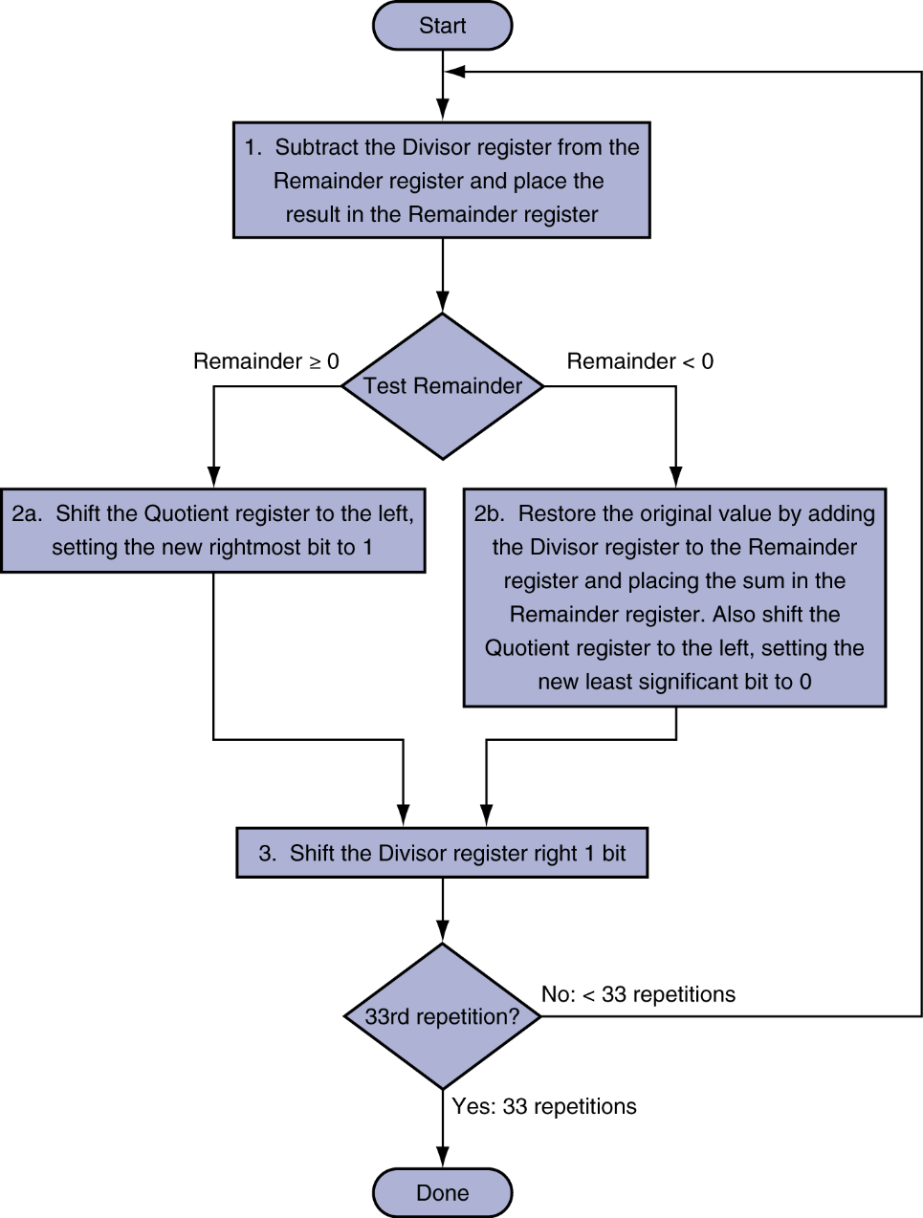
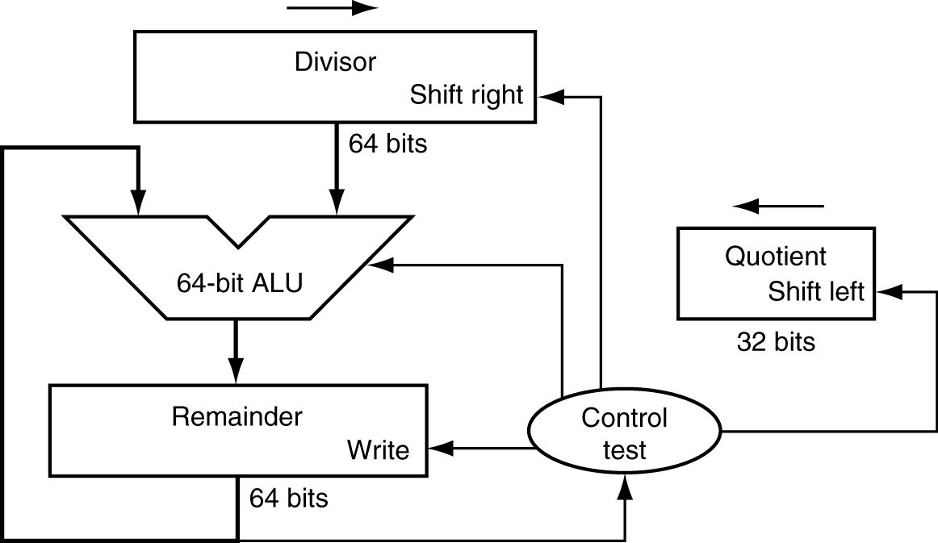
Division Hardware
Initially divisor in left half
Initially dividend
Notes:
Right - shows hardware to mimic our grammar school algorithm. We start with the 32-bit Quotient register set to 0. Each iteration of the algorithm needs to move the divisor to the right one digit, so we start with the divisor placed in the left half of the 64-bit Divisor register and shift it right 1 bit each step to align it with the dividend. The Remainder register is initialized with the dividend.
Left - shows three steps of the first division algorithm. Unlike a human, the computer isn’t smart enough to know in advance whether the divisor is smaller than the dividend.
It must first subtract the divisor in step 1; remember that this is how we performed the comparison in the set on less than instruction.
If the result is positive, the divisor was smaller or equal to the dividend, so we generate a 1 in the quotient (step 2a).
If the result is negative, the next step is to restore the original value by adding the divisor back to the remainder and generate a 0 in the quotient (step 2b).
The divisor is shifted right and then we iterate again. The remainder and quotient will be found in their namesake registers after the iterations are complete.
In short, If the remainder is positive, the divisor did go into the dividend, so step 2a generates a 1 in the quotient. A negative remainder after step 1 means that the divisor did not go into the dividend, so step 2b generates a 0 in the quotient and adds the divisor to the remainder, thereby reversing the subtraction of step 1. The final shift, in step 3, aligns the divisor properly, relative to the dividend for the next iteration. These steps are repeated 33 times.

Slide 14
Example
Notes:
Division example using the algorithm.
Divisor: 0010
Dividend: 0000 0111 (stored in reminder register)
The bit examined to determine the next step is circled in color.

Slide 15
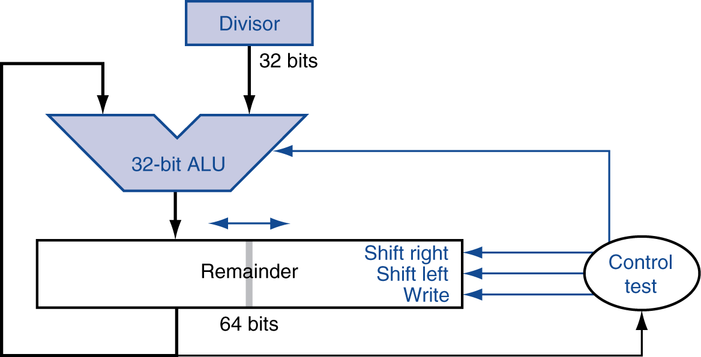
Optimized Divider
One cycle per partial-remainder subtraction
Looks a lot like a multiplier!
Same hardware can be used for both
Notes:
The Divisor register, ALU, and Quotient register are all 32 bits wide, with only the Remainder register left at 64 bits.
Compared to the previous hardware, the ALU and Divisor registers are halved and the remainder is shifted left.
This version also combines the Quotient register with the right half of the Remainder register.

Slide 16
Faster Division
Can’t use parallel hardware as in multiplier
Subtraction is conditional on sign of remainder
Faster dividers (e.g. SRT devision) generate multiple quotient bits per step
Still require multiple steps
Notes:
-Moore’s Law applies to division hardware as well as multiplication, so we would like to be able to speed up division by throwing hardware at it. We used many adders to speed up multiply, but we cannot do the same trick for divide. The reason is that we need to know the sign of the difference before we can perform the next step of the algorithm, whereas with multiply we could calculate the 32 partial products immediately.
There are techniques to produce more than one bit of the quotient per step. The SRT division technique tries to predict several quotient bits per step, using a table lookup based on the upper bits of the dividend and remainder. It relies on subsequent steps to correct wrong predictions. A typical value today is 4 bits. The key is guessing the value to subtract. With binary division, there is only a single choice. These algorithms use 6 bits from the remainder and 4 bits from the divisor to index a table that determines the guess for each step.
The accuracy of this fast method depends on having proper values in the lookup table. The fallacy on page 231 in Section 3.9 shows what can happen if the table is incorrect.

Slide 17
MIPS Division
Use HI/LO registers for result
HI: 32-bit remainder
LO: 32-bit quotient
Instructions
div rs, rt / divu rs, rt
No overflow or divide-by-0 checking
Software must perform checks if required
Use mfhi, mflo to access result
Notes:
MIPS has two instructions: divide (div) and divide unsigned (divu).
The MIPS assembler allows divide instructions to specify three registers, generating the mflo or mfhi instructions to place the desired result into a general-purpose register.
Hi contains the remainder, and Lo contains the quotient after the divide instruction completes.

Slide 18
Instructions

Slide 19
Floating Point
§3.5 Floating Point
Representation for non-integral numbers
Including very small and very large numbers
Like scientific notation
–2.34 × 10⁵⁶
+0.002 × 10^{–4}
+987.02 × 10⁹
In binary
±1.xxxxxxx₂ × 2^{yyyy}
Types float and double in C
normalized
not normalized
Notes:
- For example, decimal 1234.567 is normalized as 1.234567 x 10³ by moving the decimal point so that only one digit appears before the decimal. The exponent expresses the number of positions the decimal point was moved left (positive exponent) or moved right (negative exponent).
- Similarly, the floating-point binary value 1101.101 is normalized as 1.101101 x 2³ by moving the decimal point 3 positions to the left, and multiplying by 2³. Here are some examples of normalizations:
Binary || ValueNormalized As (mantissa). || Exponent
------------------------------------------------------------------------------
1101.101 1.101101 3
.00101 1.01 -3
1.0001 1.0001 0
10000011.0 1.0000011 7
You may have noticed that in a normalized mantissa, the digit 1 always appears to the left of the decimal point. In fact, the leading 1 is omitted from the mantissa's actual storage because it is redundant.
More details http://cstl-csm.semo.edu/xzhang/Class%20Folder/CS280/Workbook_HTML/FLOATING_tut.htm#:~:text=The%20sign%20of%20a%20binary,bit%20indicates%20a%20positive%20number.&text=Before%20a%20floating%2Dpoint%20binary,its%20mantissa%20must%20be%20normalized.

Slide 20
Floating Point Standard
Defined by IEEE Std 754-1985
Developed in response to divergence of representations
Portability issues for scientific code
Now almost universally adopted
Two representations
Single precision (32-bit)
Double precision (64-bit)

Slide 21
IEEE Floating-Point Format
single: 8 bits double: 11 bits
single: 23 bits double: 52 bits
S
Exponent
Fraction
S: sign bit (0 ⇒ non-negative, 1 ⇒ negative)
Normalize significand: 1.0 ≤ |significand| < 2.0
Always has a leading pre-binary-point 1 bit, so no need to represent it explicitly (hidden bit)
Significand is Fraction with the “1.” restored
Exponent: excess representation: actual exponent + Bias
Ensures exponent is unsigned
Single: Bias = 127; Double: Bias = 1203
Notes:
We have now reached the point where we can combine the sign, exponent, and fraction into the binary IEEE short real representation. Using Figure 1 as a reference, the value 1.101 x 2⁰ would be stored as sign = 0 (positive), fraction = 101, and exponent = 01111111 (the exponent value is added to 127). The leading "1." was dropped from the fraction. Here are more examples:
Binary Value ||| Biased Exponent. ||||. Sign,Exponent, Fraction
-1.11 127 1, 01111111, 11000000000000000000000
+1101.101 130 0, 10000010, 10110100000000000000000
-.00101 124 1 , 01111100, 01000000000000000000000
+100111.0 132 0, 10000100, 00111000000000000000000
+.0000001101011 120 0, 01111000, 10101100000000000000000
Significant = 1 + Fraction

Slide 22
Single-Precision Range
Exponents 00000000 and 11111111 reserved
Smallest value
Exponent: 00000001 ⇒ actual exponent = 1 – 127 = –126
Fraction: 000…00 ⇒ significand = 1.0
±1.0 × 2^{–126} ≈ ±1.2 × 10^{–38}
Largest value
exponent: 11111110 ⇒ actual exponent = 254 – 127 = +127
Fraction: 111…11 ⇒ significand ≈ 2.0
±2.0 × 2⁺¹²⁷ ≈ ±3.4 × 10⁺³⁸

Slide 23
Double-Precision Range
Exponents 0000…00 and 1111…11 reserved
Smallest value
Exponent: 00000000001 ⇒ actual exponent = 1 – 1023 = –1022
Fraction: 000…00 ⇒ significand = 1.0
±1.0 × 2^{–1022} ≈ ±2.2 × 10^{–308}
Largest value
Exponent: 11111111110 ⇒ actual exponent = 2046 – 1023 = +1023
Fraction: 111…11 ⇒ significand ≈ 2.0
±2.0 × 2⁺¹⁰²³ ≈ ±1.8 × 10⁺³⁰⁸

Slide 24
Floating-Point Precision
Relative precision
all fraction bits are significant
Single: approx 2^{–23}
Equivalent to 23 × log₁₀2 ≈ 23 × 0.3 ≈ 6 decimal digits of precision
Double: approx 2^{–52}
Equivalent to 52 × log₁₀2 ≈ 52 × 0.3 ≈ 16 decimal digits of precision

Slide 25
Floating-Point Example
Represent –0.75
–0.75 = (–1)¹ × 1.1₂ × 2^{–1}
S = 1
Fraction = 1000…00₂
Exponent = –1 + Bias
Single: –1 + 127 = 126 = 01111110₂
Double: –1 + 1023 = 1022 = 01111111110₂
Single: 1011111101000…00
Double: 1011111111101000…00

Slide 26
Floating-Point Example
What number is represented by the single-precision float
11000000101000…00
S = 1
Fraction = 01000…00₂
Exponent = 10000001₂ = 129
x = (–1)¹ × (1 + 01₂) × 2^{(129 – 127)}
= (–1) × 1.25 × 2²
= –5.0

Slide 27
Floating-Point Addition
Consider a 4-digit decimal example
9.999 × 10¹ + 1.610 × 10^{–1}
1. Align decimal points
Shift number with smaller exponent
9.999 × 10¹ + 0.016 × 10¹
2. Add significands
9.999 × 10¹ + 0.016 × 10¹ = 10.015 × 10¹
3. Normalize result & check for over/underflow
1.0015 × 10²
4. Round and renormalize if necessary
1.002 × 10²

Slide 28
Floating-Point Addition
Now consider a 4-digit binary example
1.000₂ × 2^{–1} + –1.110₂ × 2^{–2} (0.5 + –0.4375)
1. Align binary points
Shift number with smaller exponent
1.000₂ × 2^{–1} + –0.111₂ × 2^{–1}
2. Add significands
1.000₂ × 2^{–1} + –0.111₂ × 2–1 = 0.001₂ × 2^{–1}
3. Normalize result & check for over/underflow
1.000₂ × 2^{–4}, with no over/underflow
4. Round and renormalize if necessary
1.000₂ × 2^{–4} (no change) = 0.0625

Slide 29
FP Adder Hardware
Much more complex than integer adder
Doing it in one clock cycle would take too long
Much longer than integer operations
Slower clock would penalize all instructions
FP adder usually takes several cycles
Can be pipelined

Slide 30
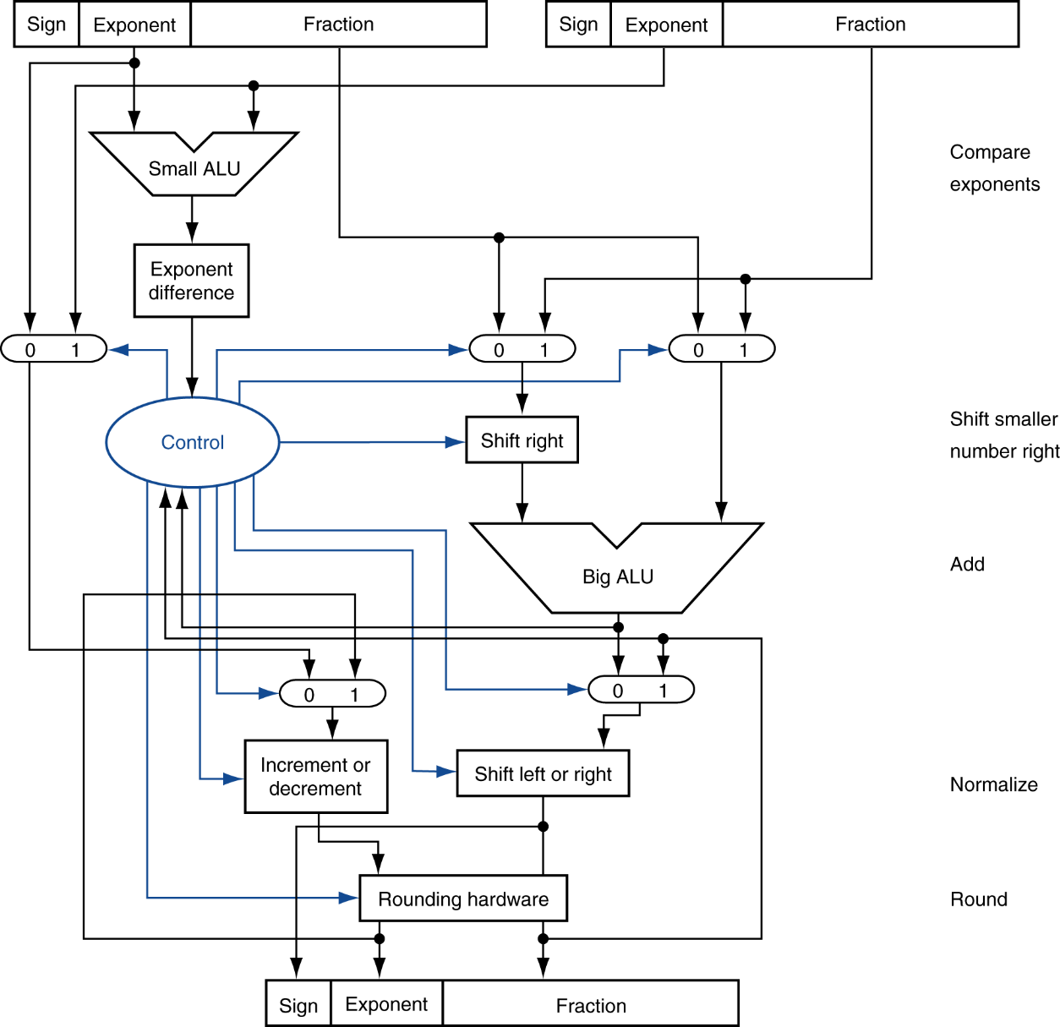
FP Adder Hardware
Step 1
Step 2
Step 3
Step 4

Slide 31
Floating-Point Multiplication
Consider a 4-digit decimal example
1.110 × 10¹⁰ × 9.200 × 10^{–5}
1. Add exponents
For biased exponents, subtract bias from sum
New exponent = 10 + –5 = 5
2. Multiply significands
1.110 × 9.200 = 10.212 ⇒ 10.212 × 10⁵
3. Normalize result & check for over/underflow
1.0212 × 10⁶
4. Round and renormalize if necessary
1.021 × 10⁶
5. Determine sign of result from signs of operands
+1.021 × 10⁶

Slide 32
Floating-Point Multiplication
Now consider a 4-digit binary example
1.000₂ × 2^{–1} × –1.110₂ × 2^{–2} (0.5 × –0.4375)
1. Add exponents
Unbiased: –1 + –2 = –3
Biased: (–1 + 127) + (–2 + 127) = –3 + 254 – 127 = –3 + 127
2. Multiply significands
1.000₂ × 1.110₂ = 1.1102 ⇒ 1.110₂ × 2^{–3}
3. Normalize result & check for over/underflow
1.110₂ × 2^{–3} (no change) with no over/underflow
4. Round and renormalize if necessary
1.110₂ × 2^{–3} (no change)
5. Determine sign: +ve × –ve ⇒ –ve
–1.110₂ × 2^{–3} = –0.21875

