Slide 1

Telecom Customer Churn Prediction
A Machine Learning Project
Presented by: Pavan Kalyan Perla (12205536)

Slide 2

Problem Statement
Churn Impact
Cost of Retention
High churn significantly reduces telecom profitability.
Retaining customers costs much less than acquiring new ones.
Need
Develop a predictive model using existing customer data.

Slide 3

Project Objectives
Predict Churn
Feature Insight
Retention Strategy
Identify customers likely to leave the service.
Determine key factors driving customer churn.
Support data-driven decision making to retain customers.

Slide 4
Dataset Overview
Records
Features
Target
Over 5,000 customer entries analyzed.
Demographics
Binary variable indicating customer churn.
Usage Patterns
Financial Information

Slide 5
Data Preprocessing & EDA
Cleaning
Removed duplicates, handled missing values.
Encoding
Used LabelEncoder for categorical data.
Scaling
Normalized numerical features with MinMaxScaler.
Feature Engineering
Created account_tenure from registration dates.
Exploration
Visualized churn impact by gender, age, and usage patterns.
Insights
Younger users churn more; used correlation matrix for feature selection.

Slide 6
Churn Prediction Techniques
Models Used
Best Performance
Evaluation
Logistic Regression
Logistic Regression achieved ~86% accuracy.
Performance validated with confusion matrix and reports.
Decision Tree
K-Nearest Neighbors

Slide 7

Key Takeaways and Best Practices
Importance of Preprocessing
Model Choice
Class Balance
Logistic Regression balances accuracy and interpretability well.
Used stratified sampling to handle imbalanced classes effectively.
Feature engineering dramatically improves model accuracy.

Slide 8
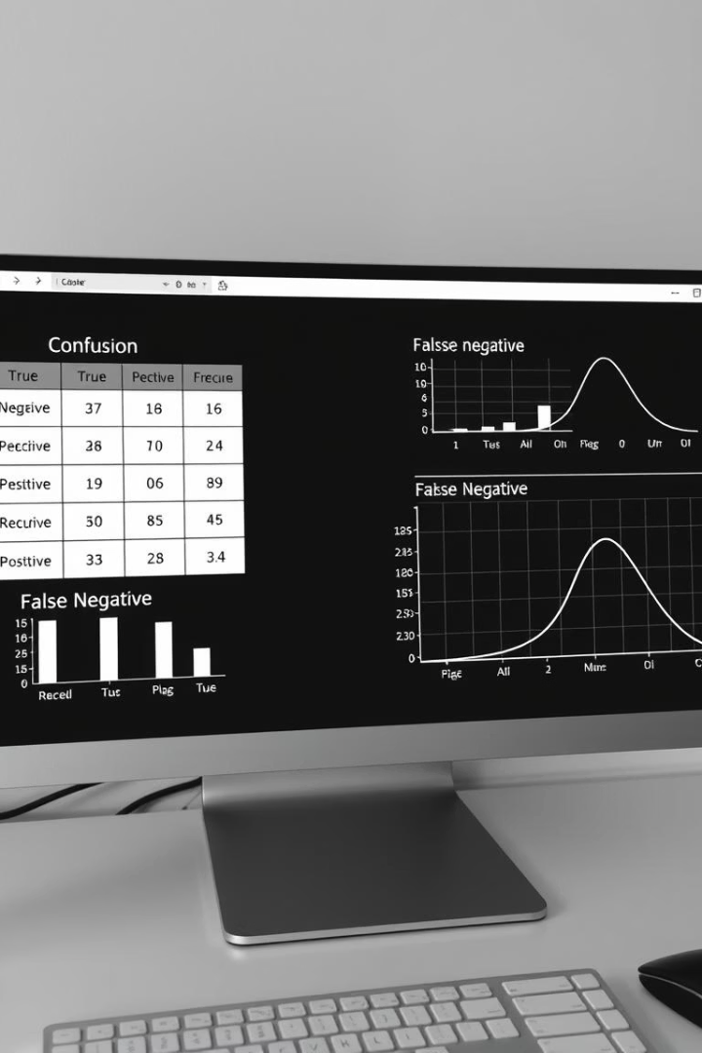



Sample Output
Accuracy
Confusion Matrix
Usage
86% achieved with Logistic Regression
Highlights true vs false positives and negatives
Predictions can be exported or visualized in dashboards

Slide 9

Challenges and Mitigation Strategies
Class Imbalance
Feature Redundancy
Addressed via stratified train-test splitting.
Dropped correlated features after rigorous analysis.
Overfitting
Used simpler models and robust evaluation techniques.

Slide 10
Conclusion & Next Steps
Outcome
Business Impact
Future Work
Reliable churn prediction model built and validated.
Insights empower better retention and reduced churn rates.
Real-time churn scoring
Deep learning methods
Model deployment in production

