Slide 1

MERN STACK HACKATHON — TEAM NO. 14
Vehicle Service Center
Management System
Problem Statement M27: Stream Surfers
Team: Trivion (Team No. 14)
GitHub: github.com/pavankarthikeyaatchyuta-lab/Stream-Surfers
Stack: React.js | Node.js | Express.js | MongoDB

Slide 2
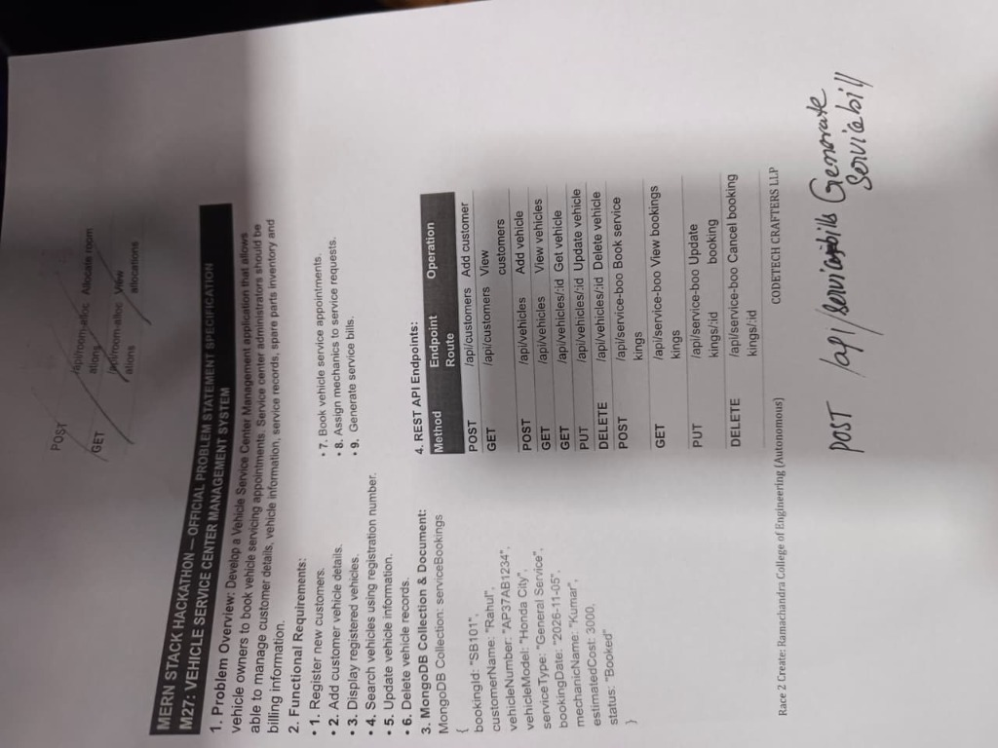
CHALLENGE & SCOPE
Problem Statement M27 & Functional Requirements
Official Requirements Breakdown:
✔ 1. Customer & Vehicle Onboarding
Register new customers and assign registration numbers & vehicle models in a single step.
✔ 2. Real-Time Vehicle Registry
View registered vehicles with live search by registration number, inline updates, and deletion.
✔ 3. Service Booking Management
Book appointments with unique bookingId, date, estimated cost, and status tracking.
✔ 4. Mechanic Allocation
Assign and reassign technicians (Kumar, Ramesh, Suresh) with live status updates to 'In Progress'.
✔ 5. Automated Billing
Generate itemized service bills linked directly to bookings, tracking parts, labor, and total cost.

Slide 3
PROPOSED ARCHITECTURE
Our Solution: Streamlined 3-Stage Pipeline
STAGE 1
Customers & Vehicles
• Unified 1-click registration for Owner & Automobile
• Eliminates duplicate entry errors
• Instant search by registration number
• Full inline edit (PUT) and deletion (DELETE)
STAGE 2
Service Bookings
• Pick registered customer from dropdown
• Auto-fills Customer, Vehicle # & Model
• Auto-generates sequential Booking ID (SB101)
• Assign mechanics & track status live
STAGE 3
Service Billing
• Select serviced vehicle from dropdown
• Auto-calculates parts + labor = total cost
• Auto-increments bill number (BILL101)
• Permanent invoice ledger stored in MongoDB
KEY BENEFIT: Zero Redundant Data Entry | 100% Data Integrity Across All 3 Stages

Slide 4
VERIFIED REAL DATA
Real Production Data & Implementation Results
Customer & Vehicle Record
Customer Name:
Vinod
Phone Number:
98797564786
Email Address:
pavankarthikeyaatchyuta@gmail.com
Vehicle Reg #:
AP37AB1234
Vehicle Model:
Honda City
Status in DB:
Active (HTTP 200 OK)
Service Booking Record
Booking ID:
SB101 (Auto-generated)
Service Type:
General Service
Booking Date:
2026-11-10
Mechanic Assigned:
Ramesh (Dispatched)
Estimated Cost:
₹2,500
Service Status:
In Progress
Generated Service Bill
Bill Number:
BILL101
Linked Booking:
SB101
Parts Cost:
₹0
Labor Cost:
₹2,500
Total Amount:
₹2,500
Billed Date:
2026-11-09

Slide 5
TECHNICAL DELIVERY
Engineering Solutions, Verification & GitHub Sync
Critical Backend Bugs Fixed:
✔ Schema Validation Fix
Mongoose required 'mail' but route read 'mailid'. Fixed via fallback parsing: req.body.mail || req.body.mailid || req.body.email.
✔ Runtime Crash Fix
Fixed ReferenceError where route called 'new ServiceBill' instead of imported 'Servicebill'.
✔ Alphanumeric CastError Fix
billNumber & bookingId were typed as Number; updated to Mixed type to support 'SB101' and 'BILL101'.
✔ Status Enum Constraint
Added 'Booked' to status enum in servicebooking.js to match Problem Statement default.
Verification & GitHub Delivery:
★ Production Build Verified
Ran 'npm run build' inside Hackathon Trivion/frontend: Compiled successfully with 0 errors and 0 warnings.
★ Complete CRUD API Tests
POST, GET, PUT, and DELETE verified on live server (Port 5000) for all 4 endpoints.
★ GitHub Repository Synchronized
Repo: github.com/pavankarthikeyaatchyuta-lab/Stream-Surfers
★ Team & Track Identifiers
Team: Trivion (Team No. 14) | Problem Statement: M27 (Stream Surfers) | Latest commits synced to main branch.

