Slide 1

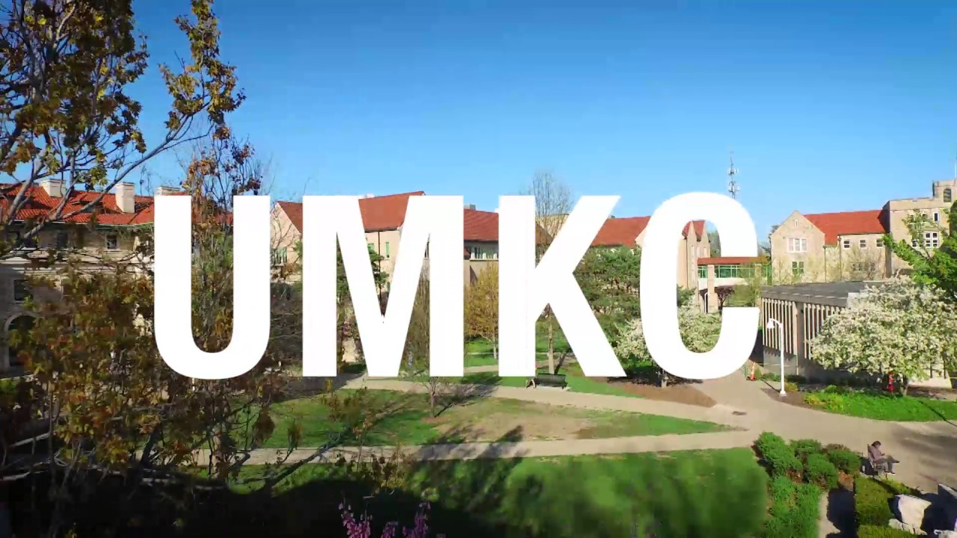
Smart Attend

Slide 2
Team Members
1. Chakra Pavan Kumar, Kota (16283878) – Team Lead
2. Dharani, Muli (16286306)
Roles:
Research on different Attendance Applications – Pavan (owner), Dharani
Documentation – Pavan, Dharani (owner)
Development – Pavan (owner), Dharani
Project Management – Pavan, Dharani (owner)
Performance Evaluation: Pavan, Dharani (owner)

Slide 3
Type of project: Development
Motivation:
We got motivated by observing some of the concerns faced by instructors like For instructor its time taking to capture attendance manually in every class and observe each individual performance and interest on subject.
Objective:
To bring ease in tracking the attendance for instructors.

Slide 4
Tools, Languages, Platforms:
Ionic 4
Mongo DB
Html5, CSS3, SCSS
Angular 7
Node.js
Express.js
Android SDK
Azure

Slide 5
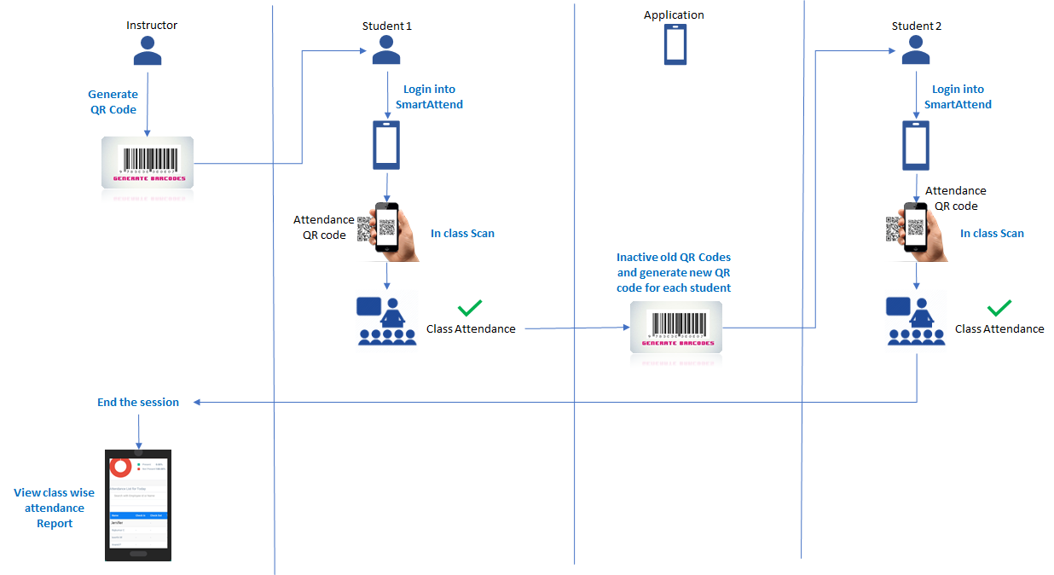
Block Diagram

Slide 6
Application Flow

Slide 7
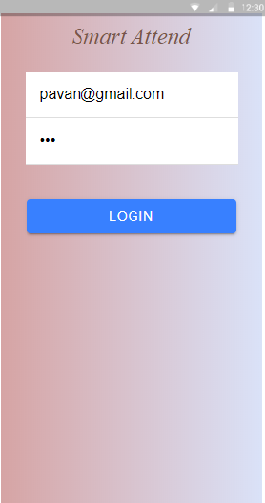
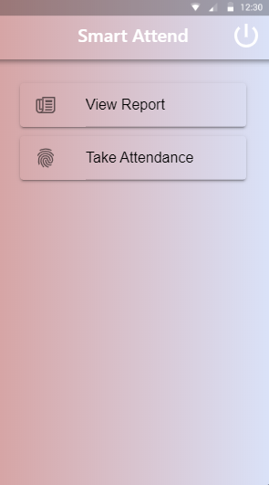
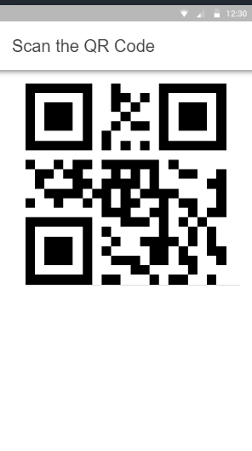
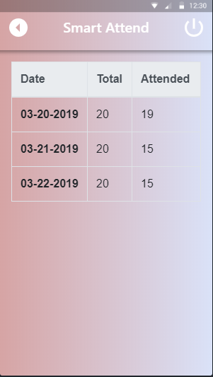
Professor Login
Home Page
Take Attendance
View Report

Slide 8
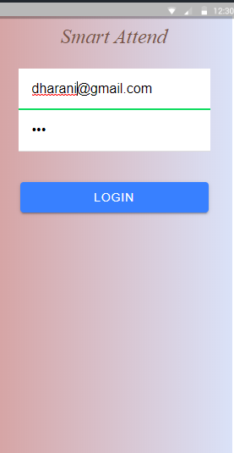
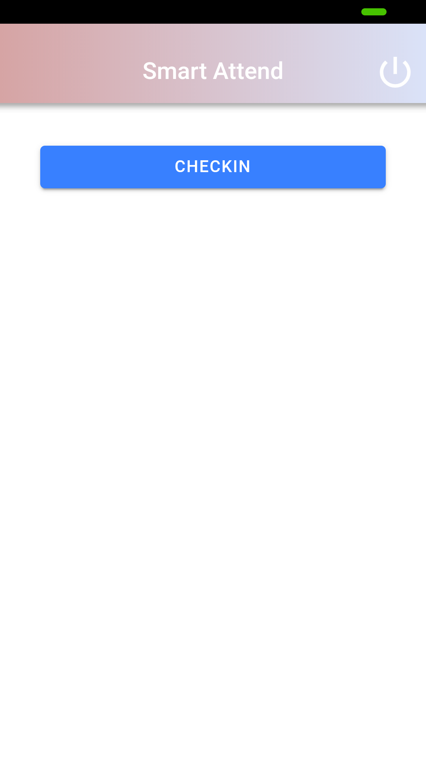
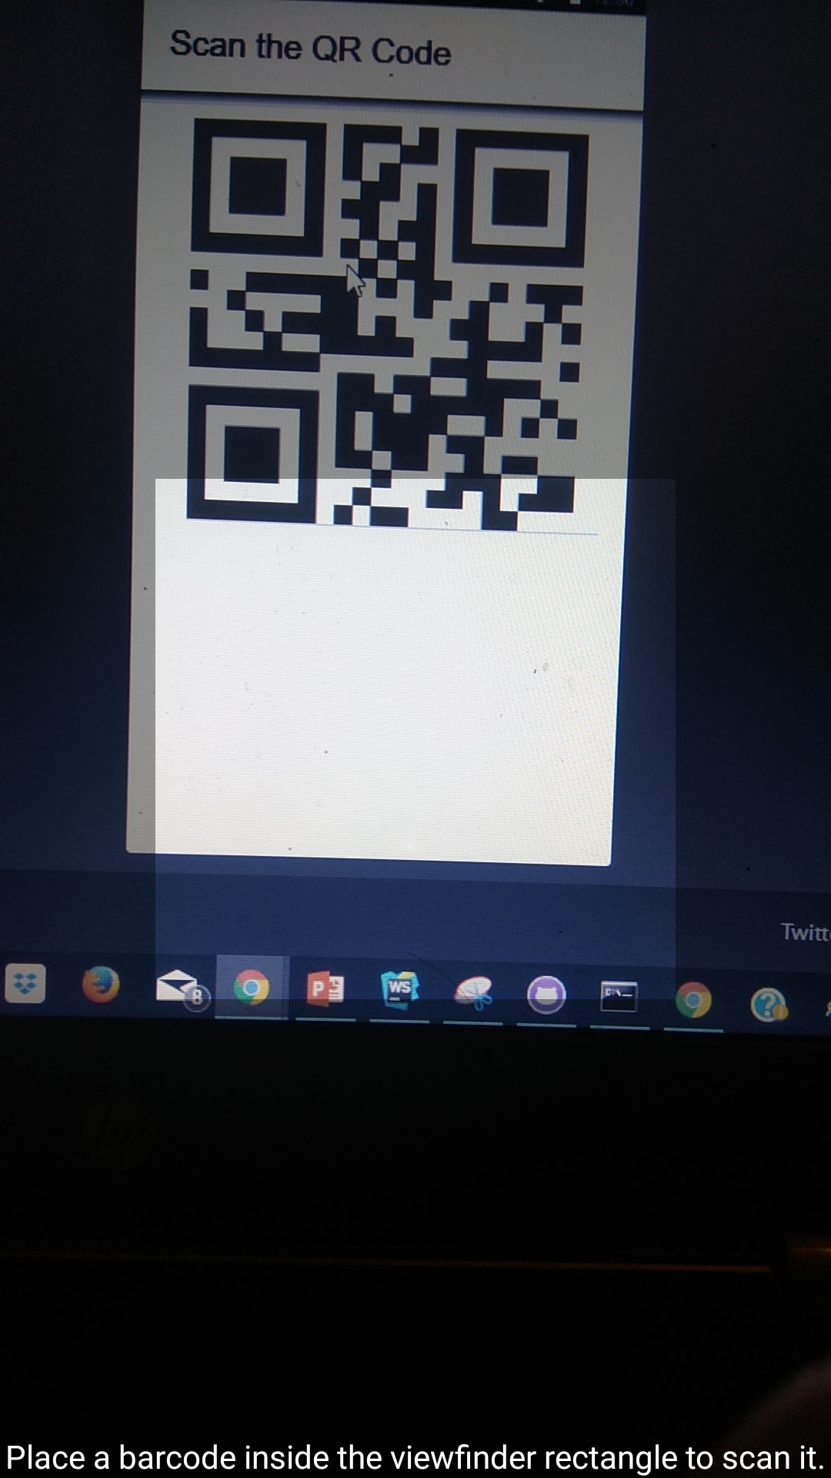
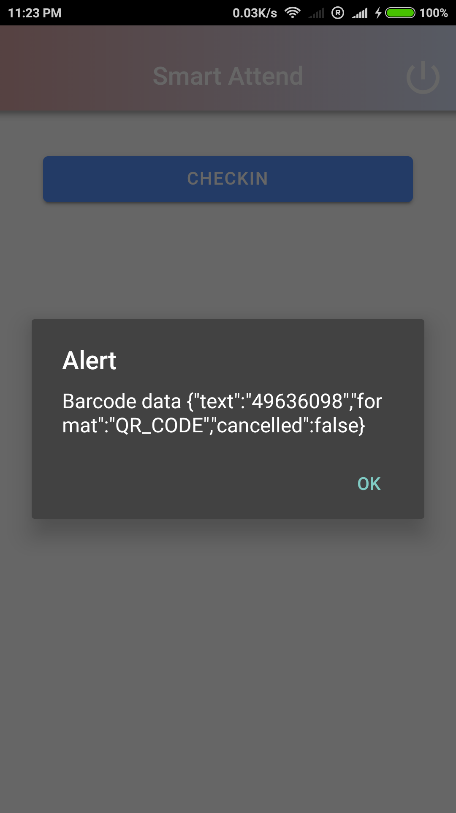
Student Login
Checkin
Scan QR Code
Alert

Slide 9
Development Status
Iteration 1: Closed
Research on the core concepts related to the project
Design the system architecture
Ends with a follow up meeting with Professor to show the progress and get feedback.
Iteration 2: Closed
Implemented Below features:
Professor Login
Professor Report View
Generate QR Code by Professor
Student Attendance Scanning
Mark Attendance in Database
Testing in Android Phone
A follow up meeting with Professor to show the progress and get feedback (this gives the status of our application).

Slide 10
Development Status
Iteration 3: In progress
Bug Fixes
Test in IOS Phone
UI Level Changes
Detailed Attendance Report for Professor
Detailed Attendance Report for Student
Cloud Deployment
Student should able to use our application and give us the feedback
A follow up meeting with Professor to show the progress and get feedback.
Final Iteration: Open
Implement changes according to Professor and Student feedback.
Final release
Go Live.

Slide 11
Challenges
Invalidation of QR Code

Slide 12
Thank you

