Slide 1


Department of Computer Science and Engineering
IDENTIFYING FAKE NEWS ARTICLE USING MACHINE LERNING
Under the guidance of
Presented By:
Mr. Munnangi Suresh, M.Tech.
Assistant Professor
Department of CSE
B. LALITHA (20KH1A0512)
K. BINDHU LAVANYA (20KH1A0548)
G.L.N. SIVA KUMAR (20KH1A0538)
K. PAVAN KUMAR (20KH1A0554)
Department of Computer Science and Engineering
1 May 2024

Slide 2
OBJECTIVE
The objective of fake news article detection using machine learning is to enhance the ability to automatically identify and filter out misleading or false information from genuine news articles, thereby promoting information accuracy and trustworthiness
NIT
Department of Computer Science and Engineering

Slide 3
ABSTRACT
Millions of News Articles are being published daily , it became challenging to classify the Real and Fake news among them. These Fake News affect Stocks , Carrier and even Personal life of a person. To prevent the further consequences of the fake news, we need a news classifier.
Our project revolves the solution for Fake news problem by implementing fake news detection model by using different classification techniques like Support Vector Machine (SVM), Naïve Bayes, Passive Aggressive and NLP Techniques to classify the news is Fake or Real
NIT
Department of Computer Science and Engineering

Slide 4
INTRODUCTION
Most fake news is initially distributed over social media conduits like Facebook and Twitter and later finds its way onto mainstream media platforms such as traditional television and radio news.
The fake news stories that are initially seeded over social media platforms share key linguistic characteristics such as excessive use of unsubstantiated hyperbole and non-attributed quoted content.
The results of a fake news identification study that documents the performance of a fake news classifier are presented and discussed in this paper.
Intentionally deceptive content presented under the guise of legitimate journalism (or ‘fake news,’ as it is commonly known) is a worldwide information accuracy and integrity problem that affects opinion forming, decision making, and voting patterns
NIT
Department of Computer Science and Engineering

Slide 5
LITRATURE SURVEY
TITLE : Characterizing and Identifying Fake Images on Twitter during Hurricane Sandy
AUTHOR: A. Gupta, H. Lamba, P. Kumaraguru, and A. Joshi
In today's world, online social media plays a vital role during real world events, especially crisis events. There are both positive and negative effects of social media coverage of events, it can be used by authorities for effective disaster management or by malicious entities to spread rumors and fake news. The aim of this paper, is to highlight the role of Twitter, during Hurricane Sandy (2012) to spread fake images about the disaster. We identified 10,350 unique tweets containing fake images that were circulated on Twitter, during Hurricane Sandy
NIT
Department of Computer Science and Engineering

Slide 6
TITLE :The Impact of Real News about “Fake News”: Intertextual Processes and Political Satire
AUTHOR :P. R. Brewer, D. G. Young, and M. Morreale
This study builds on research about political humor, press meta coverage, and intertextuality to examine the effects of news coverage about political satire on audience members. . It also tests whether such effects depended on previous exposure. when consuming news coverage about issues previously highlighted in satire programming.
NIT
Department of Computer Science and Engineering

Slide 7
TITLE : The Fake News Spreading Plague: Was it Preventable
AUTHOR : E. Mustafaraj and P. T. Metaxas
In this paper, we outline the recipe of how social networks are used to spread misinformation. One of the most important steps in such a recipe is the "infiltration" of a community of users who are already engaged in conversations about a topic, to use them as organic spreaders of misinformation in their extended subnetworks. we seize this opportunity to address limitations of the reach of research findings and to start a conversation about how communities of researchers can increase their impact on real-world societal issues
NIT
Department of Computer Science and Engineering

Slide 8
In the existing system we can’t test the web application easily. Manually we can test the web application but it is so difficult. And it is time taking process.
The existing system fake news detection can be used the KNN,DECISION TREE,PDS.
EXISTING SYSTEM
DISADVANTAGES
Web application Testing is Not Possible
Consumes lot of time for Testing Manually
Limited context understanding
NIT
Department of Computer Science and Engineering

Slide 9
PROPOSED SYSTEM
In this system, we present a methodology that uses an SVM, PASSIVE AGGRESSIVE , NAÏVE BAYSE and NLP Techniques to classify the news is Fake or Real. The test model captures both structural and behavioral test artifacts of Web applications and represents the artifacts form the object, behavior, and structure perspectives.
ADVANTAGES
Support’s Web Test Model (WTM)
Easy to Represent Artifacts
NIT
Department of Computer Science and Engineering

Slide 10
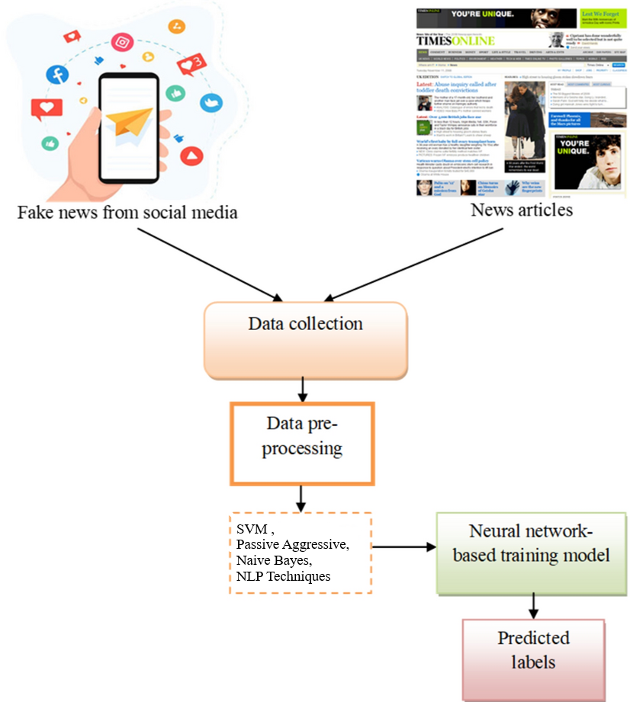
SYSTEM ARCHITECTURE
NIT
Department of Computer Science and Engineering

Slide 11
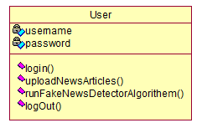
CLASS DIAGRAM
NIT
Department of Computer Science and Engineering

Slide 12
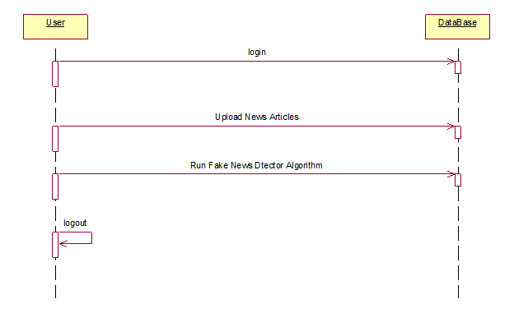
Sequence Diagram
NIT
Department of Computer Science and Engineering

Slide 13
SYSTEM REQUIREMENTS
HARDWARE REQUIREMENTS:
System : Intel i3 2.2Ghz
Hard Disk : 320 GB.
Ram : 4 GB.
NIT
Department of Computer Science and Engineering

Slide 14
SYSTEM REQUIREMENTS
SOFTWARE REQUIREMENTS:
Operating system : Windows 7 Ultimate or Higher
Coding Language : Python.
Front-End : Python.
IDE : PyCharm 2020 Community.
NIT
Department of Computer Science and Engineering

Slide 15
Modules
Data Collection
Text Pre-processing
Model Selection
Training the Model
Validation and Hyperparameter Tuning
Testing and Evaluation
NIT
Department of Computer Science and Engineering
13

Slide 16
Data Collection:
Data collection is essential for training, evaluating, and improving fake news detection models. We have made Data that contains 150 news article of present news that would be used to make predictions at final stage.
NIT
Department of Computer Science and Engineering
13

Slide 17
Text-processing:
We have made a sentiment analysis through NLP that analyse the the trust worthy in the text , So this will can classify Text as true or fake where this NLP algorithm use some background sub-algorithms that classify the text in true or fake .
NIT
Department of Computer Science and Engineering
13

Slide 18
Model Selection:
We have used SVM ,Naive Bayes ,Passive Aggressive classification algorithms for leveraging the Strength of algorithms. All the results that are given by the algorithms are taken by a voting classifiers that take majority voting and decide whether the news is true or fake.
NIT
Department of Computer Science and Engineering
13

Slide 19
Training the Model:
Train the selected models using the training data. Identify the most relevant features that contribute to News accuracy prediction. This can be done using techniques like correlation analysis, feature importance from models, or domain knowledge..
NIT
Department of Computer Science and Engineering
13

Slide 20
Validation and Hyperparameter Tuning:
Tune hyperparameters using techniques like cross-validation to improve model performance. Identification of potential vulnerabilities, improved generalization, and robustness against manipulation
NIT
Department of Computer Science and Engineering
13

Slide 21
Testing and Evaluation:
Evaluate the trained models using the testing data to assess their performance. Common evaluation metrics for regression tasks include mean squared error (MSE) Improved accountability, user trust, and the ability to identify and rectify potential biases in the model
NIT
Department of Computer Science and Engineering
13

Slide 22
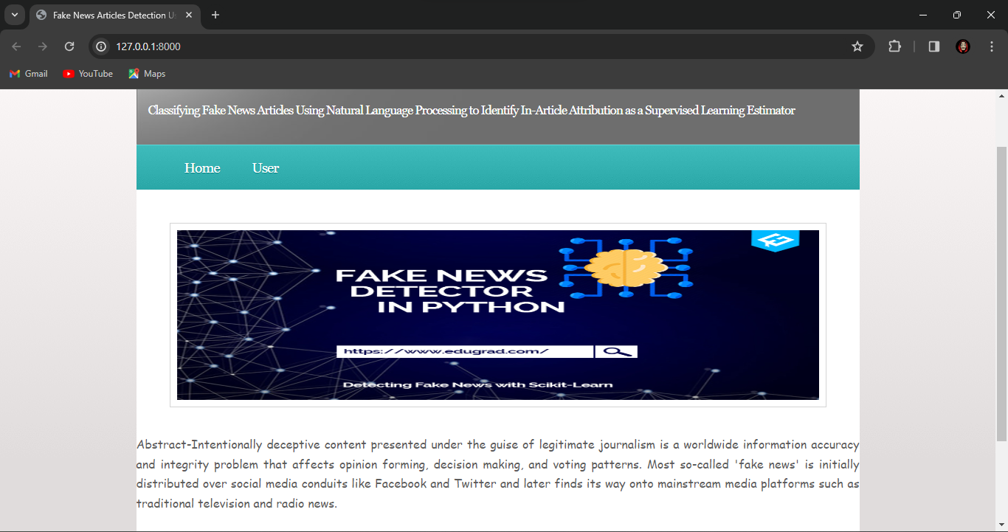
OUTPUT
HOME PAGE
NIT
Department of Computer Science and Engineering

Slide 23
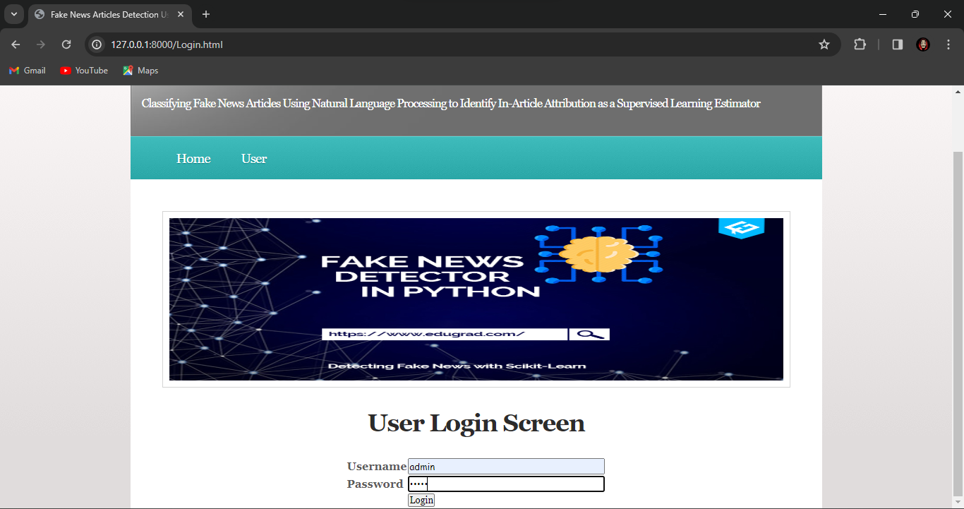
LOGIN PAGE
NIT
Department of Computer Science and Engineering

Slide 24
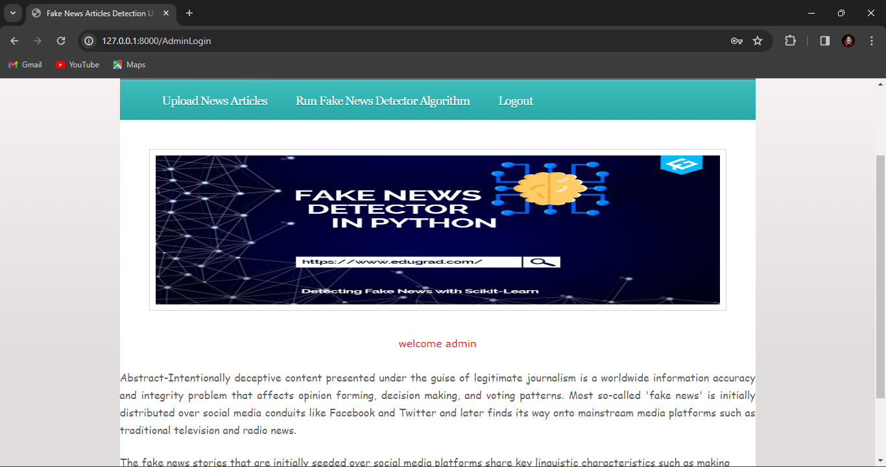
Admin Dashboard
NIT
Department of Computer Science and Engineering

Slide 25
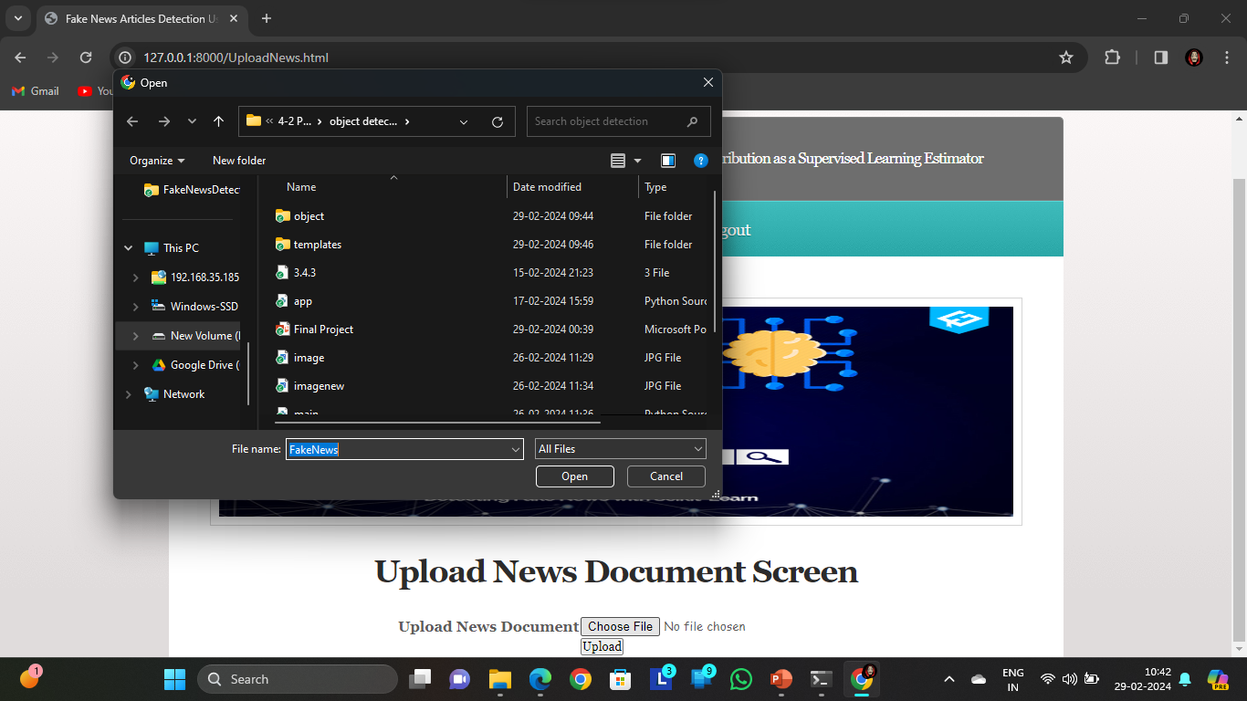
Upload News Articles
NIT
Department of Computer Science and Engineering

Slide 26
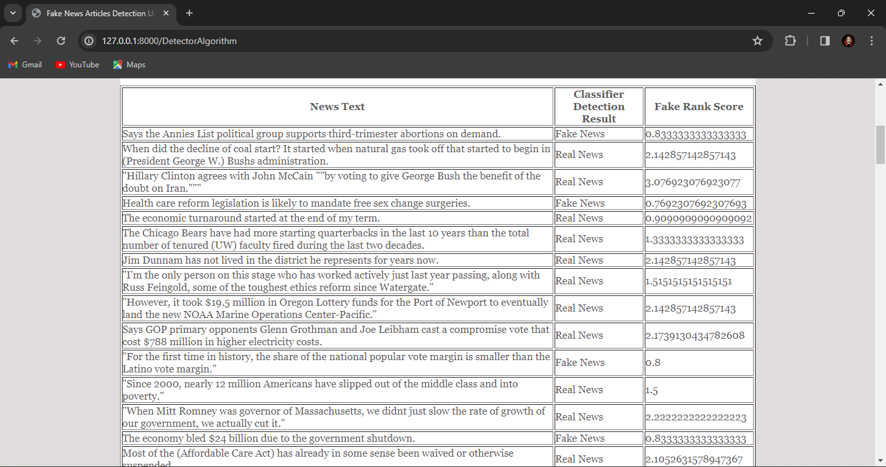
Ouput of Fake News Detector Algorithm
NIT
Department of Computer Science and Engineering

Slide 27
CONCLUSION
This project presented the results of a study that produced a limited fake news detection system. The work presented herein is novel in this topic domain in that it demonstrates the results of a full-spectrum project that started with qualitative observations and resulted in a working quantitative model. The work presented in this project is also promising, because it demonstrates a relatively effective level of machine learning classification for large fake news documents with only one extraction feature. Finally, additional research and work to identify and build additional fake news classification grammars is ongoing and should yield a more refined classification scheme for both fake news
NIT
Department of Computer Science and Engineering

Slide 28
REFERENCES
[1] H. Liu, T. Mei, J. Luo, H. Li, and S. Li, “Finding perfect rendezvous on the go: accurate mobile visual localization and its applications to routing,” in Proceedings of the 20th ACM international conference on Multimedia. ACM, 2012, pp. 9–18.
[2] J. Li, X. Qian, Y. Y. Tang, L. Yang, and T. Mei, “Gps estimation for places of interest from social users’ uploaded photos,” IEEE Transactions on Multimedia, vol. 15, no. 8, pp. 2058–2071, 2013.
[3] S. Jiang, X. Qian, J. Shen, Y. Fu, and T. Mei, “Author topic model based collaborative filtering for personalized poi recommendation,” IEEE Transactions on Multimedia, vol. 17, no. 6, pp. 907–918, 2015
NIT
Department of Computer Science and Engineering

Slide 29
[4] J. Sang, T. Mei, and C. Sun, J.T.and Xu, “Probabilistic sequential pois recommendation via check-in data,” in Proceedings of ACM SIGSPATIAL International Conference on Advances in Geographic Information Systems. ACM, 2012.
[5] Y. Zheng, L. Zhang, Z. Ma, X. Xie, and W. Ma, “Recommending friends and locations based on individual location history,” ACM Transactions on the Web, vol. 5, no. 1, p. 5, 2011.
[6] H. Gao, J. Tang, X. Hu, and H. Liu, “Content-aware point of interest recommendation on location-based social networks,” in Proceedings of 29th International Conference on AAAI. AAAI, 2015.
NIT
Department of Computer Science and Engineering

Slide 30
[7] Q. Yuan, G. Cong, and A. Sun, “Graph-based point-of-interest recommendation with geographical and temporal influences,” in Proceedings of the 23rd ACM International Conference on Information and Knowledge Management. ACM, 2014, pp. 659–668.
[8] H. Yin, C. Wang, N. Yu, and L. Zhang, “Trip mining and recommendation from geotagged photos,” in IEEE International Conference on Multimedia and Expo Workshops. IEEE, 2012, pp. 540–545.
[9] Y. Gao, J. Tang, R. Hong, Q. Dai, T. Chua, and R. Jain, “W2go: a travel guidance system by automatic landmark ranking,” in Proceedings of the international conference on Multimedia. ACM, 2010.
NIT
Department of Computer Science and Engineering

Slide 31
[10] X. Qian, Y. Zhao, and J. Han, “Image location estimation by salient region matching,” IEEE Transactions on Image Processing, vol. 24, no. 11, pp. 4348–4358, 2015.
[11] H. Kori, S. Hattori, T. Tezuka, and K. Tanaka, “Automatic generation of multimedia tour guide from local blogs,” Advances in Multimedia Modeling, pp. 690–699, 2006.
[12] T. Kurashima, T. Tezuka, and K. Tanaka, “Mining and visualizing local experiences from blog entries,” in Database and Expert Systems Applications. Springer, 2006, pp. 213– 222
NIT
Department of Computer Science and Engineering

Slide 32

NIT
Department of Computer Science and Engineering

