Slide 1
Student Management Information System
Guided By :- Dr.Thulase M.B (Lecture Dept. of Computer Science)
Presented By :-
Pavan Kumar K (102CS16039)
Gowtham S (102CS16018)
Shyam R (102CS16051)
John Bosco (102CS16023)

Slide 2



Introduction
Student Management Information System is a automated application system that manage the information such as student data, and process them to display the analytics with respective permissions.
Through this system the student can view their attendance, internals, previous semester results.
Teachers known as administrators will assign the task of updating all the records/data of the student.

Slide 3




Objective
Portability
To ensure portability I.e. to make sure that the program will run in any machine which satisfy the requirement
Organized Data
To make sure that the data retrieved from the database are properly organized and displayed, so that the user won’t be confused .
Quick Response
To minimize the time taken to retrieve the data from the database using modern frameworks.
Availability Of Data
To make sure that the data is not erased or lost due to some malfunction caused.

Slide 4
Existing System
Proposed System
Lack of important feature like Reliability.
Existing System usually carries out paper work which is indeed time consuming and a burden to maintain.
Data lose are untraceable.
Data retrieving, updating, deleting is done manually.
Requires more man power to accomplish the work.
Includes the features like Reliability and Portability.
All the task are automated doesn't require any paper work, and no burden to maintain data.
Operation such as inserting, updating, deleting and retrieving data are computerized and accomplished with minimal amount of time.
Doesn’t require more man power compared to existing system.

Slide 5
Hardware Requirement
Software Requirement
CPU : Recommended minimum CPU - Pentium 4, 3.2GHz
Memory : 4 GB DDR3 and above.
Storage : 50 GB of hard disk space.
Additional : Network Card
Operating System : Windows 7 & and above.
Tool Required : Local Server such as Xampp or Wampp
Web browser : Any Browser with latest version.

Slide 6
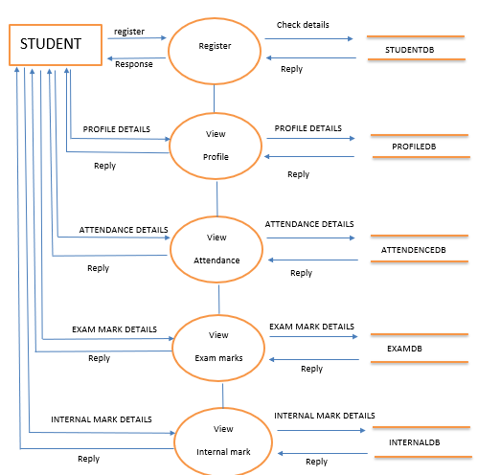
Student Module Data Flow Diagram

Slide 7
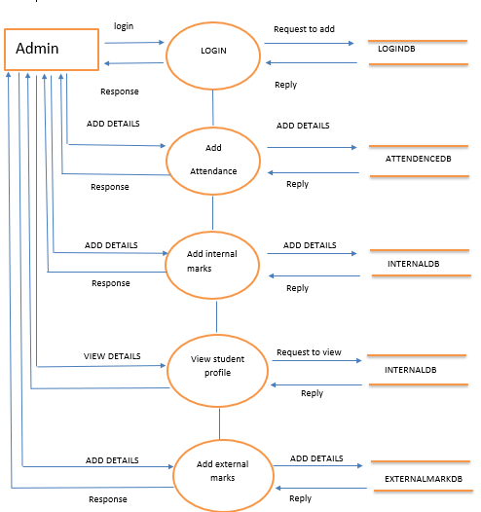
Admin Module Data Flow Diagram

Slide 8
Test Cases
Test Case No | TC-1
Test Case Description | Test for launch of the website in all browsers(Chrome,IE,Firefox)
Input Given | Give website url in the url path
Expected output | Home page should be opened
Actual output | Home page is displayed in the screen
Remarks | Success
Test Case No | TC-3
Test Case Description | Test to check the login form of admin
Input Given | Username and Password to login form of Admin
Expected output | Enter into respective login page of Admin
Actual output | Login page displayed on the screen of respective Admin
Remarks | Success
Test Case No | TC-2
Test Case Description | Test to check weather all the menus opens properly
Input Given | Click in the menus
Expected output | Webpages should open with respective menus
Actual output | Webpages opened with respective menus
Remarks | Success
Test Case No | TC-4
Test Case Description | Test to check the Registration of Student
Input Given | Details of Student
Expected output | Registration successful
Actual output | Accepted all the information and successful message was displayed
Remarks | Success

Slide 9
Test Case No | TC-5
Test Case Description | Test to check adding student internal marks
Input Given | Student internal marks
Expected output | Internal marks should be added
Actual output | Internal marks of the student added and successful message was displayed
Remarks | Success
Test Case No | TC-7
Test Case Description | Test to view students internal , external and attendence details
Input Given | Student regno and current semester
Expected output | Student internal , external and attendence details should get displayed
Actual output | Student internal , external and attendence details displayed in the screen
Remarks | Success
Test Case No | TC-6
Test Case Description | Test to check adding student attendance details
Input Given | Student attendance details
Expected output | Student attendance should be added
Actual output | Student attendance details added and successful message was displayed
Remarks | Success
-TEST CASES ENDS

Slide 10
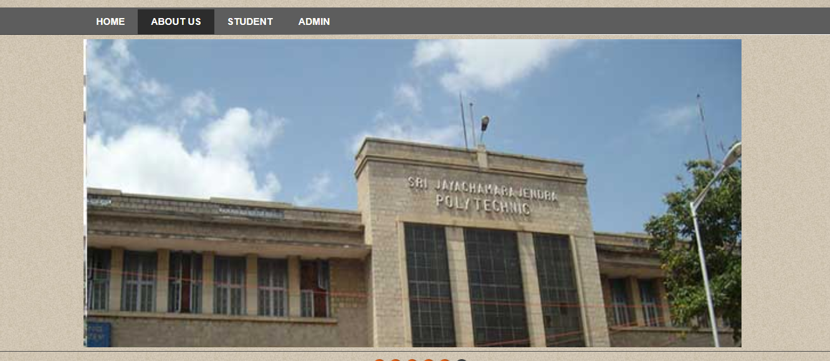
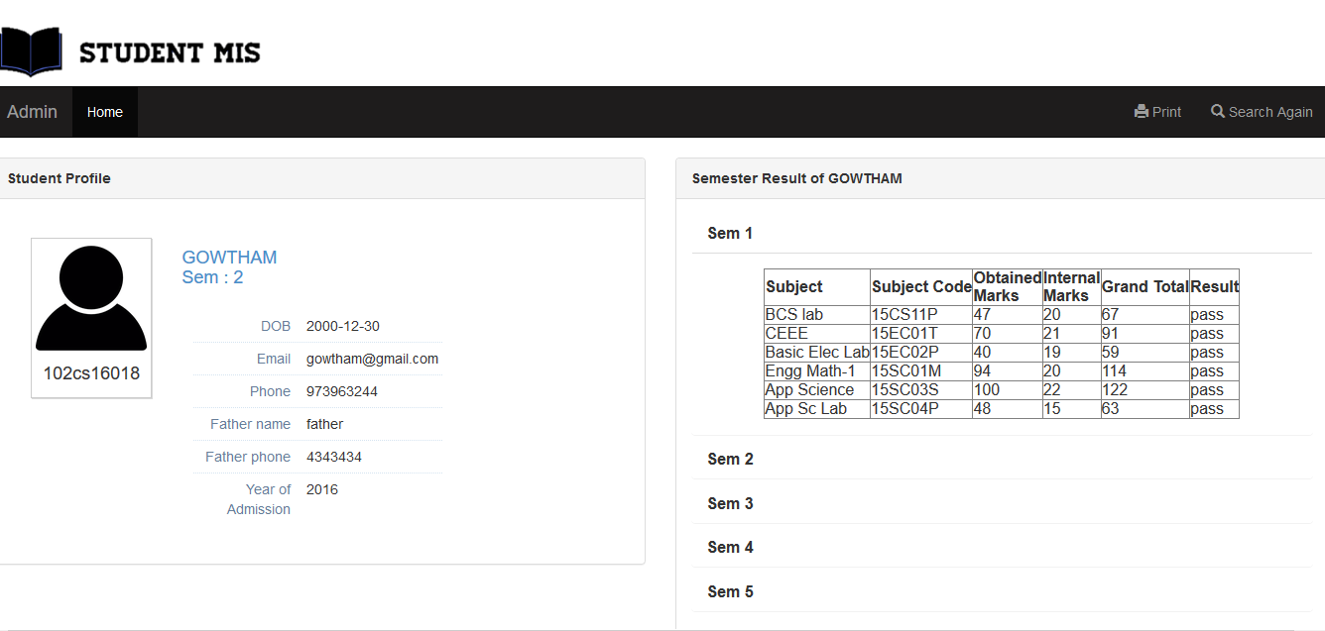
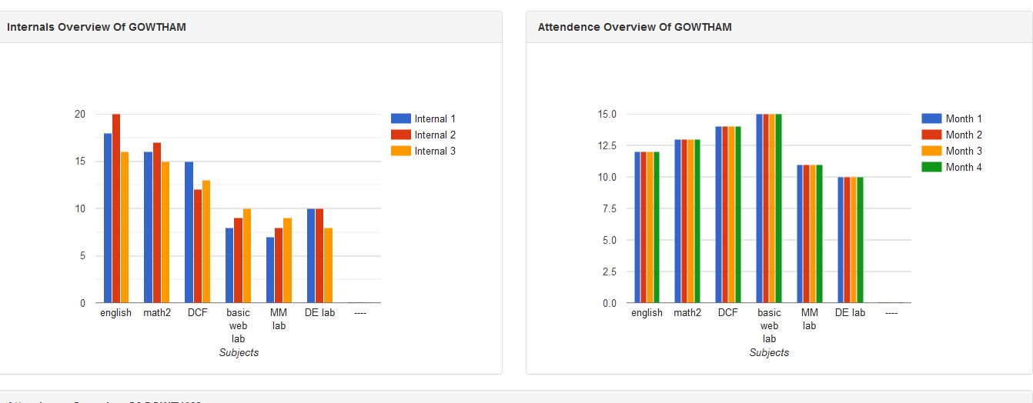
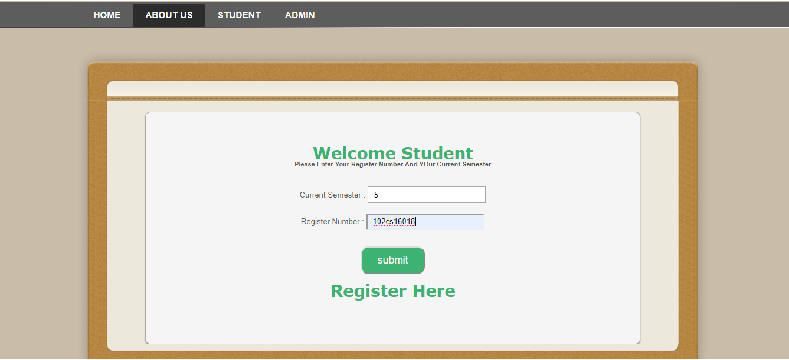
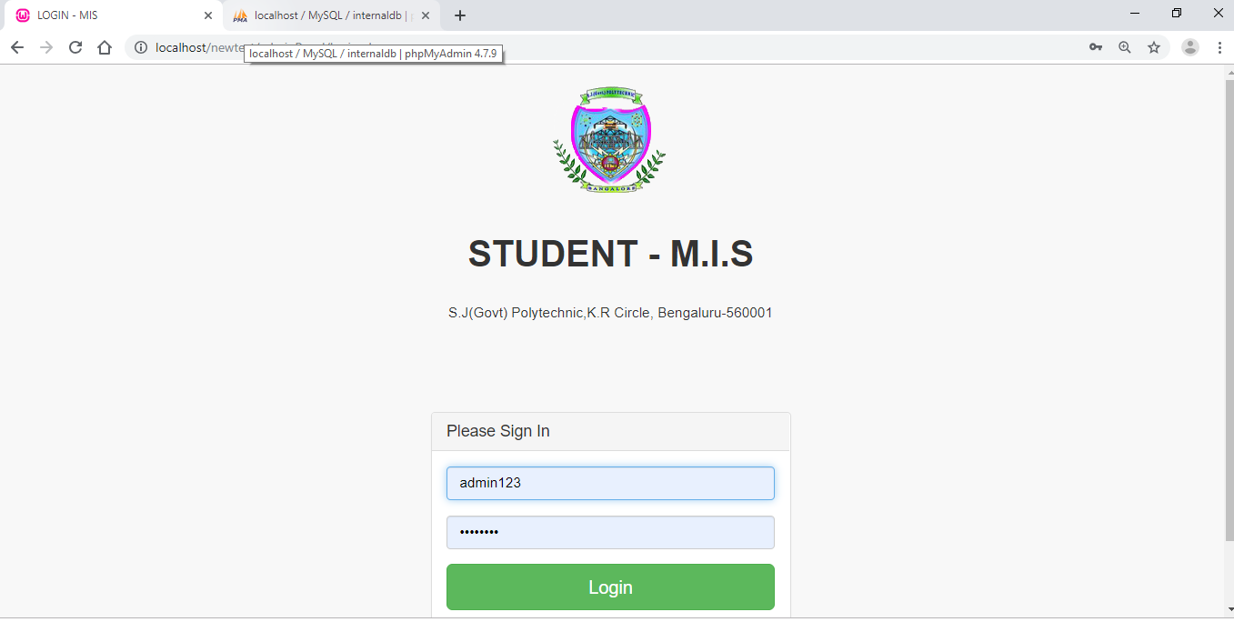
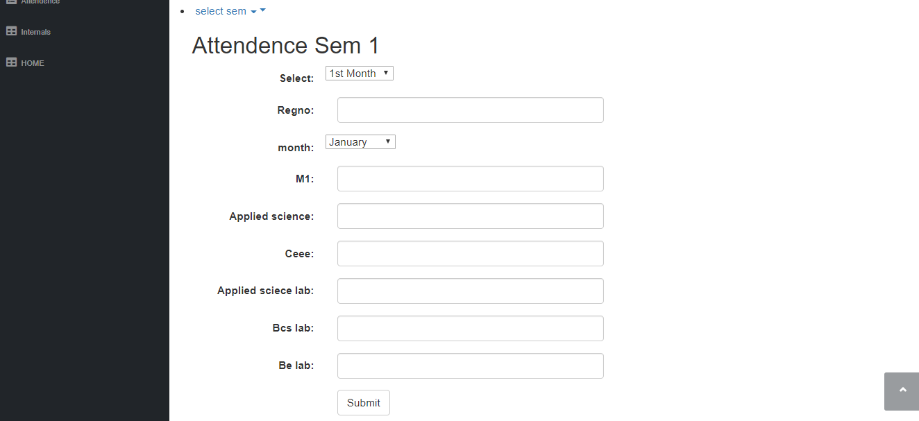
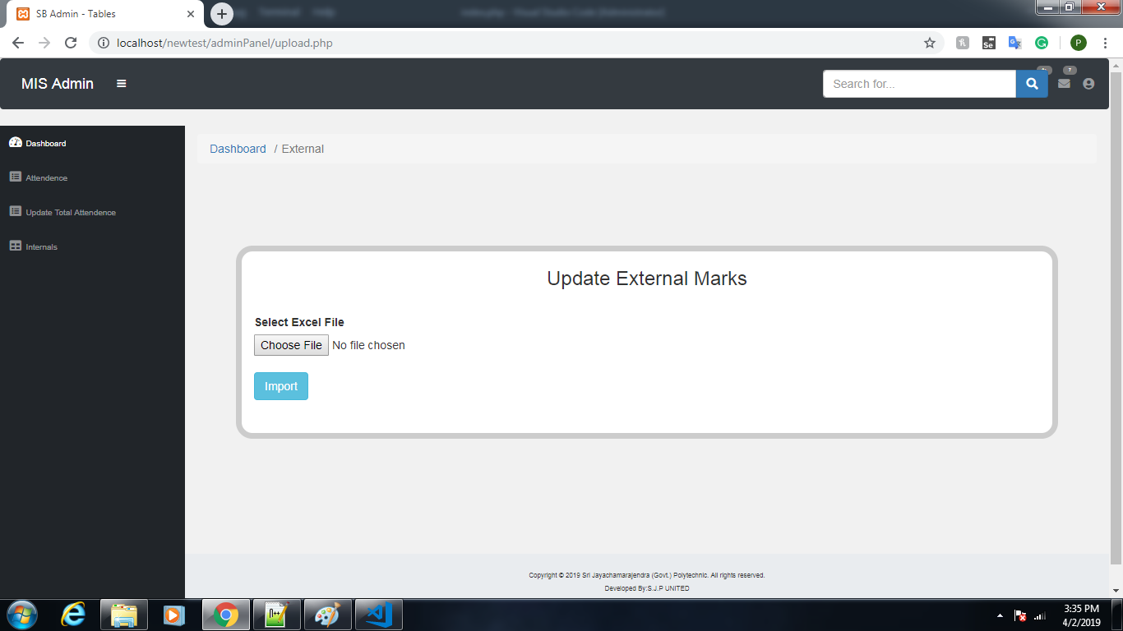
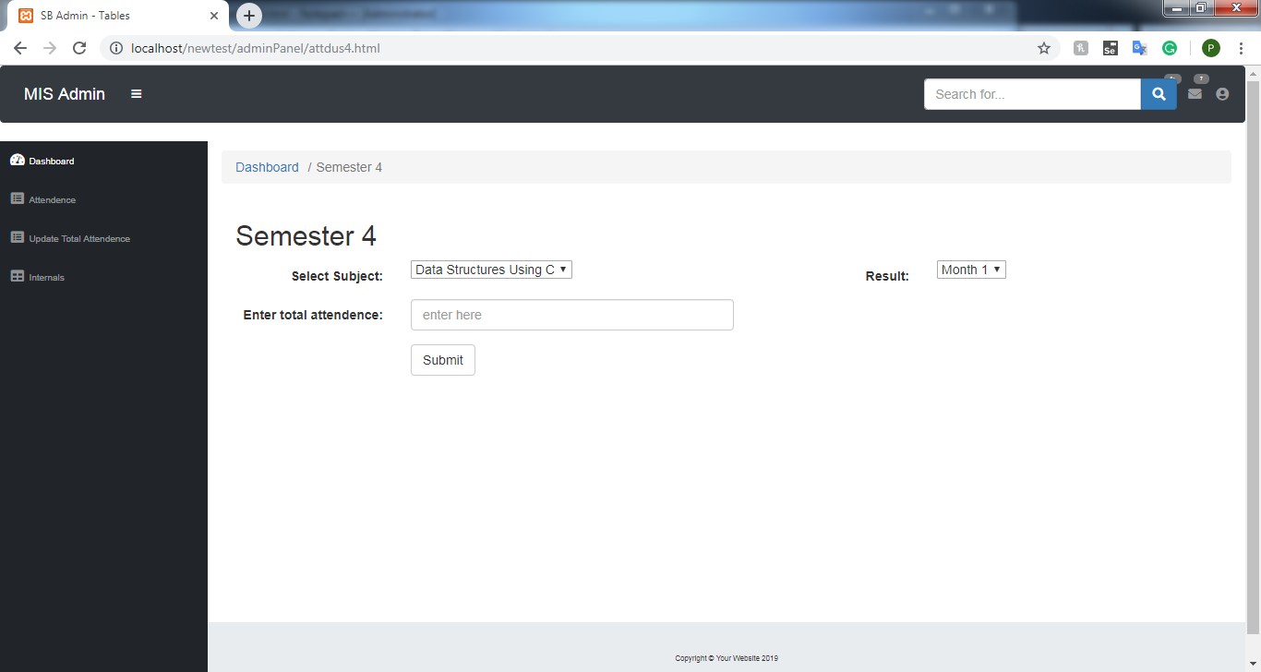
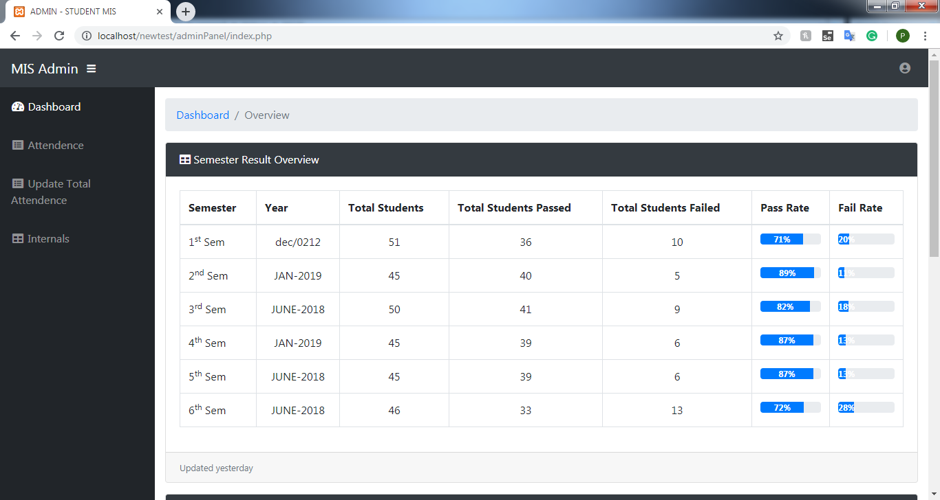
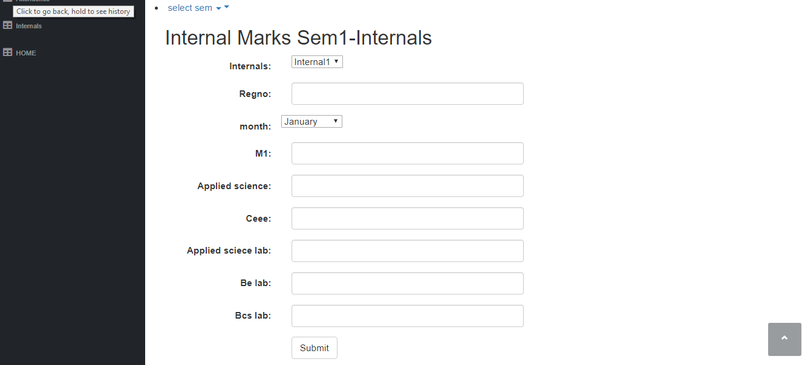
Snaps Of The Project

Slide 11
Login page for Admin
Adding Internal Marks
Home page of Admin module
Update form for admin

Slide 12
Adding Total Attendance
Updating External Marks by selecting the Excel file

Slide 13

Future Enhancement
Speed up the data fetching from database by replacing MySql with P.L Sql.
Modernizing User Interface with Mejestic.js.
Making the Project more reactive by using Angular JS and React JS.
Improve the performance of the code using various modern technologies. Eg: Vue.js, Lax.js.

Slide 14
Conclusion
Therefore, MIS are made for a speedy access to accurate data and to help the managers achieve their goals.
Management Information System (MIS) is so useful in the organization which it creates an impact on the organization’s performance, functions, and of course productivity.
In an organization, Managers has to take decisions and Management Information System (MIS) is a good help to support them in making decision by providing information at various stage of decision making.

