Slide 1
IBM/UMKC Hackathon
By
Pavan Kumar Bollaram
Sashidhar Reddy Gowra
Lavanya Kumar Somu
Srikar Reddy Mallareddygari
Rajasekhar Reddy ogirala
11/20/2014

Slide 2
Introduction
Developing a Mobile application to extract the mobile sensor readings.
Further, this sensor data can be analyzed for useful applications.

Slide 3
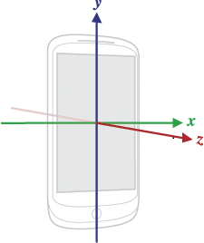
Android Sensors
Android framework provides access to many types of sensors.
Accelerometer, Proximity, Gravity, Gyroscope, Magnetic Field, Orientation, Rotation Vector etc..
Source: http://developer.android.com/guide/topics/sensors/sensors_overview.html

Slide 4
Services
IBM Bluemix Services – Mobile Cloud
Android Sensors
Android Accelerometer
GPS

Slide 5
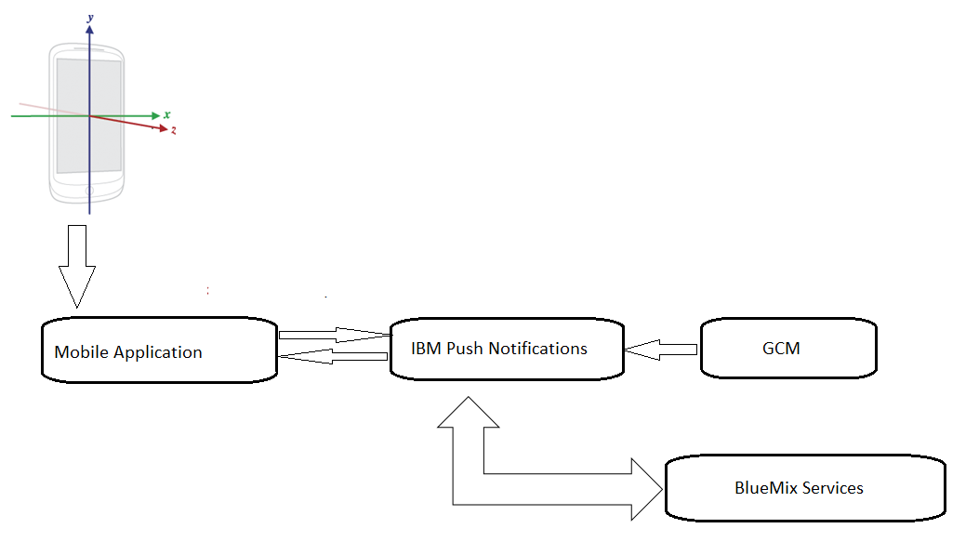
Design

Slide 6
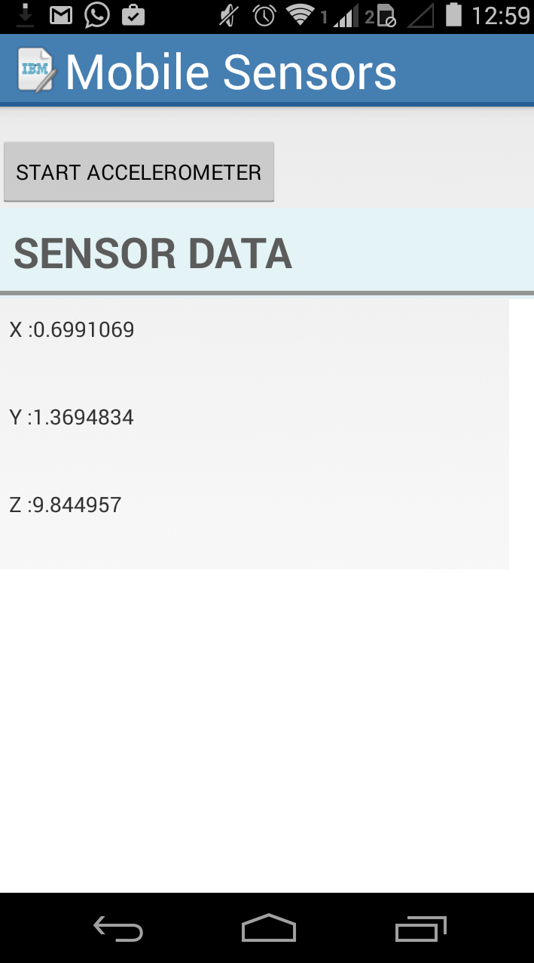
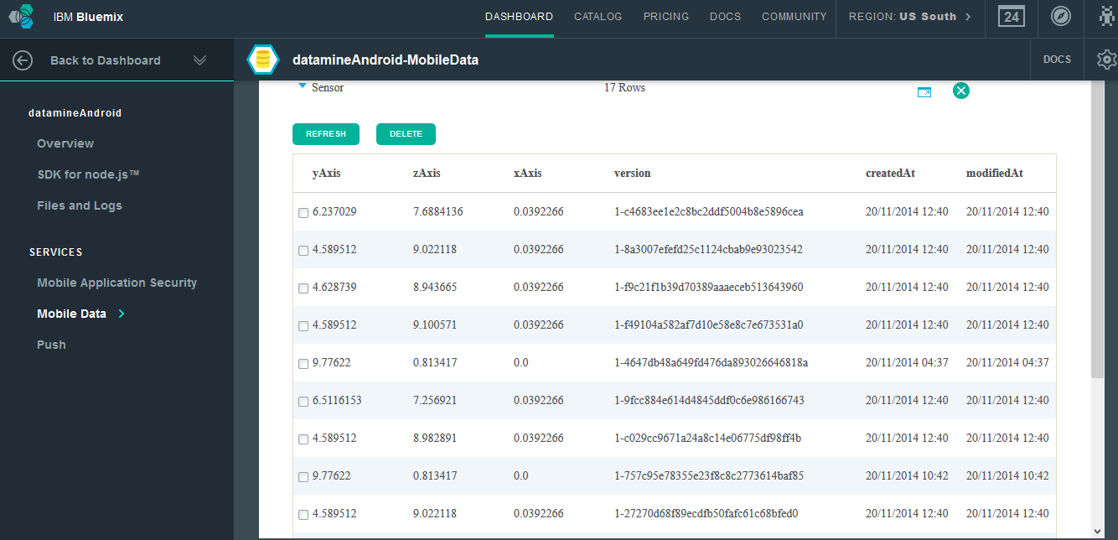
Application

Slide 7
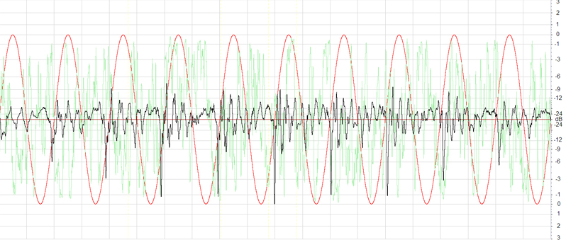
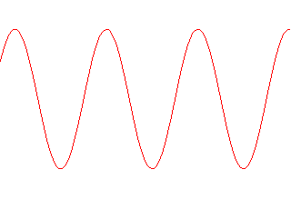
Raw Sensor Data Wave
Filtered Sensor Data

Slide 8
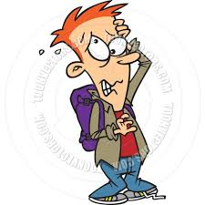



Application using GPS Sensor data
Use Case : Returning a book which reached due date at Library
Books to be returned to the library
Started to college to attend classes and return due books.
Attended the classes and spend some quality time in library.
Now you came back to home. You forgot to return the book. And its time to worry about $120 fine due to overdue.

Slide 9

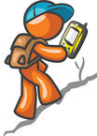
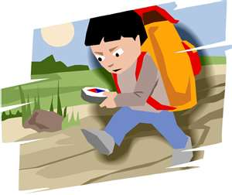
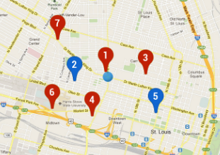
So Now How the GPS Sensor Data will be helpful to avoid 120$ fine ???
Books to be returned to the library
Attended the classes
Now associate the work to be done with the GPS coordinates of library.
Started to college
FB Status:
☺ Feeling relaxed- at home with –Tag1, Tag2.
As soon as you are in the range of library You will get a mobile notification which alerts you to return the due books.

Slide 10
How the application works ??
Using google APIs(google-play-services.jar) we can retrieve the GPS coordinates by inputting the destination address.
We will associate the work to be done with these coordinates by manually entering the todo thing in a text field of mobile app.
We will push the coordinates and todo thing to IBM Mobile Cloud.
In the coding we will be constantly gathering the GPS coordinates and will compare these coordinates with the predefined coordinates.
And a mobile alert will be generated when the current GPS coordinates reaches the range of predefined coordinates.

Slide 11
Thank You

