Slide 1
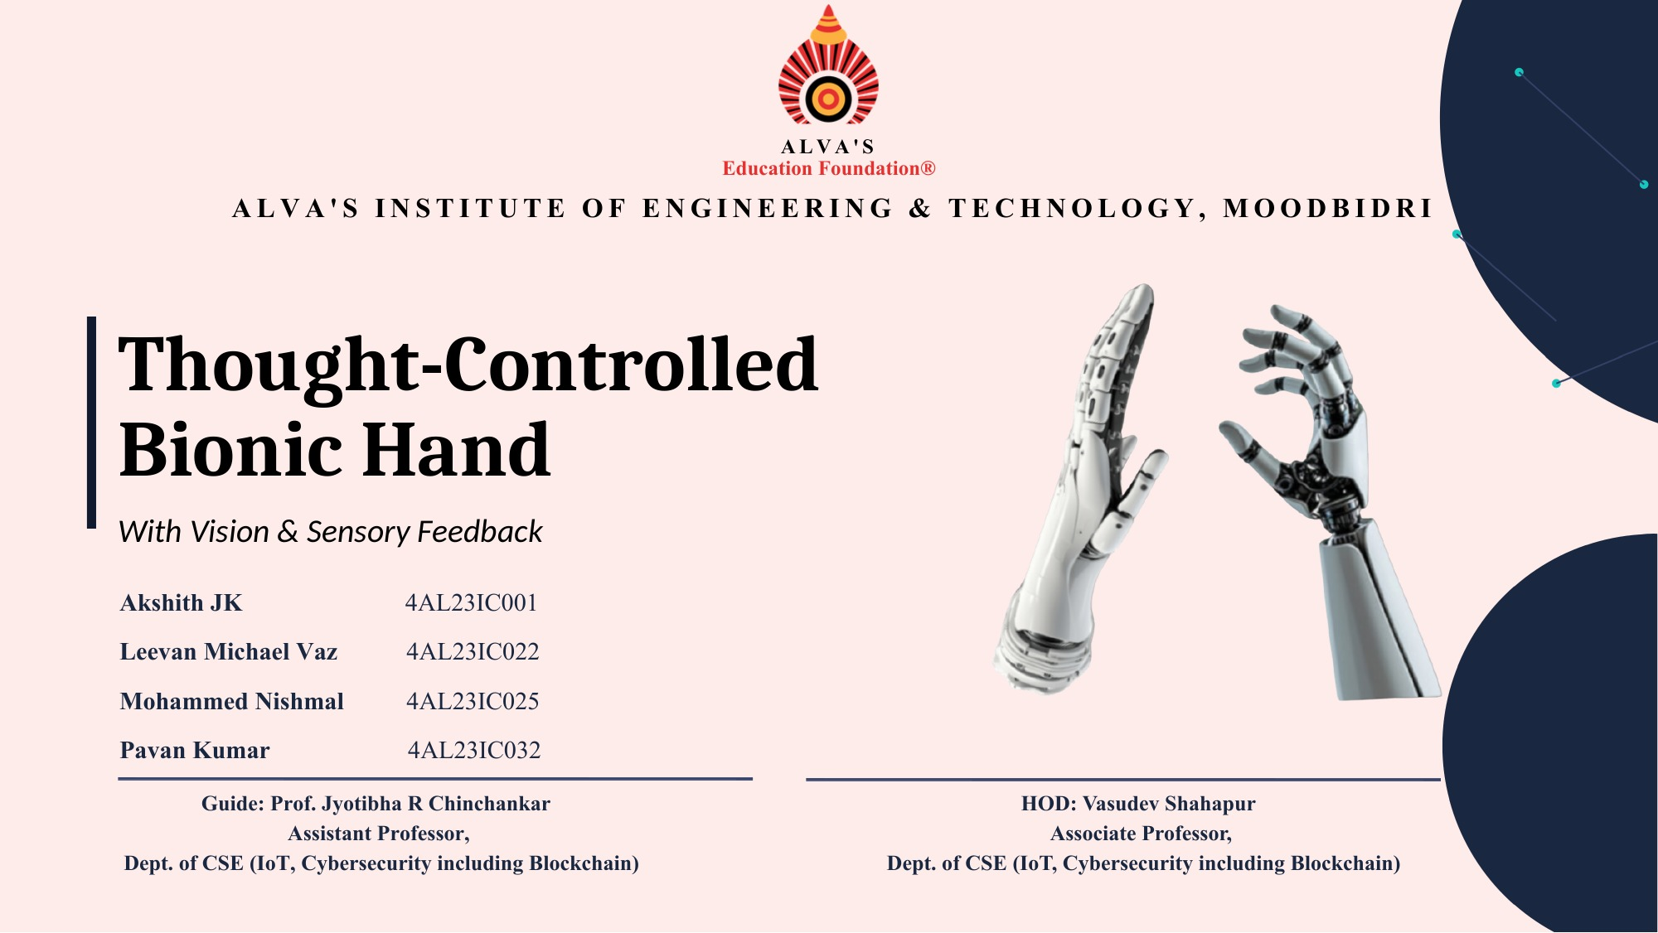

Slide 2
AGENDA
What we'll cover
01
Introduction
06
Software Requirements
02
Problem Statement
07
Expected Outcomes
03
Surface EMG Signal Processing
08
Literature Review
04
Proposed Methodology
09
References
05
Hardware Requirements
THOUGHT-CONTROLLED BIONIC HAND
02 / 14

Slide 3
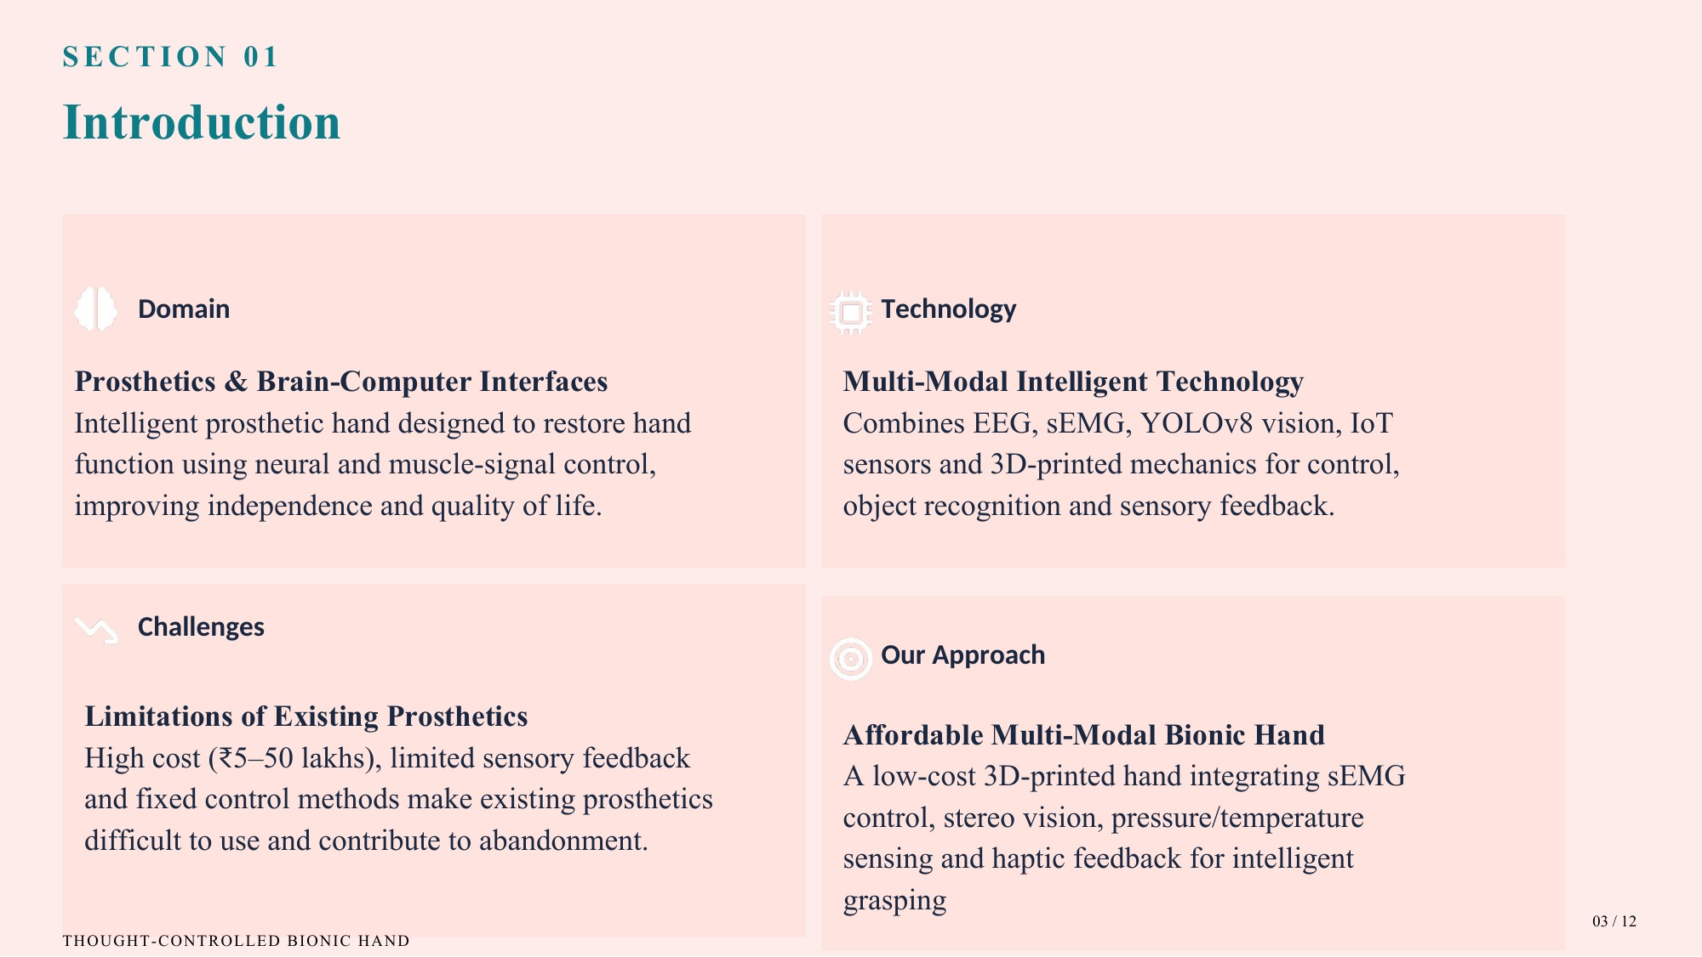
03 / 14

Slide 4
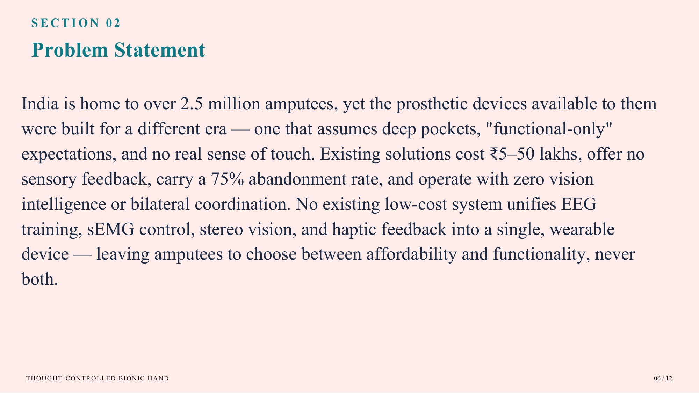
04 / 14

Slide 5
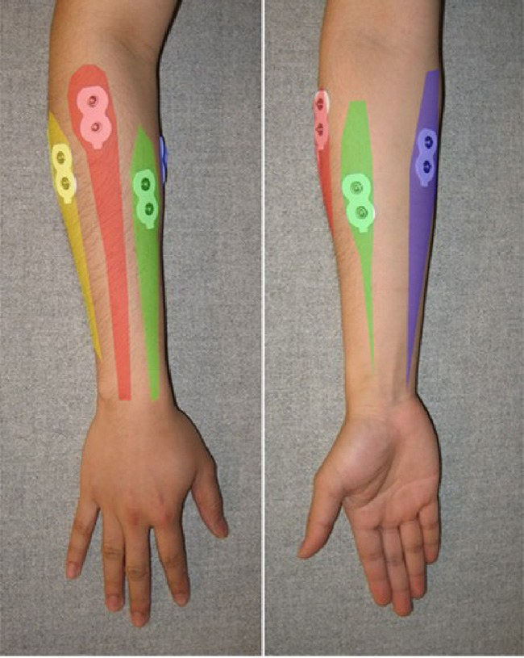
SECTION 03
Surface EMG: Reading the Muscle Signal
1
Non-invasive
Electrodes on the skin record muscle activity, with no surgery.
2
Natural control
Closing the hand fires the forearm flexors; opening fires the extensors.
3
Signal to command
Software recognizes the pattern and drives the prosthetic hand.
1 Acquire
2 Segment
3 Extract
4 Classify
5 Actuate
THOUGHT-CONTROLLED BIONIC HAND
Photo: Tavakoli et al., 2017
05 / 14
Notes:
sEMG measures the electrical activity produced when forearm muscles contract, using electrodes on the skin. Closing the hand activates the flexors, opening activates the extensors, so the pattern tells us the intended movement. The bottom row is the roadmap for the next four slides.

Slide 6
SECTION 3a
From Raw Signal to Features
1 Detect onset
2 Window
3 Extract features
threshold = baseline mean + 3σ
250 ms segments (< 300 ms for real-time)
MAV · WL · ZC · SSC
MAV
average signal strength
WL
waveform complexity
MAV = (1/N) Σ |xᵢ|
WL = Σ |xᵢ₊₁ − xᵢ|
ZC
how often the signal crosses zero
SSC
how often the slope reverses
ZC = Σ [ sgn(−xᵢ·xᵢ₊₁) ∧ |xᵢ − xᵢ₊₁| ≥ thr ]
SSC = Σ [ (xᵢ − xᵢ₋₁)(xᵢ − xᵢ₊₁) ≥ thr ]
Time-domain features are fast and simple, ideal for low-cost real-time hardware.
THOUGHT-CONTROLLED BIONIC HAND
Sources: Shi et al., 2018; Tavakoli et al., 2017
06 / 14
Notes:
First we detect when a gesture starts using a threshold above the resting baseline. Then a short window of the signal is converted into a few numbers. These four time-domain features are cheap to compute, which is why they suit real-time embedded hardware.

Slide 7
SECTION 3b
Classification: Which Gesture Was It?
SVM · one-vs-rest
k-Nearest Neighbours
Features
Close vs rest?
CLOSE
no
Open vs Change?
OPEN / CHANGE
Gaussian kernel (similarity of two feature points)
A new sample (★) takes the class of the majority of its k closest training samples. Best accuracy at k = 9.
K(xᵢ,xⱼ) = e^( −‖xᵢ − xⱼ‖² / 2σ )
Lock gesture: a double wrist flexion locks / unlocks the system, preventing false triggers.
THOUGHT-CONTROLLED BIONIC HAND
Sources: Tavakoli et al., 2017; Shi et al., 2018
07 / 14
Notes:
Two classifiers are used. The SVM splits the problem into simple yes/no decisions; the Gaussian kernel measures similarity between feature vectors. k-NN compares a new sample with stored training samples and takes a majority vote. A lock gesture makes the system ignore everything until unlocked, which prevents accidental movements.

Slide 8
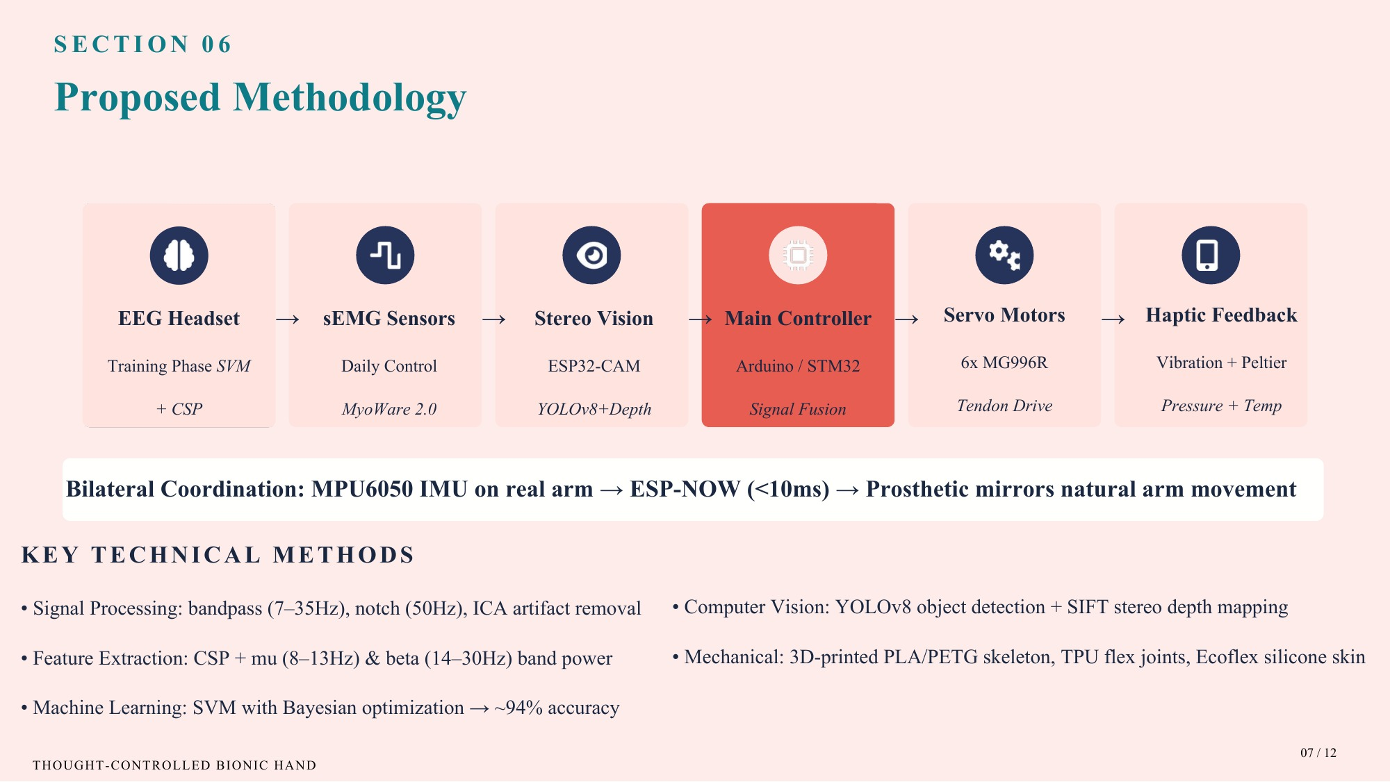
04
08 / 14

Slide 9
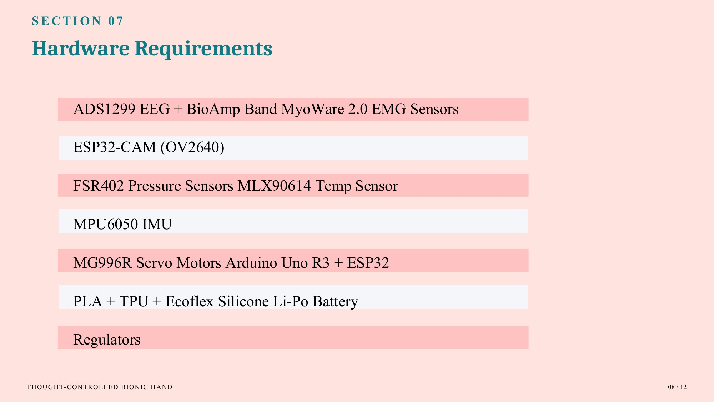
05
09 / 14

Slide 10
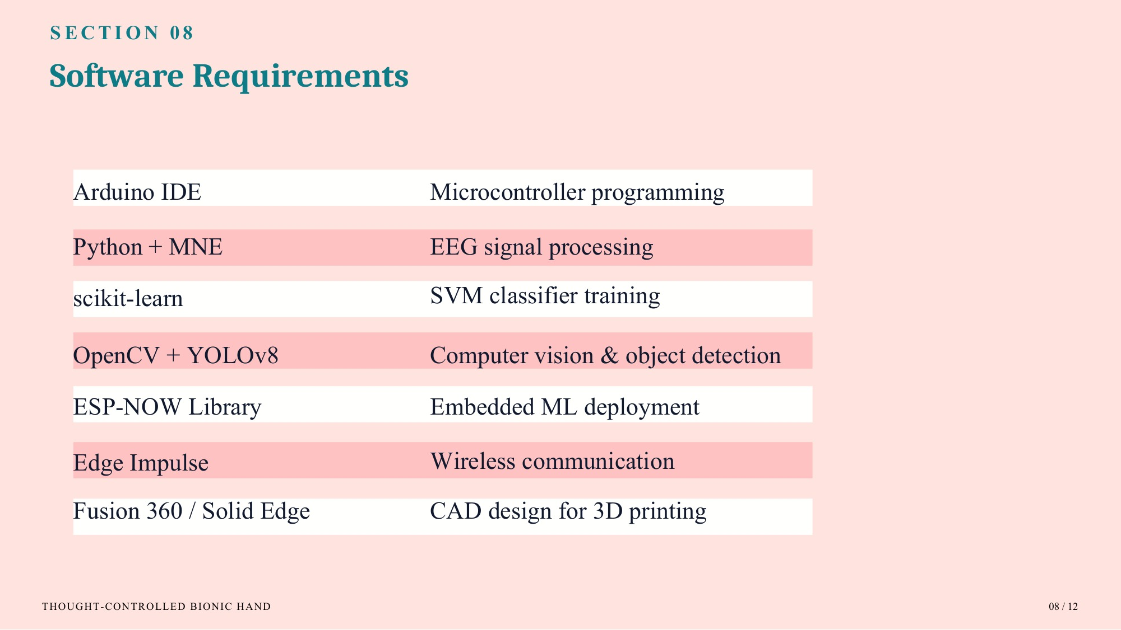
06
10 / 14

Slide 11
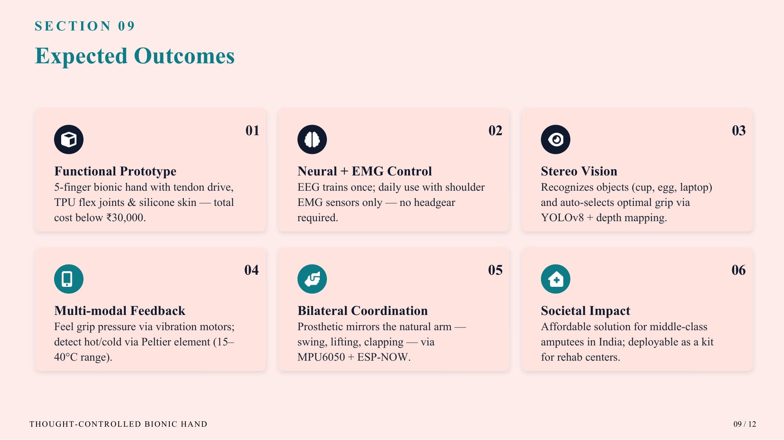
07
11 / 14

Slide 12
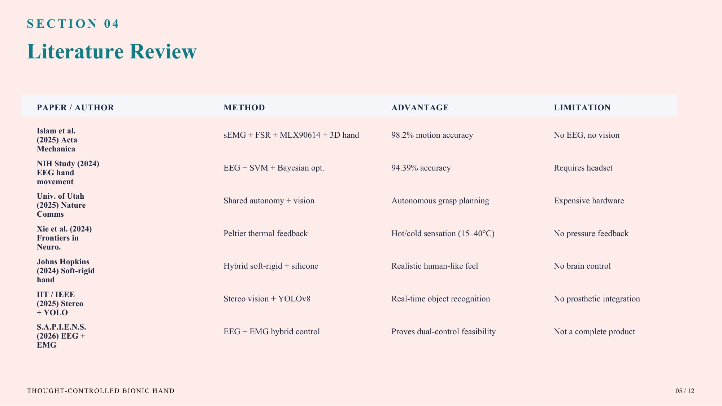
08
12 / 14

Slide 13
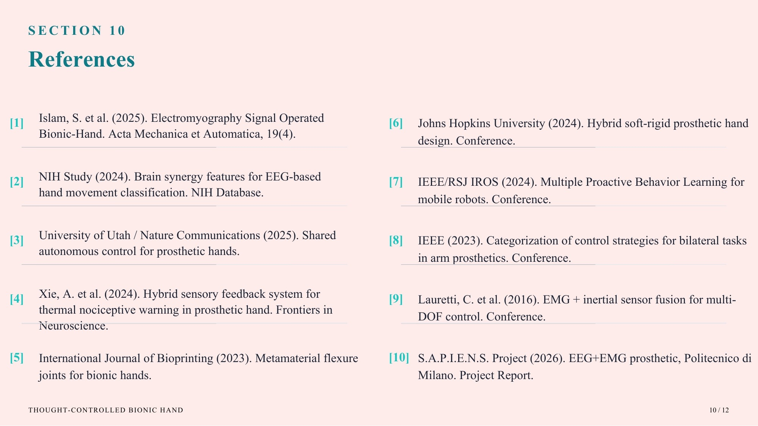
09
13 / 14

Slide 14


