Slide 1
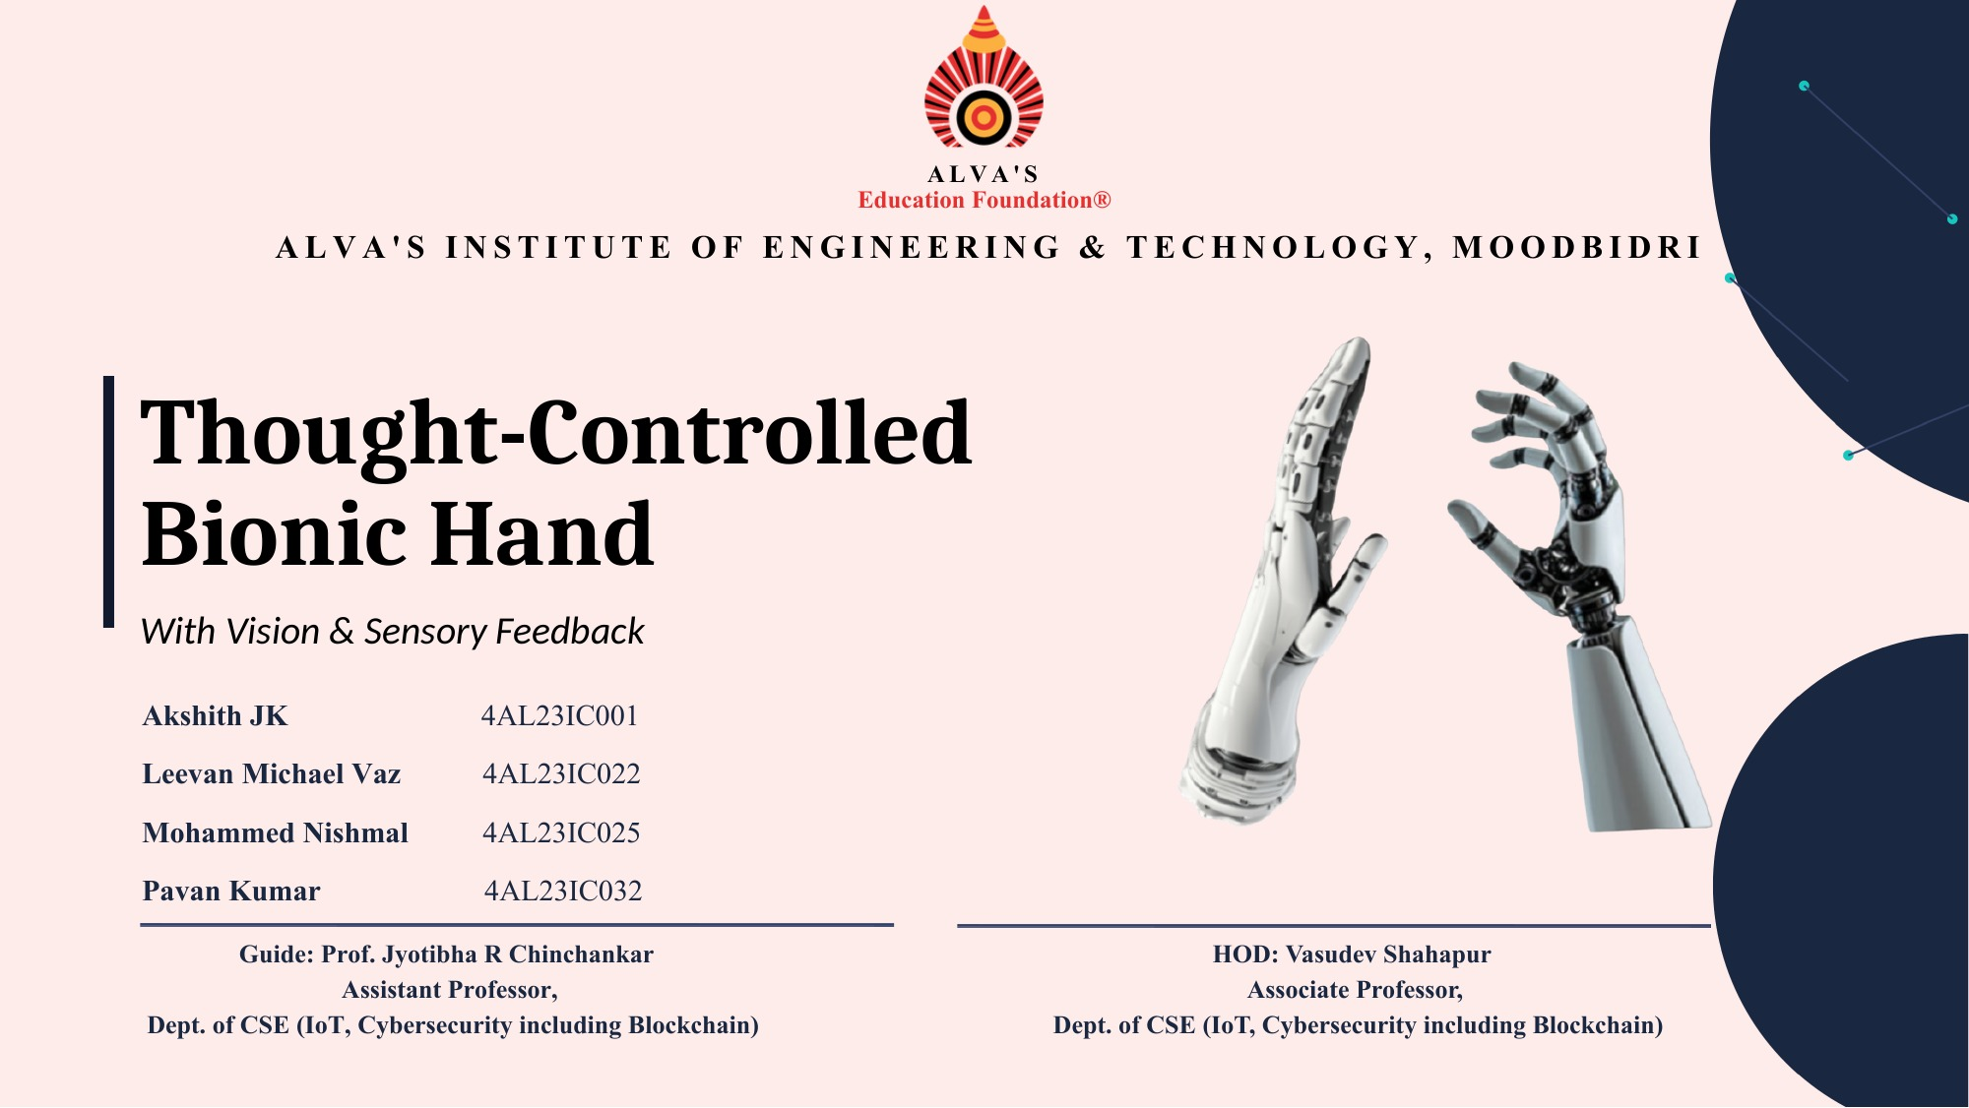

Slide 2
AGENDA
What we'll cover
01
Introduction
06
Hardware Requirements
02
Problem Statement
07
Software Requirements
03
Hand Camera & Grasp Selection
08
Expected Outcomes
04
Surface EMG Signal Processing
09
Literature Review
05
Proposed Methodology
10
References
THOUGHT-CONTROLLED BIONIC HAND
02 / 16

Slide 3
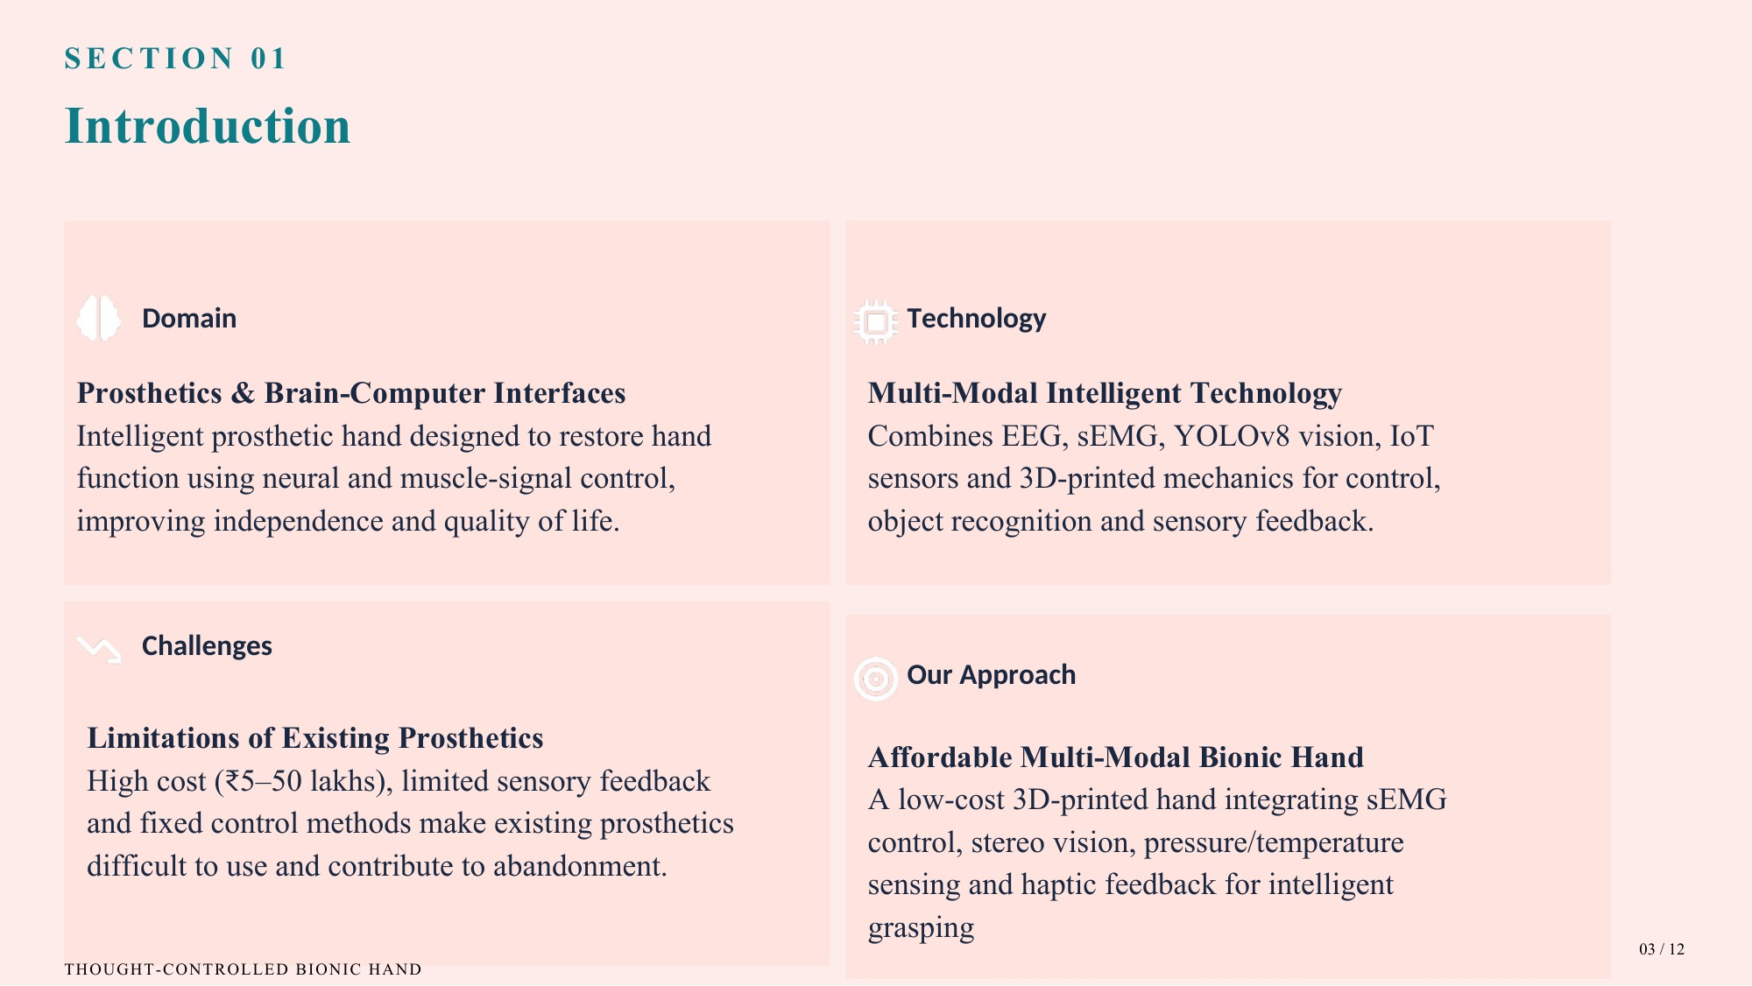
03 / 16

Slide 4
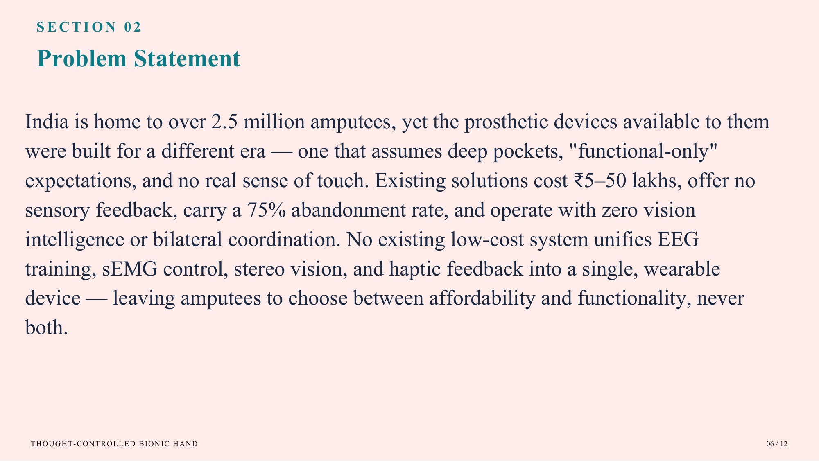
04 / 16

Slide 5
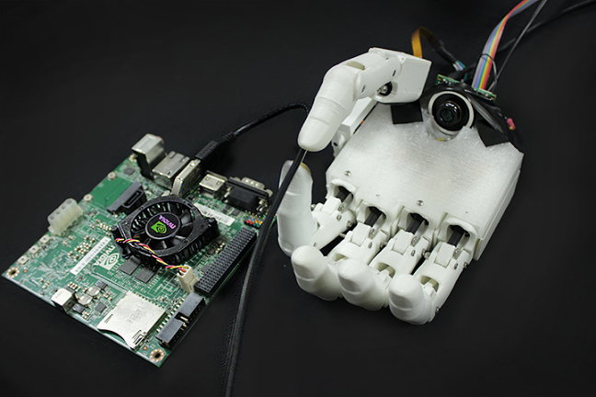
SECTION 03
Hand Camera: Letting the Hand See
1
Camera in the palm
Faces the object the hand is about to grasp. No RFID tags or head-mounted camera needed.
2
Image to grip
A CNN classifies each image into one of five grasps: power, pinch, tool, 3-jaw chuck or key.
3
Vision picks, EMG triggers
The camera chooses the grip; muscle signals only open and close. This reduces multi-grasp EMG errors.
Prosthetic hand with a palm camera and a mobile GPU processor
1 Capture
2 Detect
3 Depth
4 Select grip
5 Actuate
THOUGHT-CONTROLLED BIONIC HAND
Photo: DeGol et al., 2016
05 / 16

Slide 6
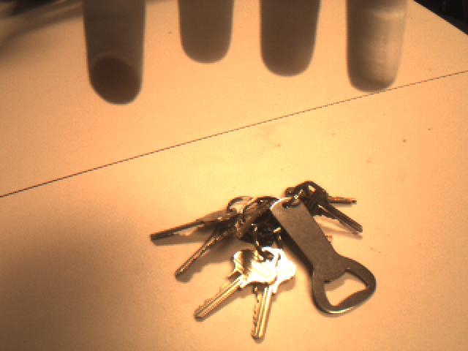
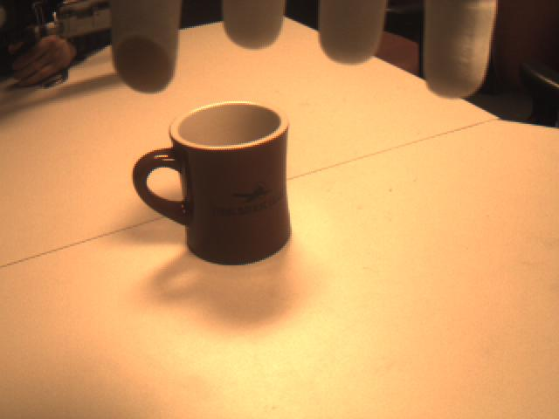
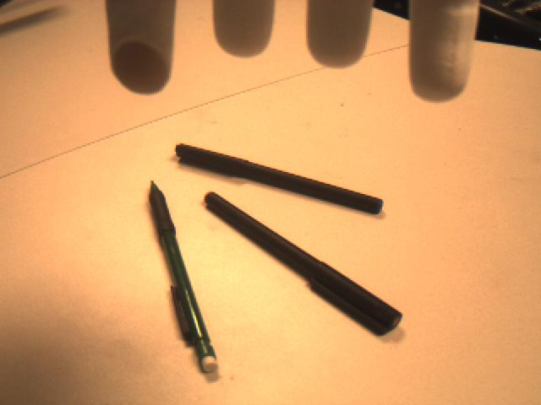
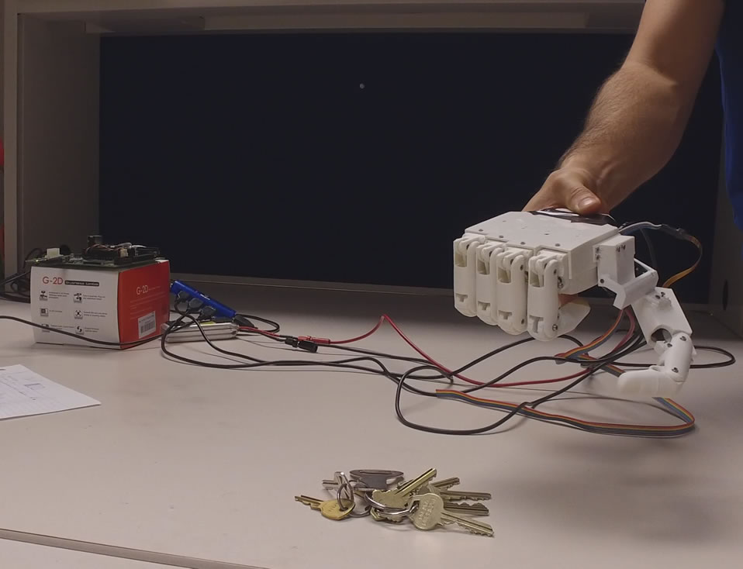
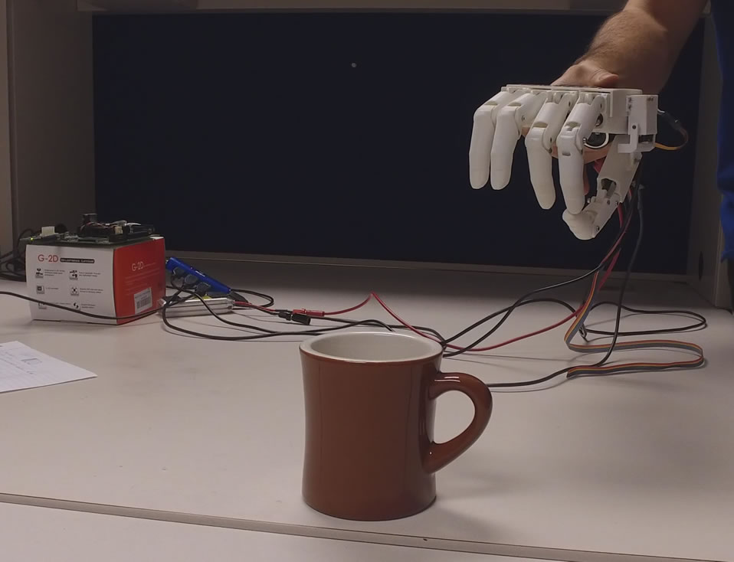
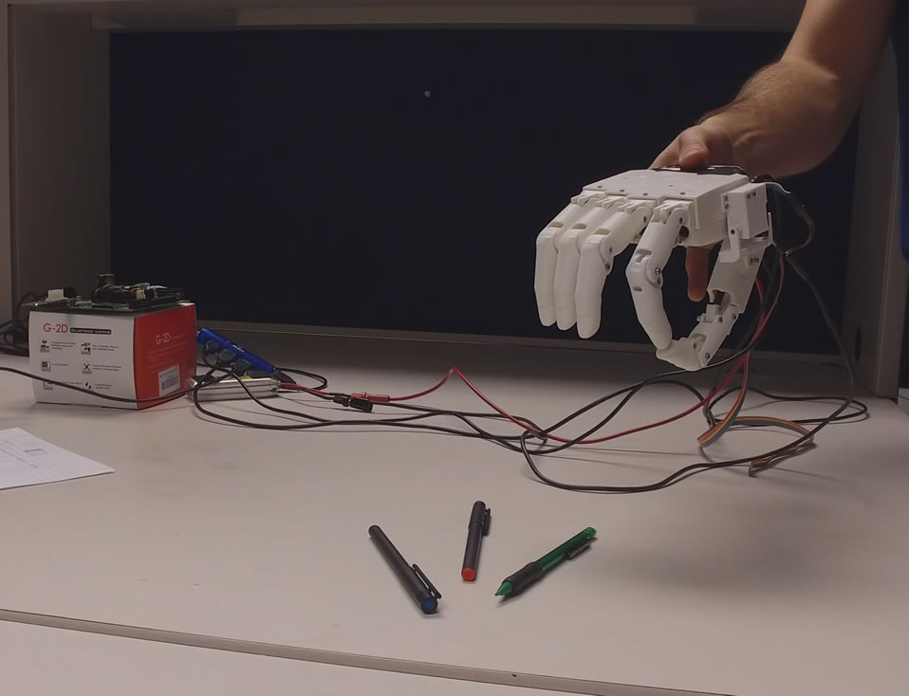
SECTION 3a
Camera Grasp Selection: Results
Grasp accuracy
Real-time test: object to grasp
93.2%
What the camera sees
mean accuracy on 250 hand-camera images (50 objects, 5 views each), unseen in training
Pinch
98%
How the hand responds
3-jaw chuck
96%
Power
94%
Key
92%
Tool
86%
Keys
Mug
Pens
Our design: ESP32-CAM + YOLOv8 + depth mapping picks the grip. Weakest case: tool grasp (86%), trigger hidden.
THOUGHT-CONTROLLED BIONIC HAND
Source: DeGol et al., 2016
06 / 16

Slide 7
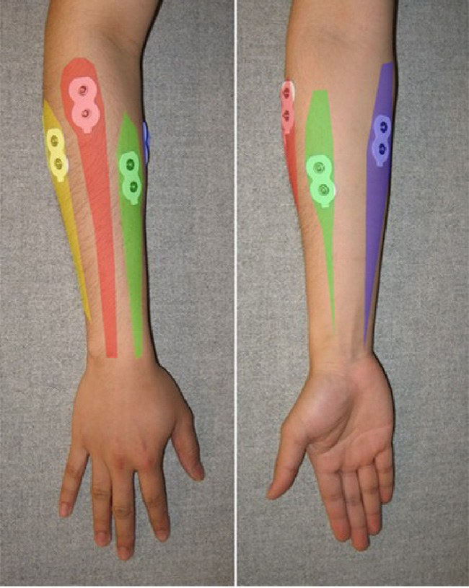
SECTION 04
Surface EMG: Reading the Muscle Signal
1
Non-invasive
Electrodes on the skin record muscle activity, with no surgery.
2
Natural control
Closing the hand fires the forearm flexors; opening fires the extensors.
3
Signal to command
Software recognizes the pattern and drives the prosthetic hand.
1 Acquire
2 Segment
3 Extract
4 Classify
5 Actuate
THOUGHT-CONTROLLED BIONIC HAND
Photo: Tavakoli et al., 2017
07 / 16
Notes:
sEMG measures the electrical activity produced when forearm muscles contract, using electrodes on the skin. Closing the hand activates the flexors, opening activates the extensors, so the pattern tells us the intended movement. The bottom row is the roadmap for the next four slides.

Slide 8
SECTION 4a
From Raw Signal to Features
1 Detect onset
2 Window
3 Extract features
threshold = baseline mean + 3σ
250 ms segments (< 300 ms for real-time)
MAV · WL · ZC · SSC
MAV
average signal strength
WL
waveform complexity
MAV = (1/N) Σ |xᵢ|
WL = Σ |xᵢ₊₁ − xᵢ|
ZC
how often the signal crosses zero
SSC
how often the slope reverses
ZC = Σ [ sgn(−xᵢ·xᵢ₊₁) ∧ |xᵢ − xᵢ₊₁| ≥ thr ]
SSC = Σ [ (xᵢ − xᵢ₋₁)(xᵢ − xᵢ₊₁) ≥ thr ]
Time-domain features are fast and simple, ideal for low-cost real-time hardware.
THOUGHT-CONTROLLED BIONIC HAND
Sources: Shi et al., 2018; Tavakoli et al., 2017
08 / 16
Notes:
First we detect when a gesture starts using a threshold above the resting baseline. Then a short window of the signal is converted into a few numbers. These four time-domain features are cheap to compute, which is why they suit real-time embedded hardware.

Slide 9
SECTION 4b
Classification: Which Gesture Was It?
SVM · one-vs-rest
k-Nearest Neighbours
Features
Close vs rest?
CLOSE
no
Open vs Change?
OPEN / CHANGE
Gaussian kernel (similarity of two feature points)
A new sample (★) takes the class of the majority of its k closest training samples. Best accuracy at k = 9.
K(xᵢ,xⱼ) = e^( −‖xᵢ − xⱼ‖² / 2σ )
Lock gesture: a double wrist flexion locks / unlocks the system, preventing false triggers.
THOUGHT-CONTROLLED BIONIC HAND
Sources: Tavakoli et al., 2017; Shi et al., 2018
09 / 16
Notes:
Two classifiers are used. The SVM splits the problem into simple yes/no decisions; the Gaussian kernel measures similarity between feature vectors. k-NN compares a new sample with stored training samples and takes a majority vote. A lock gesture makes the system ignore everything until unlocked, which prevents accidental movements.

Slide 10
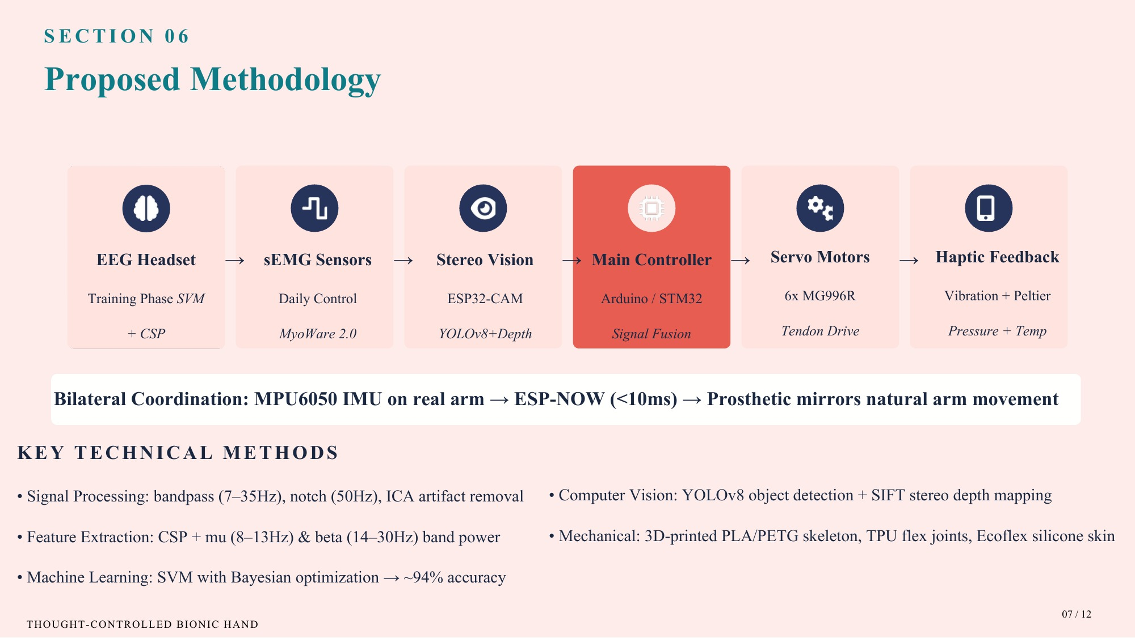
05
10 / 16

Slide 11
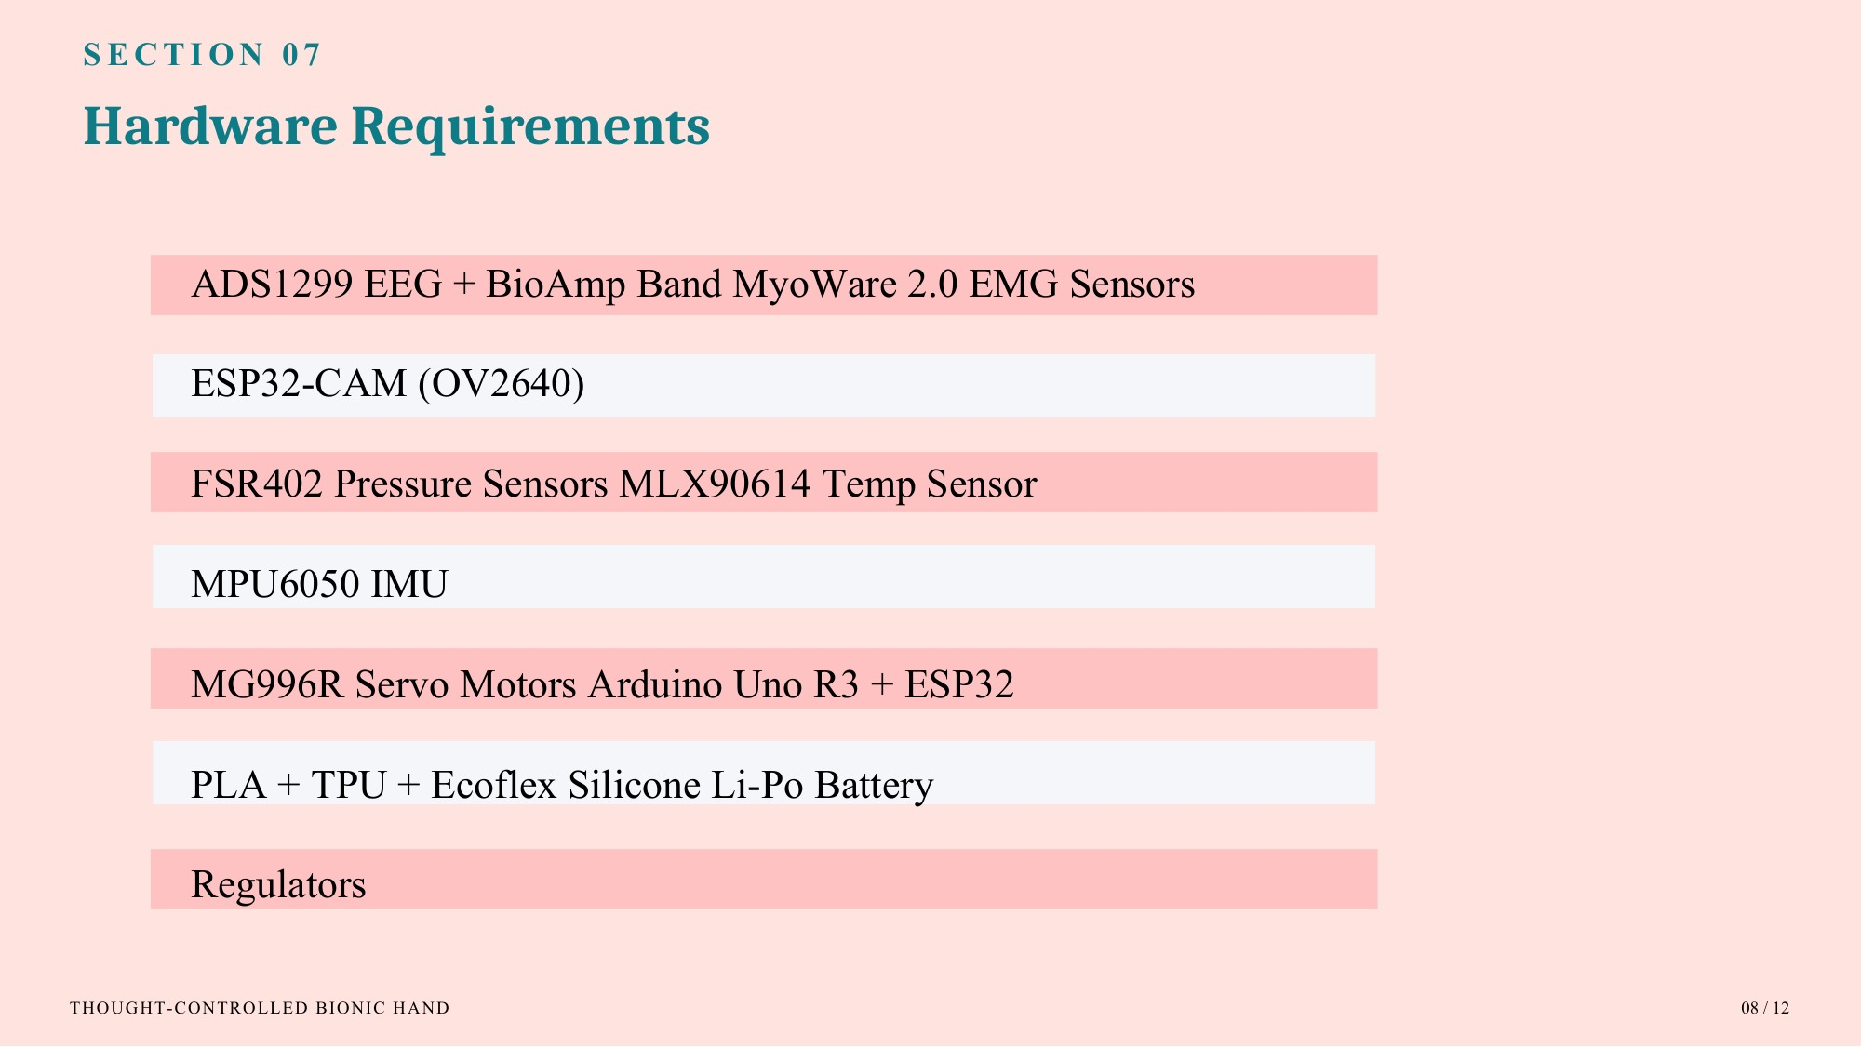
06
11 / 16

Slide 12
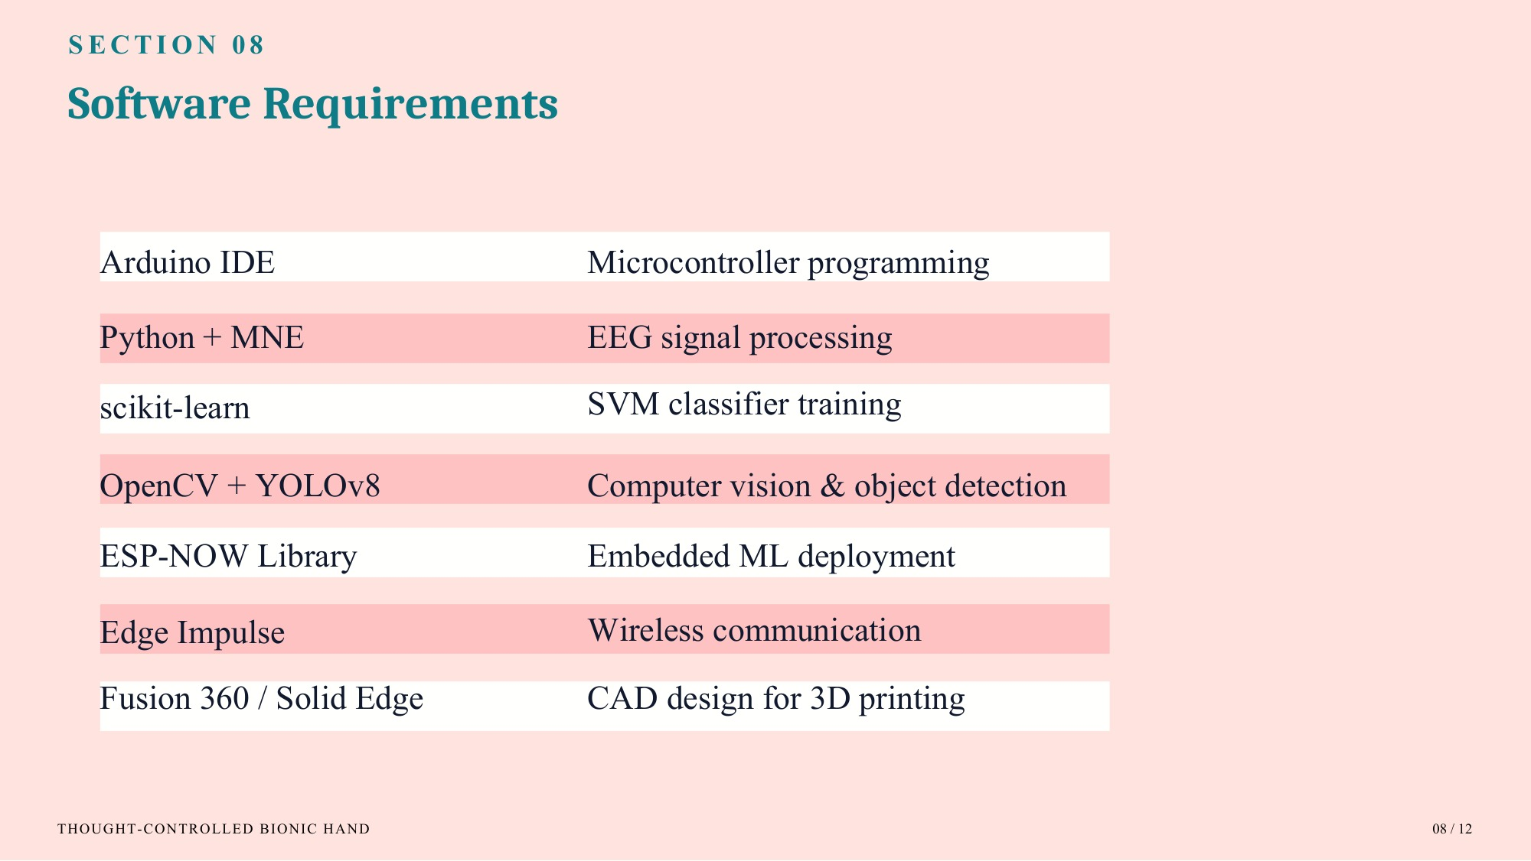
07
12 / 16

Slide 13
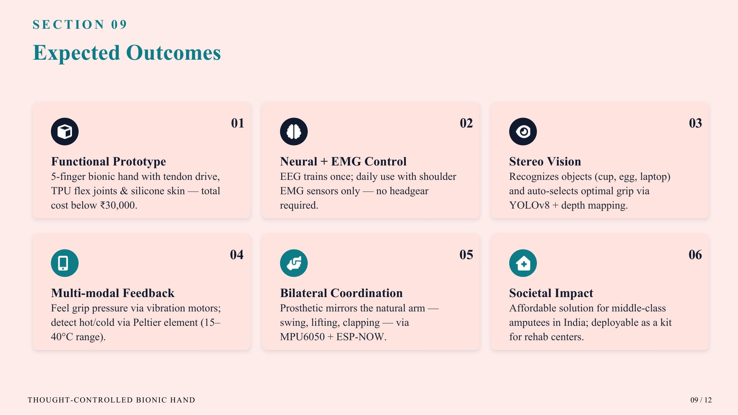
08
13 / 16

Slide 14
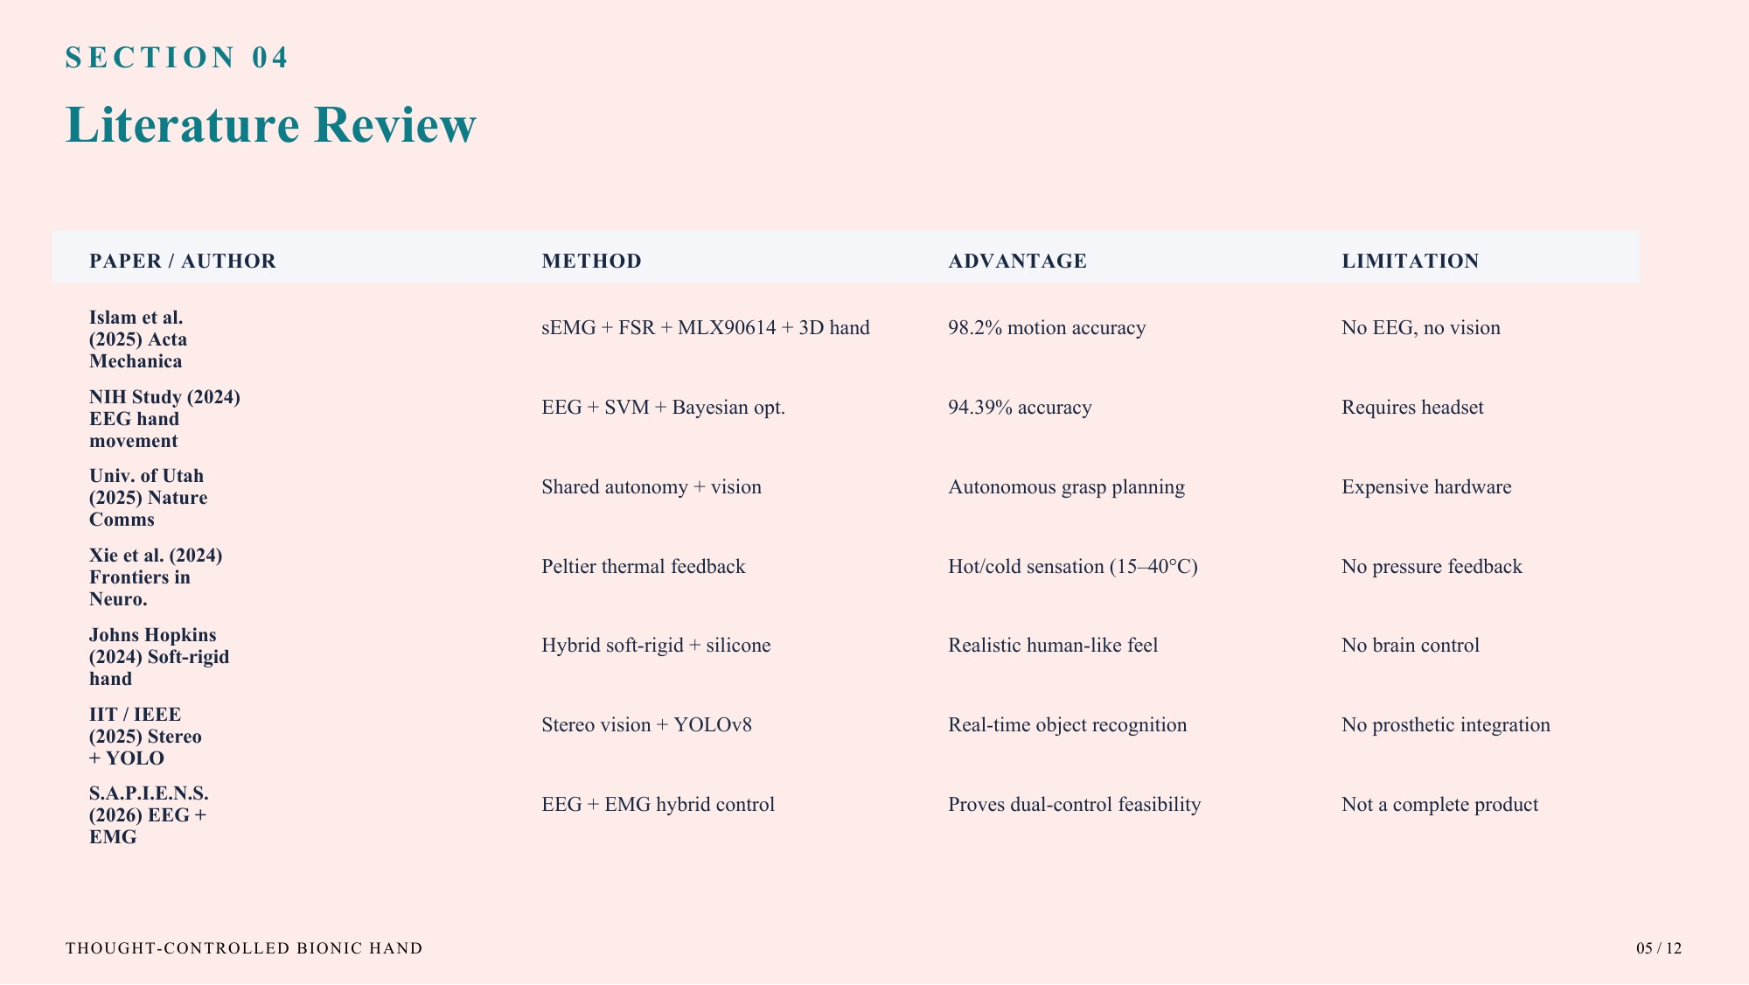
09
14 / 16

Slide 15
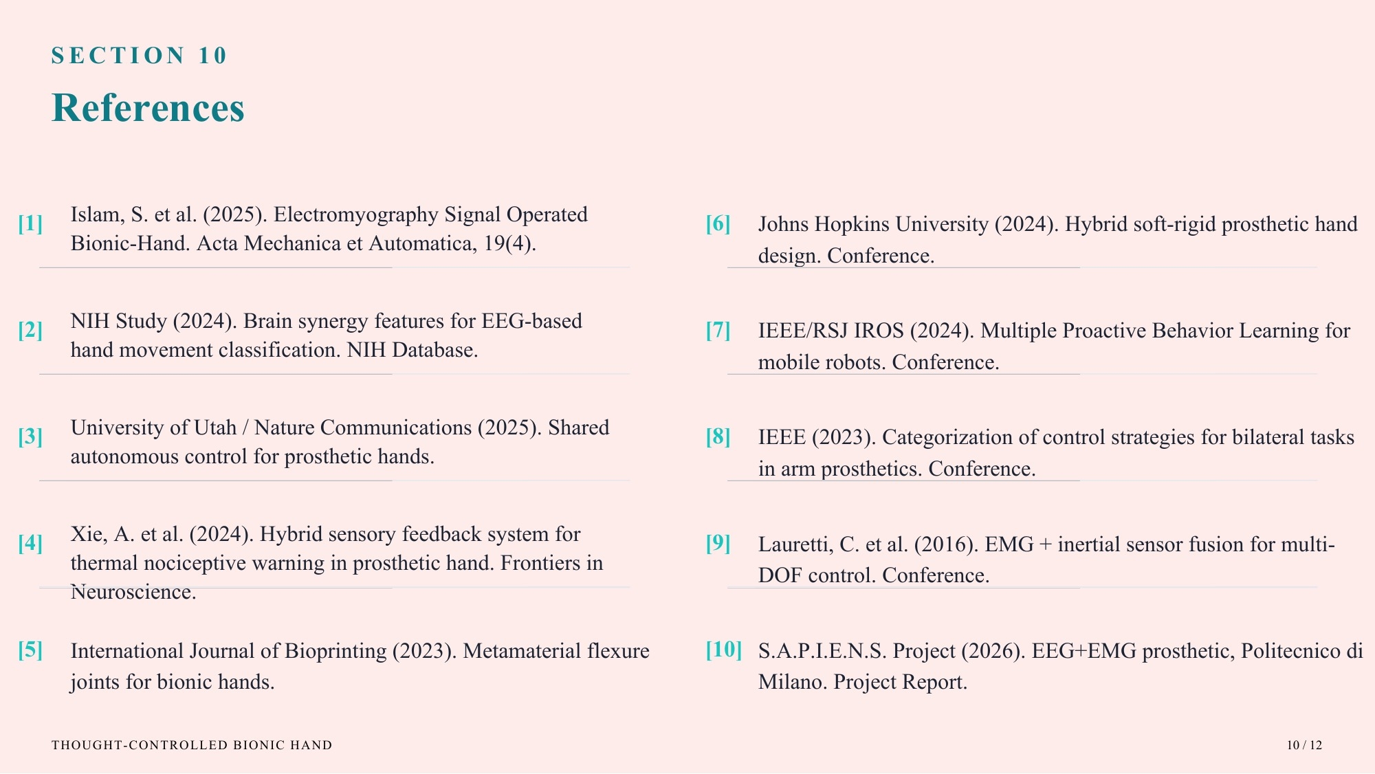
10
15 / 16

Slide 16


