Slide 1
MLOPS for cloud agnostic applications using Seldon
I. Pavan Kumar

Slide 2

Objective
The objective of this presentation
Understand the need of MLOPS in cloud agnostic
Why seldon?
Seldon features
Seldon components
A typical MLOPS architecture using Seldon
Demo- Deploying a scikit learn model on google cloud platform
Seldon Core - OSS Model Deployment

Slide 3
What is cloud agnostic MLOPS
Cloud agnostic MLOPS is a framework that uses open-source tools to develop an MLOPS system while also providing a seamless ability to lift and shift between ML infra between different cloud environments.

Slide 4
Why seldon?
Seldon core is cloud agnostic leading open-source framework for easily and quickly deploying models at scale.
Main features
Run ML pipelines onprem or cloud
Supports monitoring and explainability
Optimize traffic flow
Host multiple models on a single server

Slide 5
Why seldon?(contd)
Some other features seldon provides are
5. Converts ML models into production REST/GRPC microservices
Handles scaling of thousands of production ML models
Provides advanced monitoring and logging metrics, explainers, outlier detectors, A/B tests, canaries and shadows

Slide 6
Seldon Features
Seldon core is the leading open-source framework for easily and quickly deploy models at scale.
Main features
Run ML pipelines on Prem or cloud
Supports monitoring and explain ability
Optimize traffic flow
Host multiple models on a single server

Slide 7
Seldon Components
Following are minimum Seldon core components required for a ml deployment
Kubernetes cluster
An open-source container orchestration system for automating software deployment, scaling, and management.
Seldon Core
An open-source framework for easily and quickly deploying models.
Helm
A package manager for Kubernetes used for define, install, and upgrade complex Kubernetes application.
Istio
It is a service mesh that adds capabilities like security, observability, traffic splitting/management without adding them to actual service code. It handles routing communication between and across clusters.

Slide 8
Seldon Architecture on Google cloud
Google cloud
Kubernetes cluster
Node 1
Node 2
Service A
Service B
Envoy proxy
Envoy proxy
Istio control plane
Virtual machine
Seldon core

Slide 9
Demo – Installation and Configuration
Create a Kubernetes cluster with 3 nodes in standard mode
Install and configure Helm
Configure kubectl command line access
gcloud container clusters get-credentials seldon-cluster --zone asia-south1-a --project book-shelf-233813
Install cluster ingress
Install istio. Seldon Core automatically creates the objects and rules required to route traffic to your deployed machine learning models
Download Istio
$ curl -L https://istio.io/downloadIstio | sh -
Move to the Istio package directory
$ cd istio-1.17.2
Add the istioctl client to your path
$ export PATH=$PWD/bin:$PATH
Install istio
istioctl install --set profile=demo –y (installs core, istiod binary, ingress and egress gateways)
Create namespace to inject proxy
kubectl label namespace default istio-injection=enabled

Slide 10
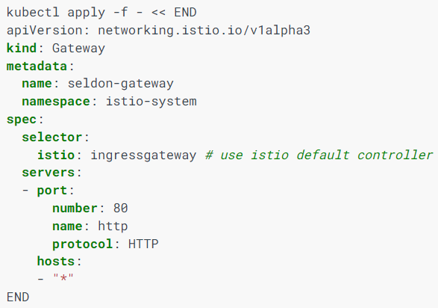
Demo – Installation and configuration
Create Istio Gateway
Copy below gateway configuration yaml to a file istiogatweay.yaml
Following command will create the ingress gateway : $ kubectl apply –f istiogateway.yaml

Slide 11
Demo – Installation and configuration
Install seldon core
Create a namespace
$ kubectl create namespace seldon-system (First create a namespace)
Install seldon using helm
$ helm install seldon-core seldon-core-operator --repo https://storage.googleapis.com/seldon-charts --set usageMetrics.enabled= true --set istio.enabled= true --namespace seldon-system
Check seldon running status
kubectl get pods -n seldon-system

Slide 12
Demo – Generate Ingress URL
Get cluster IP and port from the service isio
$ export INGRESS_HOST=$(kubectl -n istio-system get service istio-ingressgateway -o jsonpath='{.status.loadBalancer.ingress[0].ip}’)
$ export INGRESS_PORT=$(kubectl -n istio-system get service istio-ingressgateway -o jsonpath='{.spec.ports[?(@.name=="http2")].port}’)
$ export INGRESS_URL=$INGRESS_HOST:$INGRESS_PORT
$echo $INGRESS_URL
$INGRESS_URL is the public address to access the models in the cluster

Slide 13
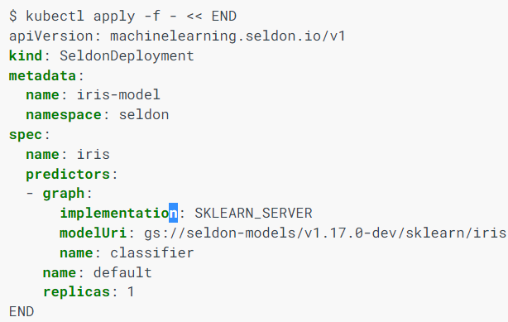
Demo – Deploy models
Create a namespace for seldon deployment
$ Kubectl create naespace seldon
Create a seldon deployment configuration yaml file. Let’s name it seldondeployment.yaml
Deploy the yaml “seldondeployment.yaml” using kubectl
$ kubectl apply –f seldondeployment.yaml

Slide 14
Demo – Sending api requests
Send request using curl command
$ curl -X POST http://34.93.200.81:80/seldon/seldon/iris-model/api/v1.0/predictions -H 'Content-Type: application/json' -d '{ "data": { "ndarray": [[1,2,3,4]] } }’
And output is
"data":{"names":["t:0","t:1","t:2"],"ndarray":[[0.0006985194531162835,0.00366803903943666,0.995633441507447]]},"meta":{"requestPath":{"classifier":"seldonio/sklearnserver:1.16.0"}}}

Slide 15
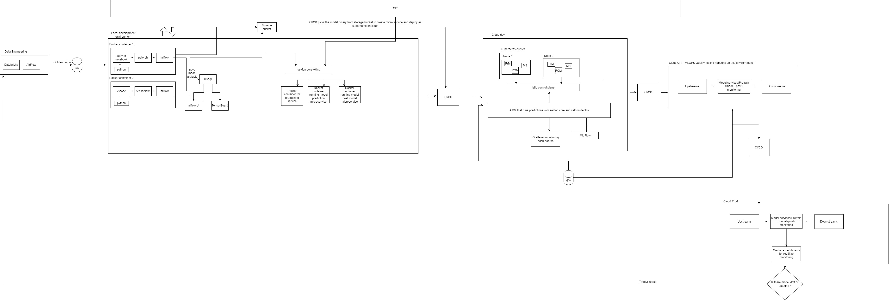
Architecture

Slide 16
Conclusion
Seldon core doesn’t have vendor lockin.
It provides out of the box inferance servers for scikit learn, tensorflow, pytorch
Easy to containerize ML models using prepacked inference servers (in example we used scikit learn)
Out of the box endpoints using rpc, grpc, swagger, python client
Provides customizable metrics with Prometheus, graffana

Slide 17


