Slide 1

Make shopping a breeze!

Slide 2

1. Introduction to project
2. Tech-stack used
3. MVC architecture
4. Privacy and Security
5. Cloudinary
6. Stripe
7. Json Web Token (JWT)
8. Redux

Slide 3

Introduction to TrendCart
TrendCart is an online shopping application that helps people easily find the things they want to buy.
It has a friendly design that works well on phones and computers, so it's easy to use.
With TrendCart, users can search for products based on how much they want to spend, the color or size they need, their favorite brand, or the category the item belongs to. It's like having a helpful guide that shows you all the best options.

Slide 4

Tech-stack Used
React.JS
Node.JS
Express.JS
MongoDB
Redux
Stripe
Cloudinary
JSON Web Token (JWT)

Slide 5
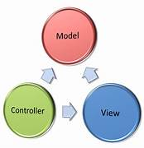
MVC Architecture
The TrendCart application is built using the MVC architecture. MVC architecture allows :
Modularity
Code Reusability
Organized Structure
Easy Maintenance and Testing
Scalability

Slide 6

Privacy and Security
At TrendCart, privacy and security of users is prioritized .
User passwords are made safe by using a strong encryption algorithm called bcrypt to hash them.
This means that even if there's any unexpected data breach, passwords remain protected and unreadable.
Users can shop with confidence knowing that their information is in good hands with TrendCart.

Slide 7

Cloudinary
In TrendCart , cloudinary is the tool we use to store all the images of products and categories.
Cloudinary allows developers to store and manage images in the cloud.
Cloudinary optimizes and delivers images in the most efficient format and size, ensuring fast loading times and better user experience.
Cloudinary can be easily integrated into various platforms and programming languages, making it user-friendly for developers.

Slide 8

Stripe
In TrendCart, Stripe is used as a payment gateway.
Stripe helps process payments securely and smoothly, making it easy for customers to complete transactions.
It allows customers to make purchases with credit cards, debit cards, and other popular payment methods.
It handles complex payment tasks behind the scenes, simplifying the task for developers.

Slide 9
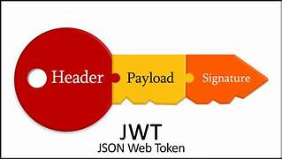
JSON Web Token (JWT)
In TrendCart , JWT is used to simplify user authentication, providing a secure way to verify users without the need for continuous database queries.
JWTs store all necessary information within the token itself, reducing server-side burden and enabling easy scalability.
JWTs use digital signatures to ensure data integrity, preventing unauthorized tampering or modifications during transit.
With JWTs, the server doesn't need to store session data, leading to improved performance and response times in high-traffic applications.

Slide 10
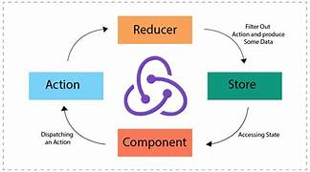
Redux
In TrendCart ,Redux is used to simplify state management by keeping all the data in a single global store, making it easier to access and update information throughout the app.
With Redux, components can efficiently communicate with each other without having to pass props down the component tree.
Redux promotes a predictable flow of data, ensuring that changes to the application state are well-organized and easy to debug.
Redux enables time-travel debugging, allowing developers to rewind and replay actions, making it easier to pinpoint and fix issues in the application.

Slide 11
Thank You

