Slide 1

THULI ARENA · HACKATHON SUBMISSION
Suta, woven
into software
A verified catalogue, an editorial lookbook, a lookbook made for one person, and a stylist with a fitting room. Four builds, one rule: every piece shown is real, at its real price.
TASK 1
Catalogue
TASK 2
Lookbook
TASK 3
Made for one
TASK 4
Stylist + try-on
Notes:
Opening. We built four connected things on one source of truth: Suta's live catalogue.

Slide 2

01 · THE BRAND
Handloom with
a memory
Suta makes handloom sarees, blouses and everyday Indian wear that feel like they came out of a grandmother's trunk: soft mul cotton, real weaves, and a story behind every product name.
Our job was to bring that soul online without losing a single fact: the same nostalgia in the pages, and the catalogue's truth underneath every word.
Chapter I · Agomoni, from the live lookbook
01
Grounded
Nothing invented. Every card, price and size is a database row.
02
Editorial
Restraint over clutter: rhythm, whitespace, the brand's own photography.
03
Fast
Cards in under 2 s; the stylist starts writing in under 3 s.
SUTA · THULI ARENA
02
Notes:
Suta's voice is nostalgic and personal. Our build had to keep that voice and never invent a product.

Slide 3
02 · ARCHITECTURE
One source of truth, three experiences
TASK 2
ONE SOURCE OF TRUTH
Utsav lookbook
SOURCE
TASK 1
Neon Postgres
Pre-rendered pages; build fails if a look names a product not in the catalogue.
suta.in
Catalogue pipeline
7,249 products · 19,246 variants. pg_trgm + GIN indexes on tags, edits, sizes, colours.
Shopify storefront's public JSON: products, variants, collections. robots.txt-aware, 1 req/s.
Python: fetch → scrape → build → normalise → export. Checks against the live site.
TASK 3
Made for one
Instagram posts → taste → SQL shortlist → three styled looks.
MODELS, VIA ONE OPENROUTER CLIENT
GPT-4.1 mini
Stylist planner + writer, photo search, fit guard
Gemini 2.5 Flash
Tags Instagram + catalogue photos
TASK 4
Stylist + try-on
Claude Sonnet 5.5
Reads taste, styles the three looks
Gemini 3.1 Flash Image
On-demand virtual try-on
Node API routes: planner, code-built SQL, streamed writer, image model.
Gemini 3 Pro Image
Editorial lookbook imagery
Shared client
Retries, fallbacks, cost logged per run
SUTA · THULI ARENA
03
Notes:
One pipeline feeds everything. The catalogue is scraped and verified once; three experiences read it.

Slide 4
03 · STACK, AND WHY
Chosen for speed, truth and taste
LAYER
CHOICE
WHY IT MATTERS
Data
Python · Shopify public JSON
Exact prices, variants and stock without parsing HTML; a full cold run takes about 4 minutes and is repeatable.
Database
Neon serverless Postgres
One catalogue for every task. Search is structured SQL over real attributes (no embeddings), so every match is explainable.
Speed
WebSocket pool · hedged reads
A warm pool, a second read fired at 1.2 s and a 5-minute cache keep the stylist's queries fast.
App
Next.js 16 App Router · React 19
Pre-rendered lookbook pages and streaming AI routes in one codebase; secrets stay server-side.
Models
OpenRouter
The right model per job, a fallback per call, and cost logged per run.
Interface
Tailwind v4 · shadcn/ui (Radix)
Brand tokens and accessible dialogs, sheets and focus handling.
Motion
Framer Motion (lazy) · Lenis
Editorial pacing without a heavy bundle; smooth scroll only for mouse and trackpad.
SUTA · THULI ARENA
04
Notes:
Each choice is justified by latency, grounding, scale or aesthetics.

Slide 5
TASK 1 · THE CATALOGUE
Every product, exactly as suta.in sells it
7,249
19,246
49,288
37 / 37
products exported
(9 add-ons and test items excluded)
variants: each size with its
own price and stock flag
full-size images,
from Shopify's CDN
categories match the counts
suta.in itself shows
FIELD COMPLETENESS
title 100%
price 100%
images 100%
sizes 100%
category 100%
url 100%
colours 99.9%
THE PIPELINE
fetch.py
scrape.py
build.py
normalise.py
export · db
robots-aware, 1 req/s, retries, disk cache
products + every menu collection
drop non-products, attach categories
one clean record per product
JSONL + REPORT.md + Neon
SUTA · THULI ARENA
05
Notes:
Task 1 numbers come straight from data/export/REPORT.md.

Slide 6
TASK 1 · DATA INTEGRITY
Built to survive a judge
re-checking the live site
PRODUCTS · KEY COLUMNS
id bigint, Shopify id
handle · url · title text
price · compare_at_price numeric
available boolean
sizes · sizes_in_stock text[]
colours · colour_source text[] · text
department · category text
categories · edits text[]
attributes jsonb facets
tags text[]
pairs_with text[]
images text[]
description text
Categories from the menu
Not Shopify's free-text product_type: judges compare against the brand's own category counts.
Nothing missed mid-scrape
Every category feed is merged and de-duplicated by Shopify id, keeping the newest copy.
Sizes are variants
Nested under their product, with per-size stock in sizes_in_stock.
Colours, most reliable first
Colour_ tags (97%), then title/URL in English or Hindi, then the photo itself (198 products).
Fields for later tasks
fabric, pattern, style, technique facets; the brand's edits; pairs_with from its own copy.
Verified, not assumed
catalogue.check: unique ids, Neon matches the export, and 20 random products re-fetched live.
SUTA · THULI ARENA
06
Notes:
Design decisions that make the data trustworthy, plus the fields later tasks needed.

Slide 7

TASK 2 · THE LOOKBOOK
Utsav: a festive
almanac in six
chapters
One festive season, from Durga Puja to the quiet after Diwali, told the way a fashion house prints its lookbook: one idea per spread, the brand's own photography, and quiet type.
I Agomoni
II Zar
III Chandrama
IV Jalebi
V Varq
VI Kavita
24
42
16
looks
real pieces
new editorial
images
The cover, live at localhost:3000
SUTA · THULI ARENA
07
Notes:
The lookbook: six chapters on six of Suta's own collections. All prices from the catalogue export.

Slide 8
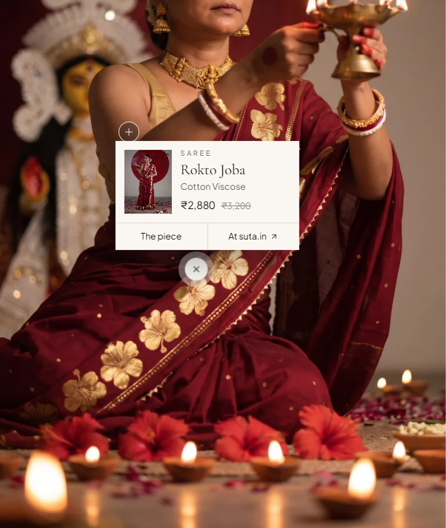
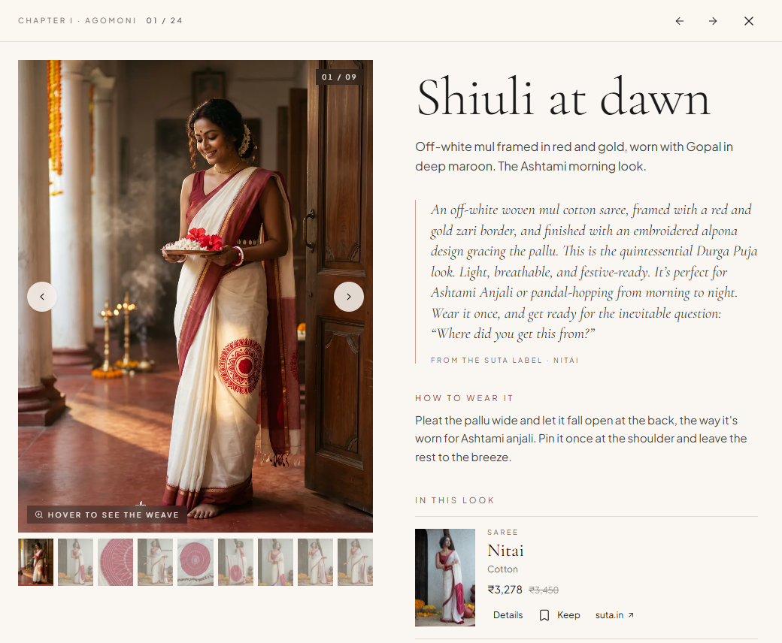
TASK 2 · FROM IMAGE TO PRODUCT
Tap the photograph, reach the real piece
— Grounded at build time. The build fails if a look names a product that isn't in the catalogue.
— Nothing hand-typed. Titles, prices, stock, sizes and fabric all come from the export.
— Three clicks from a look to suta.in.
— Fast. Lighthouse desktop 99–100, mobile 83–89; accessibility, SEO and best practices 100.
Hotspot card: piece, fabric, sale price, link. It always stays inside the frame.
Look drawer: weave zoom, the label's own story, sizes in stock, the total for the look.
SUTA · THULI ARENA
08
Notes:
Shoppable hotspots, the look drawer, and build-time grounding.

Slide 9
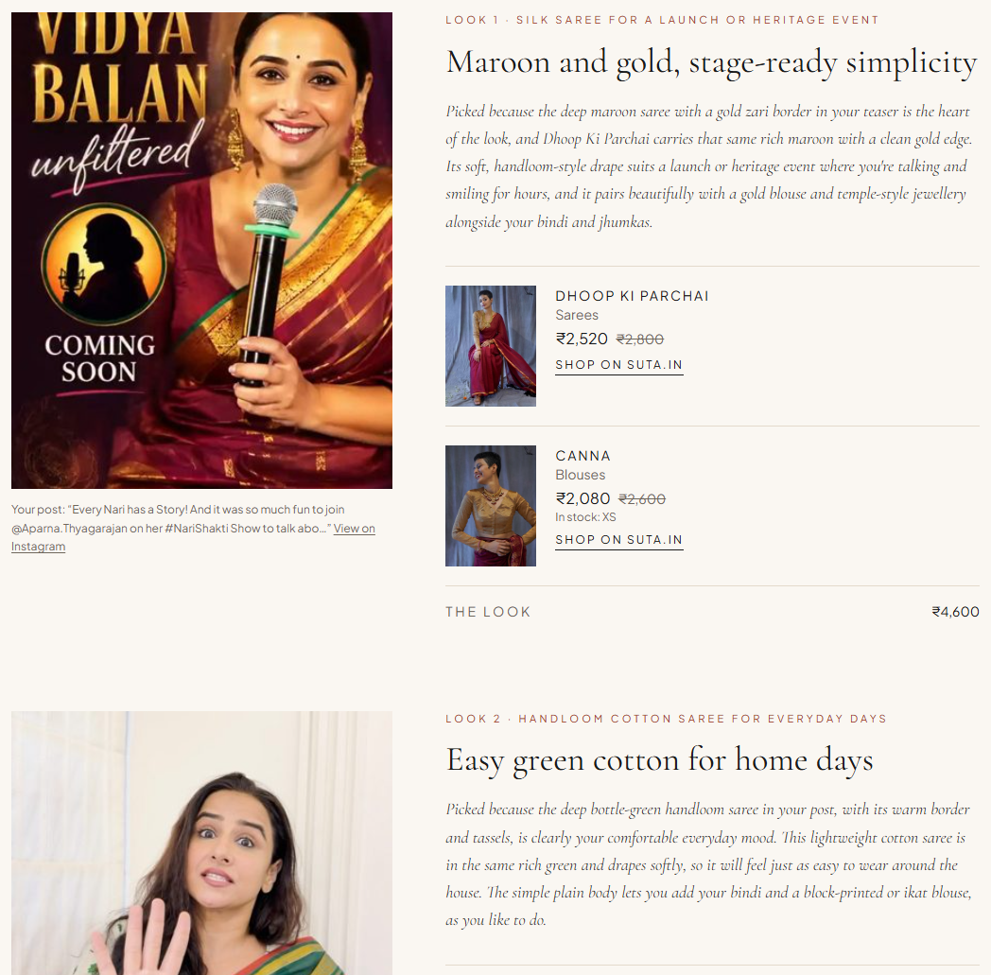
TASK 3 · MADE FOR ONE
Three looks, styled
from your own posts
1
Photos
Public posts saved to Neon once; repeat visits skip Instagram.
2
Tag
A fast vision model labels each outfit in the catalogue's own vocabulary.
3
Taste
A strong vision model reads style, palette and three moments from life.
4
Shortlist
No AI here: SQL picks in-stock pieces that match each moment.
5
Style
One call picks one piece per moment and writes why. Every id is validated.
4–18 s
~30–40 s
$0.02–0.06
saved profile
first-time profile
per lookbook
A finished lookbook: their post on the left, the reasoning and real pieces on the right
SUTA · THULI ARENA
09
Notes:
Made for one: public Instagram posts become three real looks, each tied to a post.

Slide 10
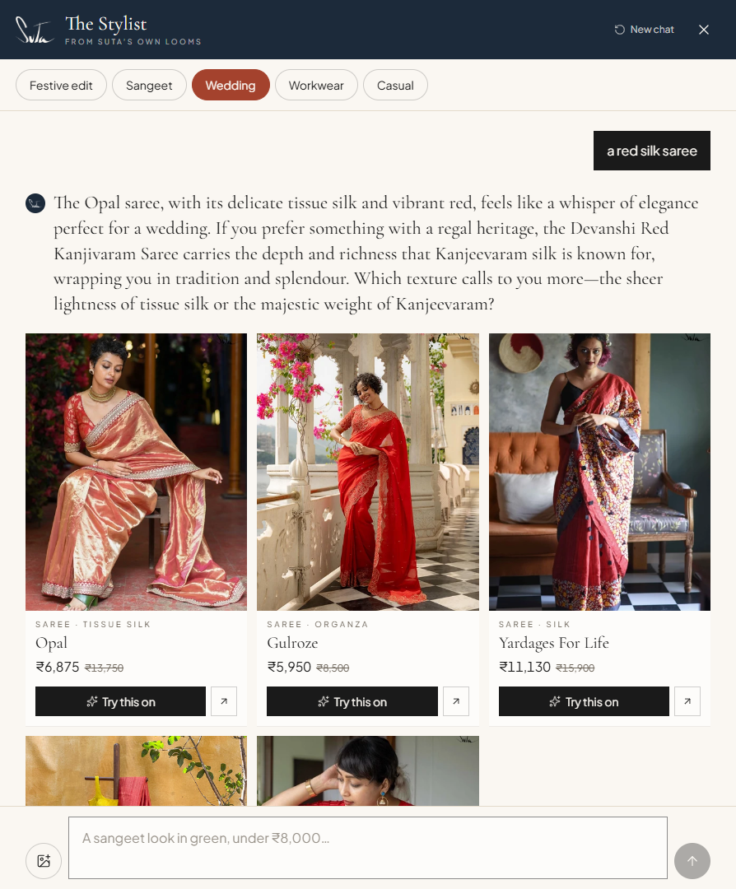
TASK 4 · THE STYLIST
A real conversation,
grounded in Neon
Guard
size caps, injection stripped, rate limits
Rules + planner
instant parser and GPT-4.1 mini choose filters from the catalogue's own values
Code-built SQL
one parameterised query ranks pieces by criteria met
Cards first
the top five real products stream to the panel
Writer
streams the reply; every sentence checked before it is sent
1.2–1.9 s
2.2–2.9 s
≤ 350
cards on screen
first words of the reply
max tokens, any call
SUTA · THULI ARENA
10
Notes:
The stylist: rules and a planner decide what to fetch; code builds the SQL; a writer streams a checked reply.

Slide 11
TASK 4 · HONESTY CIRCUIT-BREAKERS
It would rather say no than invent
Never invents
Honest when short
Remembers
— The model never writes SQL; filters come only from catalogue values.
— Any ₹ amount in a reply must be a price we fetched.
— A failed check swaps in a plain line built from the same rows.
— Nothing matches? One query finds what does exist nearby, with real counts.
— “Festive sarees under ₹2,000 · 12” becomes a tappable suggestion.
— Near misses carry a “Close match” label.
— “Something else” leaves out everything already shown this session.
— Tested: 4 turns, 20 distinct greens, 0 repeats.
— Survives a reload; “New chat” clears it.
THE 15:45 CURVEBALL
Occasion edit: one tap sets a hard filter on the catalogue's style and occasion tags, and it stacks with whatever the shopper types.
Asked for “a pure Kanjeevaram bridal saree under ₹10”, it says plainly that no such piece exists, then offers what does.
SUTA · THULI ARENA
11
Notes:
Honesty circuit-breakers, session memory, and the 15:45 curveball occasion filter.

Slide 12
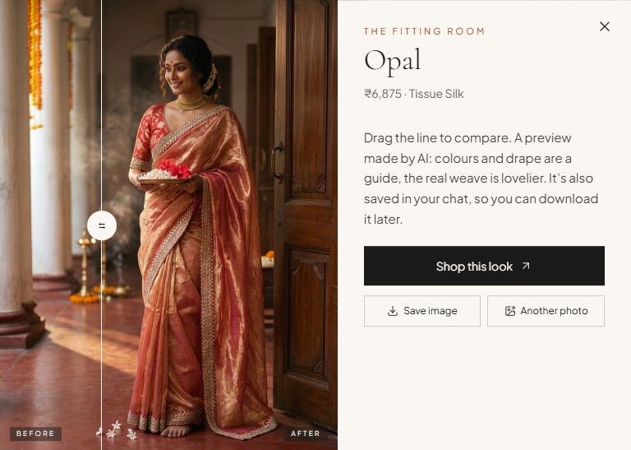

TASK 4 · THE FITTING ROOM
One click, one
try-on, on demand
— Only the piece you choose. No batch generation, so no timeouts and no wasted spend.
— Faithful to the weave. Your portrait plus the product's own catalogue photos go to Gemini 3.1 Flash Image.
— Before and after. Drag the line to compare; the result is saved in the chat to download later.
— Bounded. 4 per visitor per 10 minutes, 3 at once; identical requests served from cache.
— Private. Portraits are re-encoded with EXIF stripped and never stored on the server.
While it works, the fitting room shows its progress: reading the photo, studying the weave, pleating the drape, setting the light.
~20 s
measured, portrait to finished image
SUTA · THULI ARENA
12
Notes:
Try-on happens only when asked, for one piece. Measured 20 seconds in our test.

Slide 13
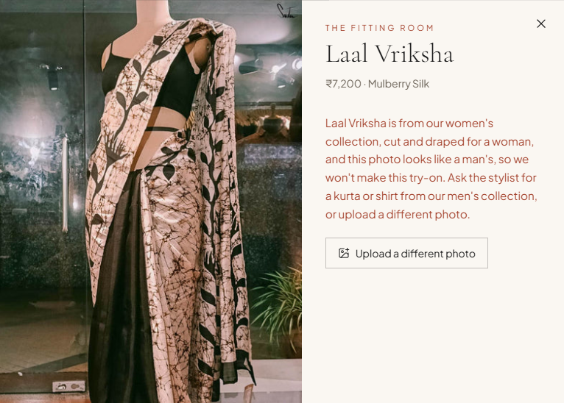
READY FOR THE STRESS TEST
Hardened against misuse
Prompt injection
Known patterns stripped and flagged; product and caption text treated as data.
Token burning
Over 500 characters rejected; messages capped at 350; max_tokens ≤ 350.
Malformed input
Empty, emoji-only or wrongly typed bodies get a 400 with a kind answer.
Images
Data URLs only (no URL fetching, no SSRF); 6 MB cap; re-encoded.
Rate limits
Chat 30 a minute; try-on 4 per 10 minutes and 3 at once.
Leaks
Replies naming prompts, keys or the database are discarded; secrets stay server-side.
The fit guardrail at work: the catalogue says the saree is womenswear, a vision check reads the photo, and nothing is generated.
Fit guardrail
No womenswear try-on on a man's photo, or menswear on a woman's; unisex passes.
Traceable
In development, “Behind this reply” shows each Neon query, its timing and every model prompt.
SUTA · THULI ARENA
13
Notes:
Task 5 readiness: abuse is handled with plain 4xx answers, never 500s, and costs are capped.

Slide 14
WHAT SETS IT APART
Design choices that hold up under pressure
THE USUAL APPROACH
WHAT WE BUILT
An LLM answers from memory and names products
→
The LLM only plans; code builds the SQL; every sentence is checked
Try-ons generated for every card, slow and costly
→
One try-on, on demand, cached, about 20 seconds
Embedding search: plausible but unexplainable
→
Structured SQL on real attributes; every match traceable
“No results” dead ends
→
Real alternatives with live counts, one tap away
Mock or hand-typed product data
→
A live catalogue, verified against suta.in
Guardrails bolted on later
→
Caps, rate limits, leak filter and fit guardrail from day one
SUTA · THULI ARENA
14
Notes:
Where the design differs from the usual approach.

Slide 15

IN ONE LINE
Every piece real.
Every price true.
7,249
24
3
5
products, verified
editorial looks
looks made for one
real cards per answer
Run it: cd lookbook · npm run dev · localhost:3000
Catalogue: uv run python -m catalogue
Products and product photography © Suta; some editorial images generated for this build. An independent hackathon project, not affiliated with Suta.
Notes:
Close. Run it with npm run dev inside lookbook/.

