Slide 1

HACKATHON PROJECT
CPU and Memory Stress Testing Tool
CPU
A Lightweight Linux-Based System Stress Testing Utility
$ ./stress-test 30 4 512
  Team Members:
  2520090038: K. Pavan Kumar
  2520090180: P. Harsha Vardhan
  2520090188: B. Purna Chander Rao
  Team Number: 11
  Guide: D. Alekhya
Course: 25CS2104E - Operating Systems and System Programming
RAM
Notes:
Introduce the team and project. Fill in the placeholders for names, institution, mentor and event. Describe the project in one sentence: a small C program for Ubuntu that applies CPU and memory load for a set time, controlled from the command line. The chip and RAM drawings are concept visuals only. Not a certified hardware diagnostic tool; it is a coursework and demonstration utility.
1

Slide 2
01 PROBLEM
Why a simple stress tool?
Controlled load
Your settings
seconds, CPU threads, memory MB
Students need an easy way to apply a known CPU and memory load on Ubuntu.
stress-test
small C program, runs for a limited time
Observe behaviour
With load applied, system behaviour under resource pressure can be watched in tools such as htop and free.
CPU and memory under load
Ubuntu / Linux system
Approachable
Observed externally: htop, free -h
Existing utilities can be powerful but unfamiliar to beginners. This tool is small and transparent.
CPU and Memory Stress Testing Tool | C / Linux command-line utility
2
Notes:
Keep this short and avoid statistics. The need: a simple educational way to apply controlled CPU and memory load on Linux and then watch what happens. Existing tools can be powerful but intimidating for beginners. Our program is small and the source is readable. The diagram shows the context: the user sets three values, the program loads the system, and htop or free in another terminal show the effect.
2

Slide 3
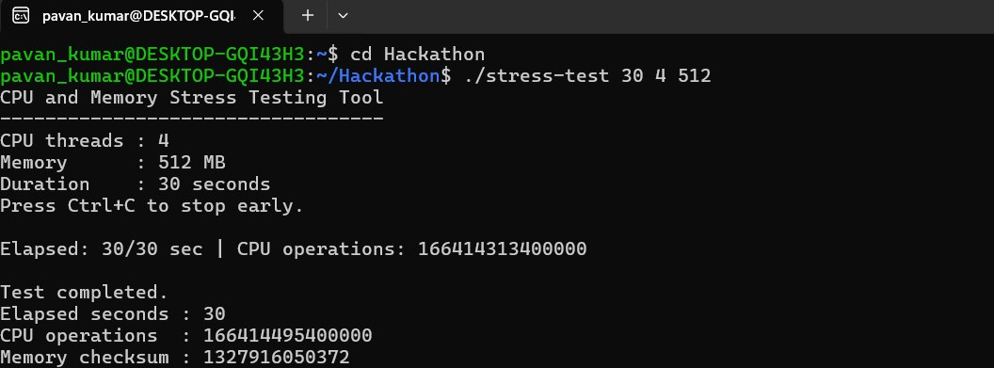
02 SOLUTION
A command-line tool with three inputs
./stress-test 30 4 512
Terminal
$ ./stress-test 30 4 512
CPU and Memory Stress Testing Tool
----------------------------------
CPU threads : 4
Memory : 512 MB
Duration : 30 seconds
Press Ctrl+C to stop early.
30
Duration in seconds (allowed range 1 to 3600)
4
CPU worker threads (1 up to the online CPU count)
512
Memory in MB (0 for CPU-only)
The example runs up to 30 seconds with 4 CPU threads and a 512 MB memory region.
Startup banner as printed by main.c for this example. Progress and summary output will be added from a real run.
Choose settings for your machine
  Threads should not exceed the CPU cores.
  512 MB is accepted only if reported free RAM is at least 1024 MB.
  Start short, and save your work first.
CPU and Memory Stress Testing Tool | C / Linux command-line utility
3
Notes:
Explain the three arguments in order: seconds, CPU threads, memory in MB. The example requests up to 30 seconds, 4 worker threads and 512 MB. The program rejects thread counts above the number of online CPUs and rejects a memory request above half of the currently reported free RAM, so 512 MB needs at least 1024 MB reported free. Stress that users must choose values suitable for their own machine. The terminal box shows the real startup banner text from main.c, not run results.
3

Slide 4
03 ARCHITECTURE
How main.c is organised
CPU worker threads
N x pthread, arithmetic loop
User input
argv
Parse and validate
strtol, range checks
Memory safety check
sysinfo free RAM
Memory workload
main thread: touch and read
Main thread
Validates input, allocates memory, creates workers, sweeps memory, prints progress, joins workers and prints the summary.
Worker threads
Run only cpu_stress(): integer arithmetic until the stop flag is set.
workers add to counter, read stop flag
SIGINT / SIGTERM
handler sets flag
Shared atomics
stop_test, operations
Terminal output
printf, stdout
Progress and results
elapsed, operations, checksum
Blue: control flow Green: counters and results
CPU and Memory Stress Testing Tool | C / Linux command-line utility
4
Notes:
Follow the arrows. Input is parsed and validated, then the memory guard compares the request with free RAM from sysinfo. After that, the CPU workers (pthreads) and the memory workload run. The memory workload is done by the main thread itself. Two atomic variables are shared: the stop flag, which workers poll, and the operation counter, which workers add to. The signal handler only sets the stop flag. The main thread reads the counter to print progress and the final summary to the terminal.
4

Slide 5
04 METHODOLOGY
Execution workflow of main.c
1
2
3
4
Parse arguments
Validate settings
Check available memory
Allocate and initialize
argc must be 4; strtol on each value
1-3600 s; 1 to online CPUs; 0-1048576 MB
Reject if request exceeds half of free RAM
malloc, then fill every byte of the region
8
7
6
5
Summary and cleanup
Stop workers
Execute workloads
Create CPU workers
Print results, free memory and worker array
Set stop flag, pthread_join each worker
Workers count; main sweeps memory, prints each second
Install signal handler, pthread_create per worker
Ctrl+C (SIGINT) or SIGTERM can end step 6 early. The flow then continues to steps 7 and 8.
CPU and Memory Stress Testing Tool | C / Linux command-line utility
5
Notes:
Walk the eight steps; the second row reads right to left. Memory is allocated and filled before any worker thread starts. The signal handler is installed just before workers are created. During step 6 the main loop ends when the duration is reached or the stop flag is set by Ctrl+C. Then the stop flag is set, workers are joined, and the summary is printed before memory is freed.
5

Slide 6
05 CORE FEATURES
What the tool does today
POSIX-thread CPU load
One pthread per requested worker, each running an arithmetic loop
IMPLEMENTED
Memory allocation and access
malloc, initialize, then page-touch writes and strided reads
IMPLEMENTED
Duration and thread count
1 to 3600 seconds; 1 up to the online CPU count
IMPLEMENTED
Validation and memory guard
Rejects bad input; memory capped at half of reported free RAM
IMPLEMENTED
Progress and operation count
Elapsed time and CPU operations shown every second
IMPLEMENTED
Early stop with Ctrl+C
SIGINT and SIGTERM set the stop flag, workers join, summary prints
IMPLEMENTED
Not included: CPU temperature measurement, comprehensive RAM-integrity testing, graphical dashboard.
CPU and Memory Stress Testing Tool | C / Linux command-line utility
6
Notes:
Every feature on this slide exists in main.c. Be precise when asked: the CPU load is an integer arithmetic loop, the memory workload touches one byte per 4 KB page and reads one byte per 64 bytes, and the guard compares against free RAM reported at start-up. We do not measure temperature, we do not claim a full RAM-integrity test, and there is no graphical dashboard.
6

Slide 7
06 TECHNOLOGY STACK
Layers used in the implementation
stress-test (main.c)
Argument handling, workers, memory sweep, output
Terminal
static void *cpu_stress(void *arg)
{
uint64_t x = (uint64_t)(uintptr_t)arg + 1;
while (!atomic_load(&stop_test)) {
for (int i = 0; i < 100000; i++)
x = x * 1664525ULL + 1013904223ULL;
atomic_fetch_add(&operations, 100000);
}
return NULL;
}
C11 and C11 atomics
stdatomic.h: stop flag and shared operation counter
POSIX threads and Linux APIs
pthread, sysinfo, sigaction, sysconf
GCC and GNU Make
Compile with warnings enabled; make and make clean
Ubuntu / Linux
Native Ubuntu or WSL2 Ubuntu
Excerpt from main.c: the CPU worker.
External monitoring in a second terminal: htop and free -h
Terminal
$ gcc -O2 -std=c11 -Wall -Wextra -Wpedantic main.c -o stress-test -pthread
CPU and Memory Stress Testing Tool | C / Linux command-line utility
7
Notes:
Read the stack from top to bottom. The Makefile uses gcc with -O2, -std=c11 and warning flags, and links with -pthread. C11 atomics give a thread-safe stop flag and operation counter without locks. htop and free are not part of the program; they are used in another terminal to observe the system. Point to the excerpt: each worker runs a multiply-and-add loop and adds 100000 to the shared counter after every batch.
7

Slide 8
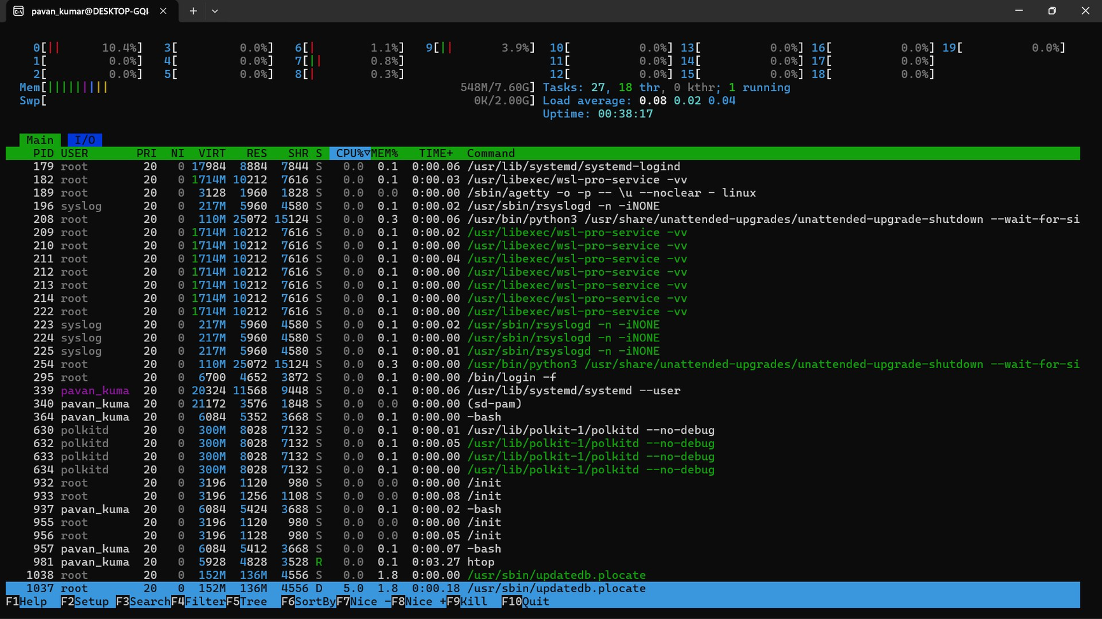
07 TESTING AND RESULTS
Test cases from the README (results pending)
Test | Command | Expected result (README) | Actual result
Basic run | ./stress-test 5 1 64 | Runs and completes in about 5 seconds | [Record actual result]
Multiple threads | ./stress-test 10 2 128 | Reports CPU operations and completes | [Record actual result]
CPU-only | ./stress-test 5 1 0 | CPU workload runs without allocating memory | [Record actual result]
Invalid duration | ./stress-test 0 1 64 | Rejects invalid duration | [Record actual result]
Too many threads | ./stress-test 5 999999 64 | Rejects invalid thread count | [Record actual result]
Early stop | ./stress-test 60 2 128, then Ctrl+C | Stops and prints summary | [Record actual result]
CPU and Memory Stress Testing Tool | C / Linux command-line utility
8
Notes:
Commands and expected results come straight from the README. The Actual result column and all three screenshot frames are empty on purpose: run each command on the demo machine and record what really happens, including the operation count and elapsed time. Do not quote operation counts or CPU percentages that you did not observe. Operation counts are not comparable between machines.
8

Slide 9
08 APPLICATIONS, LIMITS, FUTURE SCOPE
Current state and next steps
Applications
FUTURE WORK. NOT IMPLEMENTED
  Educational demonstrations of threads and memory
  Controlled workload experiments
  Observing system resources while under load
  CSV logging
  Additional workload profiles
  Structured reports
  Temperature monitoring where supported
  Graphical dashboard
Current limitations
  Operation counts are not standardized benchmark scores
  The checksum is not a complete RAM-integrity test
  CPU temperature and frequency are not measured
  Memory availability can change during execution
CPU and Memory Stress Testing Tool | C / Linux command-line utility
9
Notes:
Left of the divider is what exists today; right of it is future work only. State the four limitations honestly: operation counts are not a benchmark score, the checksum is not a full RAM-integrity test, we do not measure temperature or frequency, and free memory can change after the guard check. The future items are ideas, not promises.
9

Slide 10
09 CONCLUSION AND LIVE DEMO
What we built and how we will show it
Current implementation
A small C program using pthreads and C11 atomics that applies configurable CPU and memory load on Ubuntu, with input checks, a basic memory guard, progress output and Ctrl+C stop.
1
Compile
$ make
2
Run a short workload
$ ./stress-test 10 2 128
3
Observe CPU
$ htop (second terminal)
4
Observe memory
$ watch -n 1 free -h
5
Invalid input
$ ./stress-test 0 1 64
6
Ctrl+C termination
$ ./stress-test 60 2 128, then Ctrl+C
CPU and Memory Stress Testing Tool | C / Linux command-line utility
10
Notes:
Summarise: the tool is a small, readable C program for learning and demonstration. Demo order: run make; run a short test; in a second terminal open htop and then watch free -h; show the invalid-input message; start a 60-second run and press Ctrl+C to show the early-stop summary. Rehearse first, keep memory modest, and have screenshots ready in case the live demo fails. Then invite questions.
10

