Slide 1
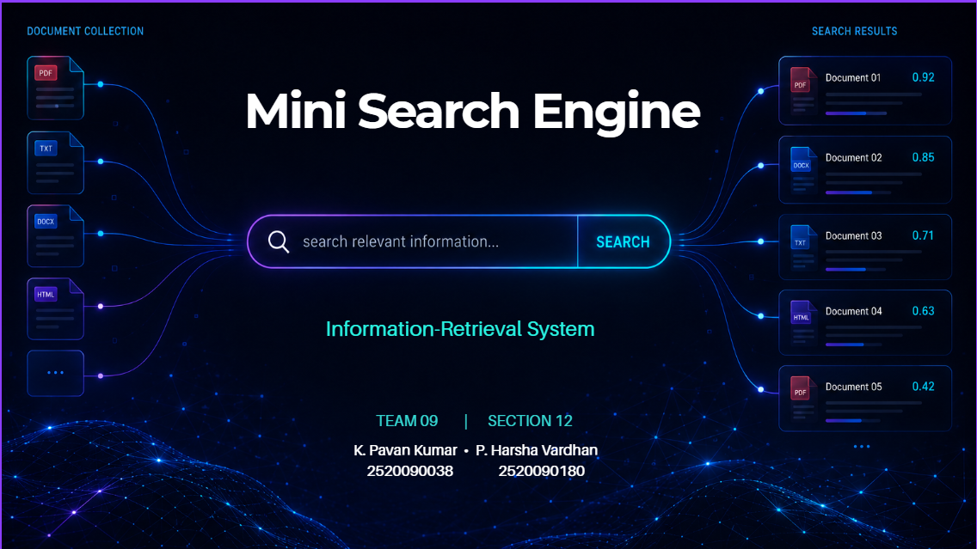
Guide: Ms.K. Chandusha Assistant Professor, CS & IT
Course: 25CS2103E Academic Year 2526-2027
Notes:
1

Slide 2







01 · ABSTRACT
Project Abstract
Locating relevant information from large document collections is increasingly difficult as data grows. This project designs and implements a Mini Search Engine capable of indexing, searching, and ranking documents according to user queries.
Large Document Collection
Indexing
Query Processing
INVERTED INDEX
HASHING
TF-IDF
Relevance Scoring
CORE IDEA
“Find the most relevant documents efficiently.”
Ranked Results
MINI SEARCH ENGINE
02 / 13
Notes:
2

Slide 3
02 · INTRODUCTION
Why Do We Need a Mini Search Engine?
WITHOUT INDEXING
WITH INFORMATION RETRIEVAL
User Query
User Query
↓
↓
Search Document 1
Hash Lookup
↓
VS
↓
Search Document 2
Inverted Index
↓
↓
Search Document 3 ...
TF-IDF Ranking
↓
↓
✕ Slow / Inefficient
✓ Best Results
1
Large document collections make naive searching inefficient.
2
Search systems need efficient indexing and retrieval.
3
Relevance ranking helps return the most useful documents first.
MINI SEARCH ENGINE
03 / 13
Notes:
3

Slide 4


03 · PROBLEM & OBJECTIVES
Problem Statement & Objectives
Efficiently locating relevant information from large document collections is challenging as digital data continues to grow.
01
02
03
04
INDEX
SEARCH
RANK
OPTIMIZE
Build an efficient document index.
Process user queries and retrieve matching documents.
Score documents according to relevance.
Use core DSA techniques for efficient retrieval.
MINI SEARCH ENGINE
04 / 13
Notes:
4

Slide 5


04 · REQUIREMENTS
Software & Hardware Requirements
SOFTWARE
HARDWARE
Operating System
Processor
Windows / Linux
Modern x86 processor
Programming Language
To be finalized based on implementation
RAM
4 GB minimum
Development Environment
To be finalized based on implementation
Storage
Input
Sufficient space for project files and document collection
Text / document collection
Output
Peripherals
Standard keyboard, mouse and display
Ranked search results
MINI SEARCH ENGINE
05 / 13
Notes:
5

Slide 6
05 · LITERATURE SURVEY
Literature Survey
APPROACH
CORE TECHNIQUE
STRENGTH
LIMITATION
Sequential Keyword Search
Direct document scanning
Simple
Inefficient for large collections
Indexed Search
Inverted index
Faster retrieval
Requires index construction
Hash-Based Lookup
Hashing
Fast term lookup
Mainly supports retrieval, not ranking
TF-IDF Based Retrieval
Term weighting
Better relevance ranking
Requires scoring computation
Proposed Mini Search Engine
Inverted Index + Hashing + TF-IDF
Combines fast lookup with relevance ranking
Integrated DSA-based retrieval system
MINI SEARCH ENGINE
06 / 13
Notes:
6

Slide 7
06 · DSA CONCEPTS
DSA Concepts Used
SEARCH ENGINE
INVERTED INDEX
HASHING LOOKUP
TF-IDF RANKING
Document Mapping
Fast Term Access
Relevance Scoring
INVERTED INDEX
HASHING LOOKUP
TF-IDF RANKING
Maps terms to the documents where they occur.
Provides efficient lookup of indexed terms.
Measures the importance of terms and supports relevance ranking.
MINI SEARCH ENGINE
07 / 13
Notes:
7

Slide 8




07 · METHODOLOGY
Methodology / System Workflow
01
02
03
04
05
06
07
08
09
DOCUMENT COLLECTION
PARSING
TOKENIZATION
INVERTED INDEX
QUERY PROCESSING
TERM MATCHING
TF-IDF SCORING
RANKING
SEARCH RESULTS
The system transforms raw documents into an efficient searchable index and ranks retrieved documents according to query relevance.
MINI SEARCH ENGINE
08 / 13
Notes:
8

Slide 9
08 · WALKTHROUGH
How the Search Works
data structures algorithms
ILLUSTRATIVE EXAMPLE — NOT ACTUAL PROJECT OUTPUT
Document A
1
Query
Relevance Score
0.82
2
Tokenization
Document B
3
Indexed Term Lookup
Relevance Score
0.64
4
Candidate Documents
5
TF-IDF Score
Document C
Relevance Score
0.41
6
Ranking
MINI SEARCH ENGINE
09 / 13
Notes:
9

Slide 10









09 · ARCHITECTURE
System Architecture
USER
INPUT
QUERY INTERFACE
PROCESSING
QUERY PROCESSOR
HASH TABLE / INDEX LOOKUP
DATA STRUCTURES
INVERTED INDEX
PROCESSING
DOCUMENT RETRIEVAL
TF-IDF SCORING
RANKING
RANKING MODULE
OUTPUT
SEARCH RESULTS
MINI SEARCH ENGINE
10 / 13
Notes:
10

Slide 11


10 · EXPECTED OUTCOME
Expected Outcome
Faster retrieval.
Better relevance.
Efficient document management.
Efficient Retrieval
Relevant Ranking
Fast Lookups
Structured Indexing
The system demonstrates how fundamental DSA concepts can be applied to a practical Information Retrieval problem.
MINI SEARCH ENGINE
11 / 13
Notes:
11

Slide 12


11 · CONCLUSION
Conclusion & Future Scope
CONCLUSION
FUTURE SCOPE
The Mini Search Engine demonstrates the application of inverted indexing, hashing, tokenization, query processing and TF-IDF ranking to build an efficient information retrieval system.
Support larger document collections
Improve ranking strategies
Add more advanced query processing
Extend the system with additional retrieval techniques
Improve search interface and usability
MINI SEARCH ENGINE
12 / 13
Notes:
12

Slide 13
THANK YOU
TEAM 09 | SECTION 12 · K. Pavan Kumar & P. Harsha Vardhan
MINI SEARCH ENGINE
13 / 13
Notes:
13

