Slide 1
Virtual Reality and Its Applications
Pavan Kumar B N
Department of Computer Science and Engineering

Slide 2
Virtual Reality and Its Applications
What is Virtual Reality?
Inducing targeted behavior in an organism by using artificial sensory stimulation, while the organism has little or no awareness of the interference.
The organism is having an “experience” that was designed
by the creator
life form such
as a fruit fly, cockroach, fish, rodent, or monkey
Senses of the organism become co-opted, and their
inputs are enhanced by artificial stimulation
“fooled” into feeling present in a virtual world. unawareness leads to a sense of presence
Notes:
<number>

Slide 3
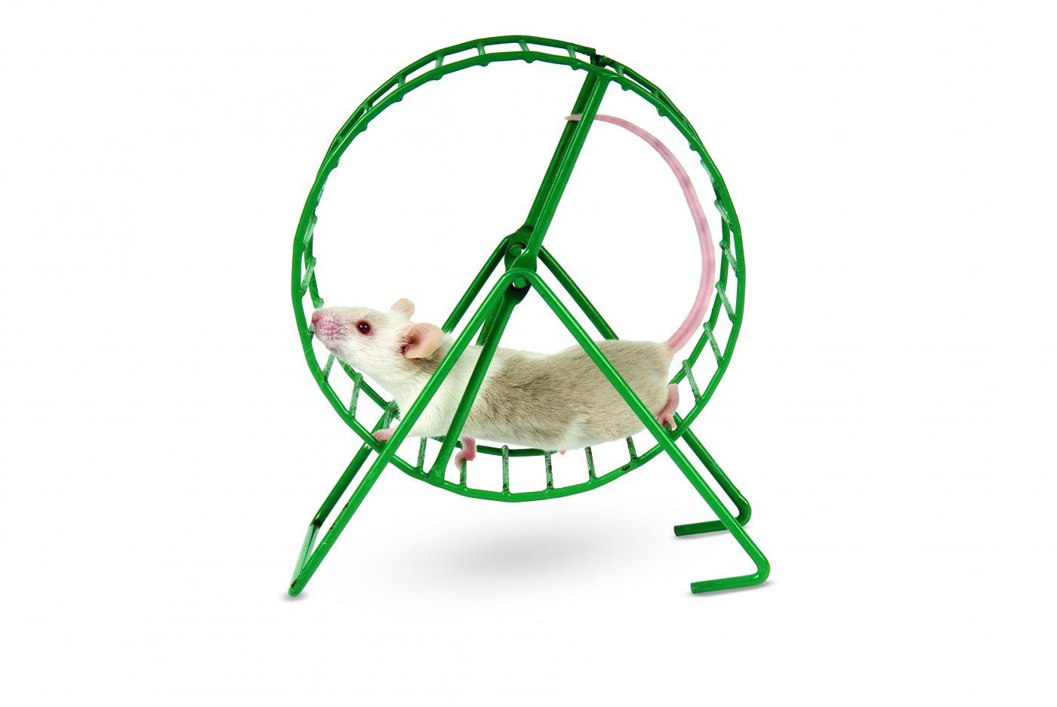

Slide 4
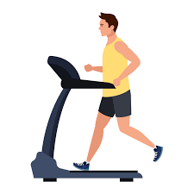

Slide 5
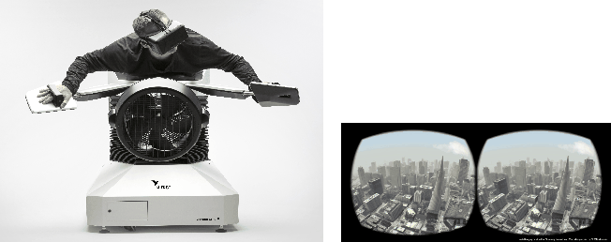
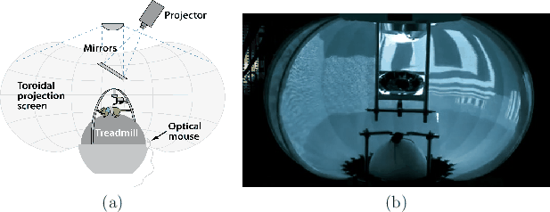
Virtual Reality and Its Applications
What is Virtual Reality?
In the Birdly experience from the Zurich University of the Arts, the user, wearing a VR headset, flaps his wings while flying over virtual San Francisco
An experimental setup used by neurobiologists at LMU Munich to present visual stimuli to a gerbil while it runs on a spherical ball that acts as a treadmill
Notes:
<number>

Slide 6
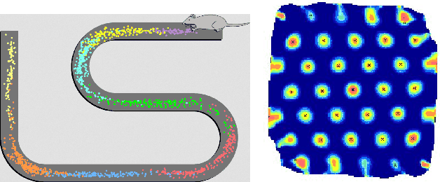
Virtual Reality and Its Applications
Testing the boundaries
Listening to music through headphones
Watching a movie at a theater
Anyone with modern VR headset and enjoying a session
Portrait or painting on the wall
Reading a novel
spatial firing patterns of eight place cells in a rat brain as it runs back and forth along a winding track
Notes:
<number>

Slide 7
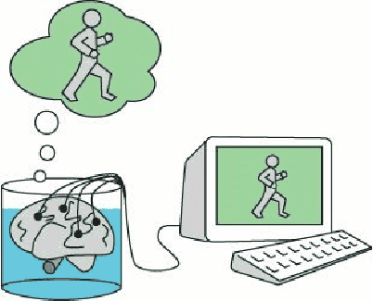
Virtual Reality and Its Applications
Who is the fool
A VR thought experiment: The brain in a vat, by Gilbert Harman
Neural structures composed of place cells are formed that encode spatial information about its surroundings
Each place cell is activated precisely when the organism returns to a particular location that is covered by it
Our brains may form place cells for places that are not real!
This is a clear indication that VR is fooling our brains, at least partially
Notes:
<number>

Slide 8
Virtual Reality and Its Applications
Interactivity
Most VR experiences involve another crucial component: interaction.
Does the sensory stimulation depend on actions taken by the organism? If the answer is “no”, then the VR system is called open-loop;
If the organism has partial control over the sensory stimulation, which could vary as a result of body motions, including eyes, head, hands, or legs, then we are in a closed-loop
Notes:
<number>

Slide 9
Virtual Reality and Its Applications
First Person Vs Third Person
Subjects have First Person Experiences
Observers have third-person experience
Switching back and forth between being the Subjects and observers while evaluating and refining their VR is a bad Idea!
Notes:
<number>

Slide 10
Virtual Reality and Its Applications
Synthetic Vs Captured
We may program a synthetic world, which is completely invented from geometric primitives and simulated physics
The world may be captured using modern imaging techniques.
Factor affecting captured
What happens when the user changes her head position and viewpoint?
What are their facial expressions while wearing a VR headset?
What can we infer about their emotional state?
Do we need to know their hand gestures?
Are their eyes focused on me?
Notes:
<number>

Slide 11
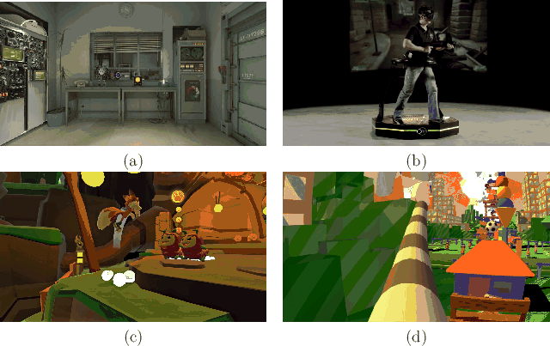
Virtual Reality and Its Applications
Modern VR Experiences – Video Games
Notes:
<number>

Slide 12
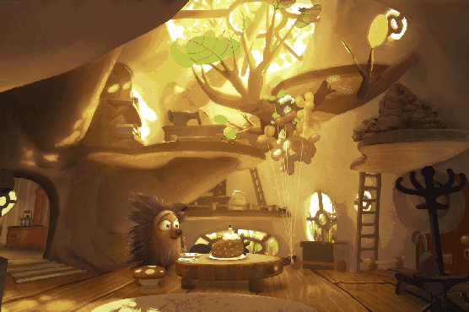
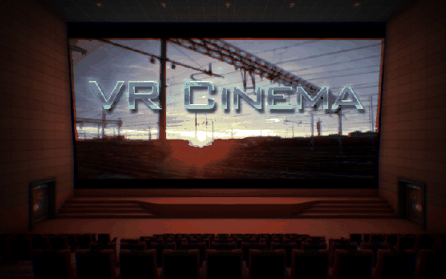
Virtual Reality and Its Applications
Modern VR Experiences – Immersive cinema
In VR, viewers can look in any direction, and perhaps even walk through the scene.
Some questions for the makers
What should they be allowed to do?
How do you make sure they do not miss part of the story?
Should the story be linear, or should it adapt to the viewer's actions?
Should the viewer be a first-person character in the film, or a third-person observer who in invisible to the other characters?
How can a group of friends experience a VR film together?
When are animations more appropriate versus the capture of real scenes?
Notes:
<number>

Slide 13
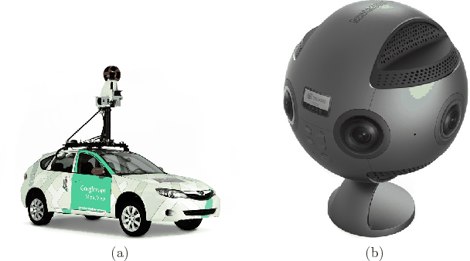
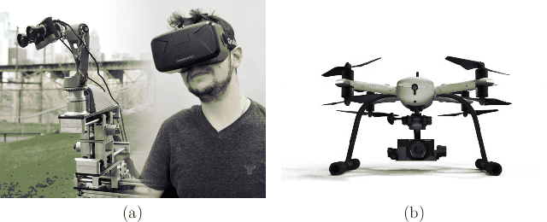
Virtual Reality and Its Applications
Modern VR Experiences – Telepresence
The first step toward feeling like we are somewhere else is capturing a panoramic view of the remote environment
Simple VR apps that query the Street View server directly enable to user to feel like he is standing in each of these locations, while easily being able to transition between nearby locations
By connecting panoramic cameras to robots, the user is even allowed to move around in the remote environment
Notes:
<number>

Slide 14
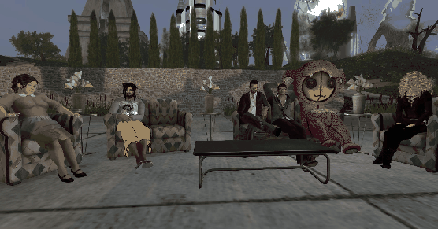
Virtual Reality and Its Applications
Modern VR Experiences – Virtual societies
Notes:
<number>

Slide 15
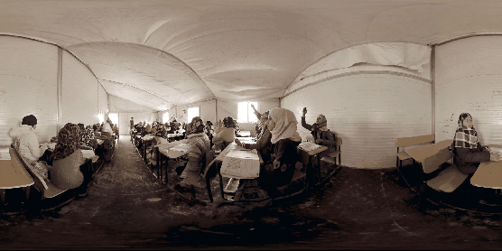
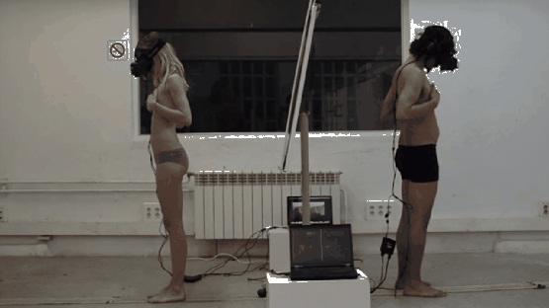
Virtual Reality and Its Applications
Modern VR Experiences – Empathy
The Machine to Be Another
In Clouds Over Sidra, 2015, offered a first-person perspective on the suffering of Syrian refugees
Notes:
<number>

Slide 16
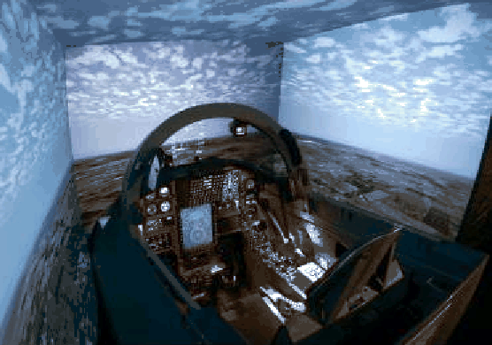
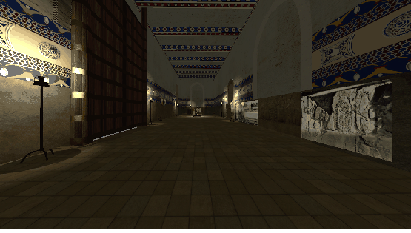
Virtual Reality and Its Applications
Modern VR Experiences – Education
A flight simulator in use by the US Air Force
A tour of the Nimrud palace
Notes:
<number>

Slide 17
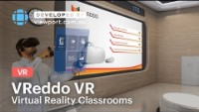
Virtual Reality and Its Applications
Modern VR Experiences – Advertisement
Notes:
<number>

Slide 18
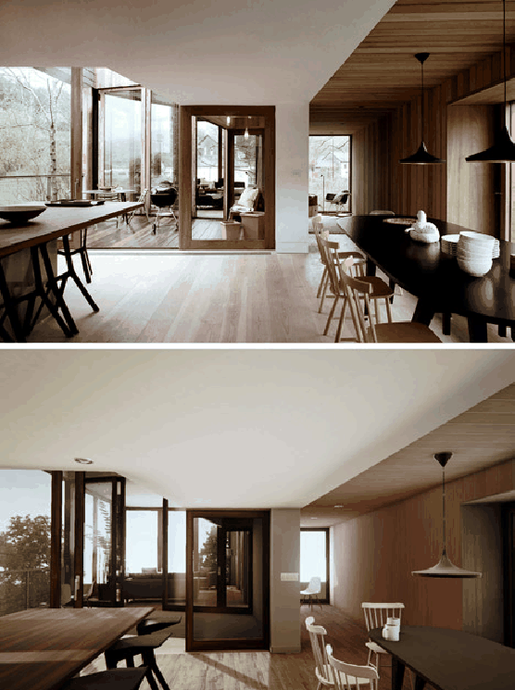
Virtual Reality and Its Applications
Modern VR Experiences – Virtual prototyping
Notes:
<number>

Slide 19
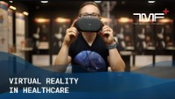
Virtual Reality and Its Applications
Modern VR Experiences – Health care
Notes:
<number>

