Slide 1
CodeAtlas AI
The Living Engineering Ontology and Knowledge Graph Platform
Every Freshservice incident and change, diagnosed and routed automatically.
Pavan Kumar H · The Great Agent Hackathon
Notes:
Introduce yourself and the one-line pitch: CodeAtlas diagnoses and routes every Freshservice incident and change before anyone opens it, with engineering context from the knowledge graph.

Slide 2
THE PROBLEM
A ticket says what broke. Nobody knows why.
FRESHSERVICE · INCIDENT #80
?
Which service is this?
Database connection pool exhausted on payment gateway
?
Who owns it?
?
What depends on it?
OPEN
UNASSIGNED
Knowledge is scattered across GitHub, Jira, Confluence, Slack, past tickets and tribal knowledge.
?
Has this happened before?
?
Which runbook do I follow?
The challenge isn't finding information. It's understanding how it connects.
CodeAtlas AI · 2
Notes:
Walk through the real ticket from our tenant. The five questions are what every on-call engineer asks first, and today the answers live in GitHub, Jira, Confluence, Slack and people's heads.

Slide 3
RATIONALE
Why now
Three shifts make an AI agent that works inside Freshservice possible today.
Freshworks is open
Agents now act
Context is scattered
• REST v2 + Workflow Automator push every ticket and change to agents
• Official Freshservice & Freshdesk MCP servers (Freshdesk GA Sep 2026)
• FDK apps can run agents inside the product UI
• Specialised agents hand off work: impact → ontology → experts
• LLM reasoning is cheap; a knowledge graph keeps it factual and cited
• Agents write back: notes, routing, change risk
• Ownership and dependencies live in GitHub, runbooks and people's heads
• Service desks see ticket text, not the system behind it
• Every wrong escalation adds to MTTR and lost revenue
WHAT THIS MAKES POSSIBLE: CODEATLAS INSIDE FRESHSERVICE
Ticket or change
Workflow Automator
8 AI agents + graph
Written back
raised in Freshservice
calls CodeAtlas instantly
GitHub · KB · LLM reasoning
diagnosis, routing, blast radius
CodeAtlas AI · 3
Notes:
Three shifts. Freshworks now exposes live tickets and changes to outside agents: REST v2, Workflow Automator events, official MCP servers and FDK apps. Agents have matured from answering to acting: specialised agents hand off work, and a knowledge graph keeps the LLM factual. Meanwhile engineering context keeps fragmenting. Together they make an agent that works inside Freshservice possible today; the strip at the bottom is exactly what we built.

Slide 4
WHO ELSE SOLVES THIS
Competitive landscape
Alternative | Strength | Gap
ServiceNow (CMDB + Now Assist) | Deep ITSM + CMDB suite | Heavy, costly, long rollout; CMDB needs manual upkeep
Developer portals (Backstage, Compass) | Service catalogue & ownership | Not connected to live ITSM incidents; no diagnosis
Built-in helpdesk AI copilots | Summarise / reply within a ticket | Sees only ticket text: no dependencies, owners, blast radius
Do nothing (Slack, wikis, "ask Alex") | Free, familiar | Slow, inconsistent, depends on a few people
Our edge A living graph of the engineering system, plus agents that act inside Freshservice. Every new ticket gets a diagnosis note automatically, without leaving the service desk.
CodeAtlas AI · 4
Notes:
Suites like ServiceNow are powerful but heavy. Developer portals know ownership but don't touch incidents. Built-in helpdesk AI only sees ticket text. Our edge: a live engineering graph plus agents acting inside Freshservice.

Slide 5
PROPOSED SOLUTION
How it works
Sources
Living ontology
8 AI agents
Back in Freshservice
Freshservice tickets, groups, KB (live)
GitHub repos & ZIP / Excel intake
Jira · Confluence · Slack (Phase 2)
Neo4j knowledge graph
Services · Teams · Owners · APIs · Incidents · Runbooks
Vector store for semantic search
Incident Context · Requirement Impact
Expert Discovery · Blast Radius
Ontology Mentor · Storyteller · Gaps · Doc Q&A
Private diagnosis note + auto-routing to the right group
Blast-radius note on every new Change
Auto-triggered by Workflow Automator
Explainable: trace + sources
Hybrid intelligence: graph traversal + semantic search + LLM reasoning, with a rule-based fallback when no LLM is available.
MVP: incidents → graph → auto-diagnosis · impact analysis · expert finder · blast radius · knowledge gaps · graph explorer
CodeAtlas AI · 5
Notes:
Left to right: Freshservice tickets, groups and KB flow in through REST v2 and our MCP-style connector. They join the knowledge graph and vector store alongside repos and docs. Eight agents reason over it with graph traversal, semantic search and an LLM. The result goes back into Freshservice as a private note, triggered automatically by Workflow Automator.

Slide 6
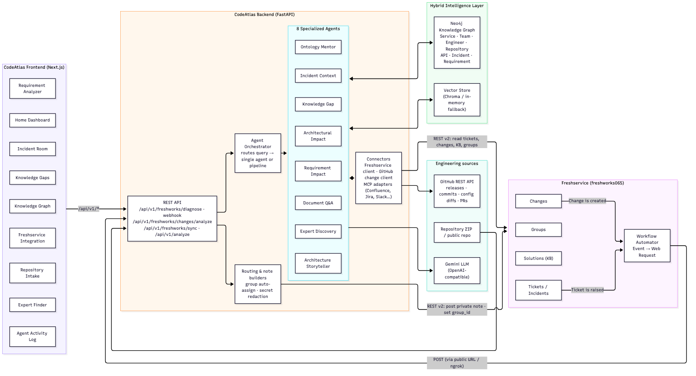
HOW THE PIECES CONNECT
Architecture
CodeAtlas AI · 6
Notes:
Frontend pages call the FastAPI backend. The orchestrator routes each request to one agent or a multi-agent pipeline. Agents reason over the Neo4j graph and vector store, GitHub changes and the Gemini LLM. Freshservice Workflow Automator calls in on ticket and change events; CodeAtlas writes back notes and group assignments through REST v2.

Slide 7
INTEGRATION MAP
Every module plugs into Freshservice
FRESHSERVICE EVENT
CODEATLAS
WRITTEN BACK
Ticket is raised
Incident Context Agent
Diagnosis note + auto-route to the right group
LIVE
Change is created
Impact → Ontology → Expert pipeline
Blast radius, risk, CAB reviewers
LIVE
Sync
Freshservice connector
Tickets → Incidents, groups → Teams
LIVE
KB search
Incident Context Agent
KB articles cited in each diagnosis
LIVE
CMDB relationships
Knowledge Graph
Code-derived dependencies as CI links
DESIGNED
Problems & KB drafts
Knowledge Gap Agent
Recurring incidents → Problem, KB drafts
PHASE 2
CodeAtlas AI · 7
Notes:
Freshservice knows what broke, who reported it and who is on call. CodeAtlas knows how the system is wired, what changed and who wrote the code. Three flows are live on our tenant today; CMDB is designed but our trial plan does not include it.

Slide 8
SEE IT WORK
Live demo
Raise a ticket
Diagnose + route
1
In Freshservice: "DB connection pool exhausted on Payment Service after deploy"
2
Workflow Automator fires → note posted, ticket lands in Database Team
Show the trace
Raise a change
3
Freshservice Integration page → brain icon → live agent trace · Activity Log
4
In Freshservice: "Upgrade SMTP relay config for Notification Service"
Blast radius
Explore
5
3-agent pipeline → impact, downstream services, CAB reviewers on the change
6
Knowledge Graph → Notification Service → Blast Radius highlights the same services
CodeAtlas AI · 8
Notes:
Create the ticket and the change fresh during the demo so judges see the before/after. Backup if the tunnel fails: the brain icon on the Freshservice Integration page runs the same diagnosis and posts the same note.

Slide 9
TARGET CUSTOMERS & USERS
Who it's for
Primary
Secondary
Mid-size software & digital companies (200–2,000 employees) running IT/engineering incidents in Freshservice, with 20+ microservices and several teams.
Freshservice MSPs supporting many client environments who need fast context on unfamiliar systems.
WHO USES IT, AND WHAT THEY GET
Service-desk agents
On-call / SRE
Change managers / CAB
Tech leads & new hires
Tickets arrive diagnosed and already in the right group, with no guessing which team owns it.
Suspected cause, the recent commit or config change behind it, past incidents, runbook, who to call.
Blast radius, risk and suggested reviewers on every new change, before it is approved.
Impact of a new requirement, owners and experts, and a map of how the system fits together.
Ticket note + auto-routing
Ticket note · Incident Room
Change note · Knowledge Graph
Analyzer · Experts · Graph
Every incident and change arrives with engineering context: faster resolution, the right owner first time, and no surprises when a change ships.
CodeAtlas AI · 9
Notes:
Primary buyer: mid-size software companies running engineering incidents in Freshservice. Secondary: MSPs who constantly face unfamiliar client systems. Then walk the four users left to right: each gets something different from the same knowledge graph, and three of the four get it without leaving Freshservice.

Slide 10
VALUE PROPOSITION
Why customers will want it
Every Freshservice ticket and change arrives already diagnosed, routed to the right team and risk-assessed, without anyone leaving Freshservice. Teams stop hunting for context across GitHub, runbooks and chat, resolve faster, and know what breaks before a change ships.
Instead of doing nothing
Instead of an alternative
✕ L1 guesses the team; tickets bounce between queues
✕ On-call spends the first part of every incident hunting for context
✕ Changes are approved without knowing what depends on them
ServiceNow CMDB: heavy rollout, relationships kept up by hand
Developer portals: know owners, but never see a ticket
Built-in AI copilots: read ticket text, not the system behind it
CODEATLAS INSTEAD · SHOWN LIVE IN THE DEMO
✓ Ticket auto-routed, zero clicks
✓ Change note shows blast radius
✓ Every claim cites its evidence
CodeAtlas AI · 10
Notes:
Read the statement as written; it is the answer to 'why would I buy this'. Then contrast: doing nothing means people hunt for context; the alternatives are either heavy (ServiceNow CMDB), disconnected from tickets (developer portals), or blind to the system (built-in copilots). Close on the proof strip: everything on it is shown live in the demo.

Slide 11
PRICING · GO-TO-MARKET · COST
Business model
PRICING · FRESHWORKS MARKETPLACE ADD-ON FOR FRESHSERVICE PRO & ENTERPRISE
FREE
PRO
ENTERPRISE · LATER
Free
$8 / agent / month
Custom
• Knowledge graph explorer
• Manual AI Diagnose, 25 tickets / month
• Gets the graph into Freshservice
• Auto-diagnosis on every new ticket
• Auto-routing to the right group
• 30-day free trial
• Change blast radius & CAB reviewers
• Jira · Confluence · Slack connectors
• CMDB sync on eligible plans
Go-to-market: inside the Freshworks ecosystem
Cost & economics
1. Discover Marketplace listing + in-product banner for eligible admins
2. Try Connect in 5 minutes: paste API key → Sync → see your graph
3. Convert Trial email to Pro/Enterprise admins + "a ticket diagnoses itself" video
4. Prove 3–5 design partners, case studies with measured MTTR drop
MVP ~$90–110K in ~3 months
Team 3 engineers + part-time design & PM
Scope auth, multi-tenant, Marketplace review
Run LLM cost in cents per diagnosis
ARR ≈ $288K illustrative (100 × 30 × $8 × 12)
ASSUMPTIONS
Prices, costs and ARR are working estimates, to be validated with design partners.
CodeAtlas AI · 11
Notes:
All figures are working assumptions to be validated with design partners. Pricing: a free tier gets the graph into Freshservice; Pro is where it runs itself on every ticket; Enterprise adds change risk and more connectors. Go-to-market lives inside the Freshworks ecosystem: Marketplace, a 5-minute connect, and a demo of a ticket diagnosing itself. Economics: roughly $100K to reach a production MVP against an illustrative $288K ARR, with LLM cost in cents per diagnosis.

Slide 12
SUCCESS METRICS · 6 MONTHS AFTER LAUNCH
How we'll know it worked
−25%
≥ 80%
+20%
≥ 20%
MTTR on diagnosed incidents
New incidents auto-diagnosed
Resolved by first team routed
Trial → paid conversion
TARGETS
Targets are assumptions; baseline measured on non-diagnosed incidents.
CodeAtlas AI · 12
Notes:
MTTR is the headline metric. Coverage shows the automation is really running. Correct first escalation shows the graph's ownership data is right. Conversion shows willingness to pay.

Slide 13
WHAT COULD GO WRONG · WHAT'S NEXT
Risks & roadmap
RISKS → MITIGATION
PHASE 2 ROADMAP
Graph quality drives diagnosis quality
Live Jira · Confluence · Slack connectors
Knowledge Gap agent flags missing owners, runbooks and docs
Trust & privacy of ticket data
Freshdesk: link customer tickets to engineering incidents
Private notes only; rule-based mode needs no LLM
Willingness to pay beyond built-in AI
Native FDK sidebar app on tickets & changes
Validate with design partners before pricing is final
CMDB sync · Problems from recurring incidents · on-call aware escalation
Auto-routing sends a ticket to the wrong queue
Only assigns unassigned tickets; reason is written in the note
Graph learns from every resolved ticket
API rate limits & plan restrictions
Graceful degradation (e.g. CMDB needs higher plans)
CodeAtlas AI · 13
Notes:
Be upfront: diagnosis quality depends on graph quality, and we mitigate with the Knowledge Gap agent. Privacy: private notes and a no-LLM mode. Roadmap turns mocked connectors live and adds a native FDK sidebar and change-risk assessment.

Slide 14
FOR REVIEWER Q&A
Appendix: what's built vs. planned
LIVE
Freshservice tickets, groups, KB search, diagnosis notes, auto-routing, Workflow Automator (REST v2)
LIVE
Freshservice Changes: 3-agent impact pipeline + graph blast radius posted as a change note
LIVE
GitHub recent releases, commits, config diffs (secrets redacted) in every diagnosis
BUILT
Neo4j graph (+ in-memory fallback), vector search, 8 agents, orchestrator, explainability, repo/ZIP intake
MOCKED
Jira, Confluence, Slack, Freshdesk connectors (same adapter interface)
BLOCKED
Freshservice agents & assets / CMDB: not available on the trial plan/role
PHASE 2
FDK sidebar app; official Freshworks MCP server wiring
CodeAtlas AI · 14
Notes:
Being upfront about what's mocked builds trust. Freshservice is fully live; the other connectors share the same adapter interface and are Phase 2.

