Slide 1

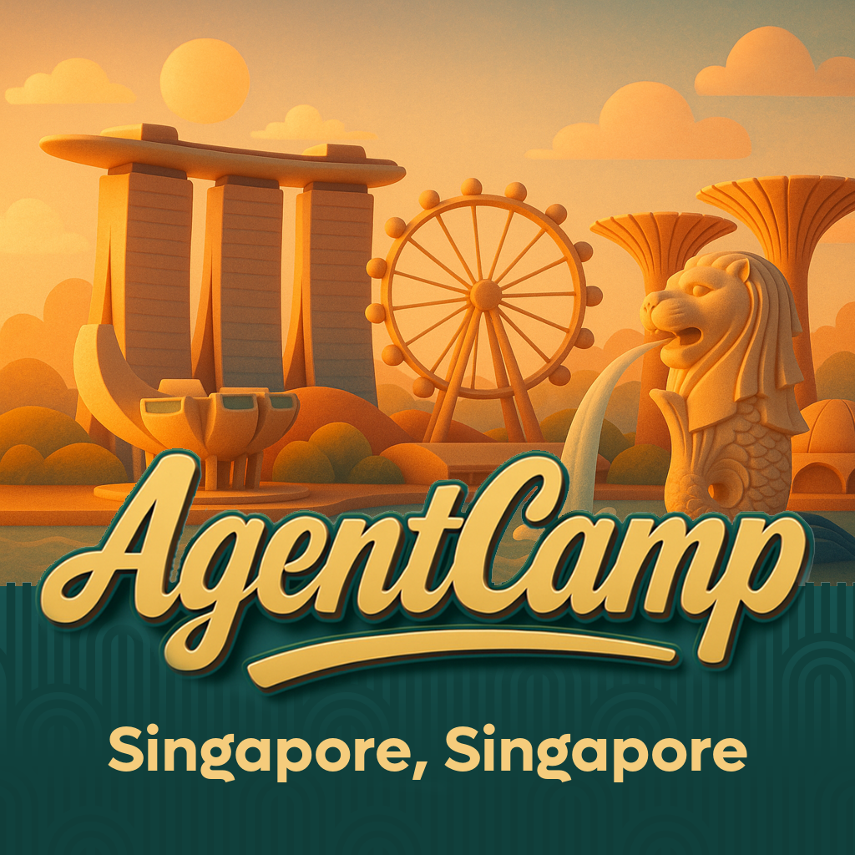

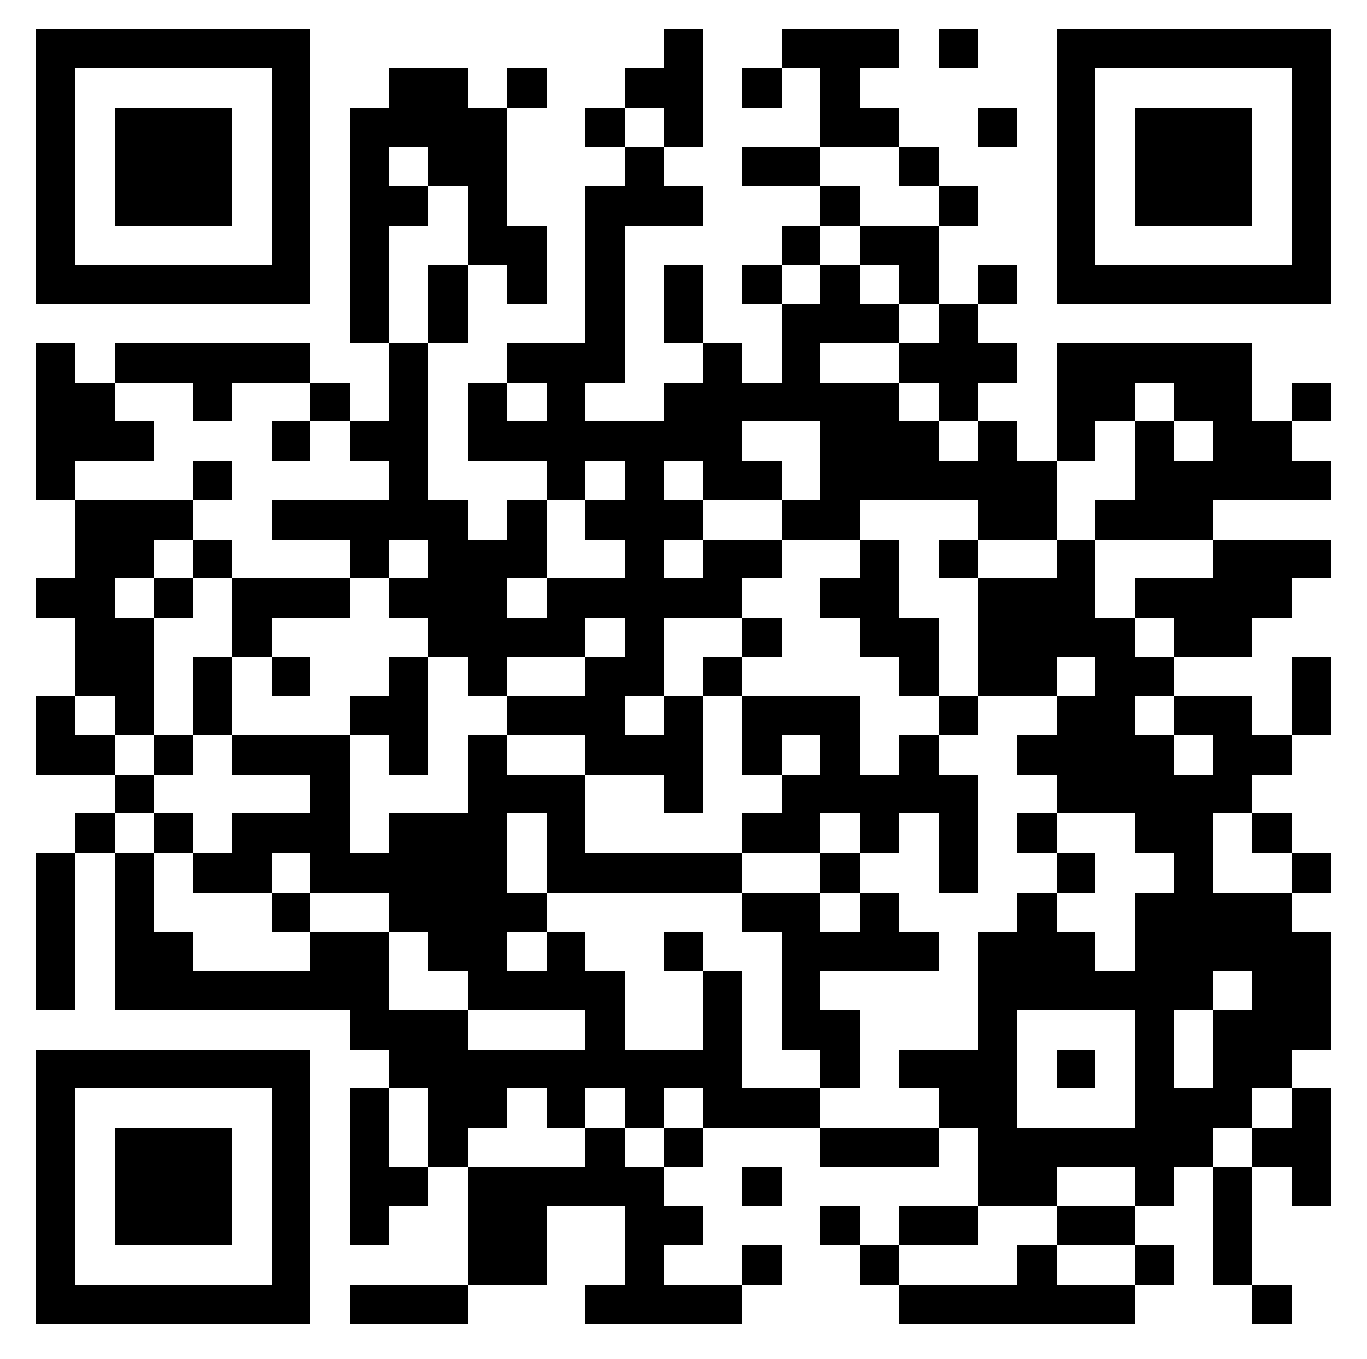

Pavan Mani Deep Yaragani
Agentify Your Apps: Bringing Azure AI
Foundry Agents into Power Apps
01:15 PM – 02:00 PM SGT
Register Here
Sponsored by:
Singapore AI & Agents UG

Slide 2
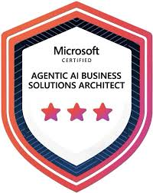
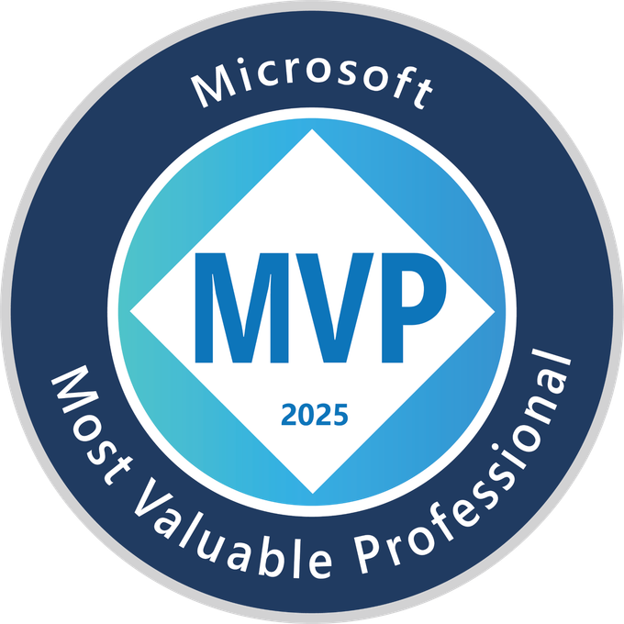
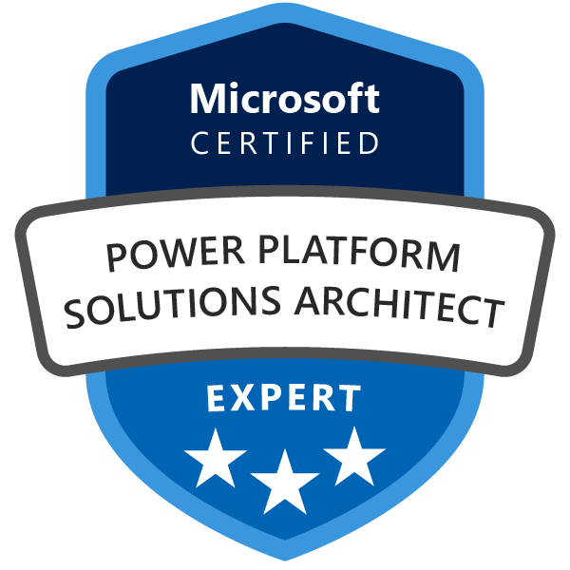
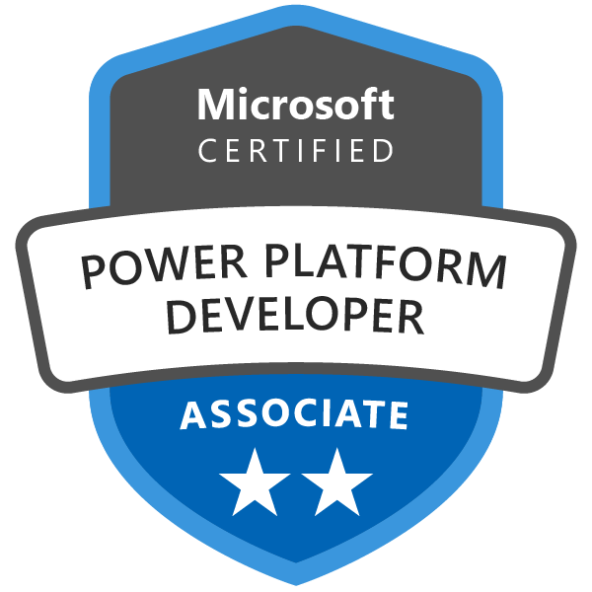
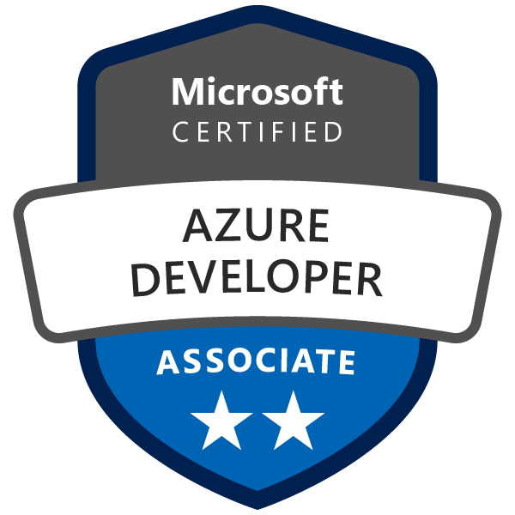
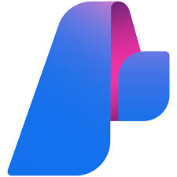
About Me
Microsoft MVP (2024, 2025) in Power Apps
Currently at NeoSoft, Dubai, United Arab Emirates
Focus: Model Driven Apps, Deployments CI/CD Automation, Cloud Architecture
#AgentCamp 2026

Slide 3

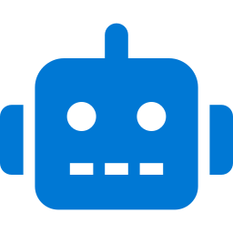
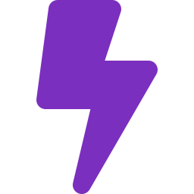


What is Azure AI Foundry?
01
Microsoft's enterprise AI platform for building, deploying & managing AI agents at scale.
Custom Agents
GPT Models
Data Grounding
Enterprise Ready
Build agents grounded in your own data & processes
Access latest OpenAI & Azure AI models out of the box
Connect to SharePoint, Dataverse, SQL & more
Production-grade, governed, auditable & scalable

Slide 4
AI Foundry Features
Unified endpoint → One Foundry project endpoint to access multiple models, tools, and MCP servers.
Governance + compliance → Built‑in RBAC, logging, and audit trails for enterprise security.
Agent orchestration → Combine models, MCP servers, and workflows into intelligent agents.
Knowledge grounding → Native RAG support to ground answers in enterprise data.
Versioning + lifecycle → Manage upgrades, rollbacks, and pinned versions seamlessly.
Cross‑service integration → Direct integration with Power Apps, Copilot Studio, and M365 Copilot.

Slide 5


POWER PLATFORM
03
Without vs With Azure AI Foundry — The Business Reality
Without Foundry
With Foundry
Dataverse = data store only
Dataverse = grounded AI knowledge
Holds records. Cannot answer questions.
Every record is queryable in natural language.
Power Apps = form + filter tool
Power Apps = intelligent assistant
Users navigate to data manually.
Users describe what they need; app retrieves & synthesises.
Flows = rule-based routing only
Flows = context-aware automation
No understanding of unstructured content.
VS
Classifies, enriches, and decides on every trigger.
Knowledge locked in files & people
Knowledge surfaced instantly via RAG
New staff spend weeks finding answers.
SharePoint + Dataverse answered in seconds.
Manual classification & enrichment
Auto-classification on record create
Every exception requires human intervention.
Foundry enriches before anyone opens the record.
Decisions take hours to days
Decisions compressed to seconds
Leaders wait for manually compiled reports.
Cemex: 120+ KPIs, days → seconds with LUCA Bot.
High headcount for repetitive queries
Agents handle queries at scale
Staff overwhelmed; costs scale with volume.
Air India: 40k queries/day, 97% resolved, millions saved.
Source: Air India + Cemex case studies via Microsoft Foundry | PwC: 8 in 10 enterprises now use agent-based AI | Cemex: decision cycles days → seconds

Slide 6


02
Why Bring AI Agents into Power Apps?
Intelligent Case Routing
AI agent reads case, assigns priority & team automatically
Smart Form Assistants
Guide users through complex forms with contextual AI help
Automate
Decisions,
Not Just Tasks
Document Summarisation
Summarise contracts, reports, emails inside your app
Low-code + AI =
Faster time to value
No Data Science Team Needed
Deploy enterprise AI with makers, not ML engineers

Slide 7


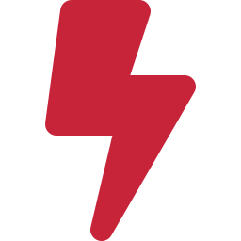
05
Key Considerations using Foundry Agents
Authentication
DLP Governance
Use Azure AD / Managed Identity. No API keys in production. Register an Entra App Registration for OAuth 2.0 flow.
Register Custom Connectors in your tenant. HTTP connector is blockable under DLP. Audit your policy before committing to a pattern.
Licensing
Cost & Monitoring
Premium Power Apps license required per user. Copilot Studio = message-based licensing. AI Foundry metered separately in Azure.
Meter AI calls via APIM or Dataverse audit table. Track consumption per app, user or department. Essential for enterprise rollout.

Slide 8
06
Foundry Integration Patterns
Foundry supports multiple integration patterns
Low-Code SaaS Connectors
Pre-built connectors for SaaS platforms like Power Platform enable rapid, low-code integration with minimal engineering effort.
Direct REST API Integration
Native REST endpoints offer full control for custom application code, fine-grained authentication, and bespoke orchestration flows.
API Gateway Mediation
Centralized API gateways (such as APIM) enforce policies, throttling, observability, and consistent governance across consumers.

Slide 9


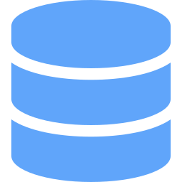

ARCHITECT VIEW
RAG via Embedding Models — What Power Platform Can & Cannot Do
02
Verdict: Query-time RAG is fully achievable in Power Platform. Index-build for large datasets or documents requires Azure services.
WHAT WORKS IN POWER PLATFORM
LIMITATIONS & GAPS
Query-time embedding
No vector store in Dataverse
Call text-embedding-3-large via custom connector on user query. Fully low-code in Power Automate.
No float array column type. Azure AI Search or Cosmos DB required — outside Power Platform.
Vector retrieval
No chunking primitive in flows
HTTP connector calls Azure AI Search with the vector. Returns top-K chunks. No code needed.
Splitting documents into 512-token chunks needs code. Requires an Azure Function — not low-code.
Prompt augmentation
Batch indexing hits flow limits
Compose action assembles chunks + user query. Pass to GPT-5.4. Native Power Automate step.
50k+ records one-by-one in a loop hits PP action limits and API throttling. Use ADF instead.
Small dataset index
No native PDF/doc extraction
Under 5,000 records: loop + embed + push to AI Search. Feasible via scheduled flow off-peak.
Document Intelligence (Foundry) works but PP can't chunk extracted text. Azure Function needed.
Azure Function Chunking + bulk embedding
Azure AI Search Vector store + retrieval
Power Platform Query layer + UX only
Recommended enterprise pattern: Azure handles index build | Power Platform handles query, retrieval, augmentation & UX

Slide 10
Integrating Azure AI Foundry Models to Power Platform
Eleven patterns for connecting Foundry models, prompts, and RAG into Power Apps and beyond
01
Custom Connector
Connect Foundry models through Power Platform custom connectors.
02
Azure AI Foundry Prompts
Reuse prompt assets defined directly inside Azure AI Foundry.
03
RAG Grounding
Ground responses in your own data using Foundry knowledge sources.
04
Copilot Studio Agents
Build agents in Copilot Studio backed by Azure AI Foundry models.
05
Power Automate Flows
Trigger Foundry models from flows for background automation on Dataverse events.
06
Canvas App Functions
Wrap Foundry inference in reusable Power Fx functions for citizen developers.
07
Dataverse Plugins
Call Foundry models from server-side plugins to enforce rules and enrich records.
08
API Management
Front Foundry endpoints with APIM for throttling, logging, and governance.
11 paths,
one platform.
Pick the entry point that fits your workload.
09
Copilot Studio Bots
Use Foundry models as the intelligence layer for bots embedded in Power Apps.
10
Copilot Studio Extensions
Surface Foundry-powered agents inside Power Apps as native copilots.
11
Fabric + Synapse Link
Sync Dataverse to Fabric, enrich with Foundry, and return insights to dashboards.

Slide 11
Questions?

