Slide 1

Final Project – Data 1200 Pavan Modh (100796933) Lecture – Sam Plati
Durham college

Slide 2
Analysis being conducted
Mr. Hughes needs help in deciding which model is best for diabetes dataset. He has given a confusion matrix and Classification report for Logistic regression model.
In this document, we will be making three models Support vector machine, Naïve Bayes and decision tree. As per Mr. Hughes requirement, we will compare the models and give suggestions to improve the accuracy of best-chosen model.

Slide 3
Methodology
We have been provided with the confusion matrix of Logistic regression. In the following slides, we will look on the accuracy of the other models.
Support vector machines, Naïve Bayes and Decision tree are three models which Mr. Hughes wants to compare. We also have the output of logistic regression model. Mr. Hughes wants to compare all four models and chose the best model among them.

Slide 4
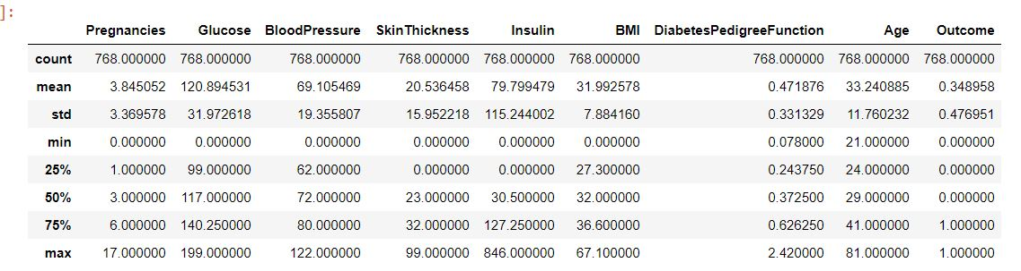
Key statistics
The Figure above shows a key statistics about our diabetes dataset.

Slide 5
Key Statistics cont…
As we can see in the previous slide, we have 768 different entries in our dataset. We have nine variables in which outcome is the only dependent variable with two distinct values 0 (No diabetes) and 1 (Diabetes).
Except DiabetesPedigreeFunction all the variables have minimum value of 0. Glucose has the highest mean value of 120.89. BMI, DiabetesPedigreeFunction and Age have almost same value for 25%.
Mean and standard deviation for Pregnancies is almost same with the value of 3.84 and 3.36.

Slide 6
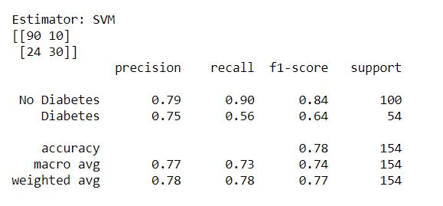
Confusion Matrix and Classification report for SVM
Figure on the left shows the output of the Confusion matrix and Classification report for Support vector machine model.
We have 154 support values in total, 100 out of 154 values are for No diabetes and 54 for Diabetes.

Slide 7
Confusion Matrix and Classification report for SVM cont’d…
If we look at our confusion matrix, we can see that out of 100 support values for No Diabetes, our algorithm was able to predict 90 values correctly and 10 values were misclassified.
SVM tries to segregate data in best possible way.
For the Diabetes values, out of 54, SVM model was able to predict 30 values correctly and 24 incorrectly.
F1 score for diabetes is 0.64 and for no diabetes it is 0.84. Overall F1 score for this algorithm is 0.77
By looking at the precision and recall values which is 0.78, we can say that F1 score, precision and recall has same values.

Slide 8
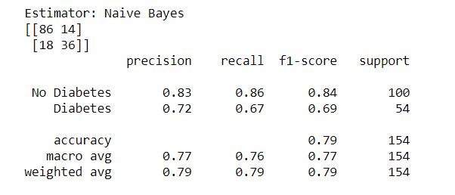
Confusion Matrix and Classification report for Naïve Bayes
This figure shows the confusion matrix and classification report of Naïve Bayes.
Same as SVM ,We have 154 support values in total, 100 out of 154 values are for No diabetes and 54 for Diabetes.
Naïve Bayes works based on probability by assuming not any variables have correlation with each other.

Slide 9
Confusion Matrix and Classification report for Naïve Bayes cont’d…
We can see that out of 100 support values for No Diabetes, our algorithm was able to predict 86 values correctly and 14 values were misclassified.
For the Diabetes values, out of 54, SVM model was able to predict 36 values correctly and 18 incorrectly.
F1 score for diabetes is 0.69 and for no diabetes it is 0.84. Overall F1 score for this algorithm is 0.79 which is 0.02 more than from the F1 score of SVM.
For Naïve Bayes F1 , precision and recall values is same which is 0.79

Slide 10
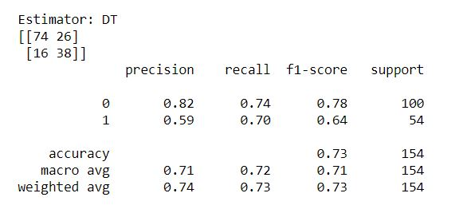
Confusion Matrix and Classification report for Decision Tree
Figure shows the output of Decision Tree Model made from our diabetes dataset.
Same as previous models ,We have 154 support values in total, 100 out of 154 values are for No diabetes and 54 for Diabetes.

Slide 11
Confusion Matrix and Classification report for cont’d…
We can see that out of 100 support values for No Diabetes, our algorithm was able to predict 74 values correctly and 26 values were misclassified.
For the Diabetes values, out of 54, SVM model was able to predict 38 values correctly and 16 incorrectly.
F1 score for diabetes is 0.64 and for no diabetes it is 0.78. Overall F1 score for this algorithm is 0.73 which is lowest in all three models including output of logistic regression model.
Decision Tree is having a F1 score of 0.73 which is lowest among all the models which we have made and the output of logistic regression model.

Slide 12
Recommending best model
If we compare the F1 score for all the models than Naïve bayes has a highest F1 score of 0.79.
Also, individual F1 score for No Diabetes and Diabetes is highest for Naïve Bayes among all the models.
For class 0 (No Diabetes), 0.85 is the highest F1 score, which comes from Logistic Classification Matrix. But it’s a difference of 0.01, which is very less so we will choose naïve bayes among all four models.

Slide 13
Way to improve the effectiveness of the model
Increasing the entries(Number of rows) in our dataset can help our model to understand the correlation between variables. Also, the variables which we are using might would not be highly correlated and we might need some new variables which are really correlated, and help models to better understand the pattern in our dataset.
Naïve Bayes works on Conditional Probably. It assumes that independent variables have no correlation.
When I looked into correlation matrix , Skinthickness is not correlating with our Diabetes dataset. We might can remove that column and try to make model with remaining variables.

