Slide 1
Employee Attrition Analysis
A data analytics project to analyze factors that impact employee attrition

Slide 2
Problem statement
The problem of | figuring out which employee will leave next is one of the biggest challenges that managers face
affects | Cost to an organization and business continuity
the impact of which is | Prohibits organization from increasing its knowledge base and experience over time, leading to errors and issues with constantly changing workforce
a successful solution would be | To find out employees who will most likely leave the company and the factors that are responsible

Slide 3
Product Position Statement
For | Managers & Business
Who | wish to retain talented workforce
Employee Attrition Prediction | is analytics for predicting attrition within organizations
That | Provides data analysis and uses machine learning models to predict which employee is most likely to leave
Unlike | HR dashboards, intuition, judgement
Our product | uses HR dataset from an organization and predicts the attrition

Slide 4
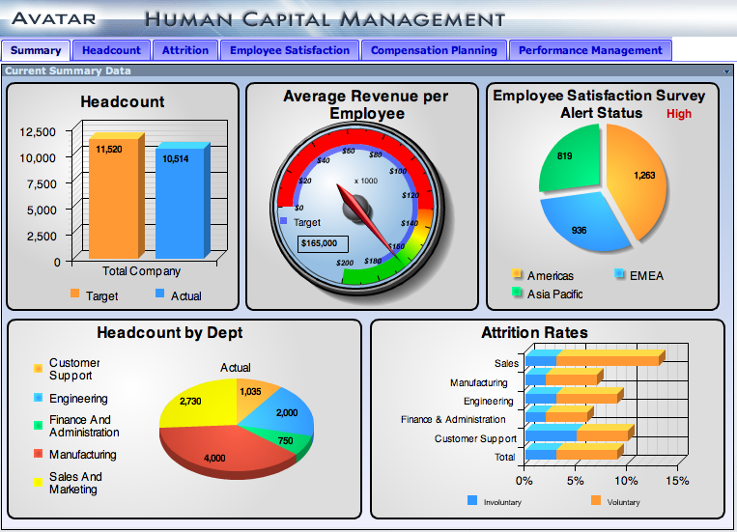
Use cases
Human Resources Dashboard
Provide accurate results for making business decisions
Data
https://raw.githubusercontent.com/mythri11/data/master/hrdata.csv
Platform
Databricks.com

Slide 5
Project plan
Download data
Explore and visualize data(tableau software)
Clean and transform data
Model data
Evaluate model accuracy
Visualize results
Deliver demo Databricks.com notebook

Slide 6
Future work
Create working product
Generate and update models online
Generate prediction based on feature selection
Provide results to decision makers
Improve employee retention

Slide 7
Which model performed the best?
Model | Accuracy | Precision | Recall | F1 score
Random Forest | 84.9% | 76.9% | 81.3% | 74.7%
Logistic Regression | 81.4% | 89.6% | 89.6% | 89.6%
Decision Tree | 60.0% | 83.5% | 83.5% | 83.5%

