Slide 1


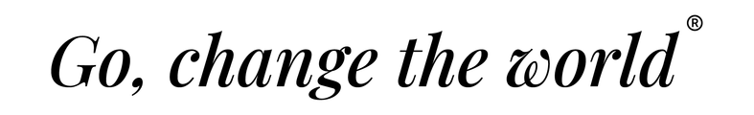
Department of Master of Computer Applications
Design Thinking
Efficient Beekeeping and Hive Box
Pavan Mohan Naik
Sumanth Bhaskar Hegde
Pramath Prakash Hegde
Under the Guidance
of
Dr. Mohan Aradhya
Assistant Professor

Slide 2




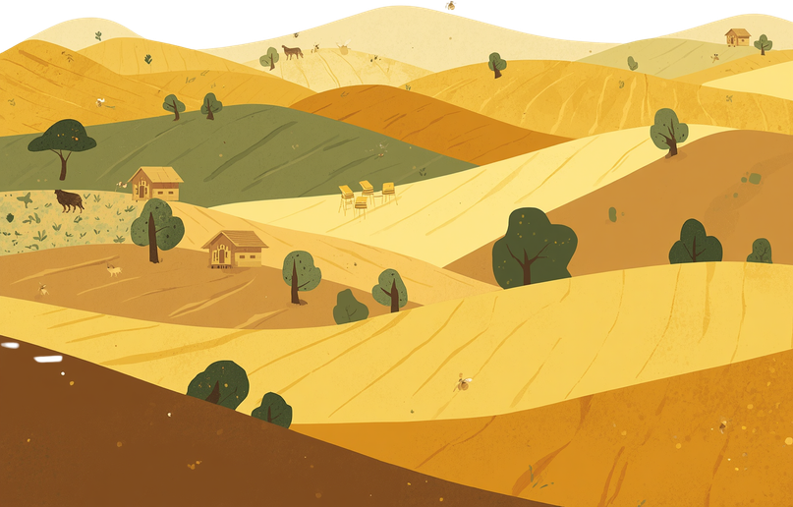
Efficient Beekeeping and Hive Box
Empathy & Define Phase

Slide 3


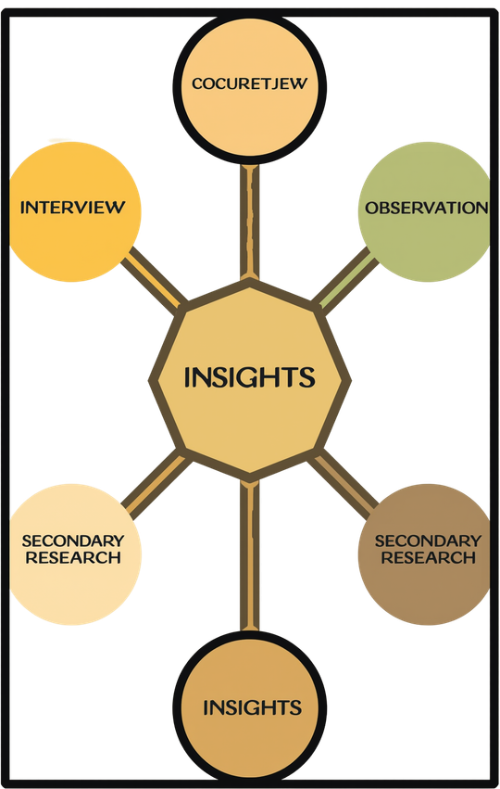
How We Collected Data
Our research approach combined multiple methods to gather comprehensive insights:
In-depth user interviews with beekeepers, bee societies & Beginners
Google Form survey for Beekeepers & Consumers
Secondary Research , Bee Training Camp

Slide 4


OUR DATA
DOCUMENTATION
Well Structured Repo
Contains Raw data and refined Results

Slide 5

User Interviews & Observation Highlights
Infrequent Inspection Due to Effort
Hive inspection feels time-consuming & exhausting → farmers only open hives when a visible problem occurs, not on a schedule.
Adoption Hesitation Fear of Stings
Small farmers interested in extra income hesitate to start beekeeping due to fear of bee stings and colony disturbance during hive opening.
Hive Opening is the Hardest Task
[INT-Manjunath][INT-Sushanth]
Survey confirms hive inspection is among the most difficult parts of beekeeping opening and checking hives ranks as a top challenge.
[INT-Harsha][INT-Manjunath]
[SUR-Beekeepers]

Slide 6
User Interviews & Observation Highlights
Colony Loss & Pest Exposure
Societies report recurring challenges: colony loss, pest infestations, and pesticide exposure all requiring careful, regular monitoring.
NO formal
Training
Most interviewees rely on informal learning rather than structured training, which leads to inconsistent practices and low confidence in “doing it right.”
Consumer Pressure on Hive Health
[SUR-Beekeepers]
Consumers strongly prioritise purity, local source, and trust in honey putting direct pressure on beekeepers to maintain healthy hives and honest practices.
[INT-Dhruv][INT-Ullas]
[SUR-Consumers]

Slide 7

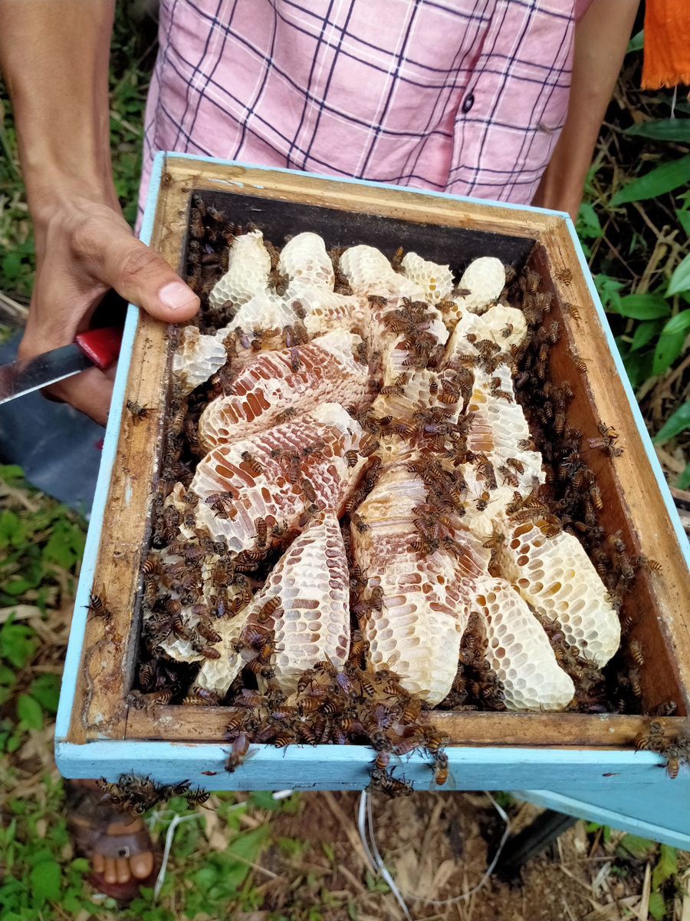
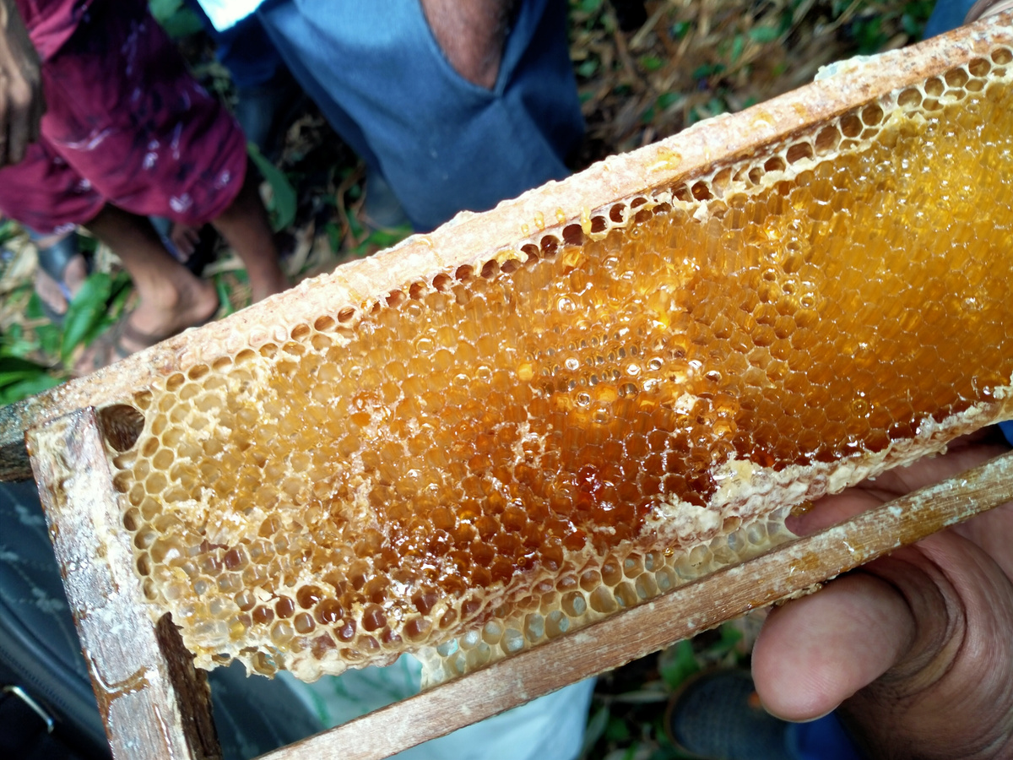
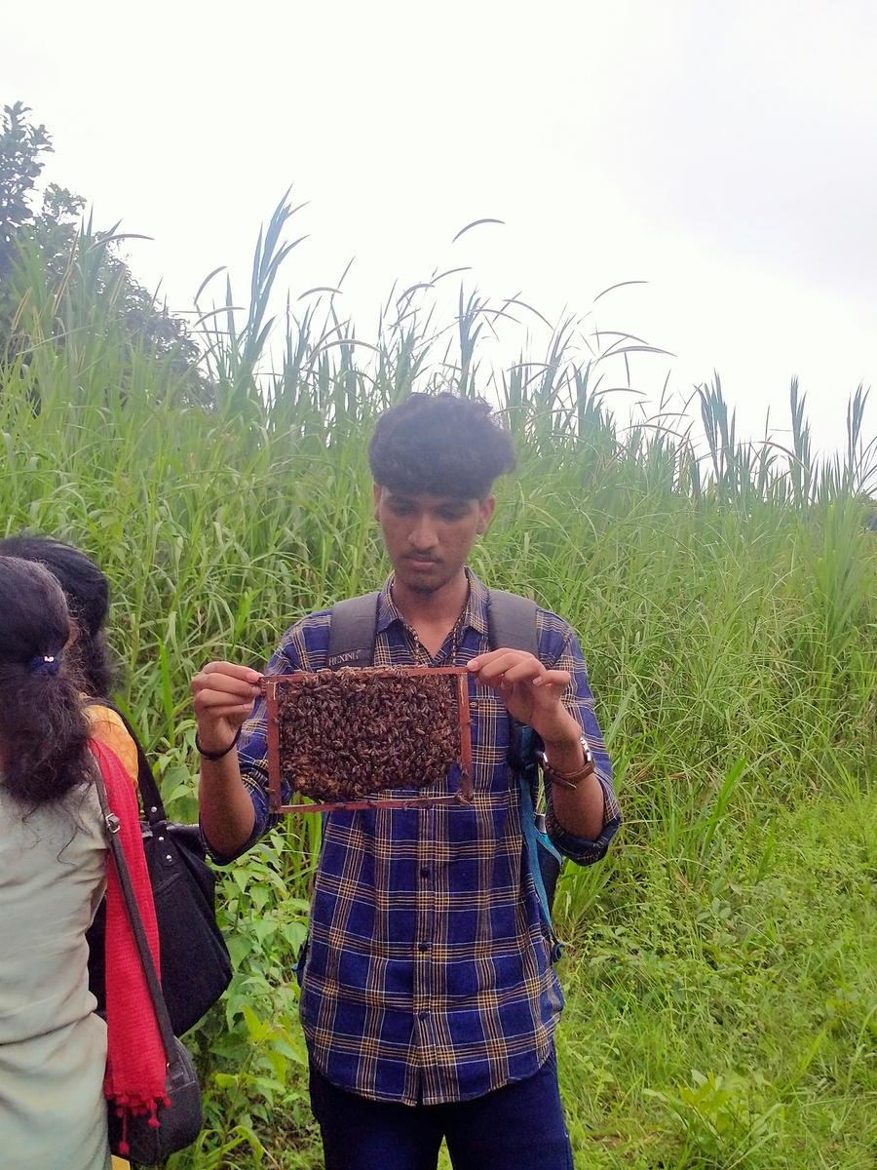
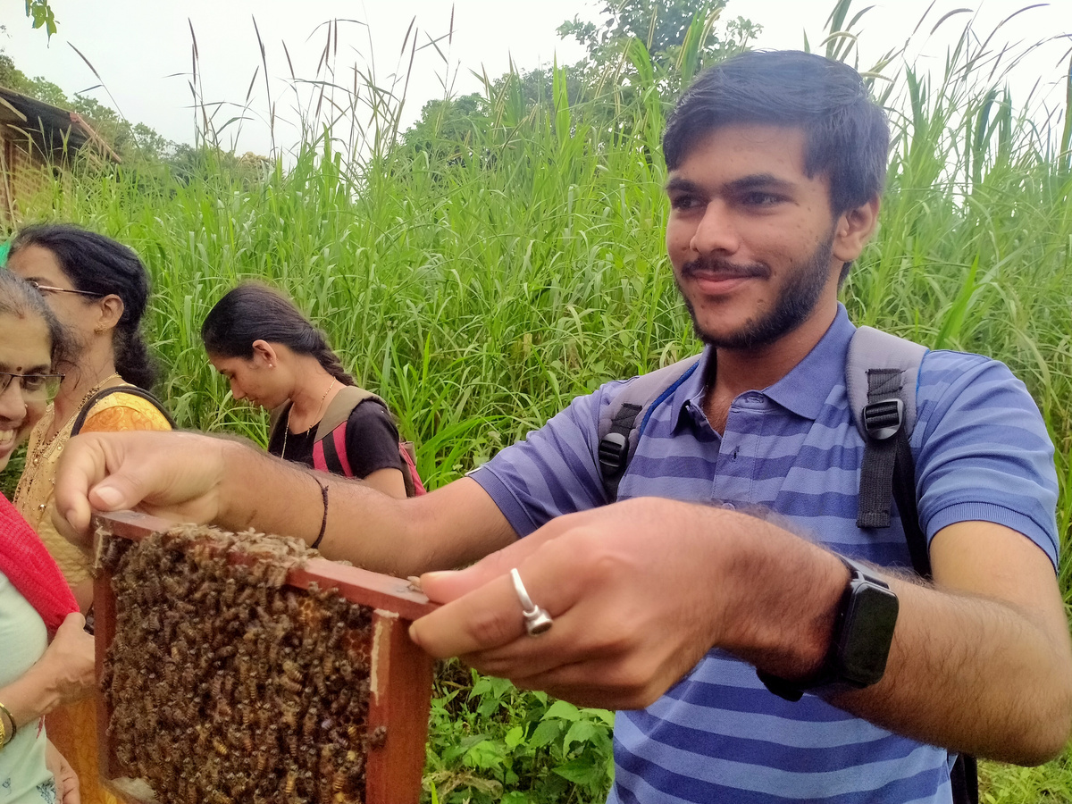
Survey Snapshot

Slide 8
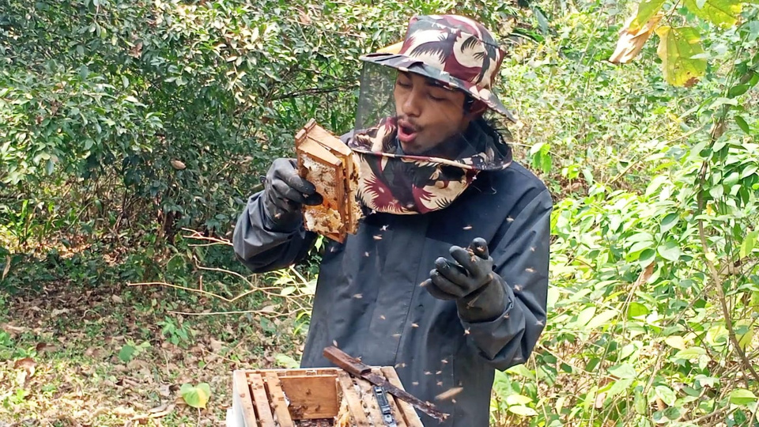
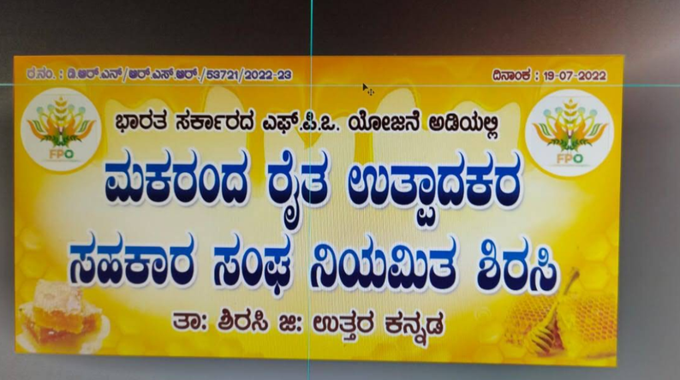

Survey Snapshot
Manages 300+ hives at Kadumane Honey Park
Needs cost-effective, modular, and eco-friendly solutions
Wants better hive health and harvesting efficiency during monsoons
Prefers external feeding systems for large-scale use
Natural materials over plastic to maintain honey quality
Dhruva Bhat
Bee Researcher
Faces climate-related hive loss and low profits
Lacks maintenance knowledge and technical support
Wants affordable, practical innovations
Prefers value-added bee products over expensive automation
Harsha Hegde
Bee Society
Executive Manager

Slide 9
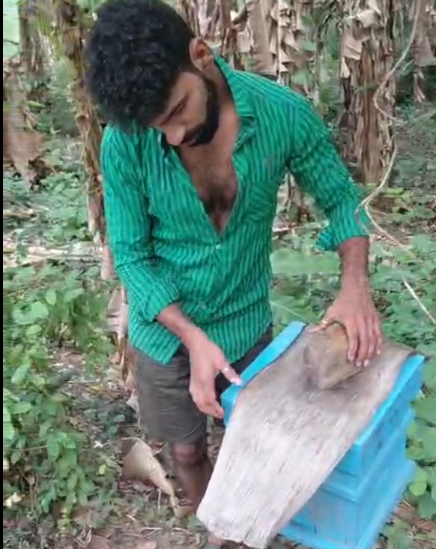
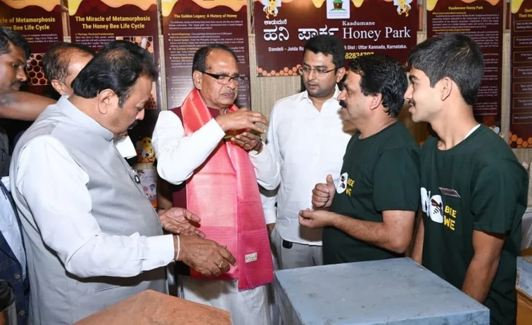
Survey Snapshot
Struggles with extreme heat, pest attacks, and hive disturbance during inspections
Finds automated hive systems too expensive for Indian farmers
Prefers shaded modular hive boxes
Wants transparent inspection windows with protective dark covers
Ullas Naik
BeeKeeper

Slide 10

Empathy Map: Understanding the Beekeeper
SAYS
THINKS
"Opening the hive disturbs the bees too much"
"I only check when something looks wrong"
"Monsoon season is the hardest time"
Fear of bee stings during inspection
Worried about colony loss from climate and pests
Doubts whether beekeeping is worth the effort
DOES
FEEL
Opens hive only when a visible problem occurs
Uses traditional methods passed down informally
Avoids frequent inspections to reduce disturbance
Anxious during hive inspection
Frustrated by low profits and high effort
Overwhelmed by lack of technical support

Slide 11
Key User Needs & Pain Points
User Needs
Pain Points
Hive inspection is risky, disruptive, and time-consuming
Fear of bee stings discourages regular monitoring
Climate change causes colony loss and pest attacks
Lack of training and maintenance knowledge
Automated solutions are too expensive for small farmers
Low profit margins reduce motivation to continue
Safer and less disruptive way to inspect hives
Affordable and locally suitable hive solutions
Simple guidance without needing expert support
Modular, eco-friendly hive materials
Better income through value-added bee products
Tools that work through harsh monsoon seasons

Slide 12

Point of View Statement
Single-Liner
"Small-scale Indian beekeepers need a safer, affordable, and easy-to-use hive management solution because current methods are too risky, costly, and technically demanding for everyday use."

Slide 13
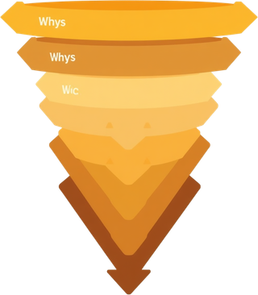
ROOT CAUSE ANALYSIS
Surface Problem : Beekeepers avoid regular hive inspection
Why? → Inspection is risky, disruptive, and exhausting
Why? → No safe, simple tools for non-invasive monitoring
Why? → Existing solutions are expensive or designed for large-scale commercial use
Why? → Innovation in beekeeping lacks focus on small-scale Indian farmers
ROOT CAUSE
Small farmers are underserved by beekeeping technology solutions don't match their budget, climate, skill level, or scale.

Slide 14

Problem Definition
"Small-scale Indian beekeepers lack a safe, affordable, and easy-to-use hive inspection method because existing tools are too expensive, too complex, and not suited for local climate and scale leading to colony loss, low income, and poor adoption of beekeeping."

Slide 15



Key Insights from Empathy & Define Phase
Fear is the Biggest Barrier
Reactive, Not Proactive
Affordability Over Automation
Climate is a Silent Threat
Knowledge Gap is Widespread

Slide 16

Thank You

