Slide 1



Department of Master of Computer Applications
Design Thinking
Efficient Beekeeping and Hive Box
Pavan Mohan Naik
Sumanth Bhaskar Hegde
Pramath Prakash Hegde
Under the Guidance
of
Dr. Mohan Aradhya
Assistant Professor
Notes:
1.7.2013
‹#›

Slide 2


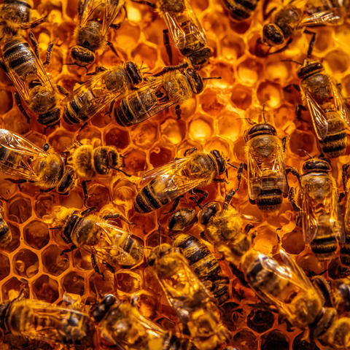
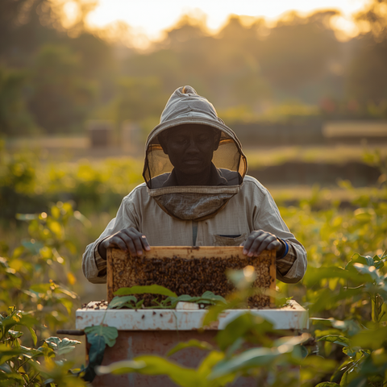
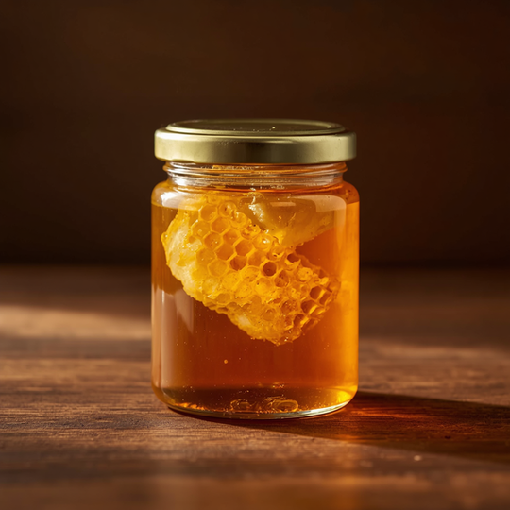
The Complete
Design Journey
Final Project Presentation · Design Thinking Lab
Efficient Beekeeping & Hive Box Empathize to Field-Ready Prototype
B
BeeHive
Design Lab

Slide 3


OUR DATA
DOCUMENTATION
Well Structured Repo
Contains Raw data and refined Results

Slide 4

OUR APPROACH
The Design Thinking Process
1
2
3
4
5
›
›
›
›
Empathize
Define
Ideate
Prototype
Test
Interviews, surveys & field research with beekeepers, societies and beginners.
Synthesised the pains into one sharp, user-centred problem statement.
Brainstormed and scored concepts against user needs and a ₹4,000 budget.
Interactive 3D visualiser plus a low-cost physical retrofit build.
Usability, thermal and bee-behaviour validation with real beekeepers.

Slide 5
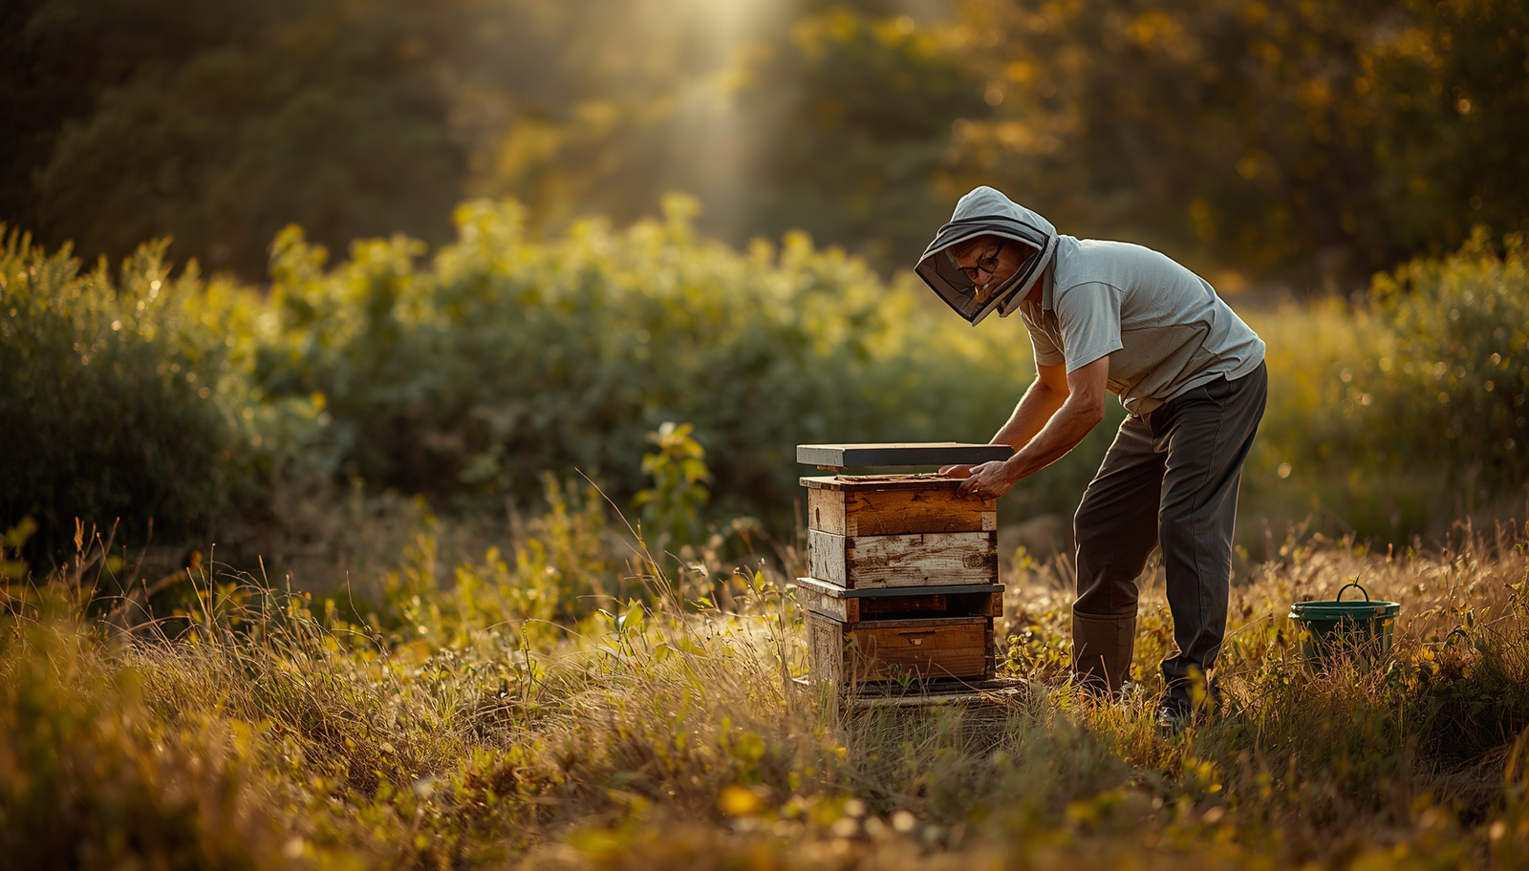
The Core Problem
Small-scale farmers fear bee stings and lack hive expertise. ^{[Harsha, Sushanth]}
Traditional hive inspection is risky, disruptive, and costly. ^{[2,3]}
Need safer, simpler, low-cost inspection and maintenance solutions. ^{[Beekeeper survey]}
Budget constraint: Upgrade cost must stay under ₹4,000.

Slide 6
01 · EMPATHIZE
Research & Key Insights
How We Researched
What We Learned
• 7 in-depth interviews — beekeepers, bee societies & beginners
• Google Form survey of beekeepers and honey consumers
• Field observation and a hands-on bee training camp
• Secondary research — Flow Hive, ISI standards, literature ^{[1,4,6]}
• Fear of stings is the biggest barrier to adoption ^{[Harsha, Sushanth]}
• Inspection is reactive — hives opened only when a problem shows ^{[Manjunath, Sushanth]}
• Climate & pests drive colony loss; monsoon is hardest ^{[Beekeeper survey, Dhruv]}
• Knowledge gap — most rely on informal, inconsistent learning ^{[Dhruv, Ullas]}
• Farmers want affordability over expensive automation ^{[Ullas, Harsha]}

Slide 7
02 · DEFINE
Point of View & Problem Definition
“Small-scale Indian beekeepers need a safer, affordable and easy-to-use hive-management solution , because current methods are too risky, costly and technically demanding for everyday use.”
ROOT CAUSE
Small farmers are underserved by beekeeping technology — existing solutions don’t match their budget, climate, skill level or scale. ^{[2,3,8]}
Safer inspection
Affordable & local
Simple — no expert needed
Works through monsoon

Slide 8
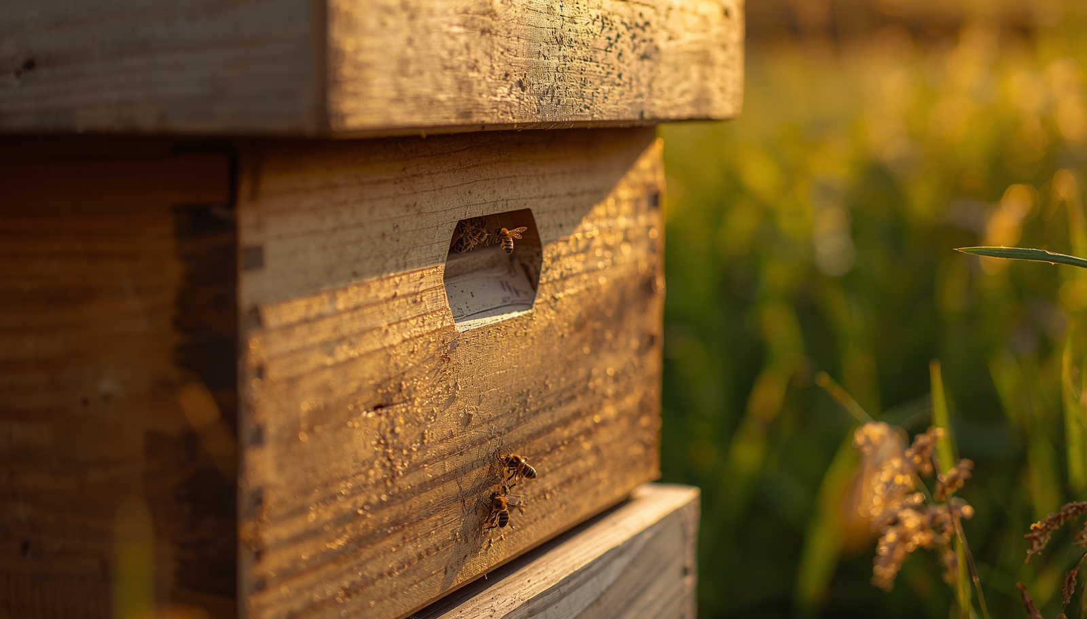

IDEATE : FROM 3 "HOW MIGHT WE"s
TO THE TOP 6 CONCEPTS
Acrylic Window with sliding cover for visual hive checks
External Sugar Syrup Feeder with outside refill funnel
Clip-On Modular Super for hive expansion
Auto-Harvest Flow System with tilt pipe for honey extraction ^{[4,5]}
Donut Water Ring for pest protection
Internal Thermal Insulation using coir/jute

Slide 9

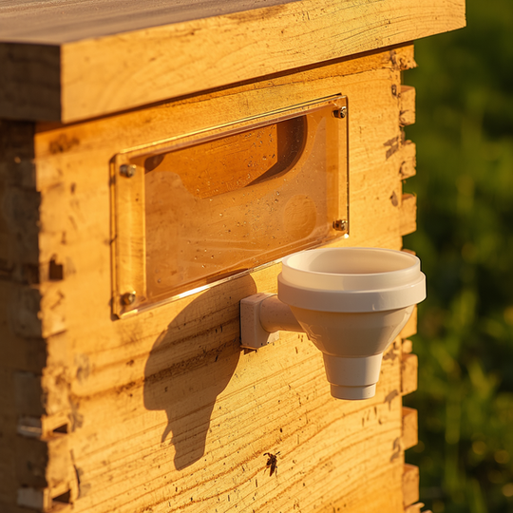
THE SOLUTION: SAFE INSPECTION & FEEDING UPGRADE
Acrylic window allows visual hive inspection without opening the lid
External feeder enables syrup feeding without hive disruption
Retrofit design fits existing ₹2,500 wooden boxes affordably
Non-disruptive design preserves hive micro-climate and reduces sting risk ^{[1]}

Slide 10
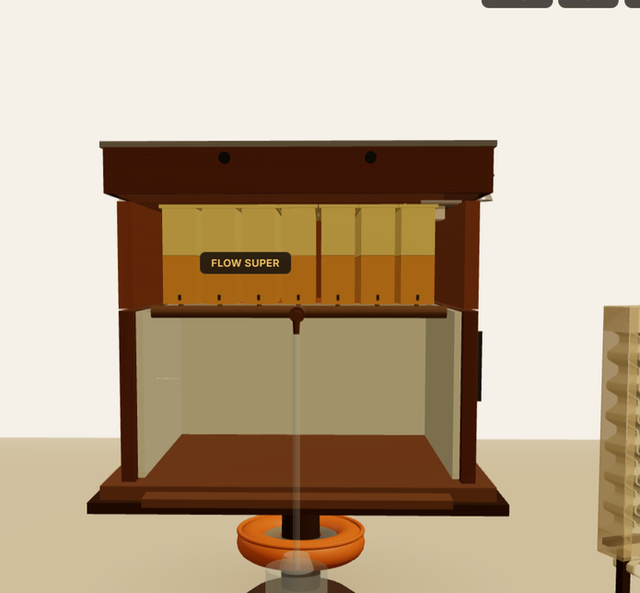
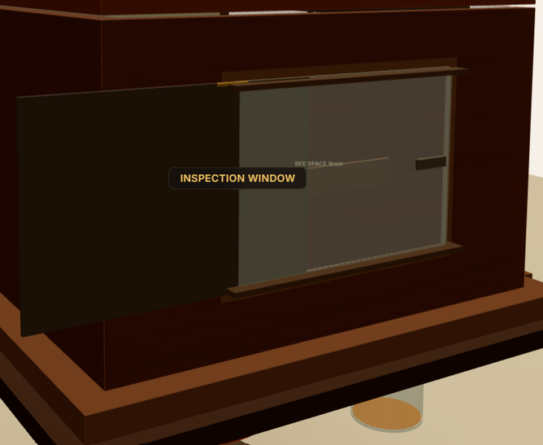

04 · PROTOTYPE
Design Realised — Safe Inspection & Feeding Upgrade
Full hive — ISI standard ^{[1]}
Acrylic inspection window
External top feeder
KEY UPGRADES
• Dual acrylic inspection windows (left + back) with sliding shutters
• External top feeder — refill syrup without opening the hive
• Flow-harvest frames: pipe → tap → ground collection jar ^{[4,5]}
• 10 mm XPS internal insulation holds the 35°C brood micro-climate ^{[1]}
• Donut water-ring ant moat that doubles as a bee waterer
• Retrofits any standard ₹2,500 wooden box — no structural change
Interactive 3D visualiser built procedurally with Three.js (no external models).

Slide 11
05 · TEST
Usability Validation Plan
1
Installation usability — fit the module with hand tools, no hive opening
CRITICAL SUCCESS CRITERIA
2
Inspection window — answer 5 colony-status questions vs. ground truth
• Zero hive openings during inspection & feeding
• Brood temperature held at 33–36°C for 5 days ^{[1]}
• Zero bee drowning in the feeder trough
• Installation under 45 minutes with hand tools
• Beekeeper satisfaction ≥ 4 / 5
3
Feeder usability — refill reservoir, confirm bees feeding, zero drowning
4
Thermal & structural — 5-day brood-temperature and condensation log
5
Bee behaviour — guarding, fanning and propolis-sealing observation
Participants: 3+ beekeepers across 2 test sites — partnering with the Karnataka Beekeepers’ Co-operative, Bengaluru.

Slide 12

Anticipated Impact
Operational Efficiency
97.5% Reduction in Inspection Time Turns a traditional 20-minute, high-prep inspection into a seamless 30-second visual check
Safety & Usability
100% Elimination of Routine Gear Completely eliminates the need to wear heavy, hot protective suits or use smoke for standard visual checks and feeding.
Risk Mitigation
₹2,000 Asset Protection External feeding prevents dry-season starvation, directly saving the farmer the ₹1,500 – ₹2,000 cost of replacing a dead bee colony.
Economic Accessibility
80% Cost Savings vs. Redesign The modular upgrade costs < ₹500, which is an 80% saving compared to forcing farmers to buy a completely new ₹2,500 wooden box.
Biological Productivity
~15-20% Projected Yield Increase Preserving the hive's 35°C internal micro-climate redirects bee energy from temperature regulation back into honey production. ^{[1]}

Slide 13
CONCLUSION
From Insight to a Field-Ready Solution
A design-thinking journey from empathy to engineering: real beekeeper research distilled into one sharp problem, then a sub-₹500 retrofit that turns a risky 20-minute hive inspection into a 30-second visual check.
NEXT STEPS
• Build the v0.2 / v0.3 physical prototype for field trials
• Run the 5-session usability test with rural beekeepers
• Iterate on UV-tint clarity, shutter humidity & propolis sealing
• Explore low-cost distribution through beekeeping co-operatives

Slide 14
SOURCES
References
1. Bureau of Indian Standards. IS 1515:1998 — Bee Hive (Newton / ISI type): Specification. BIS, New Delhi. (hive dimensions & 9 mm bee-space)
2. Monga, K. & Manocha, A. (2011). Adoption and constraints of beekeeping in District Panchkula (Haryana), India. Livestock Research for Rural Development, 23(5).
3. Gadekar, U. B. (2026). Problems of Bee Farming in Rural Maharashtra: A Case Study of Patgaon Village. Int. J. of Engineering and Management Research, 16(1), 38–45.
4. Flow Hive. Wikipedia — mechanism & caveats of one-tap flow harvesting. en.wikipedia.org/wiki/Flow_Hive
5. Agriallis (2025). Flow Hive – A Novel Technology for Beekeeping. agriallis.com
6. MANAGE. Promoting Scientific Beekeeping for Livelihood Security. National Institute of Agricultural Extension Management. manage.gov.in
7. KVK Delhi. Scientific Bee-Keeping Report. kvkdelhi.org
8. Agriculture.Institute (2025). Current Beekeeping Trends in India: Challenges & Opportunities.
PRIMARY RESEARCH — WHO / WHICH FORM
Interviews — Manjunath Hegde, Sushanth Hegde, Harsha Hegde, Ullas Naik, Akshay Kedla (beekeepers) & Dhruv Bhat (bee researcher). · Surveys — Beekeeper & Consumer Google Forms. · Field observation & bee-training camp.
In-text markers: numbered [n] cite the references above · named tags such as [Harsha, Sushanth] are the interviewees quoted · [Beekeeper survey] / [Consumer survey] are our Google Forms. Prototype visuals are the team’s procedural Three.js renders.

Slide 15

Thank You
Notes:
1.7.2013
‹#›

