Slide 1



Department of Master of Computer Applications
Design Thinking
Efficient Beekeeping and Hive Box
Pavan Mohan Naik
Sumanth Bhaskar Hegde
Pramath Prakash Hegde
Under the Guidance
of
Dr. Mohan Aradhya
Assistant Professor

Slide 2
Contents:
Problem Statement
Stakeholder
Assumptions
Current System
Context
Initial Persona
Empathy Plan

Slide 3
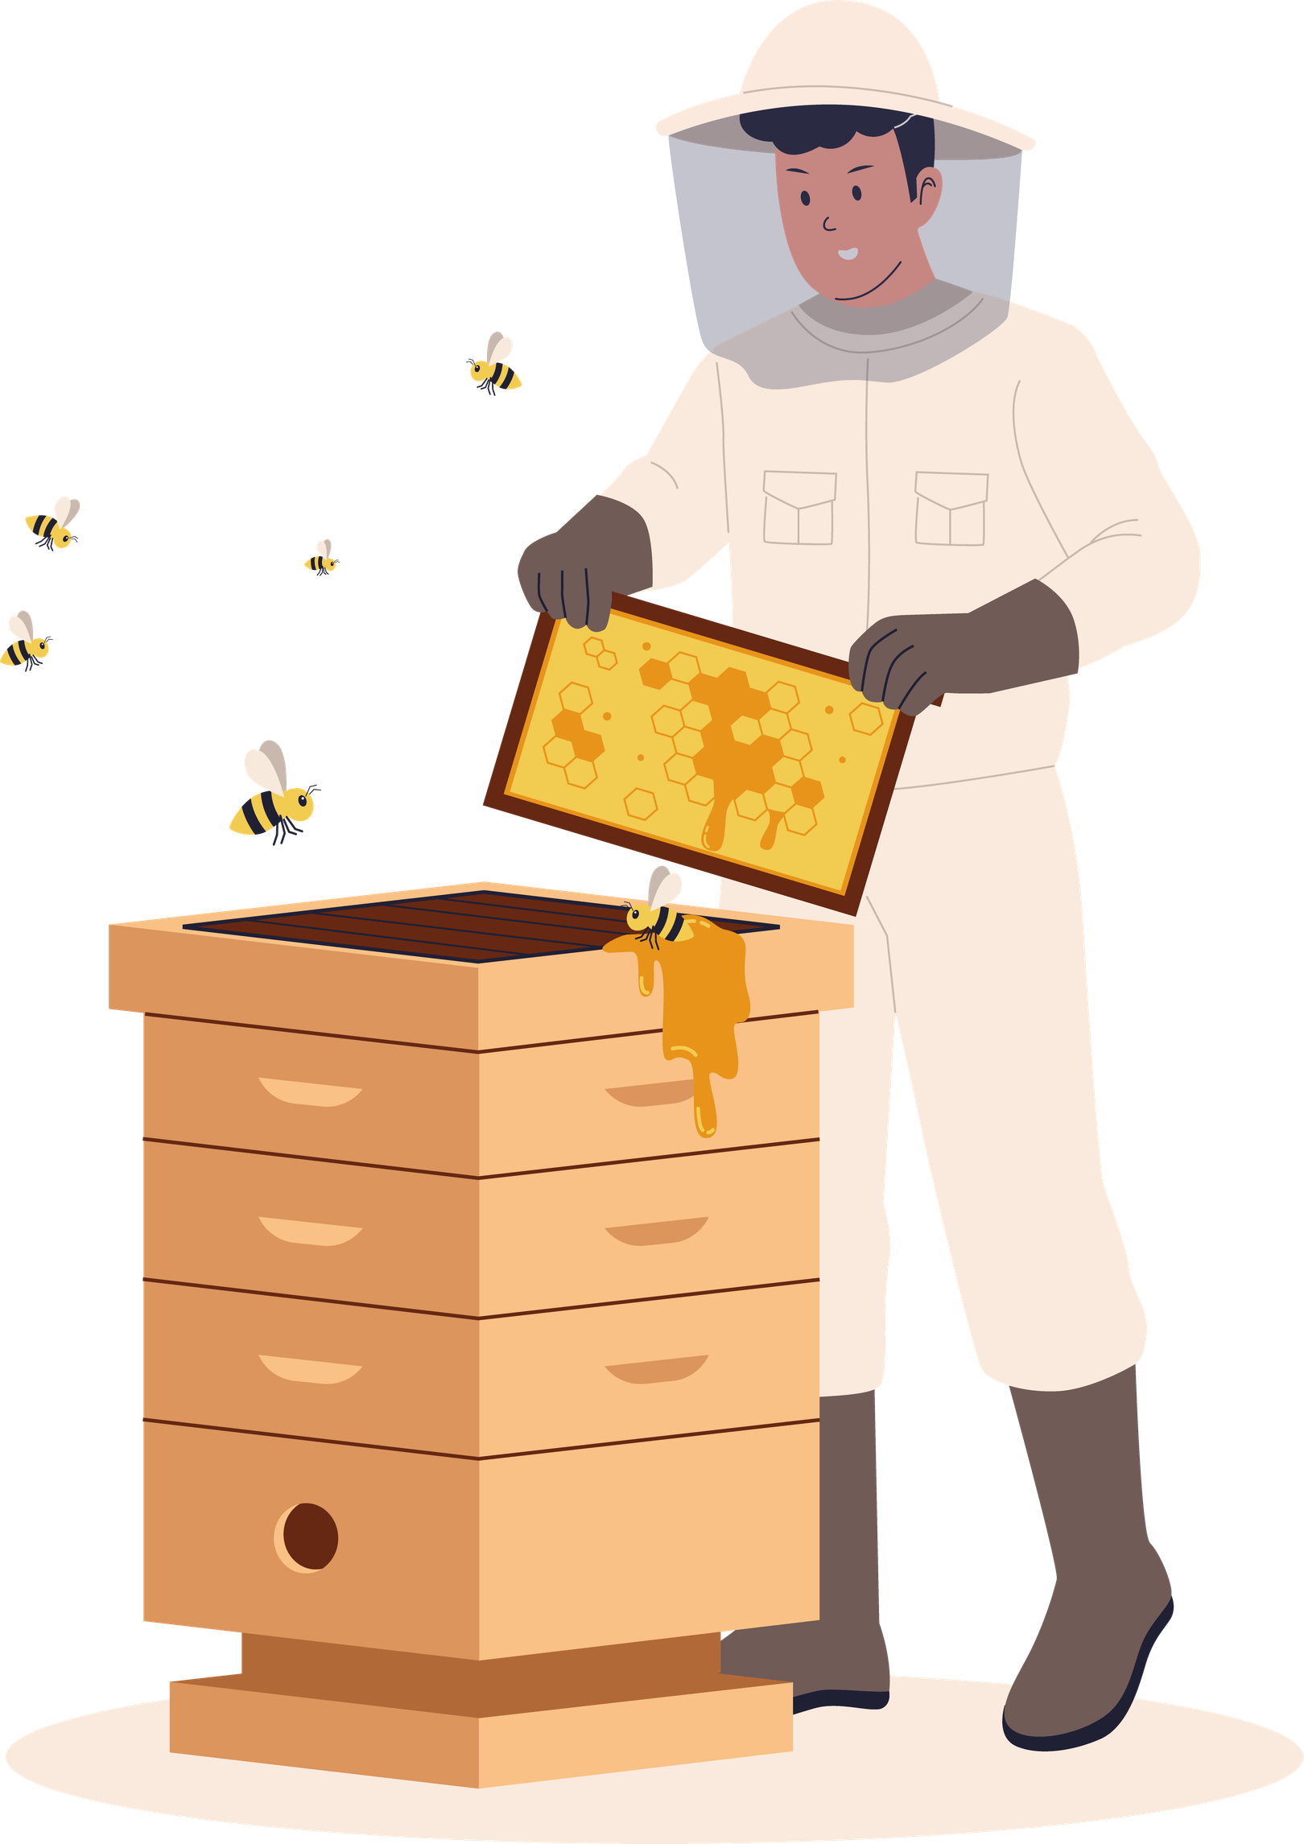
Problem Statement
Farmers face difficulty in adopting and maintaining beekeeping due to complex, risky, and inefficient traditional methods, leading to low adoption and missed opportunities for additional income and improved crop yield.

Slide 4
Stakeholders
Primary
Secondary
Indirect
Farmers
Beekeepers
Agricultural cooperatives
Honey buyers / distributors
Local markets
Consumers
Government agriculture departments
Environment (pollination impact)

Slide 5
Assumptions
ADDITIONAL INCOME
PERCEIVED RISK
Farmers seek supplementary revenue streams to improve their livelihoods and financial stability.
Beekeeping is seen as difficult and dangerous, creating hesitation among potential adopters.
SIMPLICITY DRIVES ADOPTION
LACK OF AWARENESS
Low-maintenance, simplified systems will significantly increase farmer participation rates.
Limited training and knowledge about beekeeping practices prevents farmers from starting.

Slide 6

Current System: Traditional Beekeeping
PROCESS STEPS
• Opening the hive manually
• Using smoke to calm bees
• Manual honey extraction
• Wearing full protective gear
PAIN POINTS
• High risk of bee stings
• Time-consuming process
• Colony disturbance stress
• Expertise and training needed

Slide 7
Context and Importance
Context:
Around 75% of global food crops depend (at least partly) on pollination (FAO)
Bee pollination can increase crop yields by 20–30%, especially in fruits, vegetables, and oilseeds
India is the 8th largest honey producer globally, yet scientific beekeeping adoption among small farmers is still limited
Beekeeping can increase farmer income by 15–25% through honey and related products
Constraints:
Financial limitations and cost sensitivity among beekeepers
Time availability for training and hive maintenance
Regulatory frameworks and compliance requirements
Limited access to beekeeping technologies and extension services

Slide 8
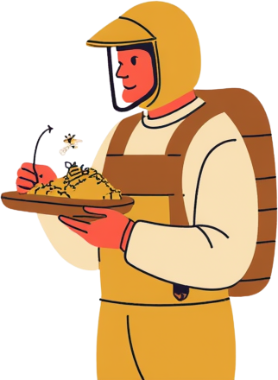
Initial Persona (Draft)
Name: Harsha Maani
Small-scale farmer (1–2 acres)
Wants to increase income
Has limited time and resources
No prior beekeeping experience
Pain Points:
Fear of bees
Lack of knowledge
Complexity of current systems

Slide 9



Farmer Interviews & Field Observation
Conduct on-site visits to understand daily farming routines, observe current beekeeping practices, and gather firsthand insights.
Beekeeper Discussions
Interview experienced beekeepers to learn techniques, identify pain points, and understand what makes systems successful.
Empathy Research
Plan
Secondary Research & Analysis
Review existing literature, case studies, and Flow Hive documentation to synthesize insights and validate findings.

Slide 10

Sample Questions

Slide 11

Thank You

