Slide 1
Neural Cache
Bit-serial in-cache acceleration for deep neural networks
Presented by: Pavan Kumar Srikanth Naik
Charles Eckert, Xiaowei Wang, Jingcheng Wang, Arun Subramaniyan, Ravi Iyer † University of Michigan
Dennis Sylvester, David Blaauw, and Reetuparna Das † Intel Corporation

Slide 2
Table of Contents
Introduction
Motivation
Existing Work and its Limitations
Background
Neural Arithmetic
Neural Architecture
Experimental Environment
Results
Related Work
Conclusion
Q & A

Slide 3


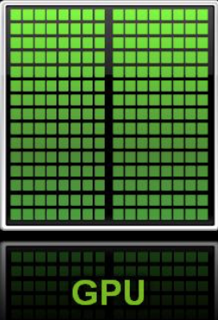
Introduction
Could we transform CPU to a data parallel accelerator?
++ Parallelism
-- Data Movement

Slide 4
Memory Wall
Processor Performance
Instructions/second → 2x every 2 years
Memory Capacity → 2x every 2 years
Memory Latency → 1.1x every 2 years
Speed
Memory wall
Memory Performance
time
A large amount of energy is spent in moving data back-and-forth between memory and compute units with the advent of data-intensive systems.
Neural Computing and other Data intensive computing have emerged exposing much higher levels of Data parallelism.
Leverage the huge caches present in modern processors to perform massively parallel processing for neural computing.

Slide 5
Existing Work
Deep memory hierarchy
Processing-in-memory (PIM)
Move computing logic near DRAM by integrating DRAM with a logic die using 3D stacking.
Bandwidth &
Latency
Substantial Cost
DRAM itself is not optimized for logic computations.
Perform computations directly on the memory itself: Neural Cache
Eliminates data movement → Better performance and energy efficiency

Slide 6
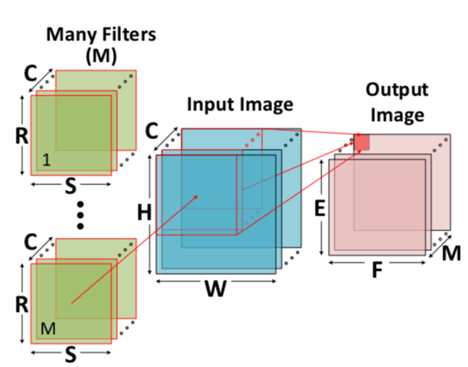
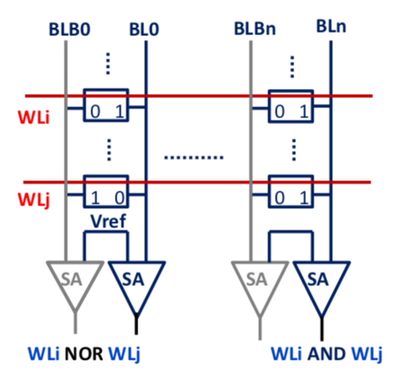
Background
Deep Neural Networks
- CNN: Convolutional Neural Networks (convolution layers with pooling, quantization, normalization and fully connected layers)
Bit-Line computing
- Computations (AND; NOR) on the data stored in the activated word-lines (for in-place computation) is performed in the analog domain.
Computation of a convolution layer
SRAM circuit for in-place operations

Slide 7
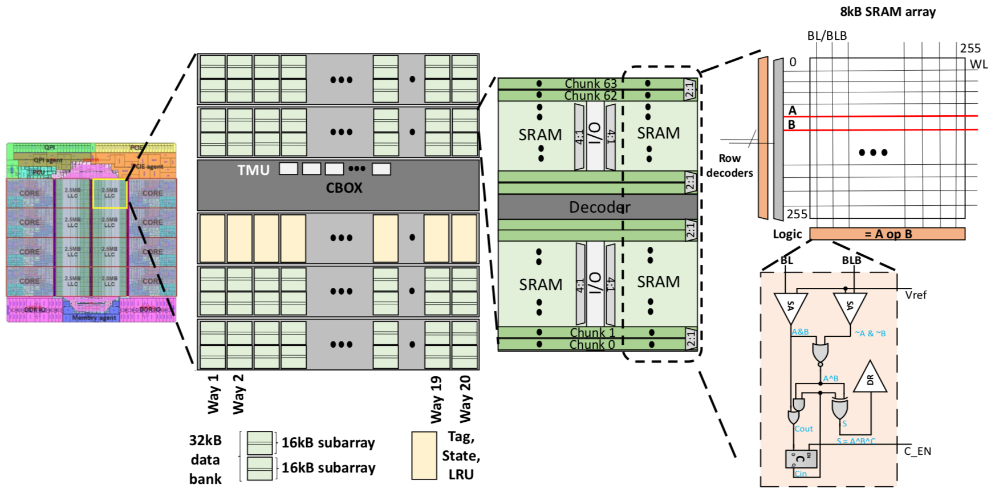
Background
Cache Geometry
- Requires SRAM array accesses and does not incur the overheads of a traditional cache access (energy and time spent on wires and memory saved).
Neural Cache Overview

Slide 8
Neural Cache Arithmetic
Bit-Serial implementation with transposed data layout
Bit-Serial Arithmetic
- Process 1 bit of multiple data elements every cycle (same operation is applied to the same bit of multiple data elements)
Compute element-wise sum of 2 arrays with 512 32-bit elements
Conventional Processor | Bit-Serial Processor
Processes arrays element-by-element | Processes arrays bit-slice by bit-slice
512 steps | 32 steps
- Has higher latency per operation → significantly larger throughput(compensates the higher operation latency)
Conventional Architectures | Bit-Serial Processor
Arrays are generated, stored, accessed and processed element-by-element in the vertical direction along bit lines. (Bit parallel or regular data layout) | Stores data elements in transpose data layout. Transposing ensures that all bits of a data element are mapped to the same bit line. (removes necessity for communication between bit lines)

Slide 9
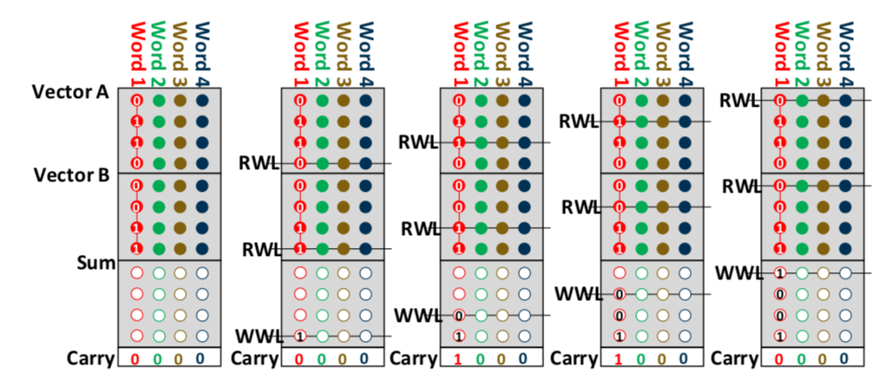
Neural Cache Arithmetic
Bit-Serial Addition
- Addition algorithm is carried out bit-by-bit starting from the LSB of the two words.
- There are two phases in a single operation cycle
Addition takes n+1, to complete with the additional cycle to write a carry at the end.
Addition Operation

Slide 10
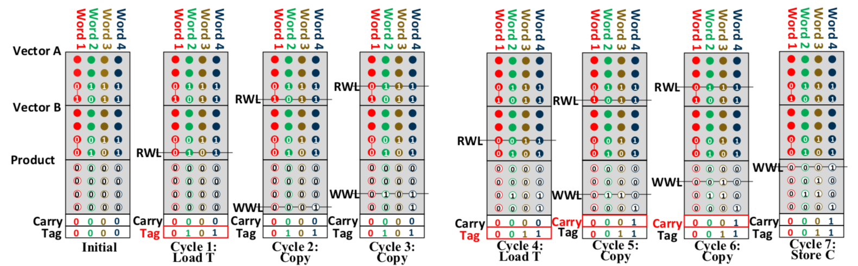
Neural Cache Arithmetic
Bit-Serial Multiplication
- It is based on addition and predication.
- Tag is zero → data in array remains, Tag is one → addition result sum will be written back to the array.
- n-bit multiplication takes n² + 5n – 2 cycles
Division is supported using a similar algorithm and takes 1.5n² + 5.5n cycles.
Multiplication Operation

Slide 11
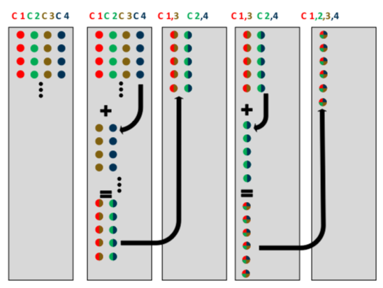
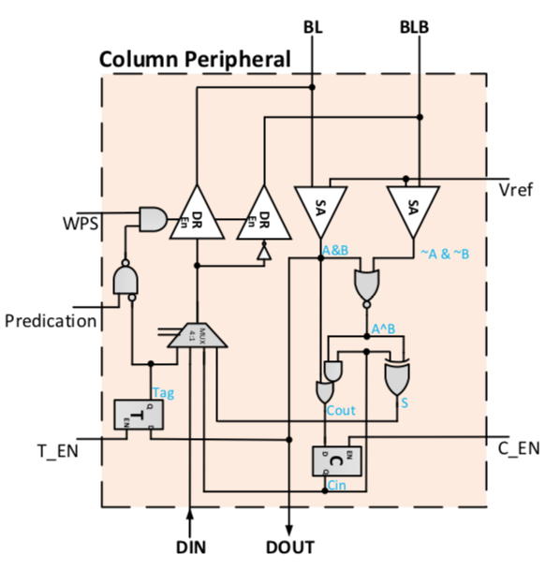
Neural Cache Arithmetic
Reduction
- In DNNs, reductions are performed across channels.
- Reduce elements stored on different bit lines to one sum is performed with a series of word line moves and additions.
- Number of reductions needed is log₂ of the words to be reduced.
Reduction Operation
SRAM Array Peripherals
- The SA in BL gives result of A & B and SA in BLB gives A’ & B’.
- Through a NOR gate we get XOR of A and B which is used to generate Sum and Carry.
- C and T latches are used to store carry and tag-bit.
- A 4-to-1 mux selects the data to be written back among Sum, Carry_{out}, Data_{in} and Tag.
Bit line peripheral design

Slide 12
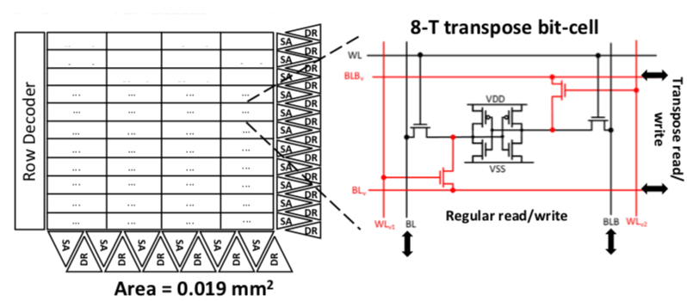
Neural Cache Arithmetic
Transpose Gateway Units
- Serves as a gateway to enable bit-serial computation in caches.
- TMU takes data in bit-parallel and converts to transpose layout before storing into or reading from SRAM arrays.
Transpose Memory Unit (TMU)

Slide 13
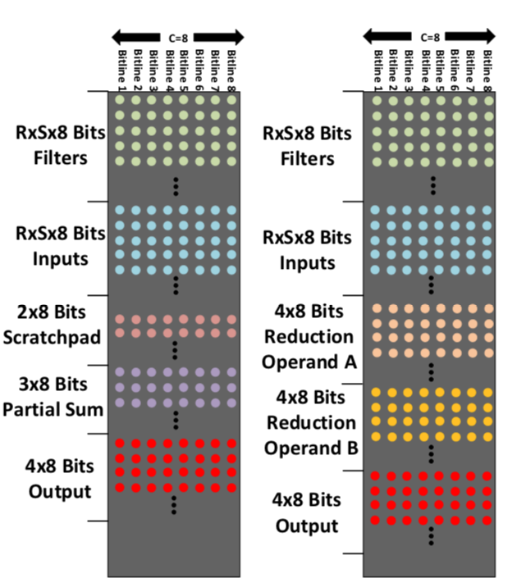
Neural Cache Architecture
The Neural Cache architecture transforms SRAM arrays in LLC to compute functional units.
Neural Cache computes layers and each branches within a layer serially.
Each of the 8KB SRAM arrays computes convolutions in parallel.
Data Layout
Neural cache exploits channel level parallelism in a single convolution.
A single convolution consists of generating one of the E x E x M output elements.
For each convolution, and array executes R x S MAC in parallel across channels, following a reduction step across the channels.
Array Data layouts

Slide 14
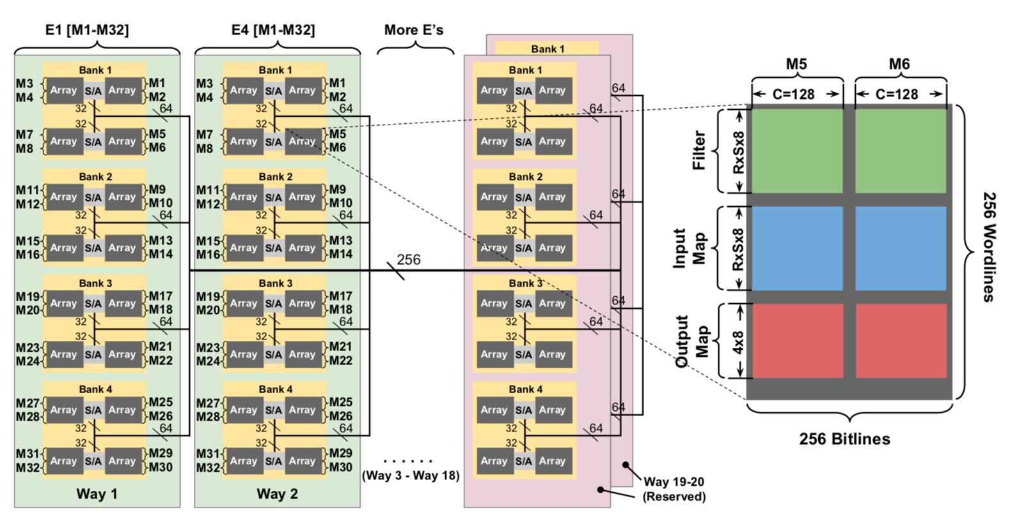
Neural Cache Architecture
Data Parallel Convolutions
Each output requires one convolution (MxExE outputs produced in each layer).
Each slice can be visualized as a massively parallel SIMD core.
When inputs and filters are mapped to the cache, maintain uniformity across the cache
Neural Cache Data layout for one LLC Cache slice

Slide 15
Neural Cache Architecture
Orchestrating Data Movement
Interconnect Sequence:
Design based on the on-chip LLC of the Intel Xeon E5-2697 processor
1) Filter Loading :
Load filter data from memory only once per layer (data loaded in serial)
Neural Cache assumes that the filter weights are preprocessed to a transpose format and laid out in DRAM -> correct bit lines and word-lines.
2) Input Data Streaming :
Load from first layer -> same input for different output channels (M’s) with the same output pixel position
3) Output Data Management :
Contiguous output pixels are assigned to same slice -> neighboring inputs at most RxE pixels required for one slice

Slide 16
Neural Cache Architecture
Supporting Functions
1) Max Pooling : compute maximum value of all the inputs inside a sliding window.
Temporary maximum: subtracted by the next output value
2) Quantization: calculate the minimum and maximum value of all outputs
3) Batch Normalization: first quantizing to 32 bit unsigned. (multiply all values by scalar and apply shift)
4) Avg Pool: inputs are summed and divided by window size
5) Fully connected Layers: converted to convolution layers in Tensor Flow
Batching
Increase system throughput.
Batching amortizes time for loading weights –> increases system throughput
ISA Support and Execution Model
Neural Cache requires in-cache addition, multiplication, reduction, and moves.
Compute instructions are followed by move instruction for data management.

Slide 17
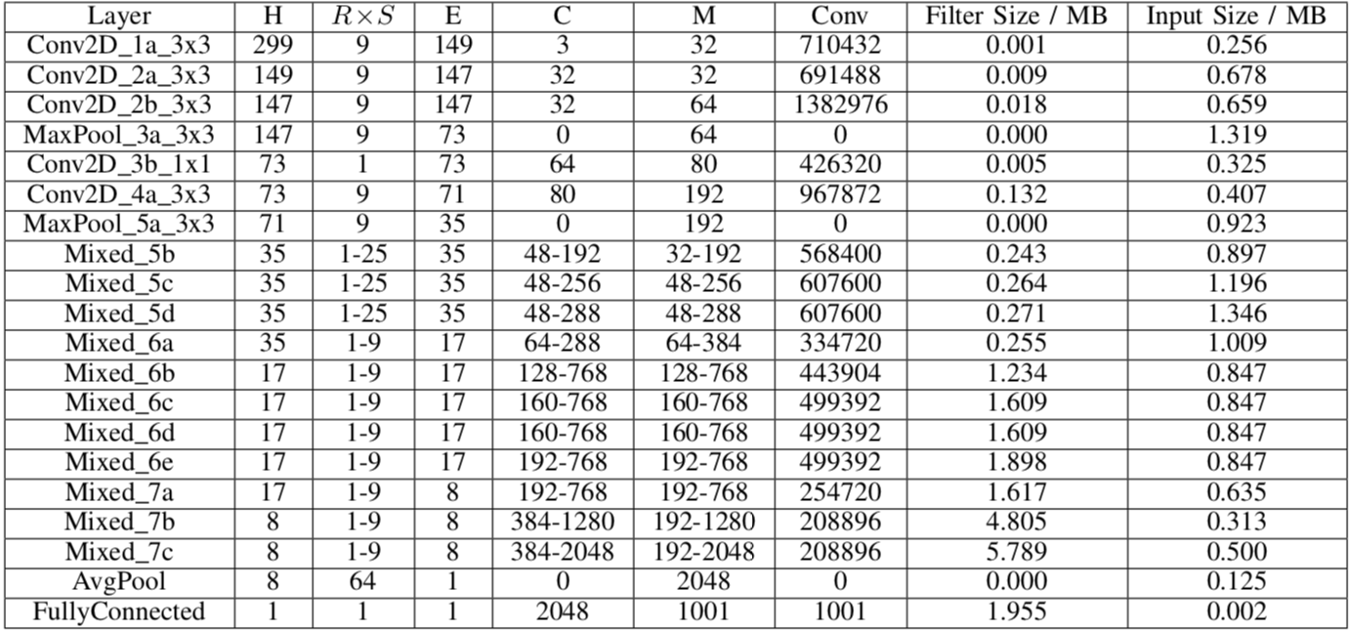
Evaluation Methodology
Baseline: Dual-socket Intel Xeon E5-2697 v3 (CPU) and Nvidia Titan Xp (GPU)
TensorFlow is used as the software framework to run NN inferences on both baseline CPU and GPU.
Execution power is measured using RAPL for CPU power measurement and Nvidia-SMI for GPU power measurement.
Modeling of Neural Cache:
- The SPICE model of an 8KB computational SRAM is simulated using 28 nm technology node for power and delay of SRAM array.
- The SPICE simulation provides total energy consumption for reading out 256 bits in SRAM mode or operating 256 bit lines in computation mode.
- A cycle-based simulator based on deterministic computation is model is developed for in-cache computation
- C micro-benchmark to model the time of data loading.
Parameters of the Layers of Inception V3

Slide 18
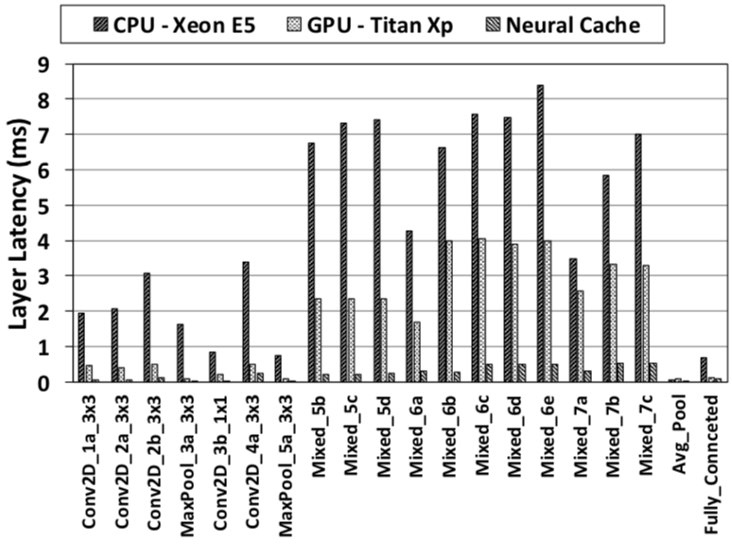
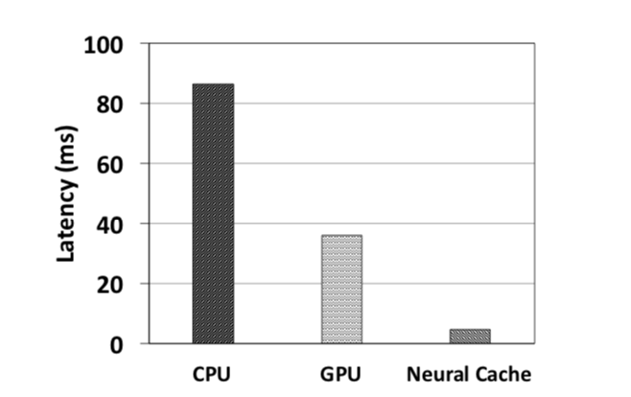
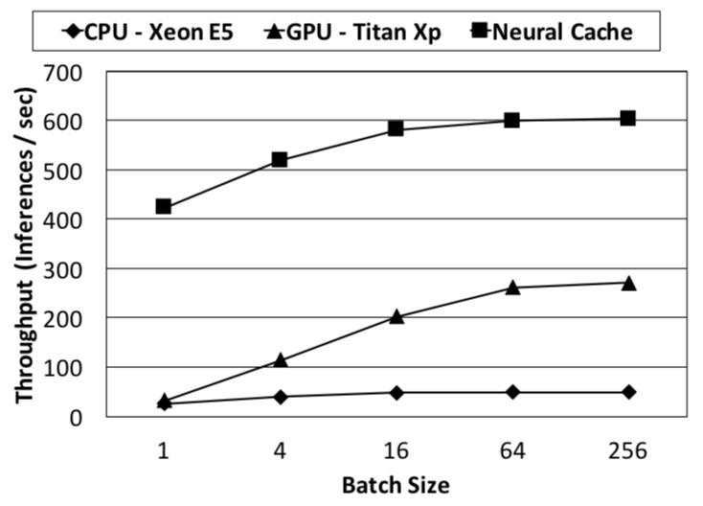
Results
Latency
- Neural Cache achieves a 7.7x speedup in latency compared to baseline GPU and 18.3x speedup on baseline CPU.
Inference Latency by layer
Total Latency
Batching
- Neural Cache achieves a throughput of 604 inferences/sec, which is equivalent to 2.2x GPU or, 12.4x CPU throughput.
Throughput with varying Batch Sizes

Slide 19


Results
Power and Energy
- The average power of Neural Cache is 53.11% and 49.87% lower than GPU and CPU baselines respectively.
Energy Consumption and Average Power
Scaling with Cache Capacity
- Increasing the slices speeds up most aspects of the inference. The total number of arrays that compute increases thus, increasing convolutions that can be done in parallel.
Scaling with Cache Capacity (Batch Size = 1)

Slide 20
Related Work
Neural Cache is the first work that exploits in-situ SRAM computation for accelerating inferences on DNNs.
In-Memory Computing:
PIMs move logic near main memory (DRAM), and there by reduce the gap between memory and compute units.
ASICs and FPGAs:
DaDianNao is an architecture for DNNs that integrates filters into on-chip eDRAM.
Eyeriss is an energy-efficient DNN accelerator which reduces data movement by maximizing local data reuse.
Neurocube is a 3D DRAM accelerator solution which requires additional specialized logic integrated memory chips.
TPU is an ASIC for accelerating DNN inferences.
BrainWave Project builds an architecture consisting of FPGAs connected with a custom network, for providing an accelerated DNN service at a datacenter scale.
Terasys is based on bit-serial arithmetic PIM architectures.
Future Work
Sparsity in DNN models for Neural Cache by exploiting accelerators.

Slide 21
Conclusion
Caches have traditionally served only as low-latency storage units.
Turn them into massively parallel vector units, and drastically reduce on-chip data movement overhead.
Neural Cache architecture provide competitive performance comparably to modern GPUs with negligible overheads.

Slide 22

Q&A

