Slide 1

Aarogya Setu App Review Insights
By
Pavan Joshi
Data Science Enthusiast
Manipal Prolearn Bangalore.

Slide 2
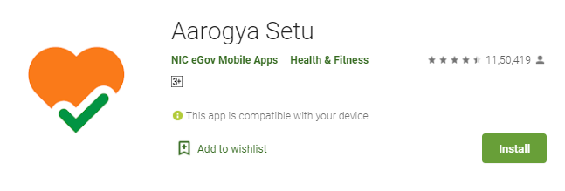
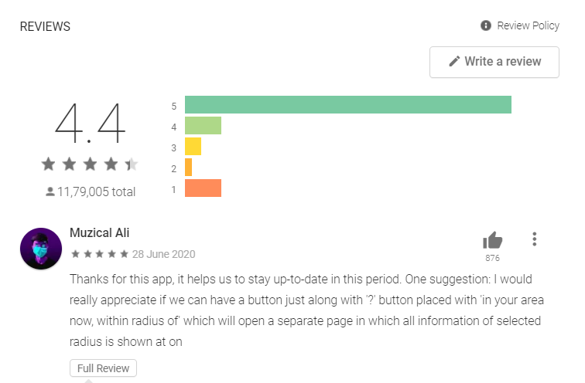
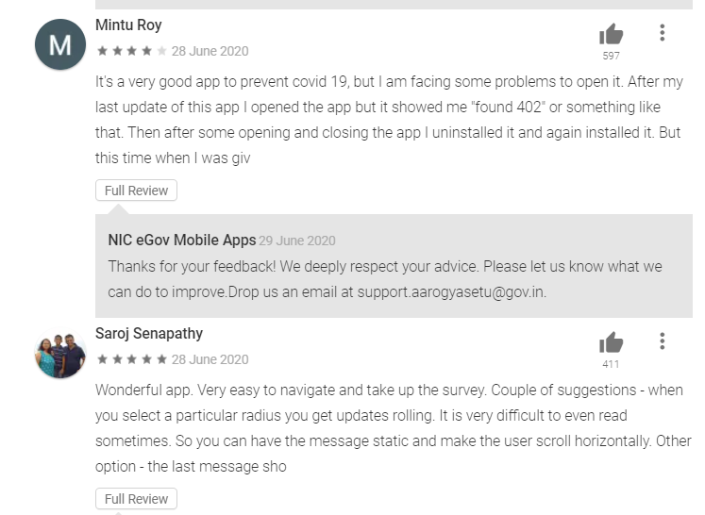
Play Store Reviews

Slide 3
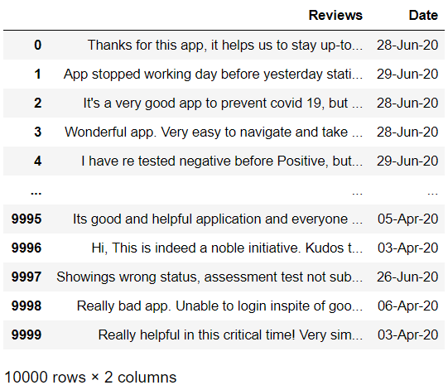
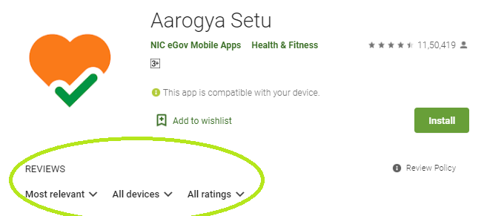
Data Collection
Web Scrapping
Play Store App Webpage
Dataset of 10,000 Reviews with Date (from April to June)

Slide 4
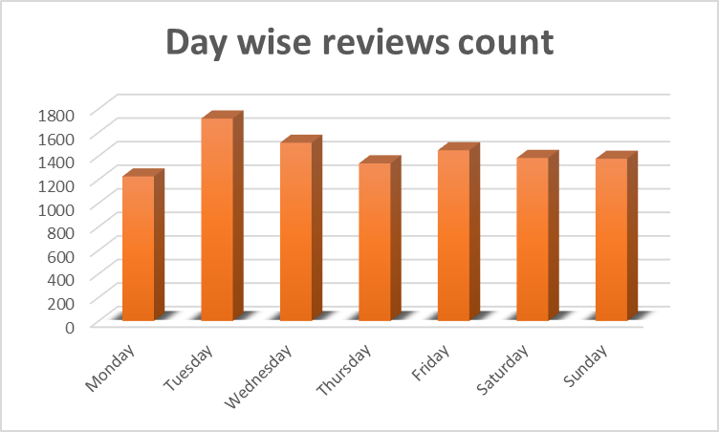
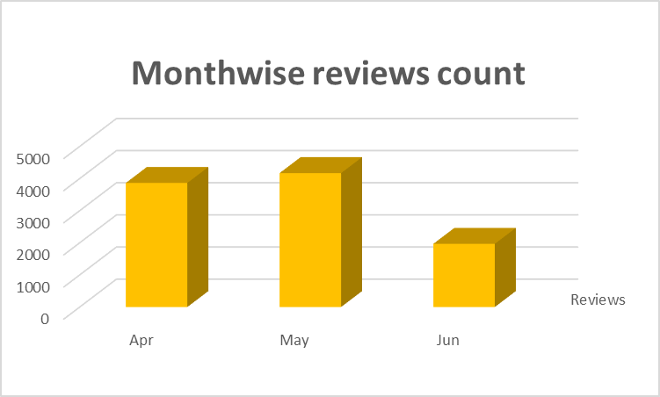
1.Month / Day wise reviews count
Weekday of Tuesday
&
Month of May have
most reviews count.

Slide 5
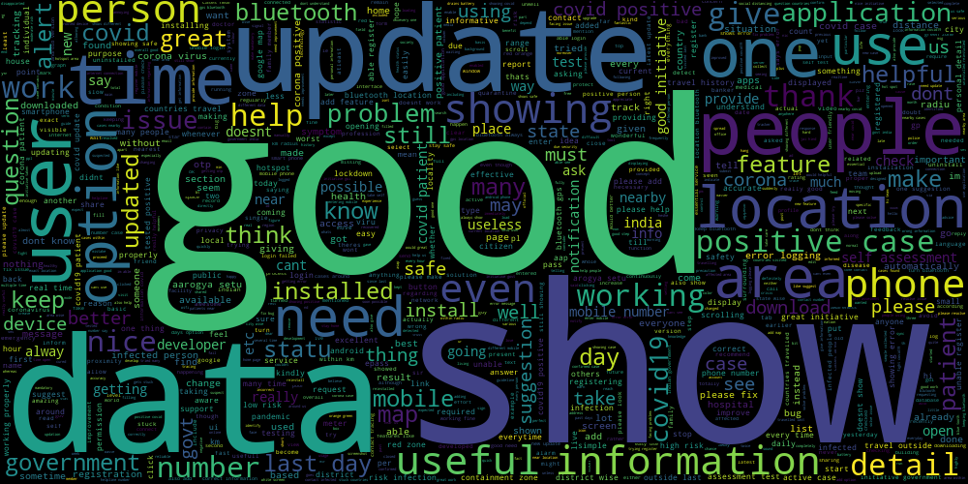
Word cloud
A World cloud is visual representation of text data, typically used to visualize free form text. The importance of each tag is shown with font size or color. This format is useful for quickly perceiving the most prominent terms to determine its relative prominence. Bigger term means greater weight from the data.
2 .Word cloud

Slide 6
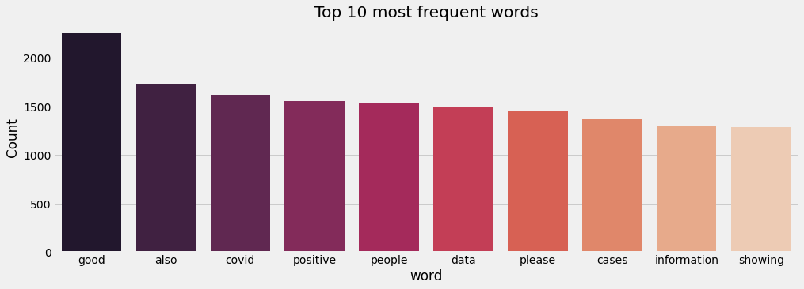
3. Ten most frequent Words
All reviews are 10000 in count.so which words are mostly used in this dataset, finding using algorithm of K most frequent words.
The k numbers means words which having most occurrence, i.e., the top k numbers having the maximum frequency. If two numbers have the same frequency then the larger number should be given preference.

Slide 7
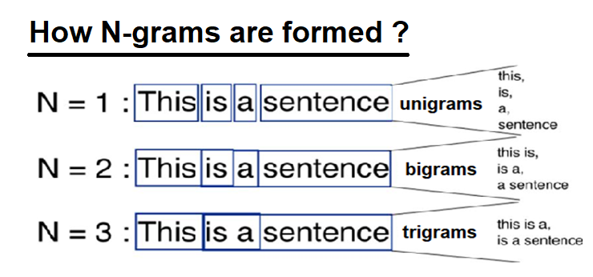
4. N-grams
N-grams are simply all combinations of adjacent words or letters of length n that you can find in your source text.
Text summarization refers to the technique of shortening long pieces of text. The intention is to create a coherent and fluent summary having only the main points outlined in the document.

Slide 8
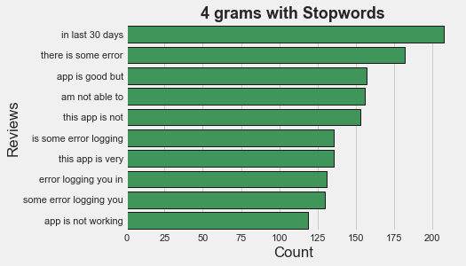
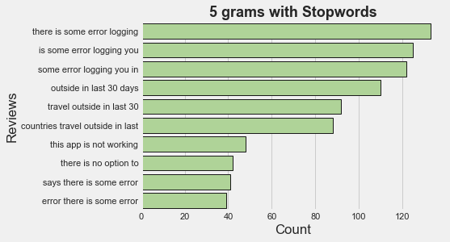
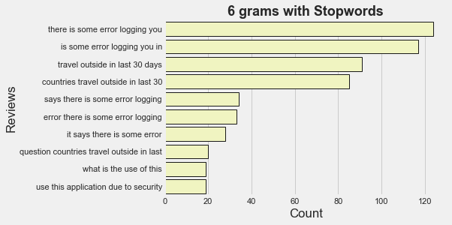
What is stop words?
Stop words are the words which does not add much meaning to a sentence.
Text contains Stop Words like ‘The’, ’is’, ’but’, ’how’, ‘or’, ’are’.
Stop words can be filtered from the text to be processed.
N-gram

Slide 9
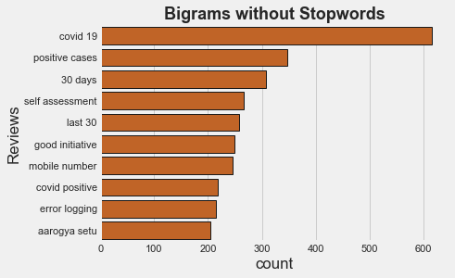
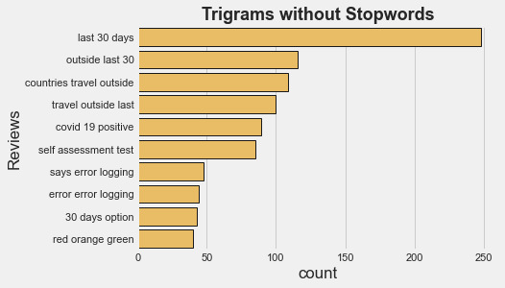
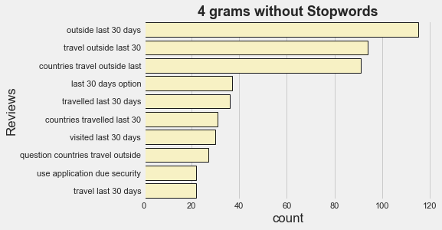
N-gram

Slide 10


4.Sentimental Analysis –
Sentiment Analysis is the process of ‘computationally’ determining whether a piece of writing is positive, negative or neutral
e.g. 1)he is very good person – Positive Sentiment
2)he is a bad person – Negative Sentiment
Sentiment Analysis (also known as opinion mining or emotion AI) is a sub-field of NLP that tries to identify and extract opinions within a given text across blogs, reviews, social media, forums, news etc.

Slide 11
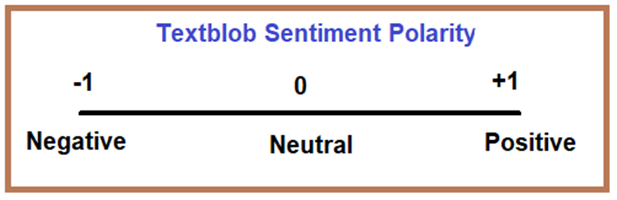
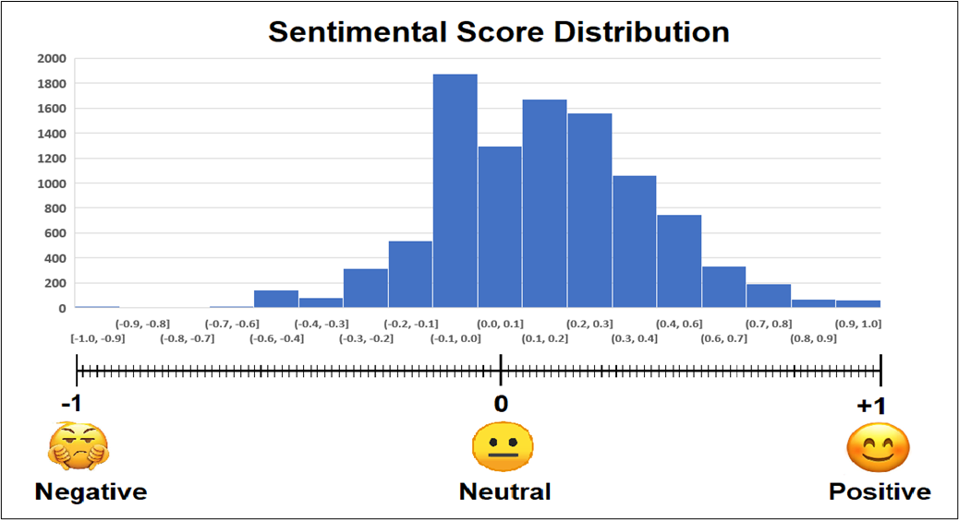
Sentimental Analysis

Slide 12
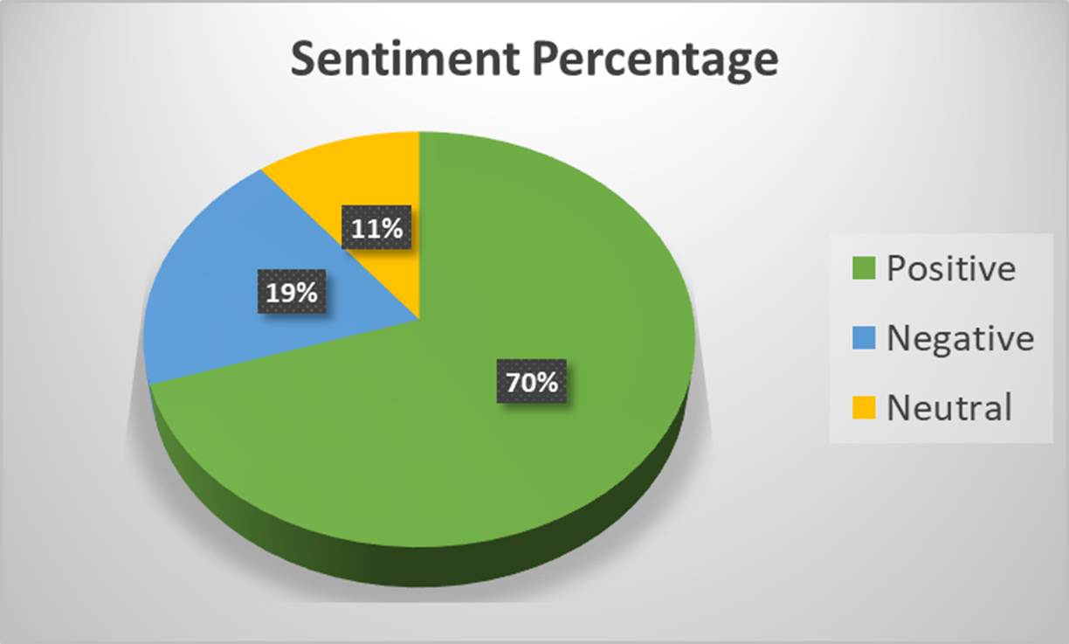
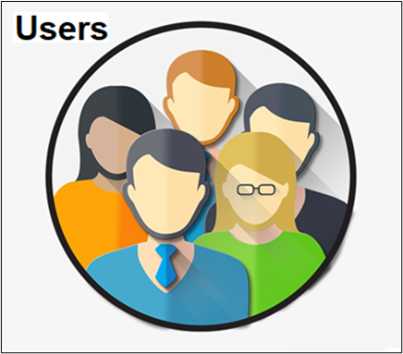
We are 70% Happy with Setu app, 19% are not satisfied,11% are Neutral with App.
Sentimental Analysis

Slide 13
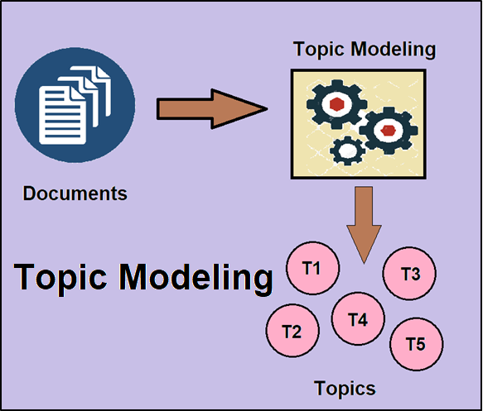
4.Topic Modelling
In a large dataset of Setu App reviews. Its difficult to trace each document to finding hidden Topics.
Topic modelling provides us with methods to organize, understand and summarize large collections of textual information.
LDA model is the method of Topic modeling in which mixture of topics that are present each document is viewed as a mixture in the corpus.
The LDA model discovers the different topics that the documents represent and how much of each topic is present in a document.
e.g. Topic 1 : Medical field words
Topic 2 : Technical field words

Slide 14
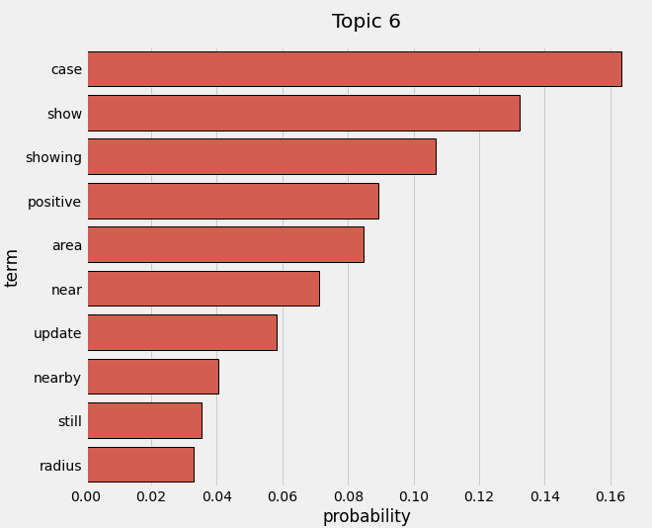
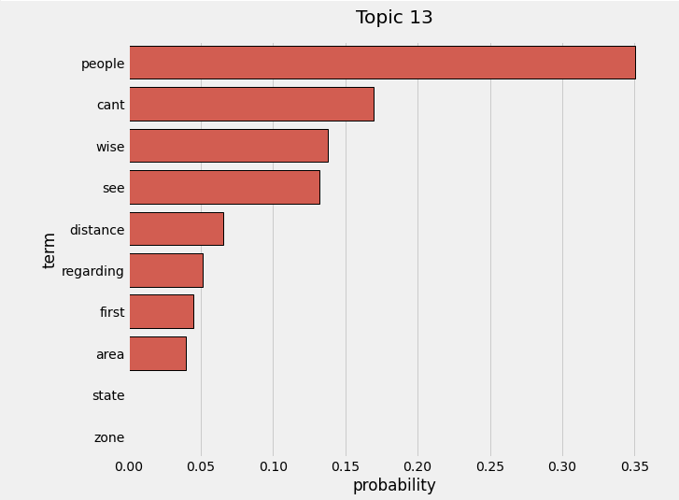
Topic : Distance ,Area

Slide 15
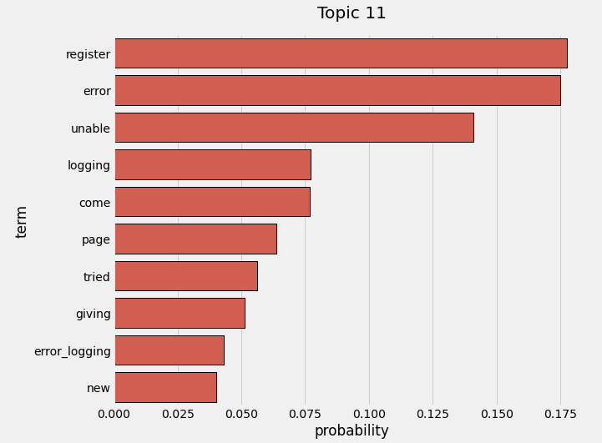
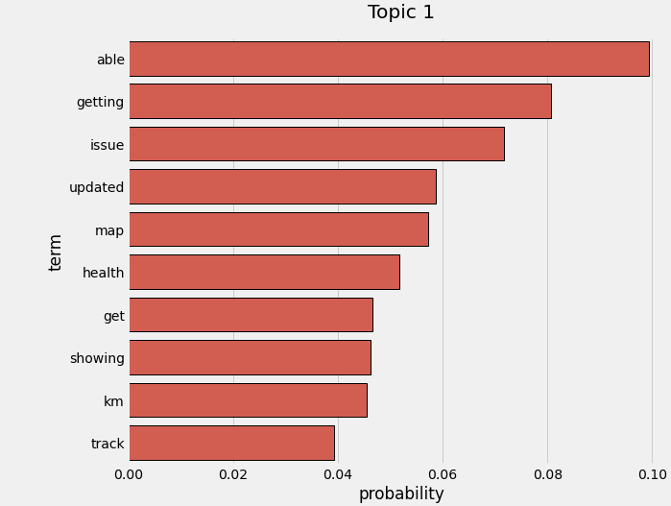
Topic : Issues with App

Slide 16
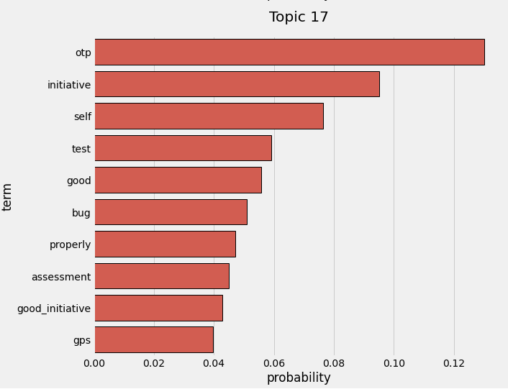
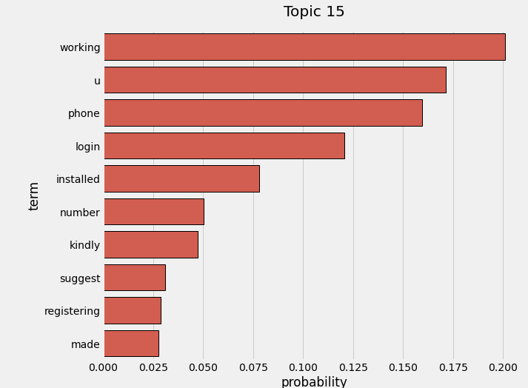
Topic : Technical Terms / Suggestion

Slide 17
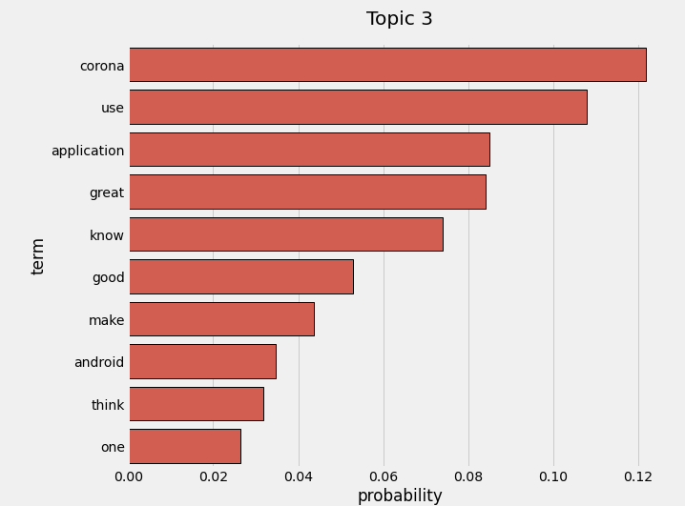
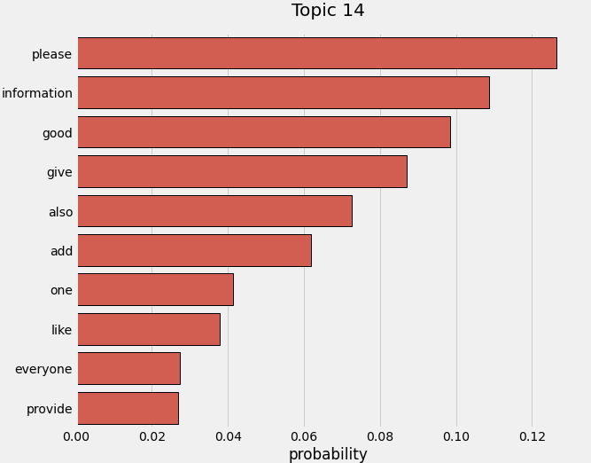
Topic : Good compliments

Slide 18
Conclusion :
Day Tuesday and Month May having most review count.
Word cloud says most talking words ‘Good’, ’show’, ’data’, ’update’
Sentimental analysis is showing 70% users have given Positive Reviews.
From Topic Modelling founded different Topics like
Distance / Area
Technical Terms/suggestion
App Issue
Good Reviews

Slide 19
Thank You…

