Slide 1
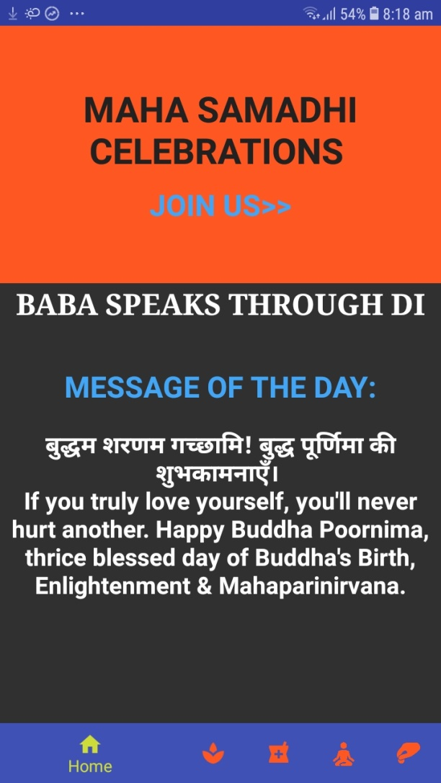


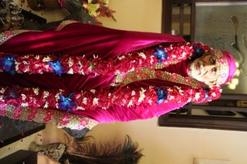
SHIRDI SAI BABA MAHASAMADHI
Look of the Home Page
SHIRDI SAI BABA
MAHASAMADHI
CELEBRATIONS
COME BE A PART OF BABA’S 100TH
MAHASAMADHI CELEBRATIONS
Home Page of the Proposed app will have dynamic banners.
Banner 1 will have Baba image
Banner 2 will have details of Walkathon event
Banner 3 will have details of Mega event on 4th Oct 2018
Om Sai Ram Om Sai Ram Om Sai Ram
Om Sai Ram Om Sai Ram Om Sai Ram
Om Sai Ram Om Sai Ram Om Sai Ram
Om Sai Ram Om Sai Ram Om Sai Ram
Om Sai Ram Om Sai Ram Om Sai Ram
Om Sai Ram Om Sai Ram Om Sai Ram
Om Sai Ram Om Sai Ram Om Sai Ram
Om Sai Ram Om Sai Ram Om Sai Ram
Om Sai Ram Om Sai Ram Om Sai Ram
Om Sai Ram Om Sai Ram Om Sai Ram
Om Sai Ram Om Sai Ram Om Sai Ram
Om Sai Ram Om Sai Ram Om Sai Ram
Om Sai Ram Om Sai Ram Om Sai Ram
Om Sai Ram Om Sai Ram Om Sai Ram
Om Sai Ram Om Sai Ram Om Sai Ram
Om Sai Ram Om Sai Ram Om Sai Ram
Om Sai Ram Om Sai Ram Om Sai Ram
Om Sai Ram Om Sai Ram Om Sai Ram
Om Sai Ram Om Sai Ram Om Sai Ram
BABA SPEAKS THROUGH DI
MESSAGE OF THE DAY
Di Jaan Speaks...
“Baba Sai is the divinity within us, the goodness within us, the love within us. He is birth-less, death-less, time-less, space-less... He is the One Eternal Cosmic Soul... our Soul.”
The homepage will also have quotes,
these quotes will change everyday
The app will have tabs on the following heads:
Di Jaan Jaya Wahi
SAIBISA- Our activities
We Heal
Events
Donate
Notes:
White background with Aum Sai Ram written in self

Slide 2
Alternative look of the Home Page
SHIRDI SAI BABA
MAHASAMADHI
CELEBRATIONS
SHIRDI SAI BABA
MAHASAMADHI
CELEBRATIONS
Save the date/COME BE A PART OF BABA’S 100TH
MAHASAMADHI CELEBRATIONS
BABA SPEAKS THROUGH DI
MESSAGE OF THE DAY
BABA SPEAKS THROUGH DI
MESSAGE OF THE DAY
Sai Ram
Sai Ram
Di Jaan Speaks...
“Baba Sai is the divinity within us, the goodness within us, the love within us. He is birth-less, death-less, time-less, space-less... He is the One Eternal Cosmic Soul... our Soul.”
Di Jaan Speaks...
“Baba Sai is the divinity within us, the goodness within us, the love within us. He is birth-less, death-less, time-less, space-less... He is the One Eternal Cosmic Soul... our Soul.”
COME BE A PART OF BABA’S 100TH
MAHASAMADHI CELEBRATIONS

Slide 3
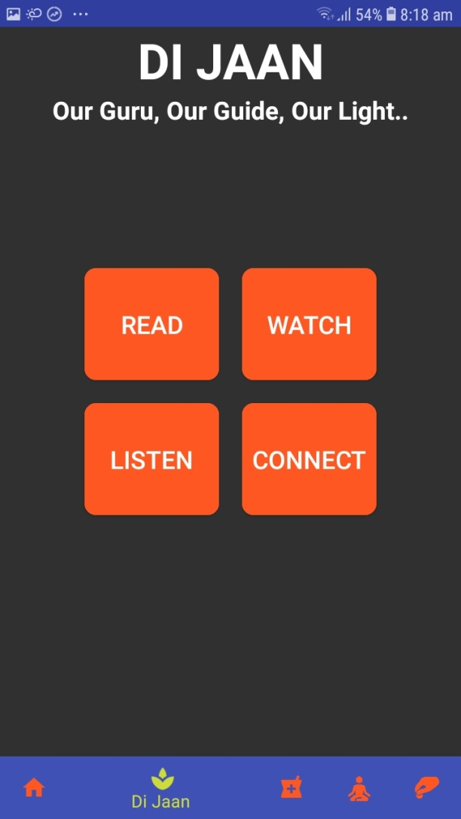
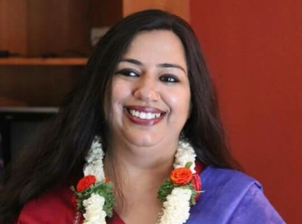
DI JAAN
Our Guru, Our Guide, Our Light…
Di Jaan page will carry
Picture of Di Jaan/
pictures to Di Jaan on the banner to be dynamic
Icons/ outline of Baba for Read, Watch, Listen
and Connect..Tab to be made in an interesting manner
Read
Watch
Listen
Connect

Slide 4
DI JAAN
Our Guru, Our Guide, Our Light…
Read
Watch
When the user clicks on READ of Di Jaan page..
page given in the next slide opens
Listen
Connect

Slide 5
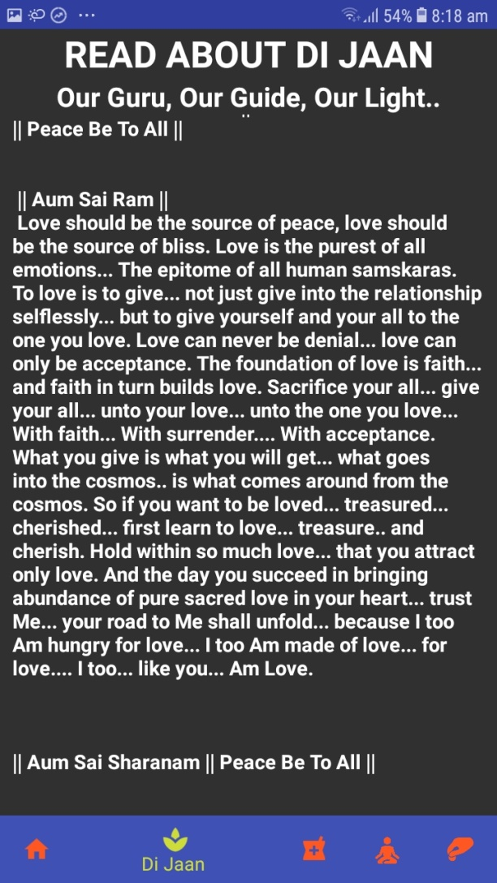
When the user clicks on READ of Di Jaan page, following page opens:
DI JAAN
Here, we will have two portions..
On left side, we will have a photograph of Di and on right we will have a write up about Di
Second portion will have: description of the two books.
Book 1 (photograph on left side)..description of the right side
Book 2 (photograph on left side)..description of the right side
Below description of both books, there will be a link mentioning, to read excerpts, click here.
Once the user clicks on this, the following pages will open
Our Guru, Our Guide, Our Light…

Slide 6
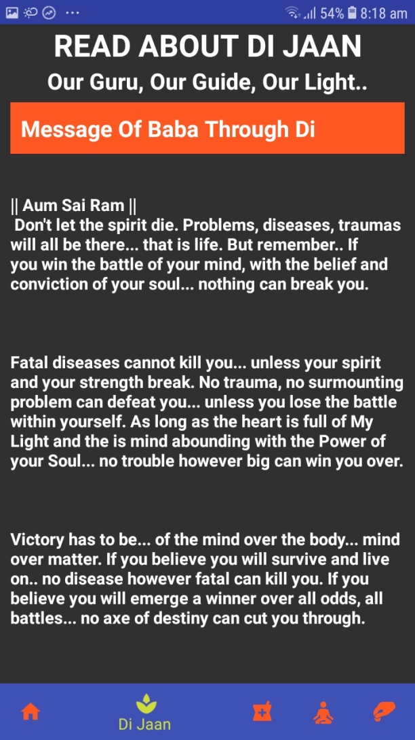
Di Jaan
Our Guru, Our Guide, Our Light
Excerpts Book 1
d
Di Jaan
Our Guru, Our Guide, Our Light
Excerpts Book 2
d
SAIBISA covers of all editions
Cover
Text fill
Text fill

Slide 7
When the user clicks on Watch tab,
slide in the following text will open
DI JAAN
Our Guru, Our Guide, Our Light…
Read
Watch

Slide 8
Di Jaan
Our Guru, Our Guide, Our Light
d
Di’s videos will be posted here,
left hand side we will have the links,
right side we will have the caption of each video
Video 1
Video 2

Slide 9
When the user clicks on the
listen, slide in the following
page opens
DI JAAN
Our Guru, Our Guide, Our Light…
Listen

Slide 10
Di Jaan
Our Guru, Our Guide, Our Light
d
Podcast 1
Podcast titles to be provided
Podcasts to be provided
Icons for Podcasts required/ Baba’s outline
Podcasts to be mentioned on the top
Podcast 2

Slide 11
When the user clicks on Connect,
page on the following slide will open
DI JAAN
Our Guru, Our Guide, Our Light…
Connect

Slide 12
Di Jaan
Our Guru, Our Guide, Our Light
Connect with us
d
Text will be provided

Slide 13
Image to change..images of Healing
WE HEAL
With Our Hands, Hearts and Love…
Who Are We
What we do
Become a Healer
Healing videos
Individual pages will
open as per following pages
Testimonials

Slide 14
WE HEAL
With Our Hands, Hearts and Love…
d
WE HEAL
With Our Hands, Hearts and Love…
d
Who We Are
What We Do

Slide 15
WE HEAL
With Our Hands, Hearts and Love…
d
WE HEAL
With Our Hands, Hearts and Love…
d
Become a Healer
Healing Videos

Slide 16
Images will change
SAIBISA- Our Activities
Touching Lives, Healing Souls…
MY GOLDEN PEN
Better Our World
Tabs to be made
in an interesting manner
Green the World
Lifeline India
Life Of Sai

Slide 17
SAIBISA- Our Activities
Touching Lives, Healing Souls…
My Golden Pen
d
Stories of Our Babies
Photographs of babies will be included
below the Stories of Our Babes

Slide 18
SAIBISA- Our Activities
Touching Lives, Healing Souls…
Better Our World
d
Kambli of Love
Baba’s Jholi
Under each initiative, photos will be added
Baba’s Handi

Slide 19
SAIBISA- Our Activities
Touching Lives, Healing Souls…
Green The World
d
Under each initiative, photos will be added

Slide 20
SAIBISA- Our Activities
Touching Lives, Healing Souls…
LifeLine India
d
Under each initiative, photos will be added

Slide 21
SAIBISA- Our Activities
Touching Lives, Healing Souls…
Life of Sai
d
Under each initiative, photos will be added

Slide 22
Images for the two events will be provided
Events
Walkathon -23rd Sept
Text and details will be provided)
Mega Fund Raiser-Oct 4th
Upcoming events

Slide 23
Images for the two events will be provided
Donate
Text to be provided
Text and details will be provided)

