Slide 1
Optimizing NSFW Content Detection Using Quantization Techniques for Faster Inference
ENGR-E 533 Deep Learning Systems Final Project
Harsh Shah (shahhh@iu.edu)
Pavan Pandya (pnpandya@iu.edu)
Dhruvil Dholariya (ddholari@iu.edu)
Dev Patel (dp67@iu.edu)

Slide 2


Introduction
The internet contains vast amounts of uncensored content, requiring effective moderation tools
Develop a classifier to handle multiple NSFW categories, addressing a broad spectrum of content moderation needs
Classifies content into five categories: Nudity, Drugs, Violence, Gore, and Safe
Useful for content-sharing websites to monitor and moderate uploaded content effectively
Potential to create browser extensions for safe and family-friendly browsing experiences
Deployment is challenging in resource-constrained environments due to high computational requirements
Why Quantization?
Optimize model size and inference speed for real-time applications.
Enable deployment on low-power devices while maintaining model accuracy.

Slide 3
Dataset Preparation
Sources:
Nudity: 5,000 images from NudeNet.
Gore: 4,573 images from Roboflow Universe.
Violence: 10,924 frames extracted from video dataset available on Kaggle.
Drugs: 6,400 images from Roboflow Universe.
Safe: 13,079 images from NudeNet-Safe and non-violent datasets.
Manual verification to ensure relevance and quality.
Preprocessing
Converted all images to PNG format.
Resized to 320x320 pixels for uniform input size.
Standardized color format to RGB.
Dataset Distribution
Category | Train | Test | Total
Nude | 3,500 | 1,500 | 5,000
Gore | 3,951 | 622 | 4,573
Violence | 7,000 | 3,924 | 10,924
Drugs | 4,480 | 1,920 | 6,400
Safe | 9,000 | 4,079 | 13,079
Total | 27,931 | 12,045 | 39,976

Slide 4
Related Work

Slide 5
Related Work
State-of-the-art in Nudity Classification: A Comparative Analysis
Focuses on CNN-based models, vision transformers, and tools like Stable Diffusion and LAION
Emphasizes the need for improved datasets to enhance model performance
Compares models across datasets like Adult Content, NudeNet, and LSPD
A Comparative Study of Tools for Explicit Content Detection in Images
Evaluate traditional computer vision techniques (e.g., skin detection using HSV and YCbCr)
Compares these techniques to modern deep learning methods like transfer learning and fine-tuning
Discusses challenges like dataset variations and resolution differences

Slide 6
Related Work
Auditing Image-based NSFW Classifiers for Content Filtering
Investigates the performance of NSFW-CNN, CLIP-classifier, and CLIP-distance
Evaluate these models across diverse datasets to detect inappropriate content
Focuses on demographic biases in misclassification rates (gender, skin tone, age).
Building a NSFW Classifier by Lucas and Isaac (Stanford University)
Proposes a classifier using CNNs and RNNs under a modified ResNet50 framework
Outperforms Google’s SafeSearch API, which achieved 78% accuracy on the same dataset
Includes additional categories like gore and weapons beyond traditional NSFW content
Explores DenseNet architectures for potential further improvements
Accuracy:
Binary Classification with ResNet50: 94%
Multiclass Classification with DenseNet34: 89%

Slide 7
OUR Work

Slide 8
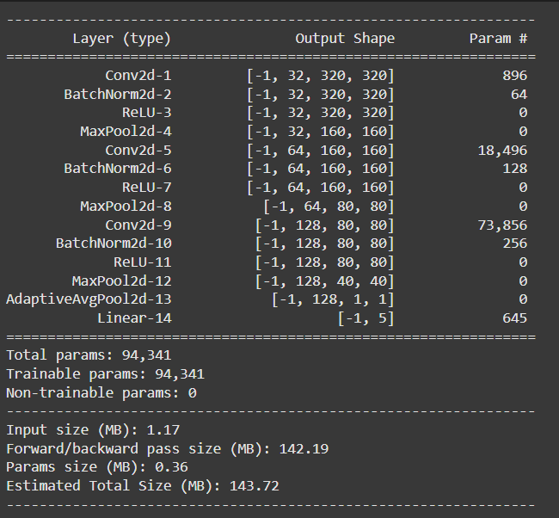
Evaluation & Results
Baseline CNN:
Model Accuracies:
Model Type | Test Accuracy
Baseline CNN | 80%
Improved ResNet18 | 94%
Category | Safe | Drugs | Gore | Nudity | Violence
Safe | 3930 | 34 | 24 | 61 | 30
Drugs | 60 | 1842 | 10 | 6 | 2
Gore | 10 | 9 | 593 | 10 | 0
Nudity | 209 | 3 | 37 | 1246 | 5
Violence | 149 | 3 | 8 | 3 | 3131

Slide 9
Neural Networks Quantization
Static Quantization
Data Requirements: Unlabelled data for calibration
Latency: Fastest
Accuracy Loss: Smaller
Key Points:
Pre-compute scales and zero points with representative data
Activations stored as integers for maximum efficiency
Risk: Non-representative calibration data can harm accuracy
Dynamic Quantization
Data Requirements: No data needed
Latency: Usually faster
Accuracy Loss: Smallest
Key Points:
Integer weights, floating-point activations
Dynamic computation of scales and zero points during runtime
No prior calibration required
Quantization Aware Training
Data Requirements: Labelled training data
Latency: Fastest
Accuracy Loss: Smallest
Key Points:
Models trained to account for quantization-induced information loss
Reduces accuracy degradation in quantized models
Includes quantization and de-quantization during training

Slide 10
Applying Quantization
Post-Training Static Quantization (PTQ)
Purpose: Converts a trained floating-point model to an integer model to reduce computation and memory usage.
Process:
Calibration data used to compute scale and zero-point values for mapping activations and weights to integers.
Quantization performed using PyTorch’s torch.quantization library.
Optimizations:
Layer fusion (e.g., convolution + batch normalization + ReLU).
Folding batch normalization into adjacent layers.
Results:
Reduced model size and inference time.
Minor accuracy degradation compared to the floating-point ResNet18 baseline.
Quantization Aware Training (QAT)
Purpose: Incorporates quantization effects during training to mitigate accuracy drop.
Process:
Fake quantization modules simulate integer arithmetic during training.
Layer fusion applied before training.
Model fine-tuned on the training dataset with simulated reduced precision.
Fully quantized integer model produced after training.
Results:
Better accuracy than PTQ model.
Accuracy exceeded the baseline ResNet18 floating-point model.

Slide 11
Evaluation & Results with quantization
Test Accuracies:
Inference Time:
Model Version | Test Accuracy (%)
Baseline CNN | 94.10%
Post-Training Quantization (PTQ) | 93.83%
Quantization-Aware Training (QAT) | 95.10%
Model Version | Platform/Mode | Latency (ms/sample)
Improved ResNet18 | CPU | 51.22
Improved ResNet18 | CUDA | 2.35
PTQ | CPU | 21.90
PTQ | CPU (JIT) | 19.84
QAT | CPU | 25.66
QAT | CPU (JIT) | 22.18

Slide 12
CONCLUSION
A Summary of our work in numbers:
40,000 data collected, cleaned, and processed from various sources
95.10%- Highest test accuracy achieved (by QAT model)
22.18 ms/sample- Inference Latency achieved by the best performing quantized model on CPU (∼57% faster than the base model on CPU)
75% reduction in model size after quantization (from 45.85 MB to 11.49 MB)

Slide 13
Thank you

