Slide 1


Sinhgad Academy of Engineering, Kondhwa
Project Based Seminar Presentation
On
“A Novel Cloud Based Auxiliary Medical System For Cardio-Vascular Disease”
By
T150438543, Karan V Nakum
T150438547, Gopal S Paraskar
T150438550, Pavan S Patil
T150438555, Hrushikesh S Rajankar
Guide
“Dr. K. S. Thakare”
Day and Date of Exam : Review2 11/June/2021

Slide 2
Contents
Project Group
Motivation
Problem Statement
Aim
Objective
Project and Seminar Topics
Abstract
motivation
Introduction
Literature Survey
Application/Advantages
Architecture
Working, Methodologies
Conclusion
Reference

Slide 3
Project Group
Project Title : A Novel Cloud Based Auxiliary Medical System For Cardio-Vascular Disease
Project Domain : Machine Learning
Project Group Members:
T150438543, Karan V. Nakum
T150438547, Gopal S. Paraskar
T150438550 , Pavan S. Patil
T150438555 , Hrushikesh S. Rajankar

Slide 4
Motivation
In traditional system, people have to wait in the queue for there turn and in rural area there is no proper medical facilities.
this project, is that to provide clinical health care remotely in distant rural communities and want to reduce there precious time by doing nothing but sitting on bench waiting for there turn.
Telemedicine will help to us break the chain of contagious diseases, making our life more easy.
The average emergency visit cost plus time in traditional system is more and that can be overcome using telemedicine.

Slide 5
Problem Statement
To design a Telemedicine application to diagnose and monitor cardio vascular disease of the patient.

Slide 6
Aim
To provide the capacity of long-term storage, flexible and convenient communication between medical provider and patient.
To track patient’s health 24x7 in real time using sensors and available technologies.
To find the near by hospital according to the patient need using GPS.

Slide 7
Objective
To provide a cloud platform that will be used for the functioning of data management and computing.
To provide the long term solution by keeping track of patient past healthcare record.
To provide a flexible and convenient real time messaging platform for frequent consultations.
As there are lot of data available regarding patient health, to create a graph on the patient healthcare recovery using data visualization

Slide 8
Project and Seminar Topics
Main Project Title : A Novel Cloud Based Auxiliary Medical System For Cardio-Vascular Disease
Karan V. Nakum : An innovative methodology for Big Data Visualization for Telemedicine
Gopal S Paraskar : A Phased Approach for the Adaptation of Telemedicine in Diabetes Management
Pavan S Patil : Application of Telemedicine in Retinopathy and Diabetes Care
Hrushikesh S Rajankar : Telemedicine Cognitive Behavioral Therapy for Anxiety After Stroke

Slide 9
Individual Seminar
on
“Application of Telemedicine in Retinopathy and Diabetes Care”
By
T150438550, Pavan S. Patil
Guide
“Dr. K. S. Thakare”
Day and Date of Exam : Review2 11/June/2021

Slide 10
Abstract
The utilization of telemedicine solutions to reduce outpatient clinic visits and visits to physicians’ offices, thus saving financial and personal resources as well as time. It has gained substantial importance in recent years. The COVID19 pandemic has made it necessary to abruptly adjust outpatient care methods in various medical settings that needlessly require consultations in person to monitor and change the disease management of patients in specific risk groups.

Slide 11
Motivation
Advances in digital technology and especially mobile smartphone technology have led to a plethora of innovative strategies aiming to improve the self-management skills of patients with chronic diseases and especially diabetes.
Utilization of telehealth solutions in retinopathy with image processing technologies can enable broader access to the health system and specialist care, particularly for underserved populations and minorities like India.

Slide 12
Introduction
Telediabetology can facilitate in taking treatment decisions, by utilizing pre-stored validated algorithms.
Making use of available smartphone technology and reatime IOT devices
It is dedicated to supporting and guiding diabetes management digitally, and aims to reduce onsite visits.

Slide 13
Literature Survey
Reference title 1 - A Smartphone Based Application for Early Detection of Diabetic Retinopathy Using Normal Eye Extraction.
Proposed system
The mobile application by through we can able to detect to detect the early stage of diabetic Retinopathy.
Collected various diabetic and non-diabetic patients eye images from the hospitals which can be able to identify specific issues.
Integrating affected retina images into a structured understanding of the eye images, inheriting the affected Patterns to generalize and finding the Disk Boundary of retina which is affected by early stage of Diabetic retinopathy.

Slide 14
Methodology
First the User will be asked to capture Image of his face, With the Help of Face detection and Eye Detection his both eyes will be cropped out.
Histogram of the RGB Channels of the both eyes will be given along with features like Mean, Standard Deviation. If He/she chooses Normal/Abnormal, the values will be saved accordingly.
If the user chooses unknown, current values will be compared with mean of normal and abnormal values and will be saved to where it has its closest neighbors.

Slide 15
The proposed application model flowchart is as follows -

Slide 16
Reference title 2 - Application of Telemedicine in diabetes care: The time is now
Available telediabetology solutions
Telephone/Video Calls for Telediabetology
Mobile Applications
Continuous/Intermittently Scanned Continuous Glucose Monitoring Systems
Decision Support Systems for Insulin Therapy
Screening for Diabetic Retinopathy

Slide 17
The possibilities of telediabetology

Slide 18
Reference title 3 - A Review on Diabetes Self-management Applications for Android Smartphones: Perspective of DevelopingCountries
Proposed Methodology
Conducted in-depth review of 54 smartphone apps which are considered to be helpful for diabetes patients. Key features of these apps are identified and enlisted with a view to comparing them and predicting the best features an app can have.
The study could well be the torchbearer for the field of smartphone applications for diabetes healthcare.
As all the important features, their usefulness and weaknesses are analyzed are mentioned, this study is a complete guide for finding, even developing a smart solution for people with diabetes.

Slide 19
Percentage of different functionalities in both Android and iOS apps

Slide 20
Reference title 4 - Smartphone-Based Technology in Diabetes Management
Available app (DIABEO)
A recent study published in the Diabetes Technology & Therapeutics on December 7, 2020, suggests that the use of the telemedicine platform DIABEO at least once a day significantly reduces blood sugar levels and HbA1c levels.
It has been designed for adults with type 1 or type 2 diabetes on insulin therapy, allowing the patient to record blood glucose levels, insulin doses, physical activity, carbohydrate intake, and hypoglycemia.

Slide 21
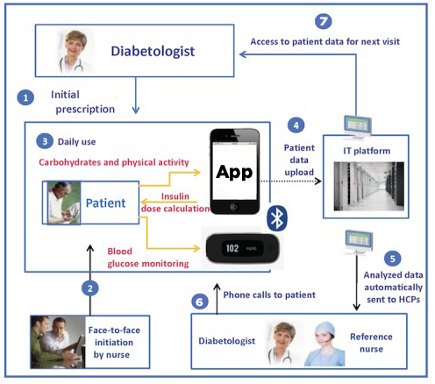
Methodology in DIABEO
Initial Prescription
Face to face initiation
Daily use of app by patient
Data Upload (firebase Jason)
Analysis of Data (ML model)
feedback to patient
Access to patient data for next visit

Slide 22
Sr. No. | Reference Name (Write Paper Title) | Implementation/methodologies | Year
1 | A Smartphone Based Application for Early Detection of Diabetic Retinopathy Using Normal Eye Extraction | the authors proposed a method of detecting the early stage of diabetic retinopathy using image processing and available datasets. | 2020
2 | Application of Telemedicine in diabetes care: The time is Now | The authors focused on Available Telediabetology solutions in current times. | 2021
3 | A Review on Diabetes Self-management Applications for Android Smartphones: Perspective of DevelopingCountries | The authors did analysis and review on available Self-management Android and iOS apps. | 2020
4 | Smartphone-Based Technology in Diabetes Management | The authors did review on available T1DM and T2DM applications. | 2020

Slide 23
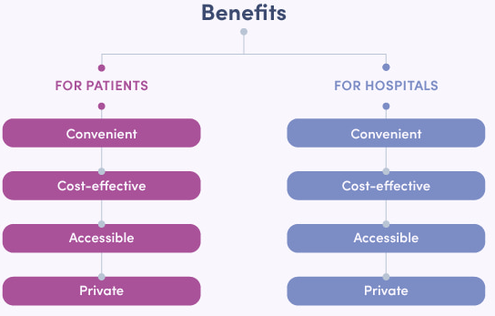
Application/Advantages
Amid the COVID-19 Pandemic and lockdown telemedicine is a useful tool for managing patients of diabetes.
Telemedicine is particularly well suited to treating diabetes, as compared to other diseases, because diabetes requires interpretation and predetermined responses to many types of data that can be measured in the home by the patient.
telemedicine improves follow-up care, allows expertise to reach and treat patients in rural areas.

Slide 24
Conclusion
This study emphasized on systematic analysis of healthcare applications in smartphones for patients especially in developing countries with diabetes with the help of information technology.
This will help patients in many ways to keep track of what is going on with their diabetes situation.

Slide 25
Reference
Agarwal P, Mukerji G, Desveaux L, et al. Mobile appfor improved self-management of type 2 diabetes:multicenter pragmatic randomized controlled trial. JMIR Mhealth Uhealth. 2019;7(1):e10321.
World Health Organization. 2018. https://www.who. int/news-room/fact-sheets/detail/diabetes. Accessed 2 Sept 2019. Felix Aberer . Daniel A. Hochfellner . Julia K. Mader “Application of Telemedicine in Diabetes Care“ 2021
American Diabetes Association. Classification and diagnosis of diabetes. Section 2. Standards of Medical Care in Diabetes—2018. Diabetes Care. 2018;41(Suppl. 1):S13–27.
Quinn C, Khokhar B, Weed K, et al. Older adult selfefficacystudy of mobile phone diabetes management.Diabetes Technol Ther. 2015;17(7):455–61.
https://medicaldialogues.in/

Slide 26
Thanks!
Any Questions?

